Slide 1


Demo for the 2x2 Systolic Array with Double Buffer
Source code
https://github.com/runyangtian/2x2_systolic_array_double_buffer.git
Architecture
b
(c)
(b)
b
b
(a)
load_sel
0 1
1 0
~load_sel
PE11
a
PE12
Array
a
Control
Logic
b
b
load_en
DFF
psum
psum
DFF
load_en
a
psum
a
PE21
PE22
act_sel
0 1
$$×$$
$$+$$
systolic.v
a
c
c
pe_en
Array_2x2.v
c
pe.v
Fig. 1. 2x2 systolic PE array architecture (a) Top module (b) 2x2 PE array (c) PE logic

Slide 2
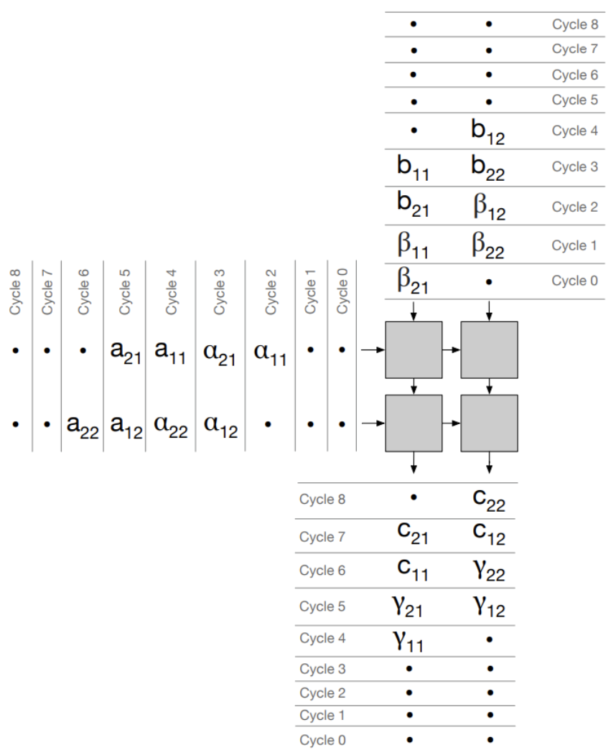
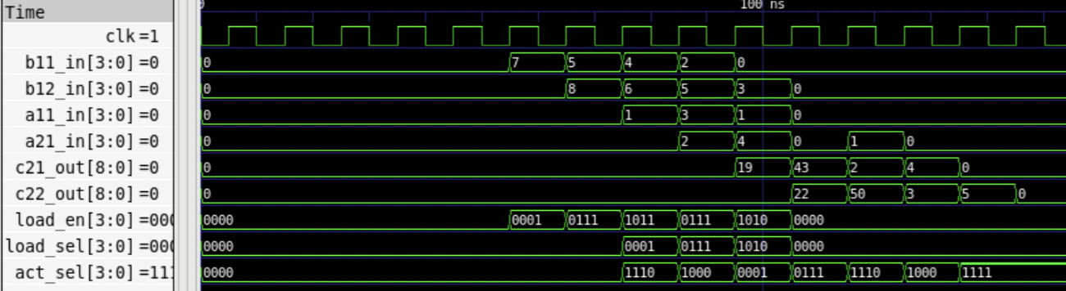




Demo for the 2x2 Systolic Array with Double Buffer
Result
Testcase:
Expected:
Functional Result:
Op1:
$$\left[\begin{matrix}1 & 2 \\ 3 & 4\end{matrix}\right]×\left[\begin{matrix}5 & 6 \\ 7 & 8\end{matrix}\right]$$
$$\left[\begin{matrix}19 & 22 \\ 43 & 50\end{matrix}\right]$$
PASS
Op2:
$$\left[\begin{matrix}1 & 0 \\ 0 & 1\end{matrix}\right]×\left[\begin{matrix}2 & 3 \\ 4 & 5\end{matrix}\right]$$
$$\left[\begin{matrix}2 & 3 \\ 4 & 5\end{matrix}\right]$$
PASS
Cycle 0
Cycle 8
Bit order: {PE22, 21, 12, 11}
en: 0 for keep; 1 for load
sel: 0 for buf0; 1 for buf1
Fig. 2. Waveform (a) With double buffer (b) Without double buffer

