Slide 1
Amazon Review Lookup and Analysis Tool Using Hashing
Amazon Review Lookup and Analysis Tool Using Hashing
Yiwei Jin

Slide 2
What problem does this application solve?
Large review datasets are hard to search manually
Real-world data is messy and inconsistent
Users need a fast way to find relevant reviews and summary information

Slide 3
What data was used?
Amazon review dataset
568,454 reviews
Includes product ID, user ID, review score, summary, text, and helpfulness information
Real-world data with multiple metadata fields and some missing values

Slide 4
How does it work?
Hashing works like a fast indexing system.
Step 1: Clean the raw data
Step 2: Build a fast index
Step 3: Use the index for lookup and counting

Slide 5
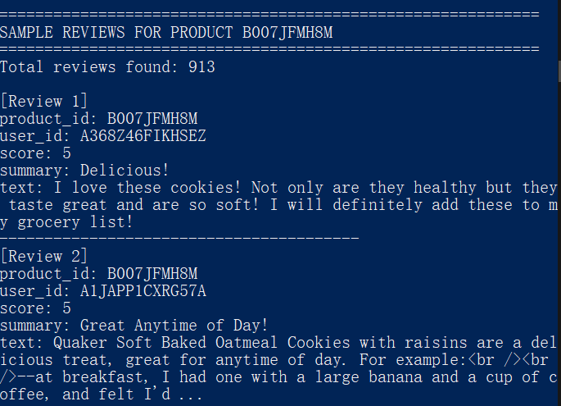
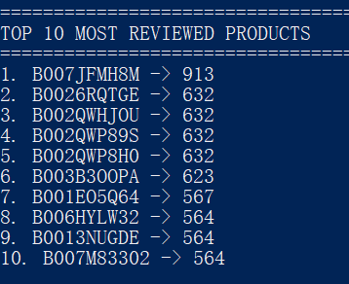
Example outputs
Top 10 most reviewed products
Sample reviews for one product

Slide 6
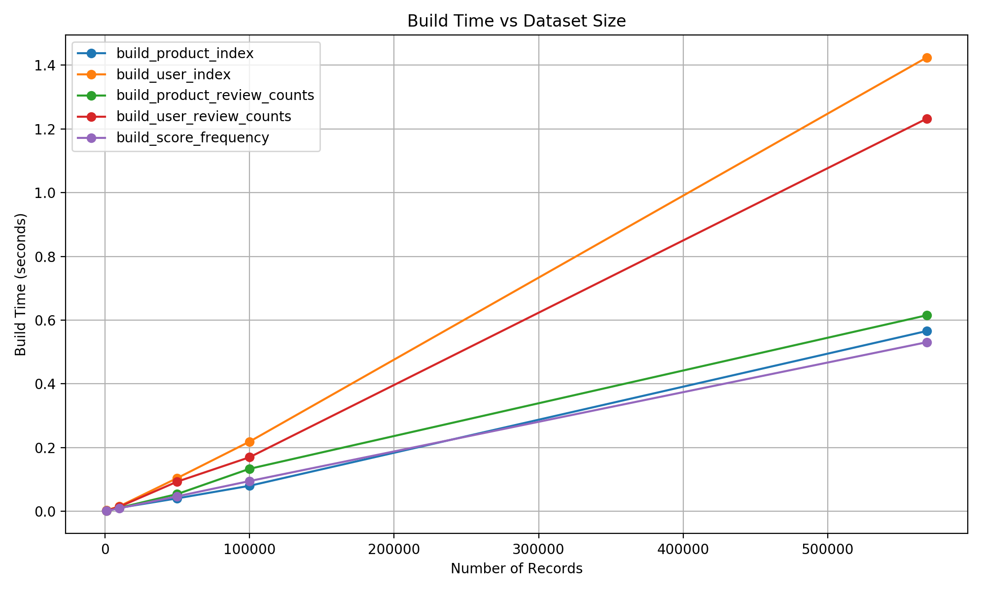
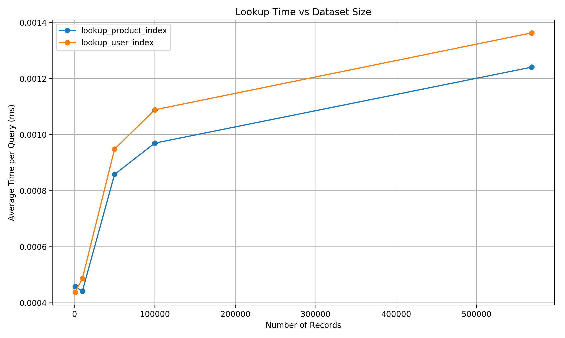
How fast is it
Build time grows as data size increases
Lookup remains very fast even above 10,000 keys

Slide 7
Conclusion
Real-world data must be cleaned before use
Hashing is effective for fast indexing and counting
The application works well on a large noisy dataset

