Slide 1
复杂EER 图转换
C_name
Proj#
Name
Cities
1
Population
Projects
r
live_in
Emp#
Name
Age
work_on
m
n
Hours
Employees
use
Hobbies
Managers
Programmers
Languages
Budget
years_of_experience
L_name

Slide 2
复杂EER 图转换
Use method 1:
Employees(Emp#, Name, Age, C_name)
Employee-Hobby(Emp#, Hobby)
Managers(Emp#, Budget)
Programmers(Emp#, Years_of_experience)
Cities(C_name, Population)
Projects(Proj#, Name)
Languages(L_name)
Work_on(Emp#, Proj#, Hours)
Use(Emp#, Proj#, L_name)

Slide 3
复杂EER 图转换
Use method 2:
Employees(Emp#, Name, Age, C_name)
Employee-Hobby(Emp#, Hobby)
Managers(Manager-Emp#, Name, Age, Budget, C_name)
Manager-Hobby(Manager-Emp#, Hobby)
Programmers(Programmer-Emp#, Name, Age, Years_of_experience, C_name)
Programmer-Hobby(Programmer-Emp#, Hobby)

Slide 4
复杂EER 图转换
Cities(C_name, Population)
Projects(Proj#, Name)
Languages(L_name)
Work_on(Emp#, Proj#, Hours)
Manager-Work_on(Manager-Emp#, Proj#, Hours)
Programmer-Work_on(Programmer-Emp#, Proj#, Hours)
Use(Programmer-Emp#, Proj#, L_name)

Slide 5

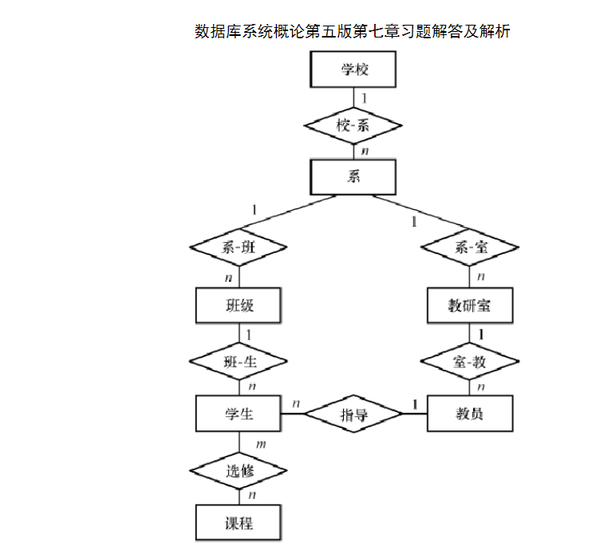
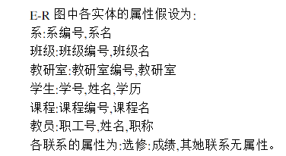
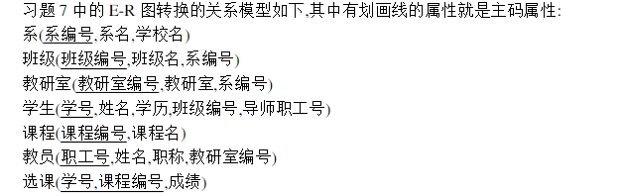
把下列E-R模型转换为关系模型

Slide 6
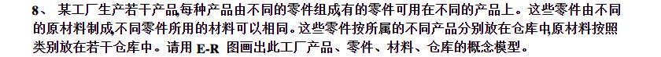
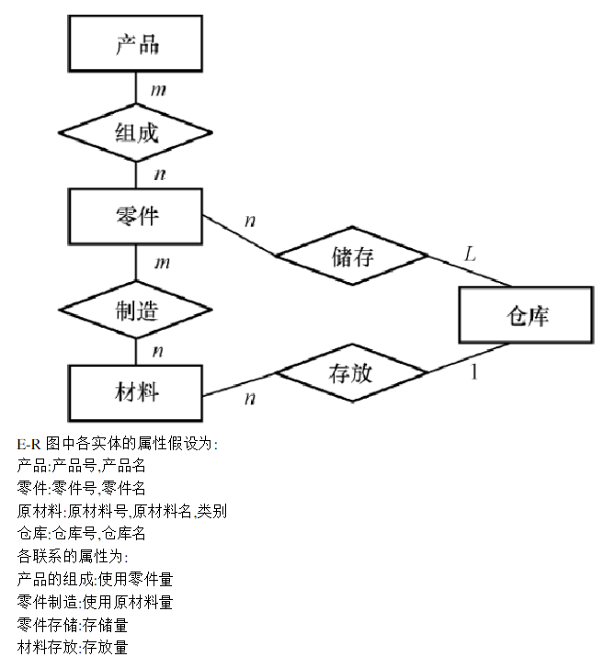

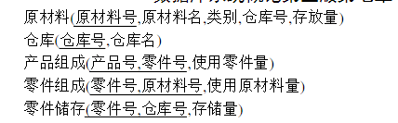
把下列E-R模型转换为关系模型

