Slide 1

Computer vision class report
The application of image processing in leaf identification
——卓越二班
LI Jie 201714374

Slide 2
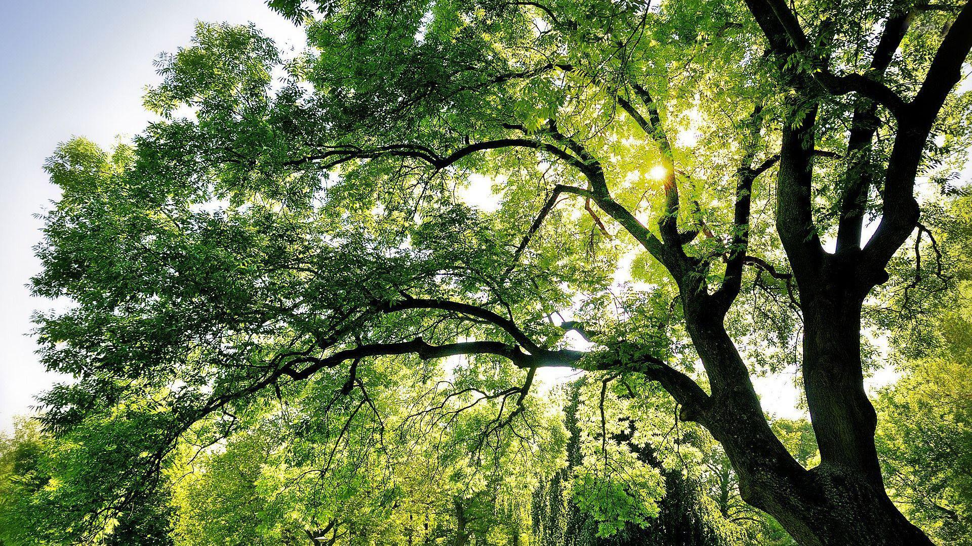
the idea of the topics
Leaf feature extraction
3
4
Classification of leaf classifiers
2
How to slove？
Leaf images preprocessing
1
The meaning of leaf recognition
6
膜厚度
肥皂膜厚度对实验影响

Slide 3
The meaning of leaf recognition
Leaves are the most basic and important place of life for plants,the extraction and identification of leaf characteristics not only distinguish the types of plant species,but also can explore the relationship between plants and the evolution of plants.
background

Slide 4
Leaf images preprocessing
Image acquisition
Image cropping
The image smooth
Image segmentation
Image edge detection
contents

Slide 5
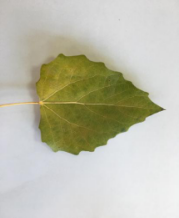
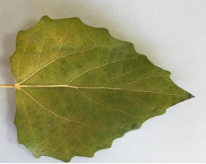
2.Image cropping
Original image
Cutting image
Notes:
使用PIL库中的crop函数对采集的图像进行截取，统一截取图像长宽为w*h像素。其中距离图片左边界距离x， 距离图片上边界距离y，距离图片左边界距离+裁剪框宽度x+w，距离图片上边界距离+裁剪框高度y+h。

Slide 6
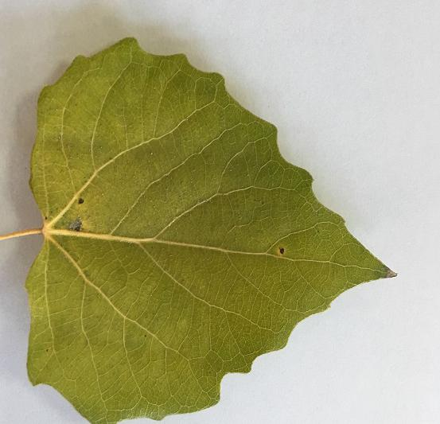
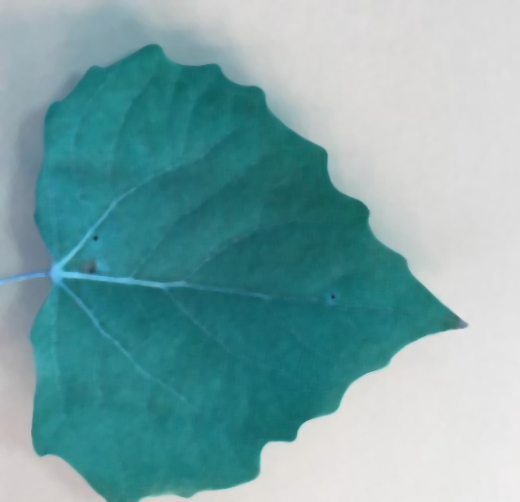
3.The image smooth
Median Filter (nonlinear)
－Very efficient to remove salt-and–pepper noise.
Original image
Filter image
Notes:
1.In a window of N*N of filter mask, order the intensity value of points.
2.Set the image pixel with intensity

Slide 7
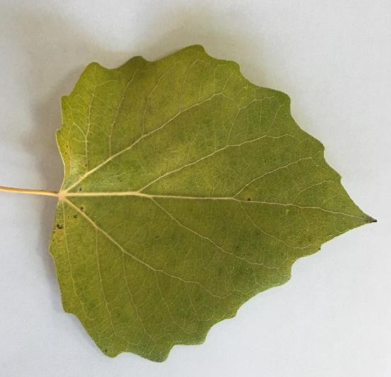
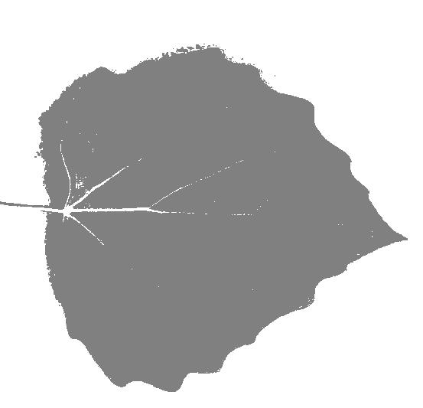
4.Image segmentation
Kmeans clustering algorithm：a cluster analysis algorithm，the main use is to compute data aggregation.And the way to do that is to keep taking the nearest average of the seed points
Original image
segmentation image
Notes:
实现步骤分为四步：1.建立工程并导入sklearn包 2.加载图片并进行预处理3.加载Kmeans聚类算法 4.对像素点进行聚类并输出。先定义一个函数load_data，以矩阵型式返回data，图片大小，然后运用KMeans和reshape函数确定每个像素所属类别，最好根据类别向图片中添加灰度值。因为图片只包括绿色和白色两种颜色，所以只选取2个聚类中心就够了

Slide 8
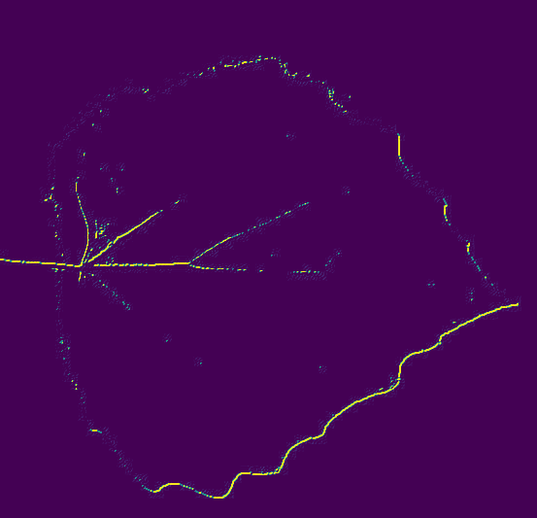
5.Image edge detection
filter2D function：Convolves an image with the kernel
Original image
detection image
Notes:
该函数使用于任意线性滤波器的图像，支持就地操作。当其中心移动到图像外，函数可以根据指定的边界模式进行插值运算。函数实质上是计算kernel与图像的相关性而不是卷积：这里的卷积核采用了[[-1,-1,0],[-1,0,1],[0,1,1]]矩阵，并且保持了目标图像与原图像的图像深度一致。

Slide 9
Leaf feature extraction
Edge characters
Shape features
Texture features
contents

Slide 10
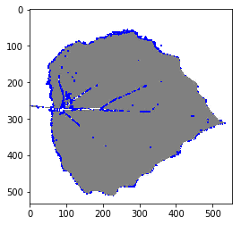
Harris Corner Detection Function
Move the window in all directions,then calculate the sum of all the differences.The function,cv2.cornerHarris,can be used to detect corner.
Original image
corner detection image
Notes:
Corner features have advantages:
— more meaningfully defined in scene.
— less likely to generate false features.
— corners are easier to match than edge points.

Slide 11
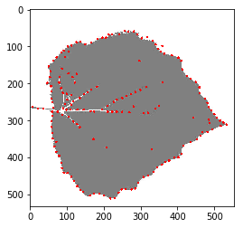
Shi-Tomasi Corner Detection Function
cv2.goodFeaturesToTrack()
Original image
corner detection image

Slide 12
the most different between two corner detection functions
Harris'mark function：
Shi-Tomasi' mark function:

Slide 13
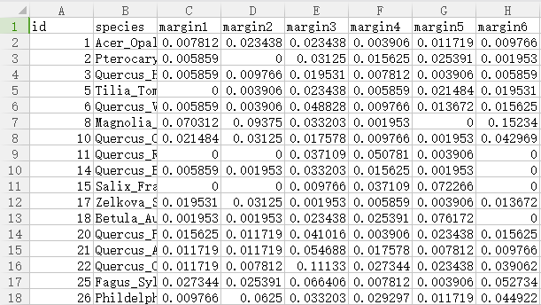
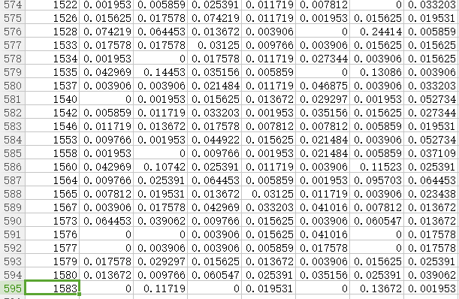
Data Presentation
training data set includes 99 plants，and every plant has 10 data arraies，every data array includes 64 margins,64 shapes and 64 textures
testing data set includes 595 data arraies

Slide 14
Classification of leaf classifiers
KNeighborsClassifier
SVC
NuSVC
DecisionTreeClassifier
RandomForestClassifier
AdaBoostClassifier
GradientBoostingClassifier
GaussianNB
contents

Slide 15
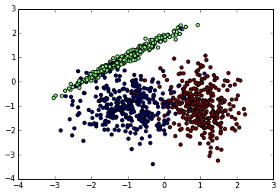
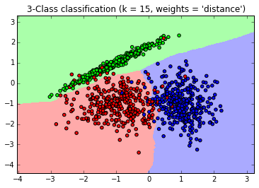
KNeighborsClassifier
lazy learning:Just keep the samples in the training phase,so the training cost 0 minute,after receiving the sample, it will deal with it.
Notes:
他的核心思想就是，要确定测试样本属于哪一类，就寻找所有训练样本中与该测试样本“距离”最近的前K个样本，然后看这K个样本大部分属于哪一类，那么就认为这个测试样本也属于哪一类。简单的说就是让最相似的K个样本来投票决定。

Slide 16
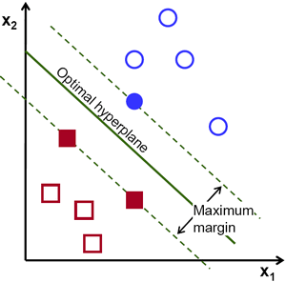
Support Vector Machine(SVM)——Maximum margin

Slide 17
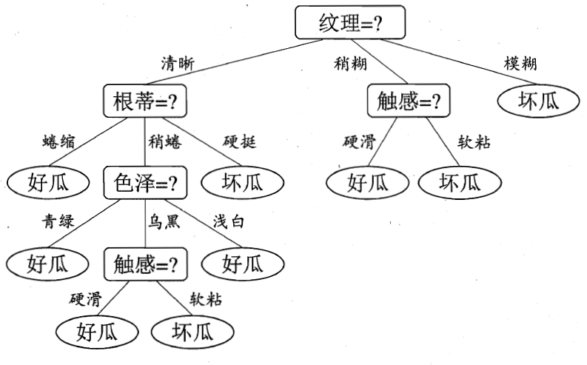
DecisionTreeClassifier
Partition selection- depend on information gain
Pruning treatment - pre-pruning and post-pruning
Multivariable decision tree - linear classifier

Slide 18
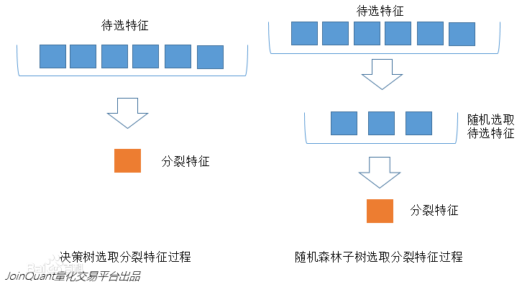
RandomForestClassifier
bring in random attribute selection
GradientBoostingClassifier
Notes:
是用随机的方式建立一个森林，森林里面有很多的决策树组成，随机森林的每一棵决策树之间是没有关联的。在得到森林之后，当有一个新的输入样本进入的时候，就让森林中的每一棵决策树分别进行一下判断，看看这个样本应该属于哪一类（对于分类算法），然后看看哪一类被选择最多，就预测这个样本为那一类。

Slide 19
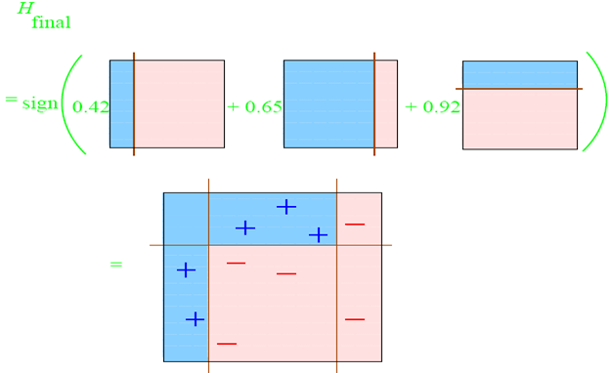
Boosting
Boosting——train a base learner-adjust the sample distribution-next base learner
AdaBoostClassifier——match a set of weak learner
GradientBoostingClassifier——Assuming that the previous iteration is a strong learner, the current iteration finds the decision tree to make the loss of the sample as small as possible.

Slide 20
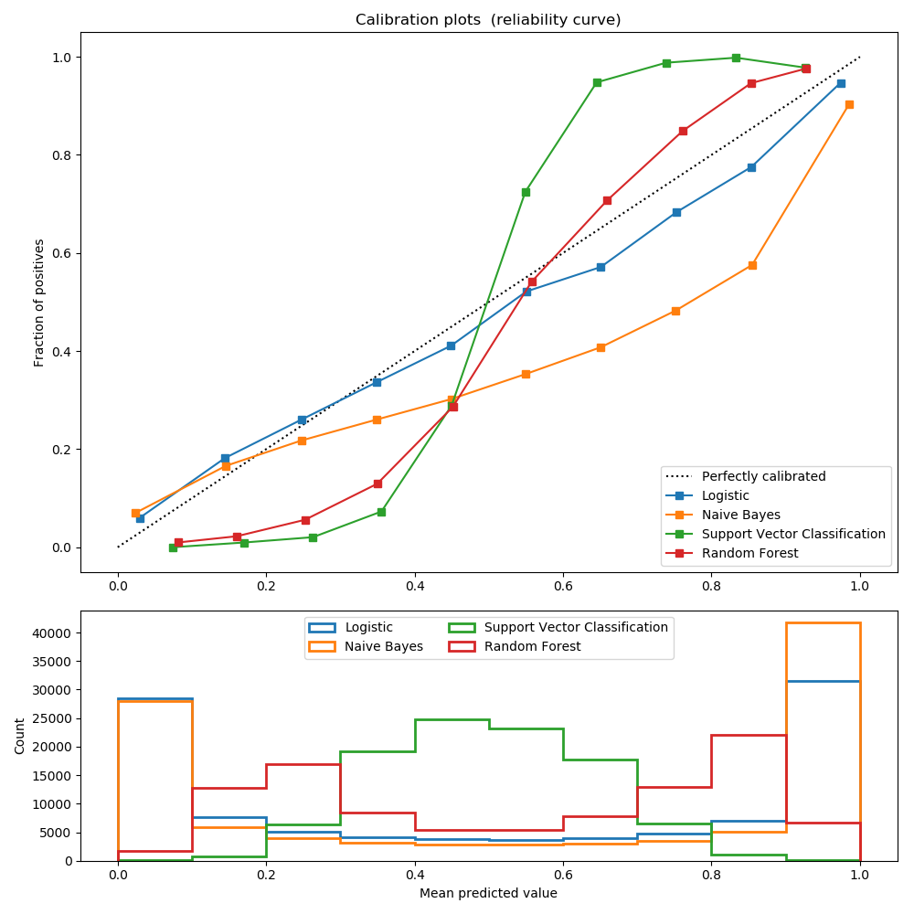
GaussianNB
Inheriting gaussion simplicity bayes, the characteristic possibility is assumed to be gaussion:

Slide 21
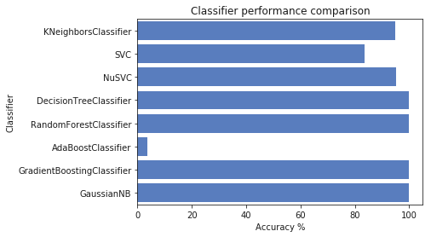
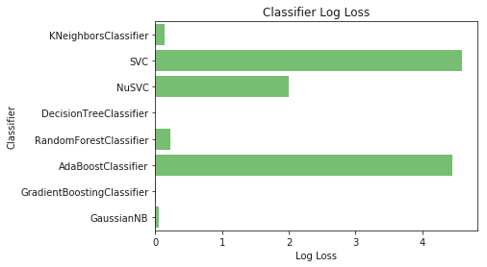
8 Classifiers effect contrast

Slide 22
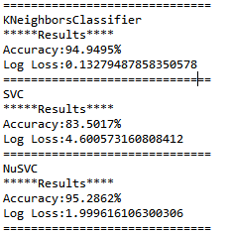
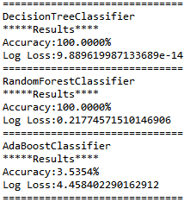
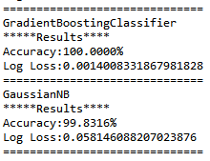

Slide 23
|
thanks for your listening]
[

