Slide 1
INFS6600
Taxonomy Pilot
Week 4 Results and Validation
Eight-category, multi-label classification baseline
WEEK 4 / V2
CS-44 Project Team
WEEK 4 / V2
1 September 2026
Notes:
[Sources]
- /Users/jacob/Dev/usyd_courses/DATA5703/infs6600-taxonomy-pilot/README.md
- https://www.sydney.edu.au/units/INFS6600/2026-S2C-NE-CC
[/Sources]

Slide 2
Week 4 delivers an auditable eight-category baseline
02
8
3
4
configured taxonomy categories
positive INFS6600 allocations
unit-outline evidence sections
Completed changes
•
Separated Simulation from Case-Based Learning
•
Applied non-mutually-exclusive multi-label classification
•
Calibrated WIL rule weights and retained provisional settings
•
Added distinct evidence counts, total scores and source-section reporting
•
Kept the analysis limited to INFS6600
CS-44 Project Team | INFS6600 Taxonomy Pilot | Week 4 v2
Notes:
[Sources]
- /Users/jacob/Dev/usyd_courses/DATA5703/infs6600-taxonomy-pilot/docs/week4_update_v2.md
- /Users/jacob/Dev/usyd_courses/DATA5703/infs6600-taxonomy-pilot/docs/week4_delivery_checklist.md
- /Users/jacob/Dev/usyd_courses/DATA5703/infs6600-taxonomy-pilot/config/taxonomy_v2.json
[/Sources]

Slide 3
The method separates positive evidence from review signals
03
01
Evidence units
Overview paragraphs, learning outcomes, assessments and weekly schedule rows are evaluated as distinct items.
02
Rule scoring
A matched rule group contributes its weight once, even when several alternative phrases appear.
03
Multi-label decision
Each item is evaluated independently against every category; no single-category winner is forced.
04
Aggregation
Positive totals and review totals are retained separately at the unit-category level.
Current decision settings: positive ≥ 3.0; high confidence ≥ 5.0. Both remain configurable.
CS-44 Project Team | INFS6600 Taxonomy Pilot | Week 4 v2
Notes:
[Sources]
- /Users/jacob/Dev/usyd_courses/DATA5703/infs6600-taxonomy-pilot/output/pdf/02_Classification_Algorithm_Detailed_v2.pdf
- /Users/jacob/Dev/usyd_courses/DATA5703/infs6600-taxonomy-pilot/config/taxonomy_v2.json
[/Sources]

Slide 4
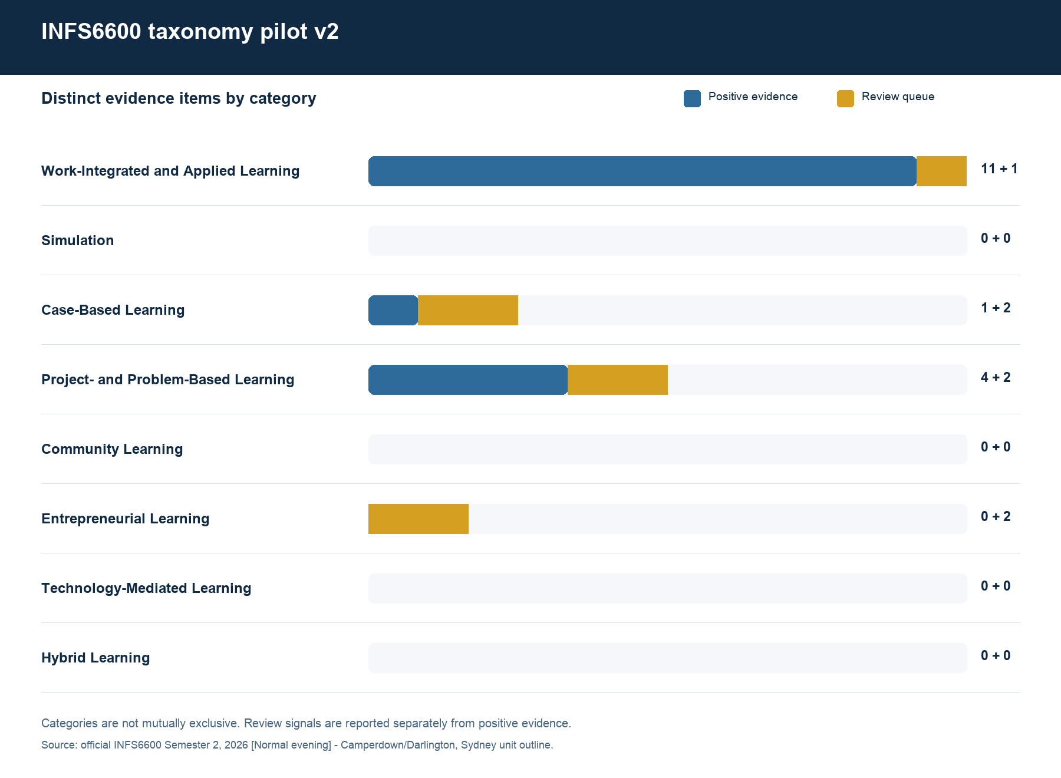
INFS6600 is positive in three taxonomy categories
04
Positive allocations
11
WIL evidence items
1
Case-Based item
4
Project / Problem-Based items
Simulation remains separate and has no positive evidence in the current outline.
CS-44 Project Team | INFS6600 Taxonomy Pilot | Week 4 v2
Notes:
[Sources]
- /Users/jacob/Dev/usyd_courses/DATA5703/infs6600-taxonomy-pilot/output/v2/visualisations/category_summary.png
- /Users/jacob/Dev/usyd_courses/DATA5703/infs6600-taxonomy-pilot/output/v2/data/processed/unit_category_summary.csv
[/Sources]

Slide 5
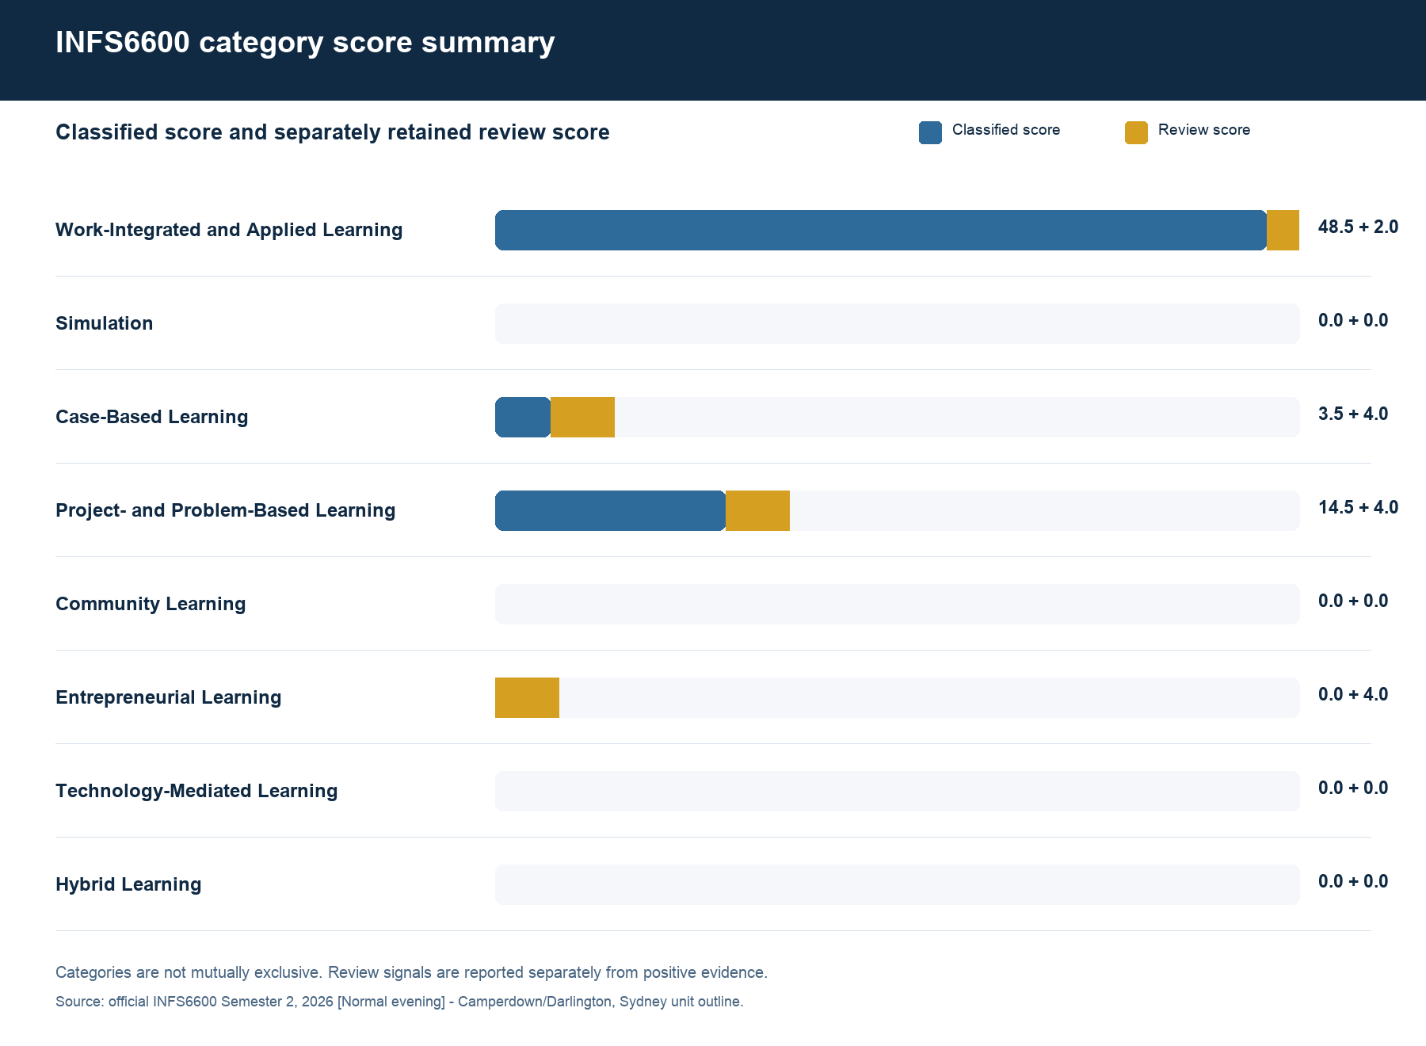
Scores show strong WIL support and distinct secondary categories
05
Classified score
48.5
Work-Integrated and Applied Learning
14.5
Project- and Problem-Based Learning
Review scores are visible but never merged into positive totals.
CS-44 Project Team | INFS6600 Taxonomy Pilot | Week 4 v2
Notes:
[Sources]
- /Users/jacob/Dev/usyd_courses/DATA5703/infs6600-taxonomy-pilot/output/v2/visualisations/category_scores.png
- /Users/jacob/Dev/usyd_courses/DATA5703/infs6600-taxonomy-pilot/output/v2/data/processed/unit_category_summary.csv
[/Sources]

Slide 6
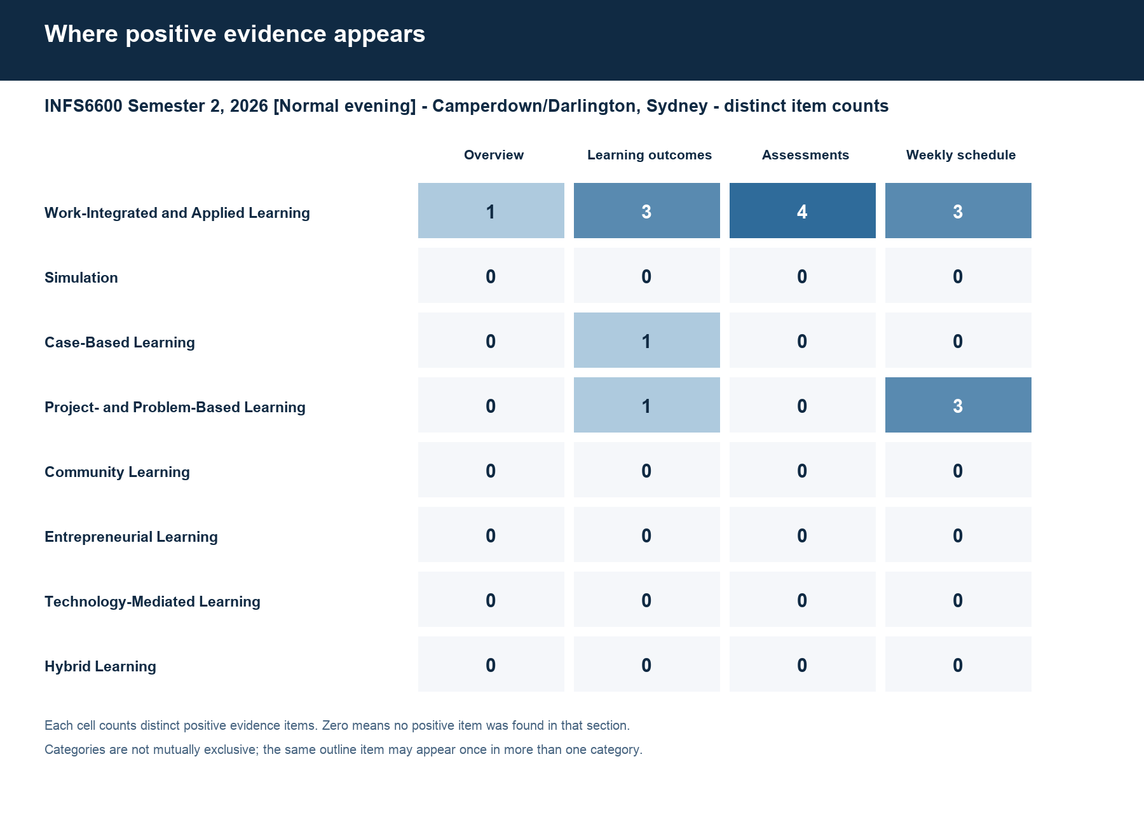
Positive evidence spans the unit outline
06
Why this matters
•
WIL spans all four source sections
•
Case-Based comes from LO02
•
Project / Problem-Based is strongest in the weekly schedule
•
All results retain item IDs and source text
CS-44 Project Team | INFS6600 Taxonomy Pilot | Week 4 v2
Notes:
[Sources]
- /Users/jacob/Dev/usyd_courses/DATA5703/infs6600-taxonomy-pilot/output/v2/visualisations/evidence_by_section.png
- /Users/jacob/Dev/usyd_courses/DATA5703/infs6600-taxonomy-pilot/output/v2/data/processed/classified_evidence.csv
[/Sources]

Slide 7
Positive results are fully traceable
07
Work-Integrated and
Applied Learning
Case-Based Learning
Project- and Problem-
Based Learning
11 items | 48.5
1 item | 3.5
4 items | 14.5
Representative evidence
Representative evidence
Representative evidence
•
Partner briefing
•
LO02: open-ended business scenarios
•
Actual business problem
•
Pitch to partner
•
Project immersion
•
Boardroom presentation
•
Problem and opportunity scoping
•
Actual business problem
•
Prototype validation
Interpretation
Interpretation
Interpretation
Authentic partner-facing and professional tasks connect theory with practice.
The learning outcome explicitly requires scenario-based analysis.
The unit requires sustained problem framing, project work and validation.
CS-44 Project Team | INFS6600 Taxonomy Pilot | Week 4 v2
Notes:
[Sources]
- /Users/jacob/Dev/usyd_courses/DATA5703/infs6600-taxonomy-pilot/output/v2/reports/pilot_results_v2.md
- /Users/jacob/Dev/usyd_courses/DATA5703/infs6600-taxonomy-pilot/output/v2/data/processed/classified_evidence.csv
- https://www.sydney.edu.au/units/INFS6600/2026-S2C-NE-CC
[/Sources]

Slide 8
The Week 4 package is ready for confirmation
08
Completed by the CS-44 team
Configuration points to confirm
•
Eight-category taxonomy and multi-label policy
•
Positive threshold: 3.0
•
INFS6600 evidence, review queue and category totals
•
High-confidence threshold: 5.0
•
Three presentation-ready figures
•
Career readiness weight: provisional 2.0
•
Detailed algorithm and course-mapping PDFs
•
Administrative ‘Case studies’ label: review-only at 2.0
•
Meeting handout, regression tests and release manifest
After confirmation, the same baseline can be applied to additional units.
CS-44 Project Team | INFS6600 Taxonomy Pilot | Week 4 v2
Notes:
[Sources]
- /Users/jacob/Dev/usyd_courses/DATA5703/infs6600-taxonomy-pilot/docs/week4_delivery_checklist.md
- /Users/jacob/Dev/usyd_courses/DATA5703/infs6600-taxonomy-pilot/docs/client_decisions_required.md
- /Users/jacob/Dev/usyd_courses/DATA5703/infs6600-taxonomy-pilot/output/v2/release_manifest_v2.json
[/Sources]

