Slide 1
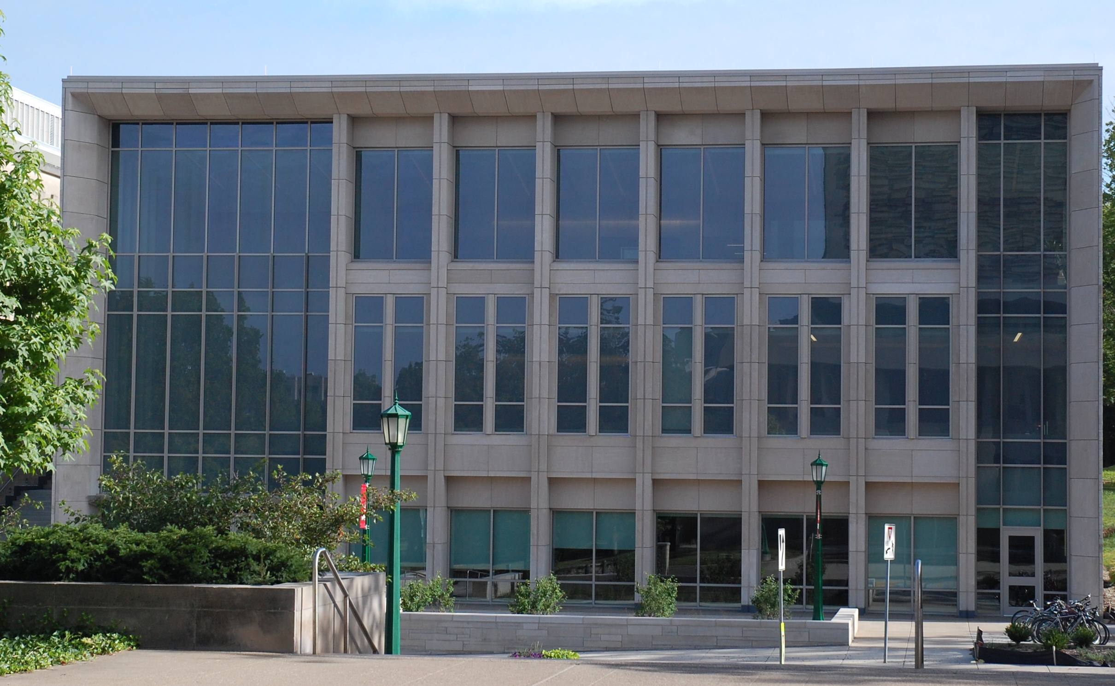
Managing Resources and Legitimacy: The Impact of Leadership Diversity on Nonprofit Survival
O’NEILL SCHOOL OF PUBLIC AND ENVIRONMENTAL AFFAIRS
Ruodan Zhang
Brad Fulton
INDIANA UNIVERSITY BLOOMINGTON

Slide 2
Leadership diversity
Leadership as a collective phenomenon (Yammarino et al. 2012)
Cost-benefit trade-off: coordination-and-communication vs. learning-and-effectiveness (Hamilton, Nickerson, and Owan 2003)
Diversity-performance: mixed findings (Ferrier 2001; Horwitz and Horwitz 2007)
“Conditions” to reap the diversity benefits (e.g. Fredette and Bernstein 2017; Fulton 2019)
Notes:
Scholars have found both value (e.g. Daley and Marsiglia 2001; Herring 2009; Opstrup and Villadsen 2015; Wollebaek 2009) as well as challenges (e.g. Hamilton, Nickerson, and Owan 2003; Horwitz and Horwitz 2007; Pitts 2005; Rho and Lee 2018) in leadership diversity.
Collective identities…→performance results
“double edged sword”
Session 1938

Slide 3
Questions
How does leadership diversity affect organizational survival?
Do social diversity dimensions lead to different performance/survival outcomes?
Age, gender, immigrant status, race/ethnicity
Notes:
longer-term //harder to observe among public organizations
Focusing on gender and race

Slide 4
Theory and hypotheses
Performance/Control
Resource dependence theory (Hillman, Withers, and Collins 2009; Pfeffer and Salancik 1978)
Strategic capacity (Ganz 2000)
Legitimacy
Institutional theory (DiMaggio and Powell 1983; 1991; Selznik 1996)
Notes:
Resource dependence theory suggests that organizations adapt to the external environment by managing their inter-organizational dependence so as to increase their power within the network by obtaining control over critical resources
Institutional theory argues that organizational survival depends on the level of conformity to institutional rules; highly conformed organizations are more likely to gain legitimacy and be perceived as accountable (DiMaggio and Powell 1983; Meyer and Rowan 1977). In particular, organizations adapt to and cope with uncertainties by mimicking the “legitimate or successful” role models (DiMaggio and Powell 1991; Selznik 1996).
Both lead to same outcome predictions – certainly explaining different mechanism

Slide 5
Theory and hypotheses
RDT
Female in leadership within network (+) → Female of the focal org. (Hillman, Shropshire, & Cannella 2007)
Institutional
Community-based organizations seek endorsement from established community institutions and external recognitions (Walker and McCarthy 2010)
Notes:
Signaling inclusiveness
**overlap

Slide 6
Theory and hypotheses
Resources:
Relational connections (Ali, Ng, and Kulik 2014; Hillman, Shropshire, and Cannella 2007)
Financial performance, budget overrun (Ali, Ng, and Kulik 2014; Opstrup and Villadsen 2015)
Gender, Age
Legitimacy:
Representative legitimacy (Pitts 2005); Reputation (Miller and Triana 2009)
Show effects over time (Watson, Kumar, and Kichaelsen 1993)
Immigrant, Race/ethnicity
Notes:
Signaling inclusiveness
→ Altogether lead to same prediction on survival..

Slide 7
Theory and hypotheses
Aggregate effect
HR: The whole is more than the sum of the parts
Diversity HR practices (+) → performance (Armstrong, et al., 2010)
Hypothesis 1: Organizations with a higher level of aggregate diversity in leadership are more likely to survive.

Slide 8
Theory and hypotheses
Resource-legitimacy difference
Hypothesis 2: Organizations with a more age & gender diverse leadership team are more likely to survive.
Hypothesis 3: Organizations with a more racially diverse leadership team or with a higher immigrant representation in leadership are more likely to survive.
Hypothesis 4: Organizations with a more age & gender diverse leadership team have better immediate financial performance.

Slide 9
Data

Slide 10
Data
The U.S. National Study of Community Organizing Coalitions (Fulton, Wood, and Interfaith Funders 2011)
Institution-based community organizations (IBCOs)
Imputation used for missing values (1%)
2011 American Community Survey; IRS Form 990s
Survey wave | 1999 | 2011
Total in field | 133 | 189
Info obtained | 79 (59%) | 160 (85%)

Slide 11
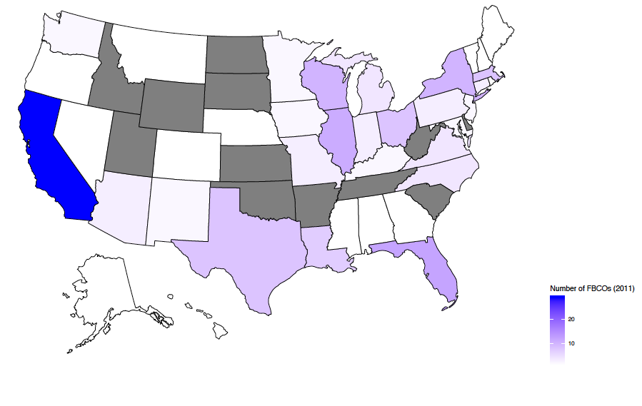
IBCOs Distribution by State, 2011 (N = 160)

Slide 12
Data
Variables | Type | Mean
Survival in 2016 | Bin: 1=existed | 93%
Race (4 groups) | Blau’s Index | 0.45
Gender (2) | Blau’s Index | 0.45
Age (2) | Blau’s Index | 0.06
Immigrant (2) | Blau’s Index | 0.20
Total revenue in 2011 (x $1,000) | Continuous | 289.49
Total revenue in 2012 | Continuous | 359.75
Total revenue in 2013 | Continuous | 339.91
Control: Org Age; Org Size (Staff; Event Turnout); Board Size; National Network Affiliation
County context:
County Race (4 grps);
White %;
Hispanic %;
County Immigrant;
Immigrant %
N = 160
Notes:
Org size: number of FTE os; log total rev., biggest turnout
Logged: turnout; revenue; board size

Slide 13
Results

Slide 14
Survival Analysis, 2011-2016: Cox Proportional Hazards Regression Results
Hypothesis 1: Organizations with a higher level of aggregate diversity in leadership are more likely to survive.
Variables | Haz. Ratio
Aggregate Diversity | 0.92*** (0.01)
Control:, # staff, total revenue (log), # board member (log) County: White %, Hispanic %, Immigrant %
F test model | 38.95
*** p<0.001 (two-tailed).

Slide 17
Survival Analysis, 2011-2016: Cox Proportional Hazards Regression Results
Hypothesis 2: Organizations with a more age & gender diverse leadership team are more likely to survive.
Hypothesis 3: Organizations with a more racially diverse leadership team or with a higher immigrant representation in leadership are more likely to survive.
Variables | Haz. Ratio
Age + Gender Diversity | 1.02 (0.41)
Immigrant + Race Diversity | 0.83*** (0.00)
Control:, # staff, total revenue (log), # board member (log) County: White %, Hispanic %, Immigrant %
F test model | 43.14
*** p<0.001 (two-tailed).

Slide 18
Results
Hypothesis 4: Organizations with a more age & gender diverse leadership team have better immediate financial performance.

Slide 19
Variables | 2011 |  | Variables | 2012 | Variables |  | 2013
Age + Gender | 0.07*** (0.01) |  | Age + Gender | 0.09*** (0.03) | Age + Gender Index |  | 0.14*** (0.04)
Immigrant + Race | -0.06*** (0.01) |  | Immigrant + Race | -0.04** (0.02) | Immigrant + Race |  | -0.02 (0.02)
County | Race ( + ***) , Immigrant ( + ***) |  | Race ( - ) , Immigrant ( + ***) |  | Race ( - ) , Immigrant ( + ***)
Control: Org age, # staff, biggest turnout (log), # board member (log), network
F test model |  | 137.8 |  | 60.43 |  | 66.21
R-Squared |  | 0.64 |  | 0.33 |  | 0.31
*** p<0.001 ** p<0.05 (two-tailed).

Slide 20
Variables | Faith-based % |  | Variables | Secular % | Variables |  | Fundraising %
Age + Gender | -1.54*** (0.61) |  | Age + Gender | 2.27*** (0.54) | Age + Gender Index |  | -0.36** (0.21)
Immigrant + Race | -0.08 (0.47) |  | Immigrant + Race | 1.51** (0.60) | Immigrant + Race |  | -0.17 (0.24)
County | Race ( - **) , Immigrant ( + **) |  | Race ( + ** ) , Immigrant ( + **) |  | Race ( - *** ) , Immigrant ( - ***)
Control: Org age, # staff, biggest turnout (log), # board member (log), network
F test model |  | 36.16 |  | 61.90 |  | 25.07
R-Squared |  | 0.17 |  | 0.31 |  | 0.19
*** p<0.001 ** p<0.05 (two-tailed).

Slide 21
Conclusion
Social diversity dimensions: Resource-driven vs. legitimacy-driven
Resource-driven (age, gender): positive effect on financial performance
Legitimacy-driven (immigrant, race/ethnicity): positive effect on 5-year survival outcome
In general, aggregate social diversity has a positive effect on 5-year survival
Survival and “profitability” hinge upon different factors

Slide 22

Managing Resources and Legitimacy: The Impact of Leadership Diversity on Nonprofit Survival
Ruodan Zhang: rz3@Indiana.edu
Brad Fulton
O’NEILL SCHOOL OF PUBLI C & ENVIRONMENTAL AFFAIRS

Slide 23
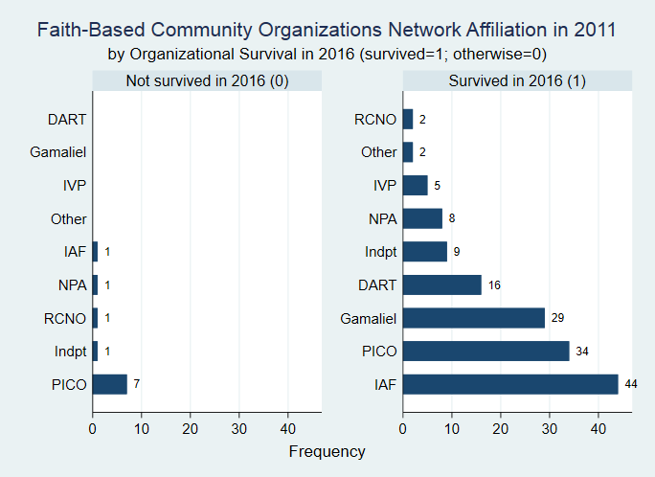

Slide 24
