Slide 1
CDNow

Slide 2
Data Restructuring - R code
cdnow=read.csv("cdnow_students_transaction.csv")
cdnow$DATE=as.Date(cdnow$DATE,format="%m/%d/%y")
#1 step 1
calibration=subset(cdnow,cdnow$DATE<="1997-09-30")
validation=subset(cdnow,cdnow$DATE>"1997-09-30")
# step 2 and step 3
monetary=aggregate(DOLLARS~ID,FUN=mean,data=calibration)
frequency=aggregate(DOLLARS~ID,FUN=length,data=calibration)
last.purchase=aggregate(DATE~ID,FUN=max,data=calibration)
calibration.summary=merge(monetary,frequency,by="ID")
calibration.summary=merge(calibration.summary,last.purchase,by="ID")
colnames(calibration.summary)=c("ID","monetary","frequency","lastpurchase")
calibration.summary$recency=as.numeric(max(calibration.summary$lastpurchase)-calibration.summary$lastpurchase)
nrow(calibration.summary)
monetary=aggregate(DOLLARS~ID,FUN=mean,data=validation)
frequency=aggregate(DOLLARS~ID,FUN=length,data=validation)
last.purchase=aggregate(DATE~ID,FUN=max,data=validation)
validation.summary=merge(monetary,frequency,by="ID")
validation.summary=merge(validation.summary,last.purchase,by="ID")
colnames(validation.summary)=c("ID","monetary","frequency","lastpurchase")

Slide 3
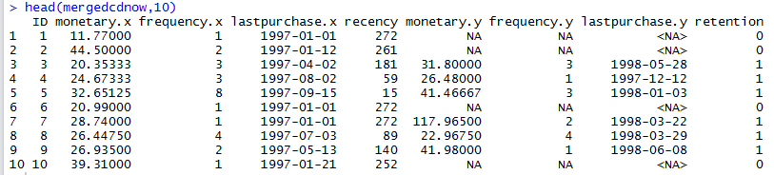
# step 4, merge the two samples
mergedcdnow=merge(x=calibration.summary,y=validation.summary,by="ID",all.x=TRUE)
# step 5
mergedcdnow$retention=ifelse(is.na(mergedcdnow$frequency.y),0,1)
Output

Slide 4
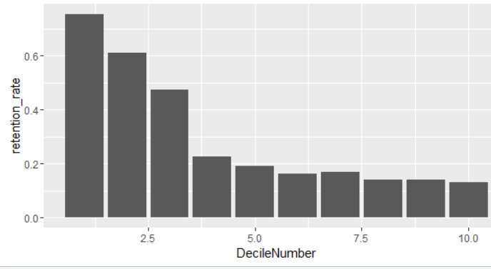
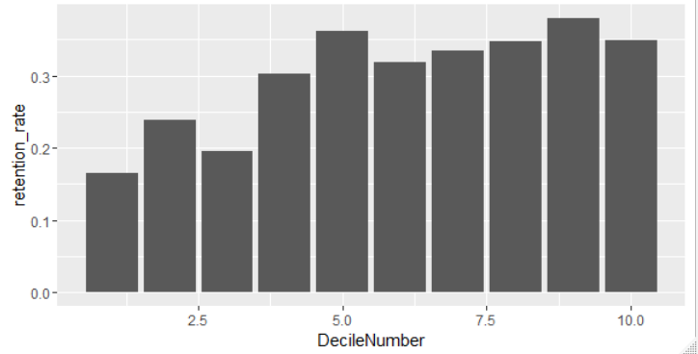
Decile Analysis
Recency Calibration Data
Monetary Calibration Data
Above graphs show that customers with the higher recency has the higher rate of retention. But the monetary value do not correlate.

Slide 5
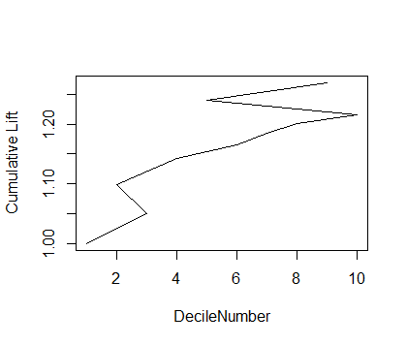
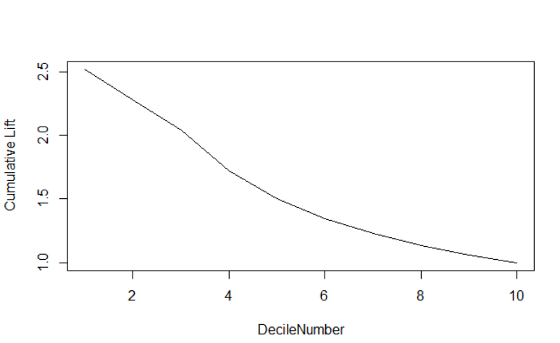
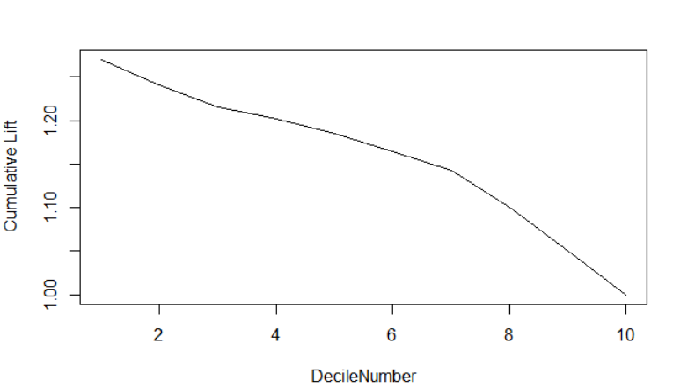
Q3 - Lift chart
recency
monetary
Here, recency seems to be more important to predict customer retention rate. The lift for top recency decile is 2.5 and that of monetary is 1.28. Higher lift value indicates that customers are more likely to respond to the recency than monetary i.e when did they purchase the last time vs how much did they spend. Although, cumulative lift chart does not provide useful info to conclude the same.
Notes:
> Decile_analysis_monetary
DecileNumber retention_times retention_rate cum_retention_rate NewNumber
1 1 387 0.1641918 1.000000 10
2 2 564 0.2392872 1.099639 8
3 3 462 0.1960119 1.050187 9
4 4 712 0.3020789 1.142574 7
5 5 855 0.3627493 1.240436 2
6 6 751 0.3186254 1.164872 6
7 7 789 0.3347476 1.185038 5
8 8 820 0.3478999 1.201828 4
9 9 896 0.3801443 1.269481 1
10 10 822 0.3487484 1.215170 3

Slide 6
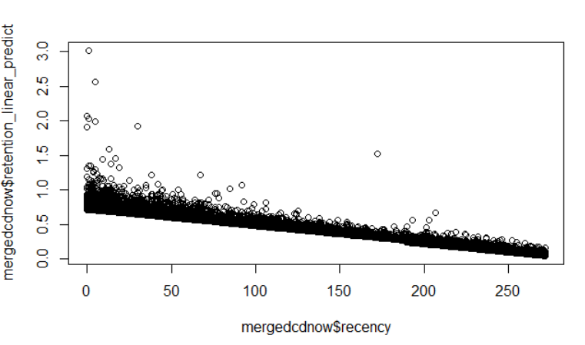
Linear Regression model
recency
Call: lm(formula = retention ~ recency + monetary.x + frequency.x, data = mergedcdnow) Residuals: Min 1Q Median 3Q Max -2.0155 -0.2224 -0.1410 0.2695 0.9497 Coefficients: Estimate Std. Error t value Pr(>|t|) (Intercept) 6.704e-01 1.009e-02 66.46 < 2e-16 *** recency -2.371e-03 4.150e-05 -57.14 < 2e-16 *** monetary.x 4.187e-04 8.776e-05 4.77 1.85e-06 *** frequency.x 2.164e-02 1.259e-03 17.18 < 2e-16 *** --- Signif. codes: 0 ‘***’ 0.001 ‘**’ 0.01 ‘*’ 0.05 ‘.’ 0.1 ‘ ’ 1 Residual standard error: 0.4018 on 23566 degrees of freedom Multiple R-squared: 0.2305, Adjusted R-squared: 0.2304 F-statistic: 2353 on 3 and 23566 DF, p-value: < 2.2e-16

Slide 7
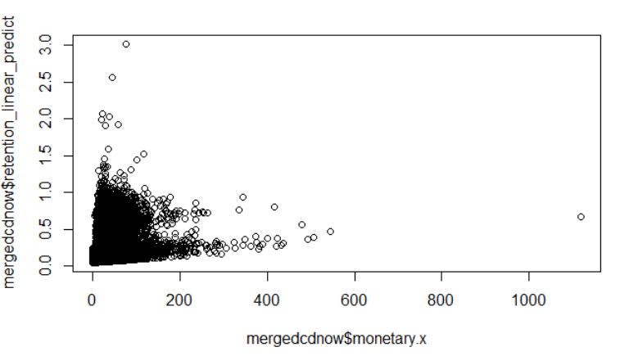
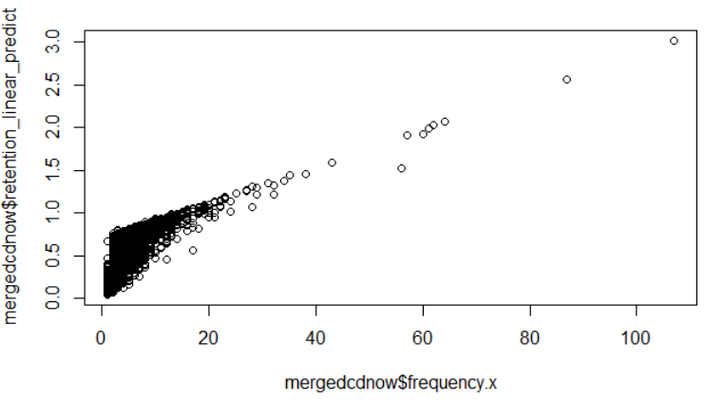
Linear Regression - Continued
Monetary
frequency
These graphs show that lower the recency, the retention rate is higher. Also if the customer has higher frequency, he/she will have higher retention rate. However, monetary value does not provide any clear idea about customer retention rate.

Slide 8
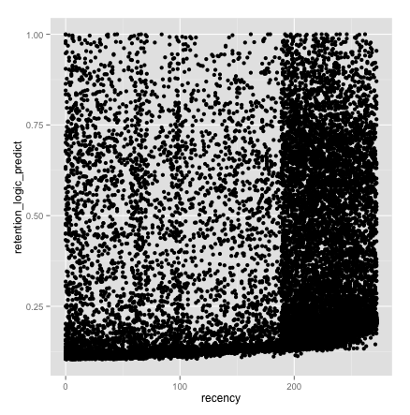
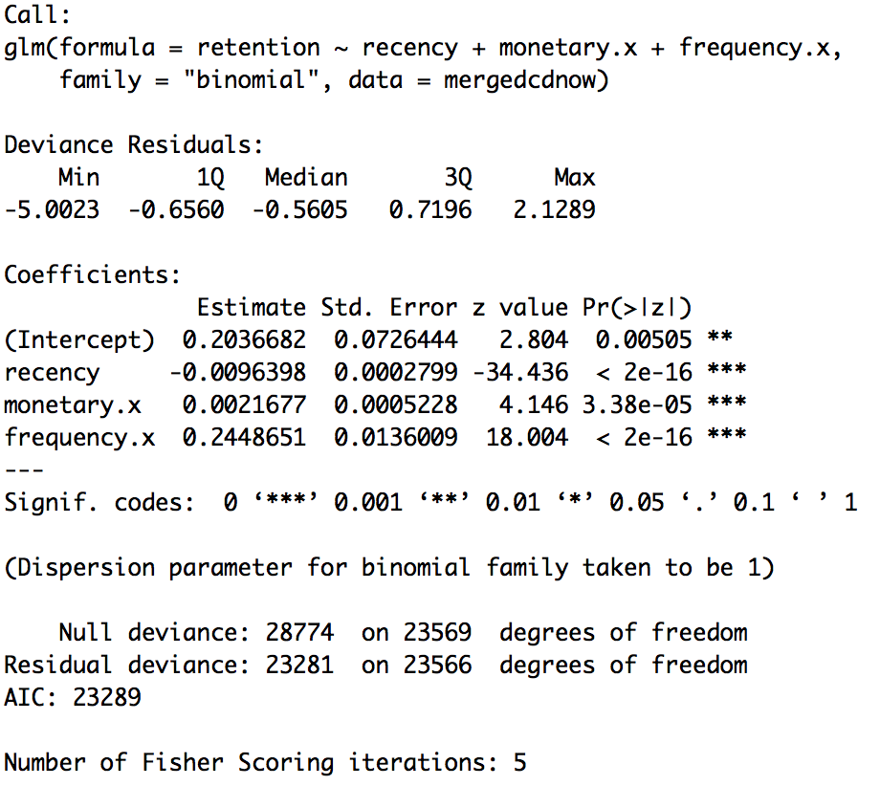
Logistic Regression Model
recency
mergedcdnow$retention_logic_predict=predict(model_logic,data=mergedcdnow,type='response')

Slide 9
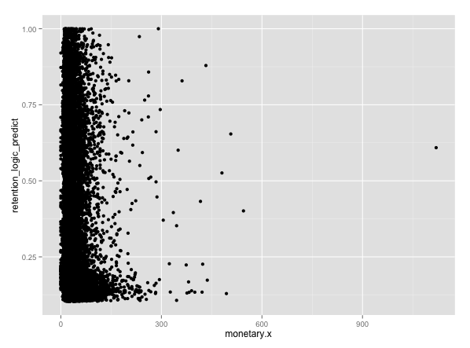
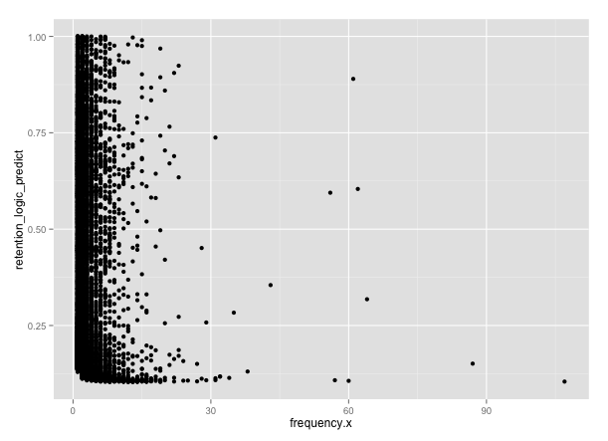
Logistic Regression - Continued
Monetary
Frequency

Slide 10
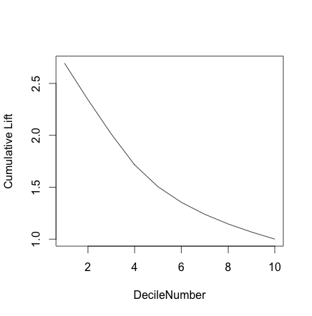
Q5 - Lift Chart - Logistic Regression
This cumulative lift chart is very different from the one we created for Q3. The lift chart shown on this slide, provides a clear idea about how top deciles are more likely to respond than the lower deciles. Adding more customers to the top deciles would have been beneficial for CDNow for the long term. The lift chart shows that customers in the first 4 deciles were more likely to respond than the average customer in the entire sample.

Slide 11
Q6
Looking at the regression results, customers who made frequent purchases and customers with lower recency were the customers with higher retention rate. CDNow saw a huge initial growth but their business began to slow down in 90’s. We would have recommended that CDNow could have focused on making customers buy their CDs regularly. The amount customer spent on each purchase had a minimum effect on the customer retention rate. Therefore, providing discounts on frequent purchases or implementing a subscription model would have helped CDNow to retain their customers for longer period of time.

