Slide 1
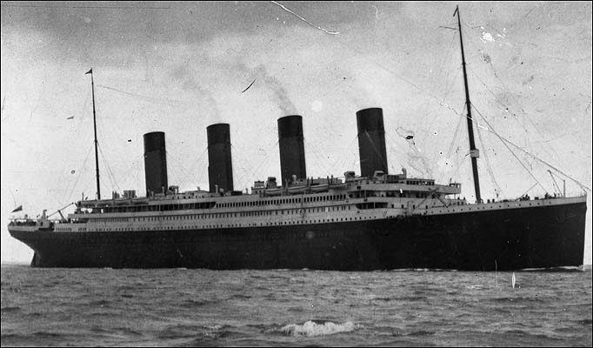
Who will survive
Kaggle Titanic Competition
Ruo Du MS Business Analytics

Slide 2

outline
Titanic Info
Competition Rule
Data Set Info
Statistic Description
Classification Tree
Current Ranking
Notes:
What kind of ranking, lot of en..

Slide 3
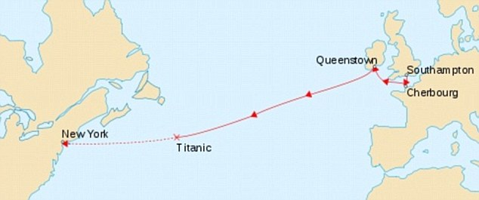
Titanic info
Route: Cherbourg; Southampton; Queenstown;—New York
Time: the early morning of 15 April 1912
2,200 passengers and crew
1500 people died and 700 survived
Notes:
Sailed from

Slide 4
Competition rule
Train data set
1-891
Test data set
892-1309
Notes:
Train not training

Slide 5
Data set info--VARIABLEs
survival Survival (0 = No; 1 = Yes)
pclass Passenger Class (1 = 1st; 2 = 2nd; 3 = 3rd)
name Name
sex Sex
age Age
sibsp Number of Siblings/Spouses Aboard
parch Number of Parents/Children Aboard
ticket Ticket Number
fare Passenger Fare
cabin Cabin Number
embarked Port of Embarkation (C = Cherbourg; Q = Queenstown; S = Southampton)
Notes:
Step 1Choose
Meaninless data

Slide 6
Statistic description
Class Age Sex Survived
Crew:885 Adult:2092 Female:470 No:1490
First:325 Child:109 Male:1731 Yes:711
Second:285
Third:706
Notes:
三等舱和船员所占人数较多，儿童人数很少，女性和男性比例大约为1:3.5，整体存活率在30%左右。

Slide 7
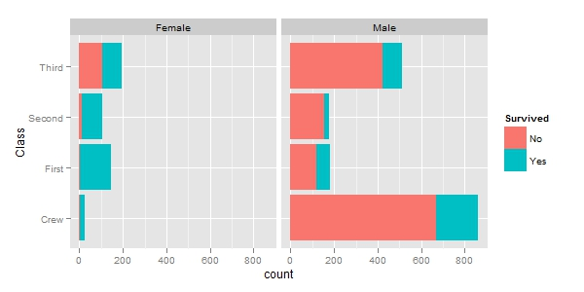
Statistic description
Notes:
就整体而言女性的存活率高于男性。这一点证实了当时“让妇女和孩子先走”的援救原则。如果将舱位因素考虑进来。一、二等舱的女性存活率都相当高，在船员中的少量女性也得以存活，但是三等舱的女性相对而言存活率较低。因此，虽然同为女性，但舱位的差别仍然决定了生死的命运。

Slide 8
Statistic description
Class Gender Age Total Survive Survive Rate
First Female Child 1 1 100.00%
Second Female Child 13 13 100.00%
First Male Child 5 5 100.00%
Second Male Child 11 11 100.00%
First Female Adult 144 140 97.00%
Crew Female Adult 23 20 87.00%
Second Female Adult 93 80 86.00%
Third Female Adult 165 76 46.00%
Third Female Child 31 14 45.00%
First Male Adult 175 57 33.00%
Third Male Child 48 13 27.00%
Crew Male Adult 862 192 22.00%
Third Male Adult 462 75 16.00%
Second Male Adult 168 14 8.00%

Slide 9
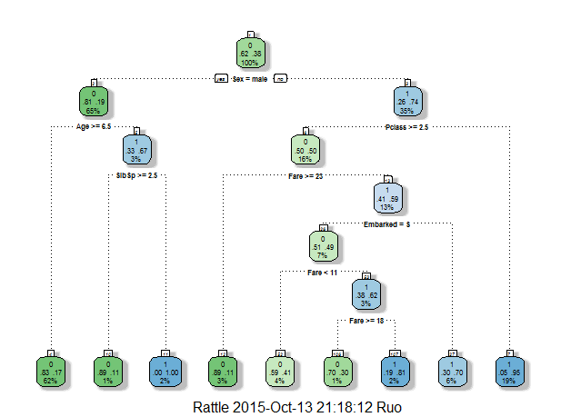
classification tree
Notes:
Child in first and second class

Slide 10
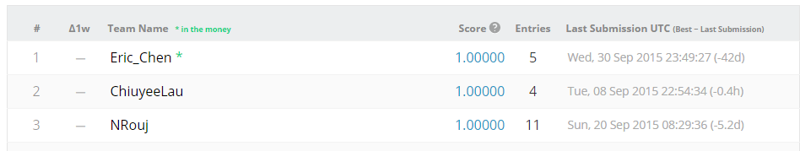
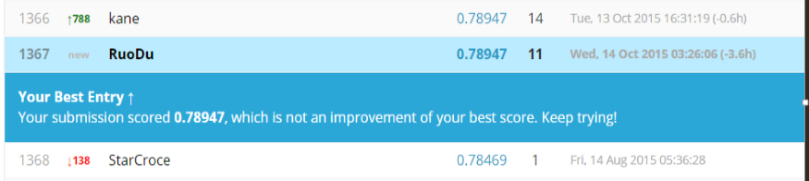
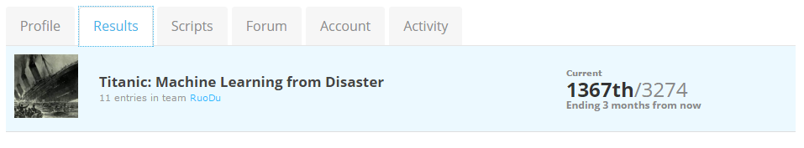
current ranking
Notes:
One more slides

