Slide 1
The REPORT Procedure and ODS Destination = Microsoft Excel Presented by: Rekha Mani, Laxim & Ruohnan Hu, STAT6250 2018
Paper SAS235-2017, Jane Eslinger, SAS Institute Inc.

Slide 2
ABSTRACT
The new ODS destination for Excel enables you to create native Excel files (XLSX) directly from SAS. Now you can include just the data you need, create great-looking tabular output, and do it all in a fraction of the time!
This paper shows you how to use PROC REPORT to create polished tables that contain formulas, colored cells, and other customized formatting. Also presented in the paper are the destination options used to create various workbook structures, such as multiple tables per worksheet. Using these techniques to automate the creation of your Excel reports will save you hours of time and frustration,

Slide 3
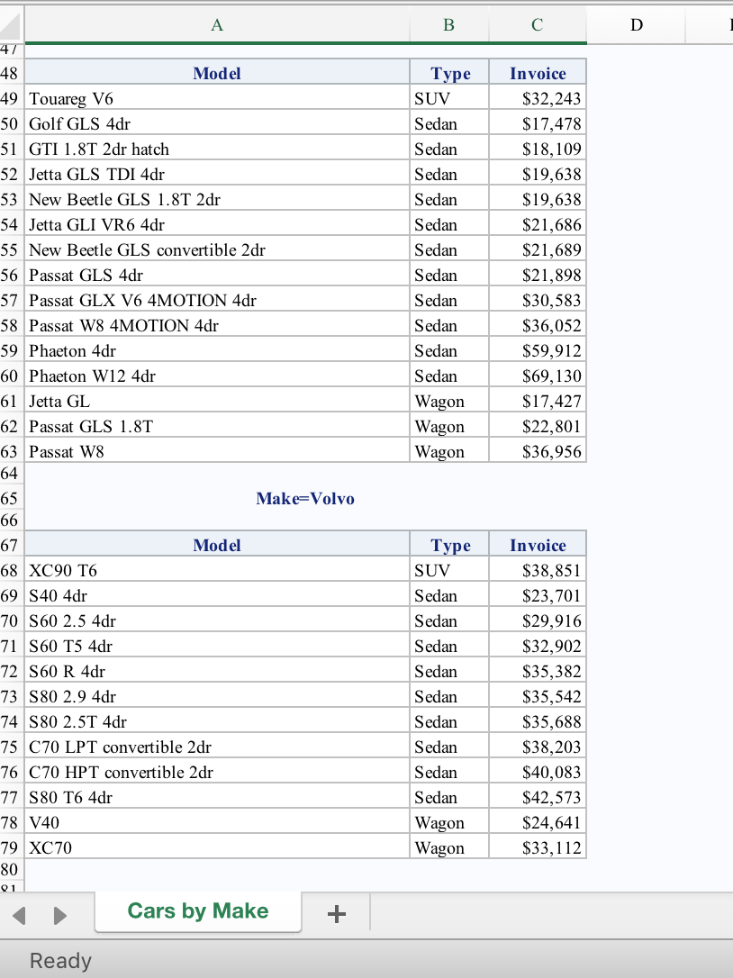
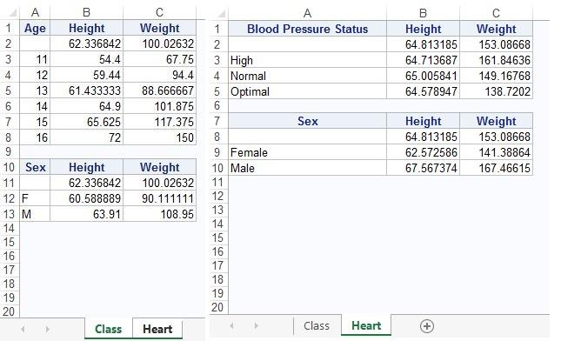
/*example 5*/
/*adding the worksheet name*/ ods excel file="/folders/myshortcuts/sf_myfolders/finalProject/example5.xlsx" options(sheet_name='Cars by Make’ sheet_interval='none’);
/*adding the worksheet name; keep all of the tables generated in the same worksheet */ proc report data=sashelp.cars; by make; column model type invoice; run; ods excel close;
/*example 6*/
/*create statistical tables for mutiple variables with page inserted after each table*/
ods excel file="/folders/myshortcuts/sf_myfolders/finalProject/example6.xlsx" options(sheet_interval='none' sheet_name='Class’);
proc report data=sashelp.class;
column age height weight;
define age / group; define height / mean; define weight / mean;
rbreak before / summarize;
run;
proc report data=sashelp.class;
column sex height weight;
define sex / group; define height / mean; define weight / mean;
rbreak before / summarize;
run;
ods excel options(sheet_interval='output’);
/* dummy output object generated by a DATA _NULL_ step, processing without creating datasets */
ods exclude all; /* prevent the results of the DATA _NULL_ step from being included in the workbook*/
data _null_;
declare odsout obj();
/*The local variable (obj) communicates with the ODS system and remains active throughout the entire DATA step */
run;
ods select all;
ods excel options(sheet_interval='none' sheet_name='Heart’);
proc report data=sashelp.heart;
column bp_status height weight; define bp_status / group; define height / mean; define weight / mean;
rbreak before / summarize;
run;
proc report data=sashelp.heart;
column sex height weight; define sex / group; define height / mean; define weight / mean;
rbreak before / summarize;
run;
ods excel close;

Slide 4
/*example 7 - create exact same file as example 6, using macros*/
%macro prcode(sheetname, dsname, grpvar);
ods excel options(sheet_interval='none' sheet_name="&sheetname");
proc report data=&dsname;
column &grpvar height weight;
define &grpvar / group; define height / mean; define weight / mean;
rbreak before / summarize;
run;
%mend prcode;
%macro newsheet;
ods excel options(sheet_interval='output’);
ods exclude all;data _null_;
declare odsout obj();
run;
ods select all;
%mend newsheet;
ods excel file="/folders/myshortcuts/sf_myfolders/finalProject/example7.xlsx";
%prcode(Class, sashelp.class, age);
%prcode(Class, sashelp.class, sex);
%newsheet;
%prcode(Heart, sashelp.heart, bp_status);
%prcode(Heart, sashelp.heart, sex);
ods excel close;

Slide 5
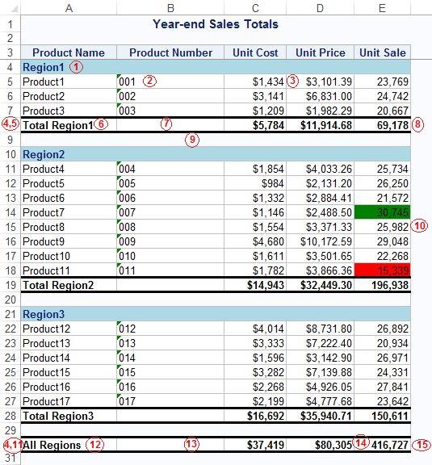
The key features of the above Excel report are as follows:
① Section headers with a colored background ② Leading zeros for character variables ③ Appropriately formatted analysis variables ④ Bolded values in all summary rows ⑤ Summary row for each region
⑥ Customized text in the summary row for each region ⑦ Borders on the summary row for each region ⑧ Formulas for the SALE variable in the summary row for each region ⑨ A blank row between each section
① Coloring of the SALE column based on sales criteria ① Summary row for the entire report ① Customized text in the summary row for the entire report ① Borders on the summary row for the entire report
① Change the format for the PRICE variable in the summary row for the entire report ① Formulas for the SALE variable in the summary row for the entire report
/*example 8*/
data pricedata; length productname $50.; set sashelp.pricedata;
if productname="Product8" then product=8;
else if productname="Product9" then product=9;
else if productname="Product10" then product=10;
else if productname="Product11" then product=11;
productnum = put(product,z3.);
run;
ods excel file="/folders/myshortcuts/sf_myfolders/finalProject/example8.xlsx" options(embedded_titles='yes' frozen_headers='yes’);
title "Year-end Sales Totals";
proc report data=pricedata style(summary)=[font_weight=bold];
column region regionname product productname productnum cost price sale;
define region / group noprint order=internal; define regionname / group noprint;
define product / group noprint order=internal; define productname / group;
define productnum / group 'Product Number' format=$3.;
define price / style(column)=[tagattr="format:$#,###.00;$-#,###.00"];
define cost / style(column)=[tagattr="format:$#,###;$-#,###"];
define sale / style(column)=[tagattr="format:#,###"]; break after regionname / summarize;
rbreak after /summarize;
compute before regionname /style=[background=lightblue just=l font_weight=bold];
line regionname $20.;
endcomp;
compute after regionname;
productname = catx(' ','Total',regionname);
if _break_ ^= '' then call define(_row_,'style','style=[bordertopstyle=solid bordertopwidth=1ptbordertopcolor=black
borderbottomstyle=solid borderbottomwidth=1ptborderbottomcolor=black]'); line ' ‘;
endcomp;
compute after;
productname = "All Regions";
call define(_row_,'style','style=[bordertopstyle=solidbordertopwidth=1pt bordertopcolor=black borderbottomstyle=solidborderbottomwidth=1pt borderbottomcolor=black]’);
call define('price.sum','style','style=[tagattr="format:$#,###;$-#,###"]’);
endcomp;
compute sale;
if _break_ = '' then do;
if sale.sum < 20000 then call define(_col_,'style','style=[background=red]’);
else if sale.sum > 30000 then call define(_col_,'style','style=[background=green]’); end;
else if upcase(_break_) = 'REGIONNAME' then do; if region = 1 then call define('sale.sum','style','style=[tagattr="formula:sum(E5:E7) format:#,###"]’);
else if region = 2 then call define('sale.sum','style','style=[tagattr="formula:sum(E11:E18) format:#,###"]’);
else if region = 2 then call define('sale.sum','style','style=[tagattr="formula:sum(E22:E27) format:#,###"]’); end;
else if _break_ = '_RBREAK_' then do; call define('sale.sum','style','style=[tagattr="formula:sum(E8,E19,E28) format:#,###"]’); end;
endcomp;
run;
ods excel close;

