Slide 1
Instrument Recognition
Ruohua Li & Tianhao Yu
ECE 2021

Slide 2
Reading in of files
Reading in a list of categorized, single-pitched, and fixed-duration *.wav files in performed with different instruments
Before the processing of time-domain signals first modify them for better results
Categorization: categorize the input signal by categories of instruments
Normalization: normalize the amplitude of the signal

Slide 3
Pre-Decision Processing
After reading, process the input signals via Discrete Fourier Transform.
The resulting DFT array will be used as training set
Same processing precedure will be appled to test signals later

Slide 4
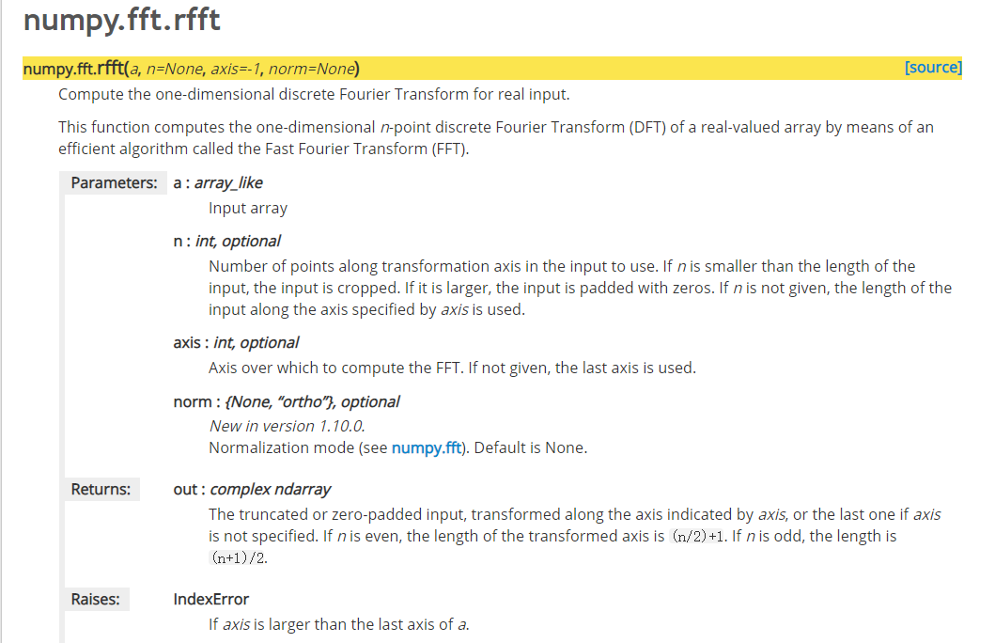
Library Used

Slide 5
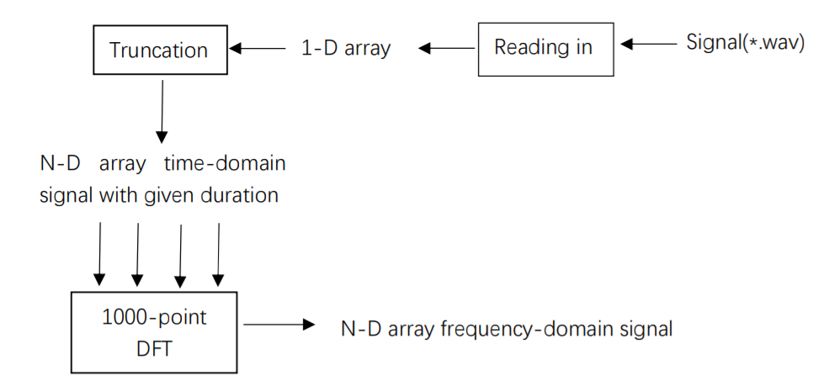
Working flow for processing of a single file

Slide 6
Bayes Theorem
P(A|B) is a conditional probability of A given B is true
The probability of P(B|A) can therefore be estimated based on the probability P(A|B)

Slide 7
Training Process
counting the occurrence of a certain spectrum in training data
smoothing data
calculating probabilities

Slide 8
Counting Occurrence
The occurrence of spectrum allows the computer to get hold of the basic distribution of P(spec|instru).
Using the Bayes Theorem, this can be used to get P(instru|spec).

Slide 9
Smoothing data
Smoothing assigns non-zero probabiities to unseen words. Since all probabilities have to add up to 1, this means we need to reduce the estimated probabilities of the words we have seen. Smoothing moves mass from the seen words to the unseen words.

Slide 10
Why Smoothing
Smoothing is critical to the algorithm--if the test file contain spectrum we have never seen, the occurrence would return 0 and thus make the probability 0.
The final outcome would be spoiled even if we successfully recognized the rest of the spectrums.

Slide 11
Calculating Probabilities
The decision is based on cumulative probabilities: we take the product of individual step probabilities.
A potential problem here is downflow: the probabilities are fractions and product gets smaller as process goes on.

Slide 12
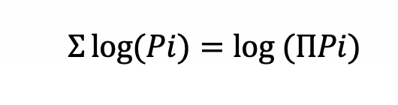
Solution to Downflow
Take logs of the probabilities and take sums.
Since log keeps the relation of probabilities, we can still find the largest P

Slide 13
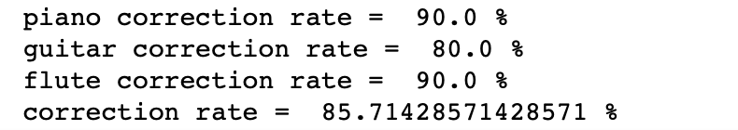
Result
The outcome of our recognizing program is decent: it reached a correction rate of 85.71% with most regular solo files successfully recognized.
The mistakes lies in high pitches of piano. The accuracy is also lower when two pitches are simultaneously played.

Slide 14
Limitations
Training set: current training set used for this version of the program are mainly composed of single pitched, fixed-duration signals
Processing: Fast Fourier Transform fails to take time scale into consideration, causing problems when comparing signals with different durations and unstable signals

Slide 15
Future Perspective
To fully exploit the value of Bayes deciding algorithm, the next step would be introducing real solo music pieces in diverse categories in large scale
To solve the problem with processing, a different processing algorithm for the program is required such as Wavelet Transform

Slide 16
Thank you !

Slide 17
Reference
np.fft.rfft documentation. Retrieved from
https://docs.scipy.org/doc/numpy/reference/generated/numpy.fft.rfft.html#numpy.fft.rfft

