Slide 1
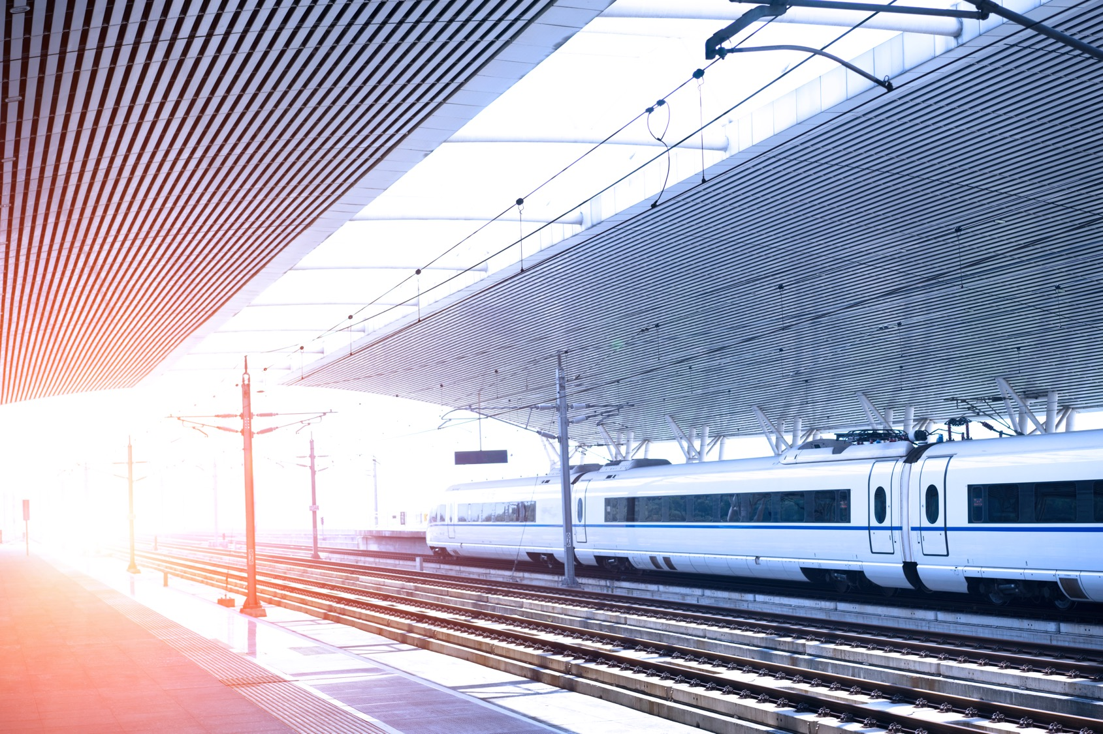
Lightweight Recycled Carbon Fiber Carriage Materials for Sustainable High-Speed Rail
Presenter: Liu XuTong
Reducing energy use and carbon emissions through lighter carriage design
Core idea
Less mass -> less energy demand
Team members: Liu JunHan, Dang JiaYing,Liu XuTong,Guo GuangHan,Ning WanZheng
order: Liu XuTong,Liu JunHan,Dang JiaYin,Guo GuangHan,Ning WanZheng
Notes:
Presenter: [Name 1]. Open with the project theme: sustainable high-speed rail technologies. State clearly that the team's final design solution is lightweight recycled carbon fiber carriage materials. The key argument is that reducing carriage mass can reduce operational energy use, which may lower electricity cost and carbon emissions over the long life cycle of Australia's future high-speed rail. Timing guide for a 15-18 minute team presentation: each speaker should speak for at least 2 minutes.

Slide 2
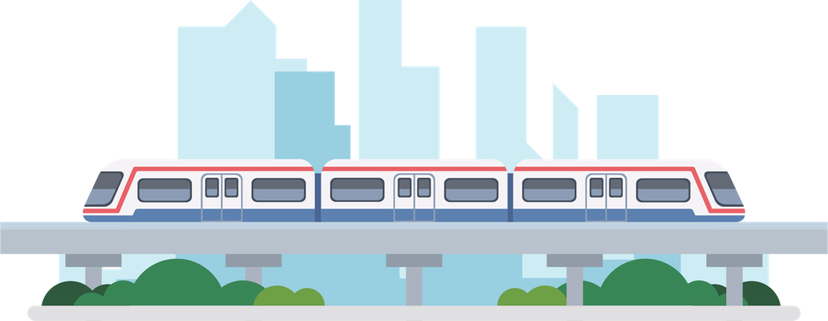
Context: Australia’s Future High-Speed Rail
Presenter:Liu XuTong
02
Newcastle-Sydney is the case example for this design project.
Newcastle-Sydney: first major stage
194 km
Up to 320 km/h
Long-term need
proposed alignment
planned speed outside tunnels
energy-efficient and sustainable operation
Newcastle
Central Coast
Sydney
Design focus: lower energy per carriage
Sources: Infrastructure Australia; High Speed Rail Authority
Notes:
Presenter: [Name 1]. Explain that the project sits inside Australia's future high-speed rail context. Use Newcastle-Sydney as the case example because it is identified as a major early stage. The proposed alignment is 194 km and the planned speed is up to 320 km/h outside tunnels. The design challenge is not only building fast rail, but operating it efficiently and sustainably for decades. Sources: Infrastructure Australia High Speed Rail Newcastle-Sydney evaluation; High Speed Rail Authority corridor context.

Slide 3
Problem Definition
Presenter:Liu JunHan
03
Heavy carriage materials can increase energy demand across the operating life of high-speed rail.
Problem
Heavy carriages increase lifetime energy and emissions pressure.
Heavier carriage
Higher energy use
Higher cost + CO2-e
Lower sustainability
More mass to move
More electricity
More pressure
Long-term impact
Design target: carriage mass
Notes:
Presenter: [Name 2]. Define the problem using the causal chain. The issue is not that current trains cannot work; the issue is that heavy and energy-intensive carriage materials can increase energy use, electricity cost, and operational emissions. This creates sustainability pressure over a long rail operating life. This slide sets up why lightweight materials are a relevant engineering design direction.

Slide 4
Solutions
Presenter: Liu JunHan
Problems mapped to options, then filtered by impact, feasibility, and risk.
Problems
Candidate solutions
Energy use
!
AI
Recycled CFRP
panels
Fewer
stops
AI dynamic
routing
Study
pods
C
Carbon pressure
>
CHOSEN
NOT SELECTED
NOT SELECTED
NOT SELECTED
Direct + testable
Service trade-off
High tech risk
Off-scope
?
Rail safety
Delivery risk
Final choice: lightweight recycled CFRP carriage materials
Cuts weight
Lowers energy
?
Can be validated

Slide 5
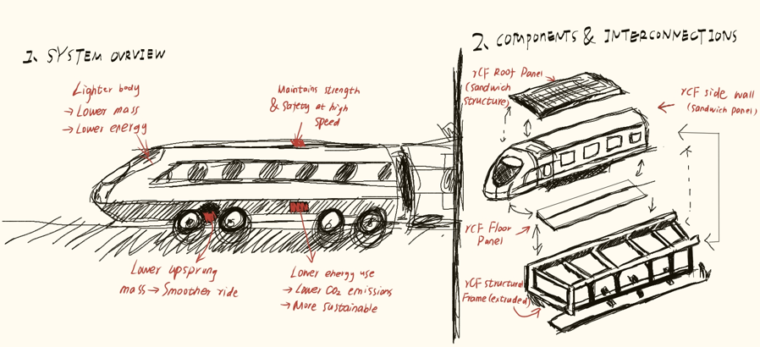
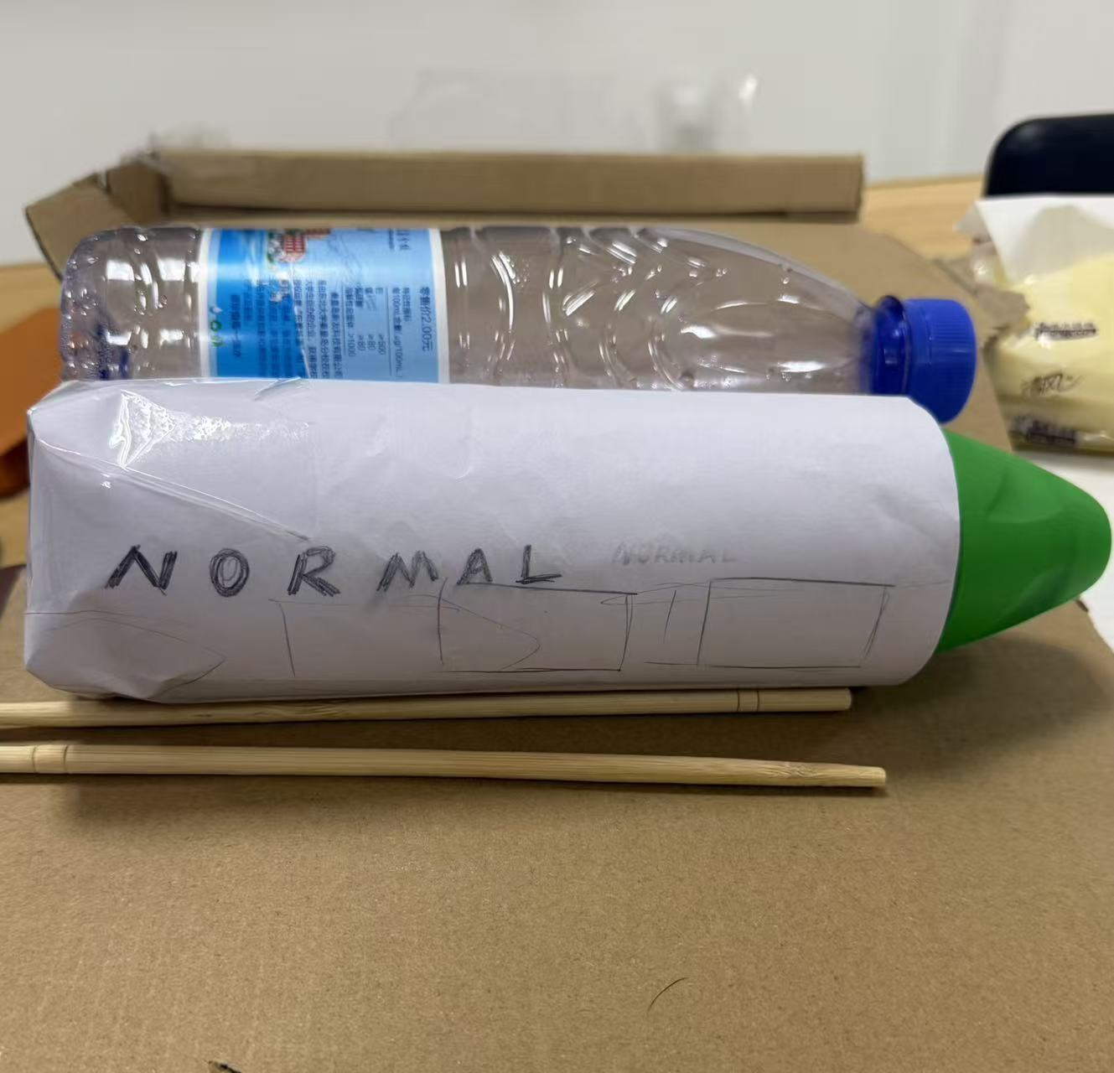
Our Design Solution
Presenter: Dang JiaYin
05
Use lightweight, recycled carbon fiber carriage materials for selected components.
Main solution
Recycled CFRP panels
Reduce mass
Lower energy
Less material weight
Less energy demand
Interior panels
Seat shells
Partitions
Covers
Recycle value
Lower risk
Circular material use
Test selected parts first
Lighter carriage -> lower operating energy
Sources: Ulbricht et al. 2023
Notes:
Presenter: [Name 2]. Present the solution clearly: lightweight recycled carbon fiber carriage materials. The idea is to use recycled carbon fiber composite panels in selected carriage components such as interior panels, seat shells, partitions, or non-primary covers. This is a partial substitution that should be tested against strength, fire, safety, maintenance, and certification requirements. Source: Ulbricht et al. 2023 discusses high-performance composite lightweight rail components and the need to meet rail standards.

Slide 6
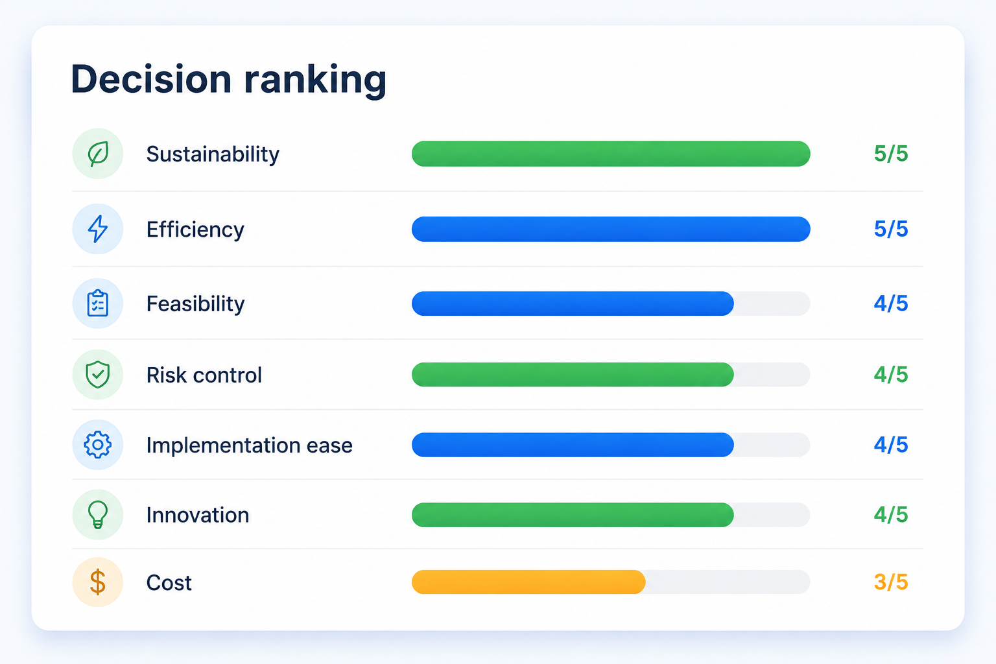
Why We Chose This Solution
Presenter: Dang JiaYin
06
The selected option performs strongly across sustainability, efficiency, feasibility, and risk control.
Decision ranking
Sustainability fit
Sustainability
5/5
Circular material use + lower emissions potential
Efficiency
5/5
Feasibility
4/5
Risk control
4/5
Controlled risk
Implementation ease
4/5
Start with selected components
Innovation
4/5
Cost
3/5
High benefit potential + realistic validation
Notes:
Presenter: [Name 4]. Explain that the team selected this solution because it scores strongly on sustainability and efficiency, while still being feasible to validate through material and component testing. Cost is lower than the top criteria because recycled CFRP may involve high upfront material, processing, testing, and certification costs. The decision matrix is a design summary, not a precise financial model.

Slide 7
Base-Case Cost and Carbon Estimate
Presenter: Guo GuangHan
Visible calculation, but not a guaranteed saving.
Inputs
Energy use
Energy saved
194 km route
15m x 194 x 0.033 / 0.70
= 137.2 GWh/year
137,185,714 x 5%
= 6.86 GWh/year
15m trips/year
0.033 kWh/seat-km
70% load factor
Cost saved
CO2-e cut
5% saving assumption
6,859,286 x 0.075
≈ A$0.51m/year
6,859,286 x 0.67 / 1000
= 4,596 t/year
A$0.075/kWh
0.67 kg CO2-e/kWh
Estimate inputs
30-year gross electricity saving
Conclusion
≈ A$15.4m
Could save per year:
6.86 GWh | A$0.51m | 4,596 t CO2-e
Gross saving before material, testing, certification, and maintenance costs
Sources: Greengauge 21; AEMO Q4 2025; National Greenhouse Accounts 2025
Notes:
Presenter: [Name 4]. Walk through the calculation step by step. Annual energy use = 15,000,000 x 194 x 0.033 / 0.70 = 137,185,714 kWh/year, or about 137.2 GWh/year. Annual electricity saved = 137,185,714 x 5% = 6,859,286 kWh/year, or about 6.86 GWh/year. Annual electricity cost saving = 6,859,286 x 0.075 = A$514,446/year, or about A$0.51 million/year. Annual CO2-e reduction = 6,859,286 x 0.67 / 1000 = 4,596 tonnes CO2-e/year. Over 30 years this equals about A$15.43 million in gross electricity savings before deducting extra material, testing, certification, and maintenance costs. The figures are base-case estimates, not guaranteed savings. Sources: Greengauge 21 energy benchmark, AEMO Q4 2025 electricity price, Australian National Greenhouse Accounts Factors 2025.

Slide 8
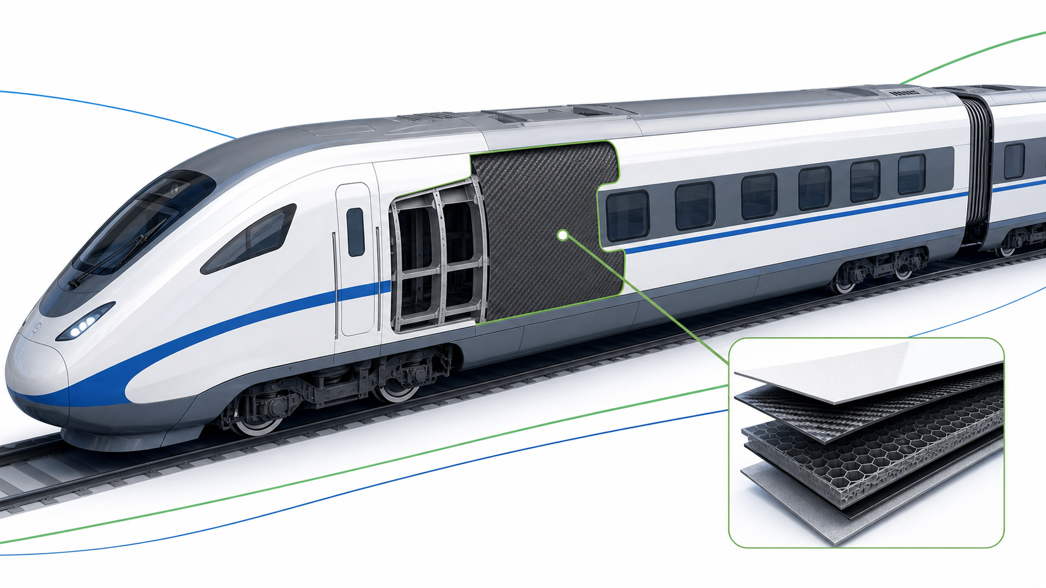
How the Solution Works
Presenter:Guo GuangHan
08
Lightweight recycled CFRP reduces carriage mass while keeping structural performance in selected components.
Material substitution
Mass reduction
Operational effect
Recycled CFRP panels
Lower carriage weight
Lower energy demand
Life-cycle benefit
Less energy use may reduce cost and CO2-e over long operation.
Selected carriage panels
Key principle: reduce mass without compromising rail safety.
Notes:
Presenter: [Name 3]. Explain how the material solution works. The team is proposing recycled CFRP composite panels for selected carriage components. CFRP can provide high strength-to-weight performance, so selected panels can reduce carriage mass while still needing to meet rail safety, fire, durability, and maintenance standards. Lower carriage mass can reduce the energy required during operation, which may reduce electricity cost and CO2-e emissions over the long service life.

Slide 9
Engineering Validation Plan
Presenter: Guo GuangHan
09
The next stage is material, safety, and component testing.
1
Select components
2
Compare samples
3
Strength testing
4
Fire + safety review
5
Maintenance check
6
Life-cycle analysis
Evidence needed: mass reduction + strength + safety + whole-life value
Notes:
Presenter: [Name 3]. Explain the engineering validation plan. The team should first identify suitable non-primary carriage components, compare recycled CFRP samples with conventional materials, test strength and stiffness, review fire and rail safety requirements, check maintenance and repair implications, and then complete a life-cycle cost and carbon analysis. This is appropriate for a final rail materials solution.

Slide 10
Stakeholder Needs
Presenter:Ning WanZheng
10
The same design choice supports different stakeholder priorities.
Stakeholder
Need
Solution link
Railway operators
Lower cost
Less energy use
Government authorities
Carbon reduction
Lower emissions
Passengers
Reliable green rail
Efficient operation
Local communities
Lower footprint
Lower operational impact
Engineers + manufacturers
Practical innovation
Test selected parts first
Technical performance + sustainability outcomes
Notes:
Presenter: [Name 5]. Connect the design to stakeholder needs. Operators care about efficient operation and lower costs; government and transport authorities care about emissions and sustainable infrastructure; passengers need reliable and sustainable services; communities benefit from a lower operational footprint; manufacturers and engineers need practical innovation that can be tested first. The solution meets these needs because it targets energy use through carriage mass reduction.

Slide 11
Risks, Limitations, and Next Steps
Presenter: Ning WanZheng
11
The proposal is promising, but it needs material evidence, cost analysis, and rail-safety validation.
Risks
Limitations
Next steps
Upfront cost
Material data gaps
Select components
Material supply
Real-train physics
Test CFRP samples
Certification
Passenger load
Compare stability
Repair/recycling
Traction efficiency
Check rail standards
Manufacturing changes
Net cost uncertainty
Life-cycle analysis
Final message: lower carriage mass may reduce energy, cost, and emissions.
Notes:
Presenter: [Name 5]. Close by being balanced. The proposal has risks: high upfront material cost, uncertain recycled carbon fiber supply, safety certification, repair and recycling complexity, and manufacturing changes. Real HSR performance also depends on aerodynamics, gradients, passenger loading, and traction efficiency. The next steps are to select suitable components, test recycled CFRP samples, compare stability and durability, research material costs and rail safety standards, and complete a life-cycle cost analysis. End with the core sentence: reducing carriage mass can reduce operational energy use, which may lower electricity cost and carbon emissions over the life cycle.

