Slide 1

Worst-Case Latency Analysis of Message Synchronization in ROS
RTSS 2023
44th IEEE Real-Time Systems Symposium
December 5-8, 2023
Taipei
Ruoxiang LI¹, Xu Jiang², Zheng Dong³, Jen-Ming Wu⁴,
Chun Jason Xue¹, Nan Guan¹
¹City University of Hong Kong
²Northeastern University
³Wayne State University
⁴Hon Hai Research Institute

Slide 2
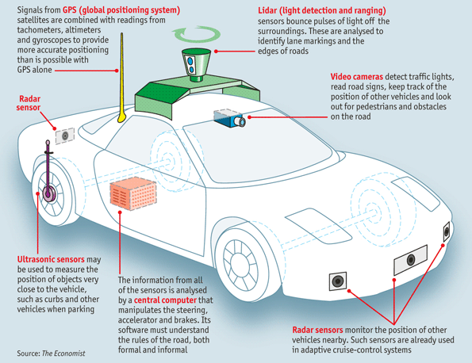
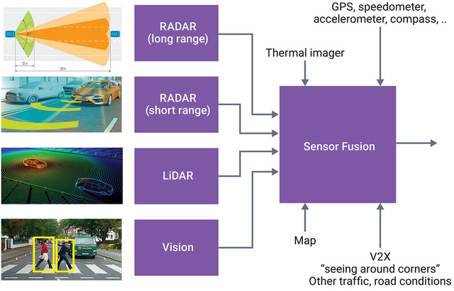
Sensor Fusion
Widely used in autonomous machines
Robotics, autonomous vehicles, UAVs…
For example, autonomous vehicles use
Camera, LiDAR, Radar, GNSS, IMU, …
Picture from The Economist, “How does a self-driving car work?”
A DSP For Implementing High-Performance Sensor Fusion On An Embedded Budget

Slide 3
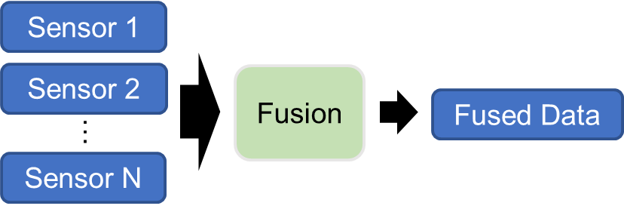
Sensor Fusion
Widely used in autonomous machines
Robotics, autonomous vehicles, UAVs…
For example, autonomous vehicles use
Camera, LiDAR, Radar, GNSS, IMU, …
Combining sensor data from disparate sources provides information with high precision and less uncertainty
Picture from The Economist, “How does a self-driving car work?”

Slide 4
Sensor Fusion
Sensor fusion algorithms assume “data from different sensors are sampled at the same time”
Sensor 1
Fusion
Sensor 2
Sensor 3

Slide 5
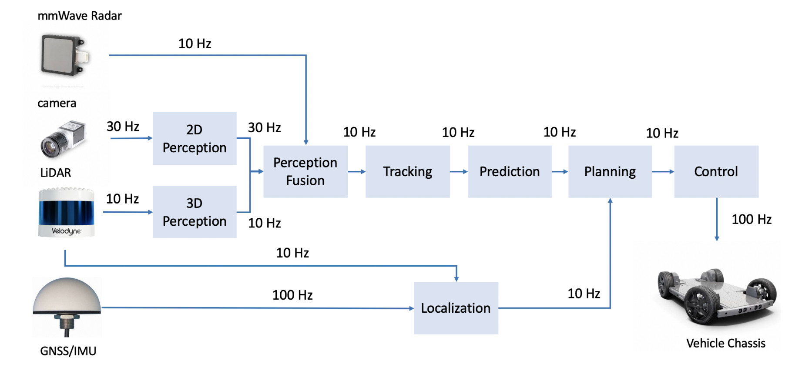
Sensor Fusion
Sensor fusion algorithms assume “data from different sensors are sampled at the same time”
However, this assumption rarely holds in reality
Different sensor sampling frequencies
Delays before reaching the fusion point
Sensor 1
Fusion
Sensor 2
Sensor 3
Picture from RTSS 2021 Industry Challenge

Slide 6
Data Synchronization
Add data synchronization before sending them to fusion
Time disparity
maximal sampling time difference of a set of synchronized data
Sensor 1
Data Sync.
Fusion
Sensor 2
time
disparity
Fusion
sampling time

Slide 7
Data Synchronization
Add data synchronization before sending them to fusion
Different synchronization policies
Sensor 1
Data Sync.
Fusion
Sensor 2
Apollo Cyber RT
simple policy – always group the newest data
ROS
sophisticated policy – group those with close sampling time
small latency but large time disparity
small time disparity but large latency

Slide 8
Data Synchronization
Add data synchronization before sending them to fusion
Different synchronization policies
Sensor 1
Data Sync.
Fusion
Sensor 2
ROS
group messages with close sampling time
sampling time
delay time
arrival time

Slide 9
ROS Synchronization Policy
ROS: the most popular software framework for robotics
In message_filters::sync_policies::ApproximateTime
Applicable to both ROS 1 and 2
Widely used in ROS applications, e.g., Autoware
Previous work don’t consider this component.
D. Casini, etc. Response-Time Analysis of ROS 2 Processing Chains Under Reservation-Based Scheduling. ECRTS 2019.
Y. Tang, etc. Response Time Analysis and Priority Assignment of Processing Chains on ROS2 Executors. RTSS 2020.
T. Blass, etc. Automatic Latency Management for ROS 2: Benefits, Challenges, and Open Problems. RTAS 2021.
H. Teper, etc. End-To-End Timing Analysis in ROS2. RTSS 2022.
X. Jiang, etc. Real-Time Scheduling and Analysis of Processing Chains on Multi-threaded Executor in ROS 2. RTSS 2022.
H. Sobhani, ect. Timing Analysis and Priority-driven Enhancements of ROS 2 Multi-threaded Executors. RTAS 2023.

Slide 10
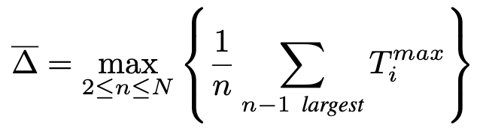
Summary of Our Work
Worst-case time disparity analysis
[1] Worst-Case Time Disparity Analysis of Message Synchronization in ROS. RTSSS 2022.
Formal modeling under limited buffer size
[2] Modeling and Property Analysis of the Message Synchronization Policy in ROS. MOST 2023.
Worst-case latency analysis
[3] Worst-Case Latency Analysis of Message Synchronization in ROS. RTSS 2023.

Slide 11
Technical Contributions of This Work
Study two key latency metrics for ROS message synchronization
passing latency
reaction latency
Theoretical upper bounds for both the passing and reaction latency

Slide 12
Modeling ROS Synchronization Policy
Each message is associated with a timestamp (sampling time)
N input channels, each has an input buffer queue Qi
Each channel has a minimal/maximal timestamp separation T_{i}^{min}/T_{i}^{max}
Measage in each channel can experience a minimal/maximal delay time D_{i}^{min}/D_{i}^{max}
Each queue Qi stores arrived messages + a predicted message
Predicted message’s timestamp = Timestamp of the newest arrived message + T_{i}^{min}
Pivot: the one with largest timestamp among all oldest messages in each Qi
Pivot must be included in the next published set (sent to fusion point)
Q1
T₁^{min}
Q2
T₂^{min}
pivot
T₃^{min}
Q3
1
2
3
4
5
6
7
8
9
10
11
12
13
14
15
16
17
18
19
20
21
timestamp
(not arrival time)
Notes:
a predicted message is the last message in each queue
focus on delay!!!!!

Slide 13
Modeling ROS Synchronization Policy
Selected set
Includes one message from each channel
Includes the pivot
Has the minimal time disparity among all such sets
If selected set has no predicted message, it is published (sent to fusion)
Otherwise, wait, until the selected set is publishable
Q1
T₁^{min}
Q2
T₂^{min}
pivot
T₃^{min}
Q3
1
2
3
4
5
6
7
8
9
10
11
12
13
14
15
16
17
18
19
20
21
timestamp
(not arrival time)

Slide 14
Modeling ROS Synchronization Policy
Selected set
Includes one message from each channel
Includes the pivot
Has the minimal time disparity among all such sets
If selected set has no predicted message, it is published (sent to fusion)
Otherwise, wait, until the selected set is publishable
Publish this publishable selected set, and remove older messages
Q1
T₁^{min}
Q2
T₂^{min}
pivot
T₃^{min}
Q3
1
2
3
4
5
6
7
8
9
10
11
12
13
14
15
16
17
18
19
20
21
timestamp
(not arrival time)

Slide 15
Modeling ROS Synchronization Policy
Selected set
Includes one message from each channel
Includes the pivot
Has the minimal time disparity among all such sets
If selected set has no predicted message, it is published (sent to fusion)
Otherwise, wait, until the selected set is publishable
Publish this publishable selected set, and remove older messages
Q1
Q2
Q3
1
2
3
4
5
6
7
8
9
10
11
12
13
14
15
16
17
18
19
20
21
timestamp
(not arrival time)

Slide 16
Modeling ROS Synchronization Policy
The selected set may turn out to be “wrong”
A message may have larger timestamp than predicted
Q1
T₁^{min}
Q2
T₂^{min}
T₃^{min}
Q3
1
2
3
4
5
6
7
8
9
10
11
12
13
14
15
16
17
18
19
20
21
timestamp
(not arrival time)
Notes:
prediction is not always correct.

Slide 17
Modeling ROS Synchronization Policy
The selected set may turn out to be “wrong”
A message may have larger timestamp than predicted
In this case, change the selected set
Q1
T₁^{min}
Q2
T₂^{min}
T₃^{min}
Q3
1
2
3
4
5
6
7
8
9
10
11
12
13
14
15
16
17
18
19
20
21
timestamp
(not arrival time)

Slide 18
Modeling ROS Synchronization Policy
The selected set may turn out to be “wrong”
A message may have larger timestamp than predicted
In this case, change the selected set
This can cause an extra delay time!
Q1
T₁^{min}
Q2
T₂^{min}
T₃^{min}
Q3
1
2
3
4
5
6
7
8
9
10
11
12
13
14
15
16
17
18
19
20
21
timestamp
(not arrival time)

Slide 19
Passing Latency Definition
Passing latency
the time between when a message arrives and when it is sent out
end-to-end delay
end-to-end delay
passing latency
passing latency
T₁^{min}=6
sensor₁
T₂^{min}=20
sensor₂
channel₁
synchronzier
channel₂
discarded messages
fusion
actuator
0
2
4
6
8
10
12
14
16
18
20
22
24
26
28
arrival time
Notes:
It defines the time interval that a message can experience in the synchronizatoin component

Slide 20
Reaction Latency Definition
Reaction latency
the time between the arrival of the last message that wasn't discarded and when the message we're focusing on is sent out.
end-to-end reaction time
reaction latency
event
A
T₁^{min}=6
sensor₁
T₂^{min}=20
sensor₂
channel₁
synchronzier
channel₂
discarded messages
fusion
actuator
0
2
4
6
8
10
12
14
16
18
20
22
24
26
28
arrival time

Slide 21
Reaction Latency Definition
Reaction latency
the time between the arrival of the last message that wasn't discarded and when the message we're focusing on is sent out.
end-to-end reaction time
Is the difinition correct?
reaction latency ?
event
A
T₁^{min}=6
sensor₁
T₂^{min}=20
sensor₂
channel₁
synchronzier
channel₂
discarded messages
fusion
actuator
0
2
4
6
8
10
12
14
16
18
20
22
24
26
28
arrival time

Slide 22
Reaction Latency Definition
Reaction latency
the time between the arrival of the last message that wasn't discarded and when the message we're focusing on is sent out.
We focus on worst-case!
end-to-end reaction time
reaction latency
reaction latency
event
B
sensor₁
sensor₂
channel₁
synchronzier
channel₂
discarded messages
fusion
actuator
0
2
4
6
8
10
12
14
16
18
20
22
24
26
28
arrival time
Notes:
our interest is to analyze the worst-case end-to-end reaction time no matter when the event actually occurs.
The worst-case scenario is that the external event happens right after the sampling time of the last message that is not discarded

Slide 23

Passing Latency vs Reaction Latency
arrival time
departure time
Metric | Meaning | End-to-end Metric
Passing latency | time for message going through the synchronizer | E2E delay

Slide 24

Passing Latency vs Reaction Latency
arrival time
occurs after the sampling time
of this message
Metric | Meaning | End-to-end Metric
Passing latency | time for message going through the synchronizer | E2E delay
Reaction latency | time for the synchronizer to react to an external signal | E2E reaction time

Slide 25

Passing Latency vs Reaction Latency
arrival time
departure time
Metric | Meaning | End-to-end Metric
Passing latency | time for message going through the synchronizer | E2E delay
Reaction latency | time for the synchronizer to react to an external signal | E2E reaction time

Slide 26
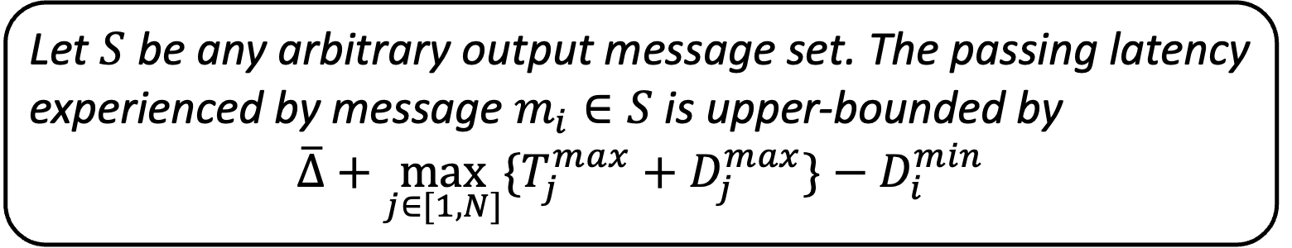
Passing Latency Analysis - Result 1
Theorem 1
Let $S$ be any arbitrary output message set. The passing latency experienced by message $m_{i}∈S$ is upper-bounded by
$$\overline{∆}+\max_{j∈[1,N]}{\{T_{j}^{max}+D_{j}^{max}\}}−D_{i}^{min}$$
Insight: Not only selected messages, but also predicted ones (but unselected) should be waited to arrive.

Slide 27

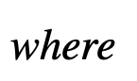
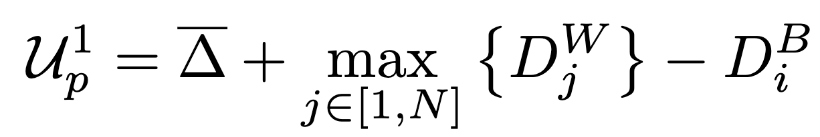
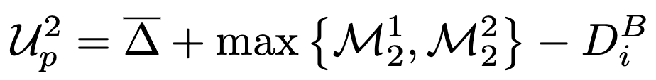
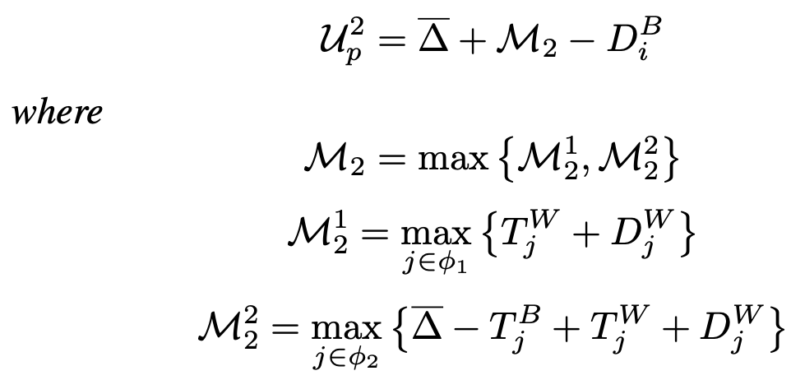
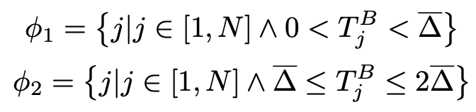
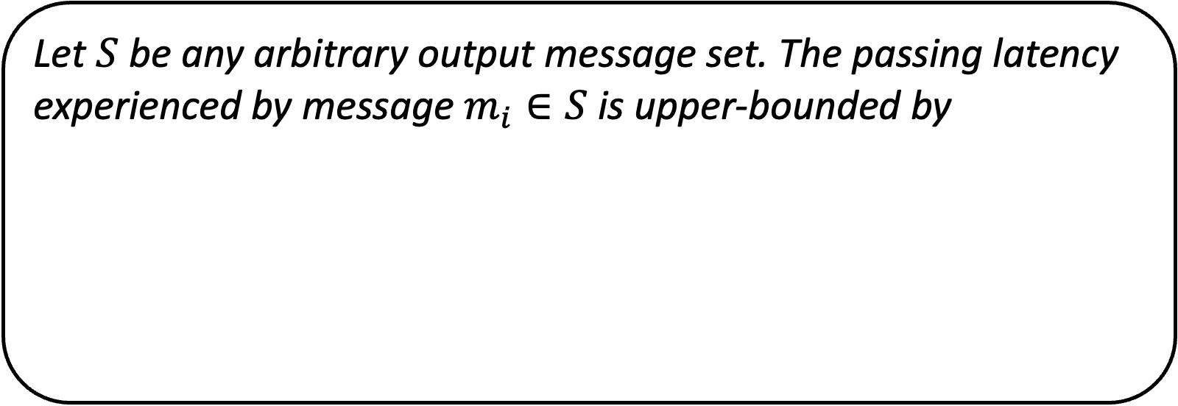
Passing Latency Analysis - Result 2
Theorem 2
Let $S$ be any arbitrary output message set. The passing latency experienced by message $m_{i}∈S$ is upper-bounded by
Insight: Not all predicted messages should be waited to arrive.

Slide 28

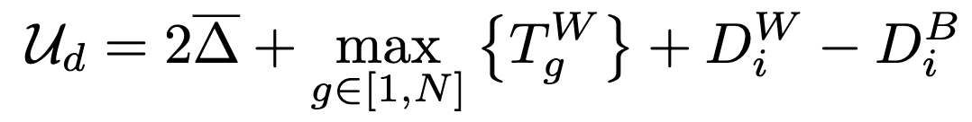
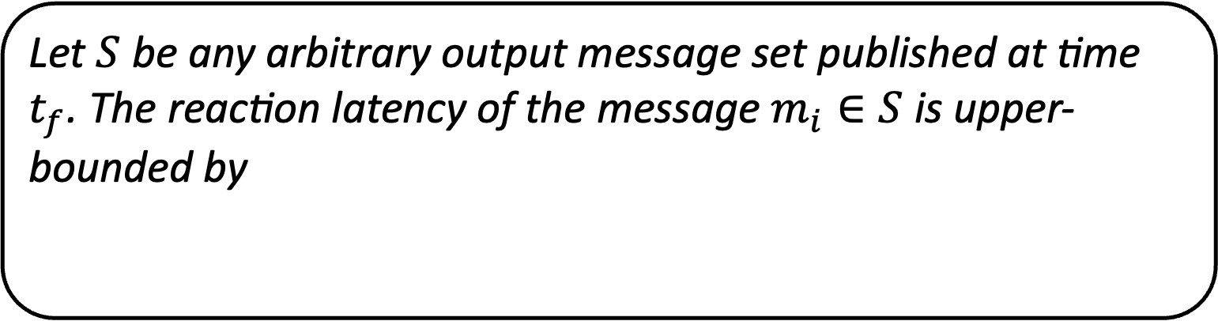
Reaction Latency Analysis - Result
Theorem 3
Let $S$ be any arbitrary output message set published at time $t_{f}$. The reaction latency of the message $m_{i}∈S$ is upper-bounded by
Insight: Reaction latency is the combination of passing latency and delay time caused by discarded messages.

Slide 29
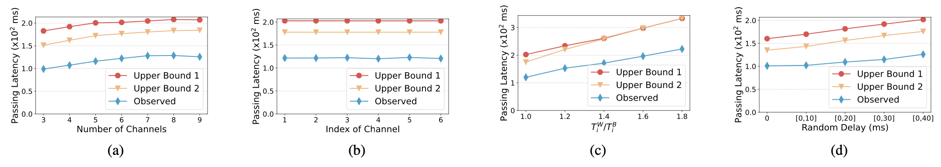
Experiments on ROS 2 Humble
Compare theoretical upper-bounds and observed maximum of passing latency under different settings:
Different number of channels
Different ratio of maximal and minimal timestamp seperation
Different delay time experienced by messages before arriving at synchronizer
Passing latency evaluation results

Slide 30
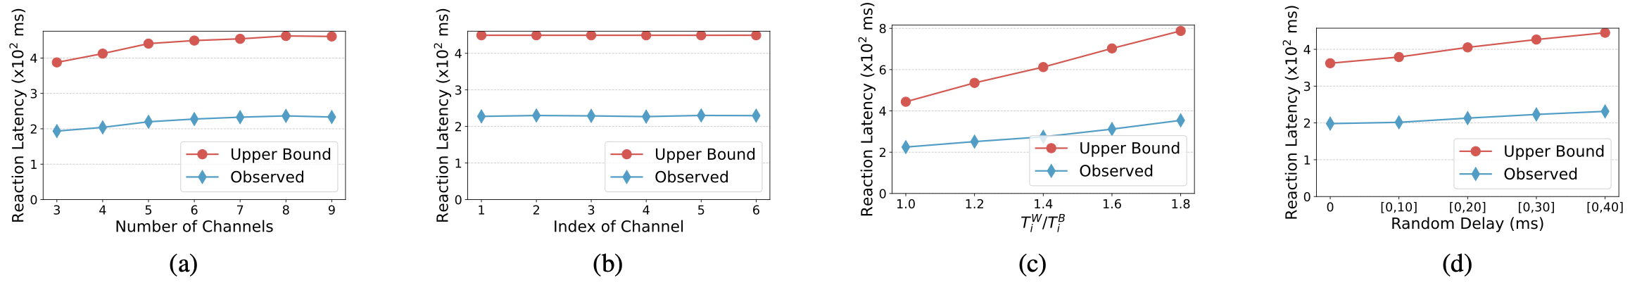
Experiments on ROS 2 Humble
Compare theoretical upper-bounds and observed maximum of reaction latency under different settings:
Different number of channels
Different ratio of maximal and minimal timestamp seperation
Different delay time experienced by messages before arriving at synchronizer
Reaction latency evaluation results

Slide 31
Summary
Study two key latency metrics for ROS Synchronization Policy
passing latency
reaction latency
Theoretical upper-bounds for both the passing and reaction latency
Experiment verification on ROS 2 Humble
Future work
Further analysis to reduce the pessimism
Explore a better evaluation method

Slide 32

Ruoxiang LI, PhD Candidate
Email: ruoxiang.li@my.cityu.edu.hk
Supervisor: Prof. Nan Guan
Thanks!
Question?

