Slide 1
Customer Shopping Behaviour Analysis
Uncovering spending patterns, customer segments, and product preferences from 3,900 transactions to guide strategic business decisions.

Slide 2
Dataset at a Glance
3,900
18
37
Purchases
Columns
Missing Values
Review Rating column
Demographics
Purchase Details
Behaviour
Age, Gender, Location, Subscription
Item, Category, Amount, Season, Size, Colour
Discount, Frequency, Review Rating, Shipping

Slide 3

Data Preparation in Python
01
Load & Explore
Imported via pandas; df.info() and describe()
02
Clean & Standardize
Imputed missing ratings by category median; renamed columns to snake_case
03
Feature Engineering
Created age_group and purchase_frequency_days
04
Load to PostgreSQL
Cleaned DataFrame loaded for SQL analysis

Slide 4
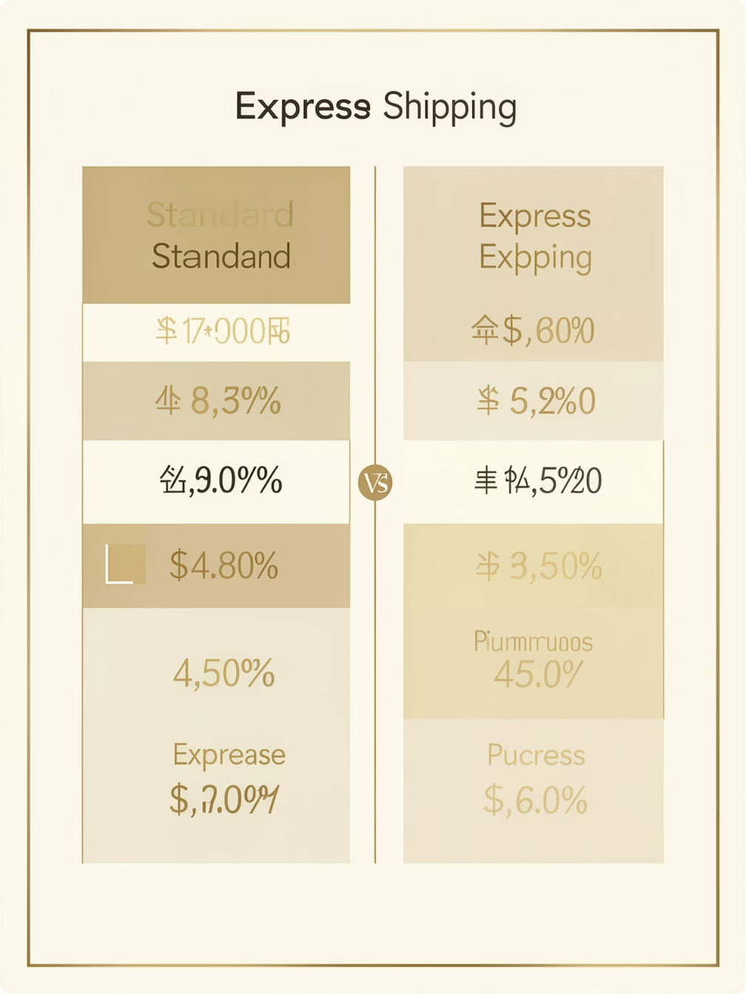
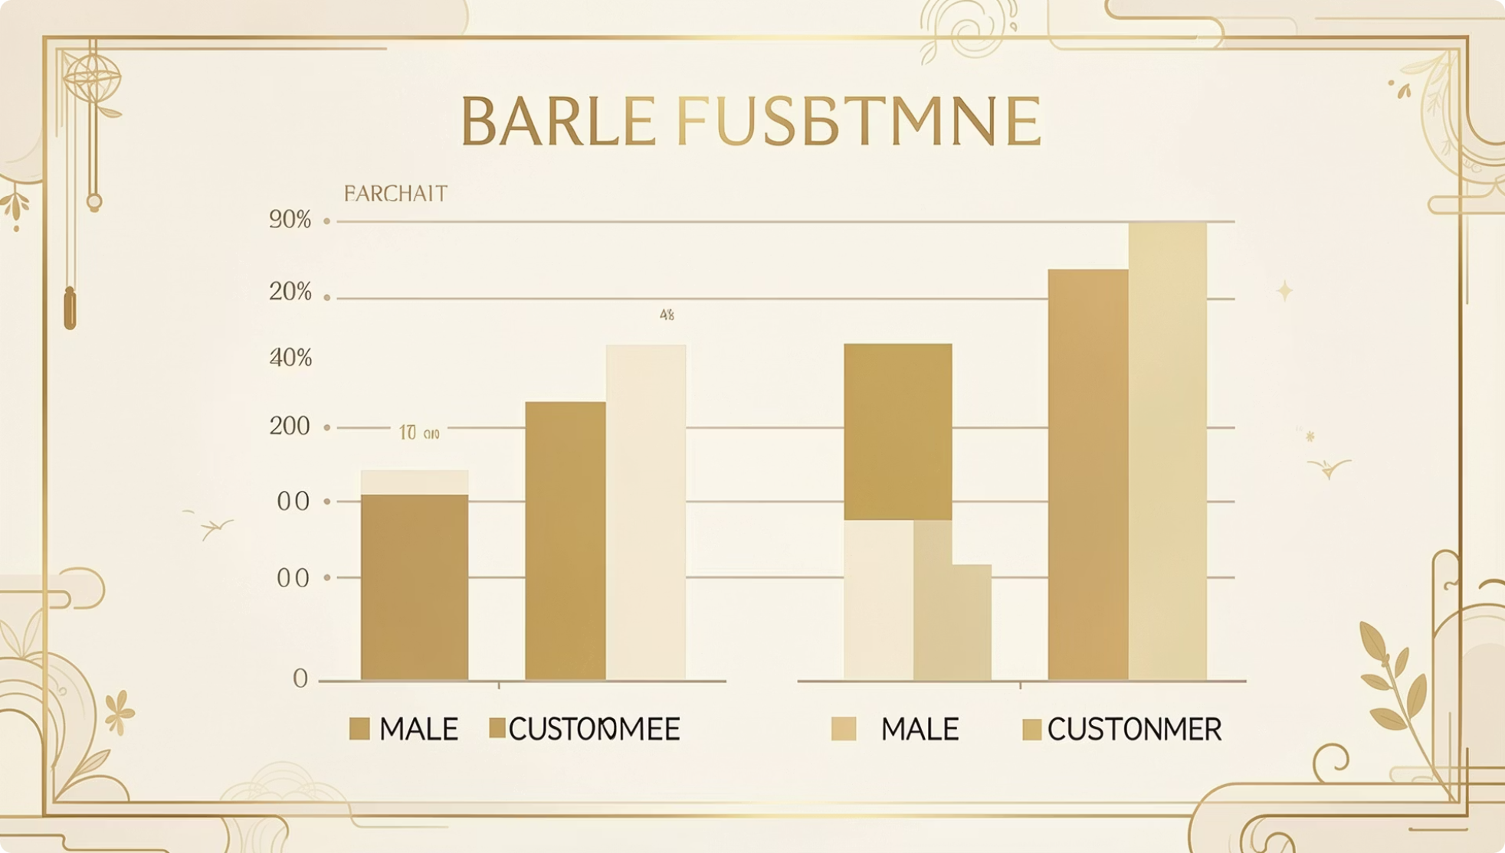
Revenue by Gender & Shipping Type
Shipping Type Comparison
Revenue by Gender
Average purchase amounts: Standard vs. Express shipping.
Compared total revenue generated by male vs. female customers.

Slide 5
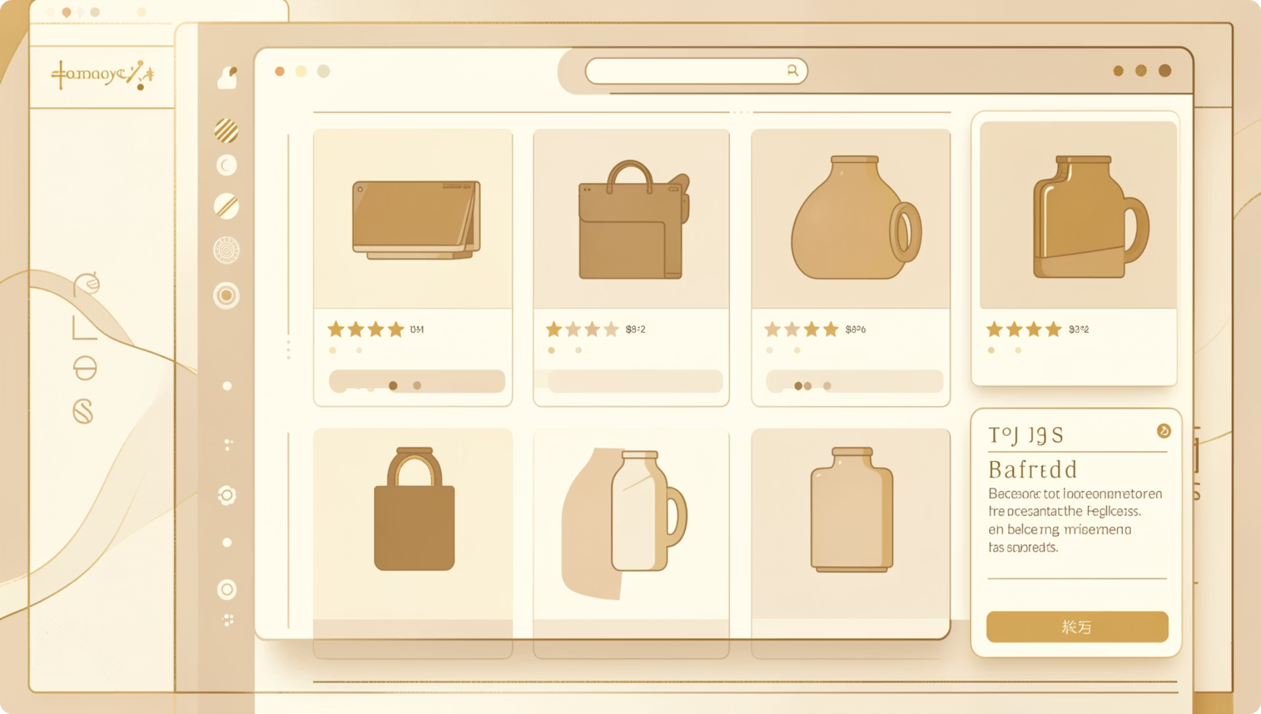
Top Products & Discount Insights
Top 5 Products by Rating
Highest average review ratings identified.
Discount-Dependent Products
5 products with the highest percentage of discounted purchases.
High-Spending Discount Users
Customers using discounts but spending above average purchase amount.

Slide 6
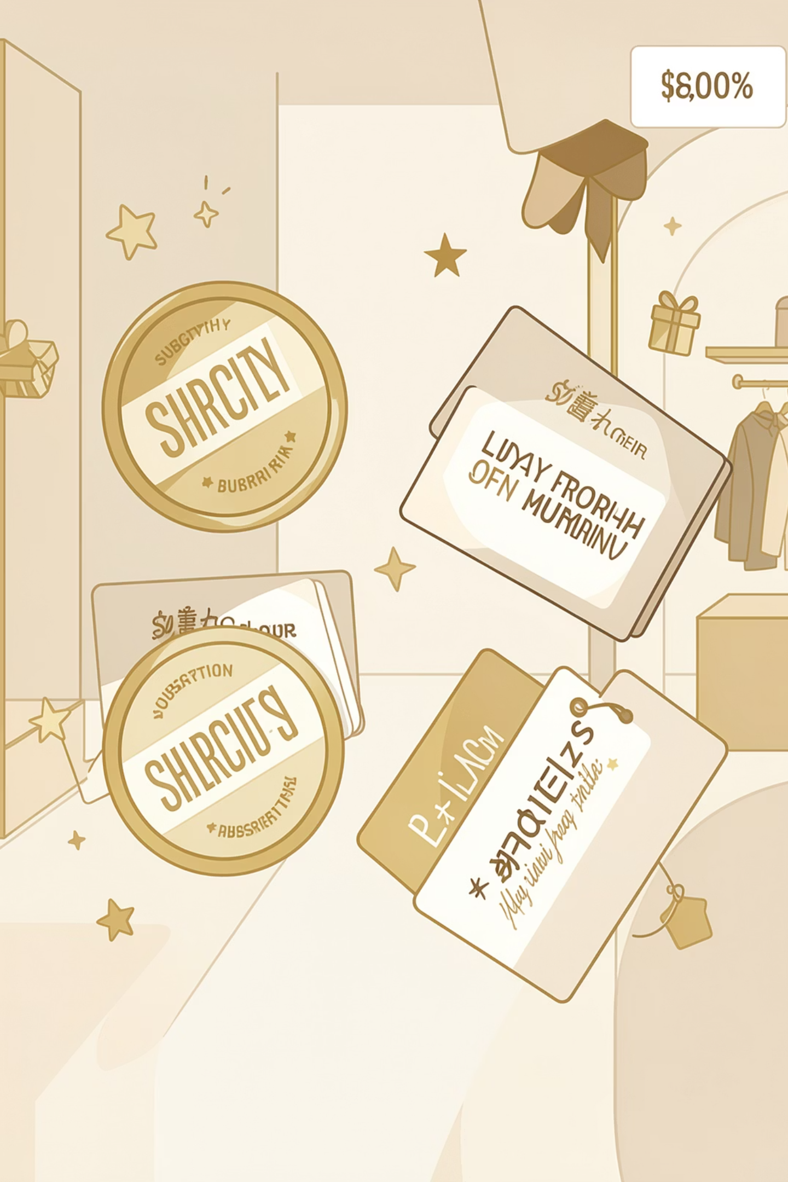
Subscribers vs. Non-Subscribers
Subscribers
Compared average spend and total revenue
Non-Subscribers
Compared average spend and total revenue

Slide 7
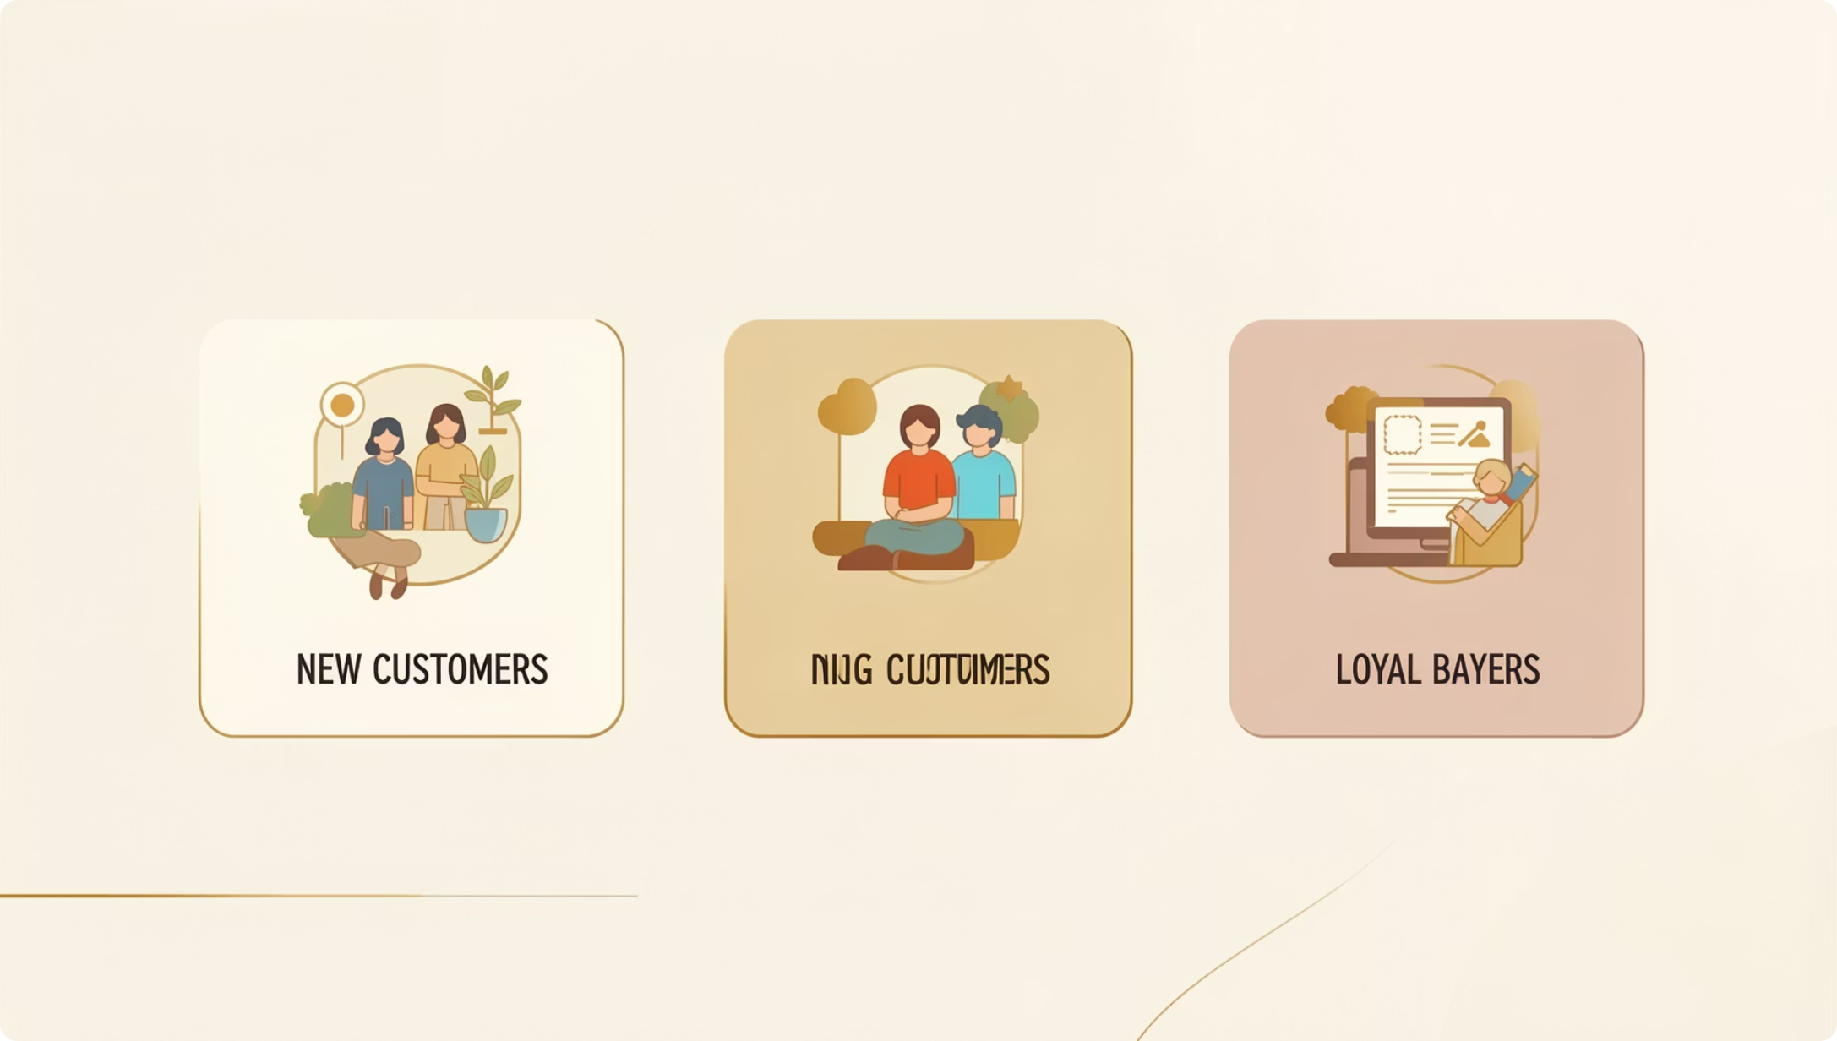
Customer Segmentation
Three Customer Segments
New
First-time buyers
Returning
Repeat purchasers
Loyal
High-frequency buyers

Slide 8

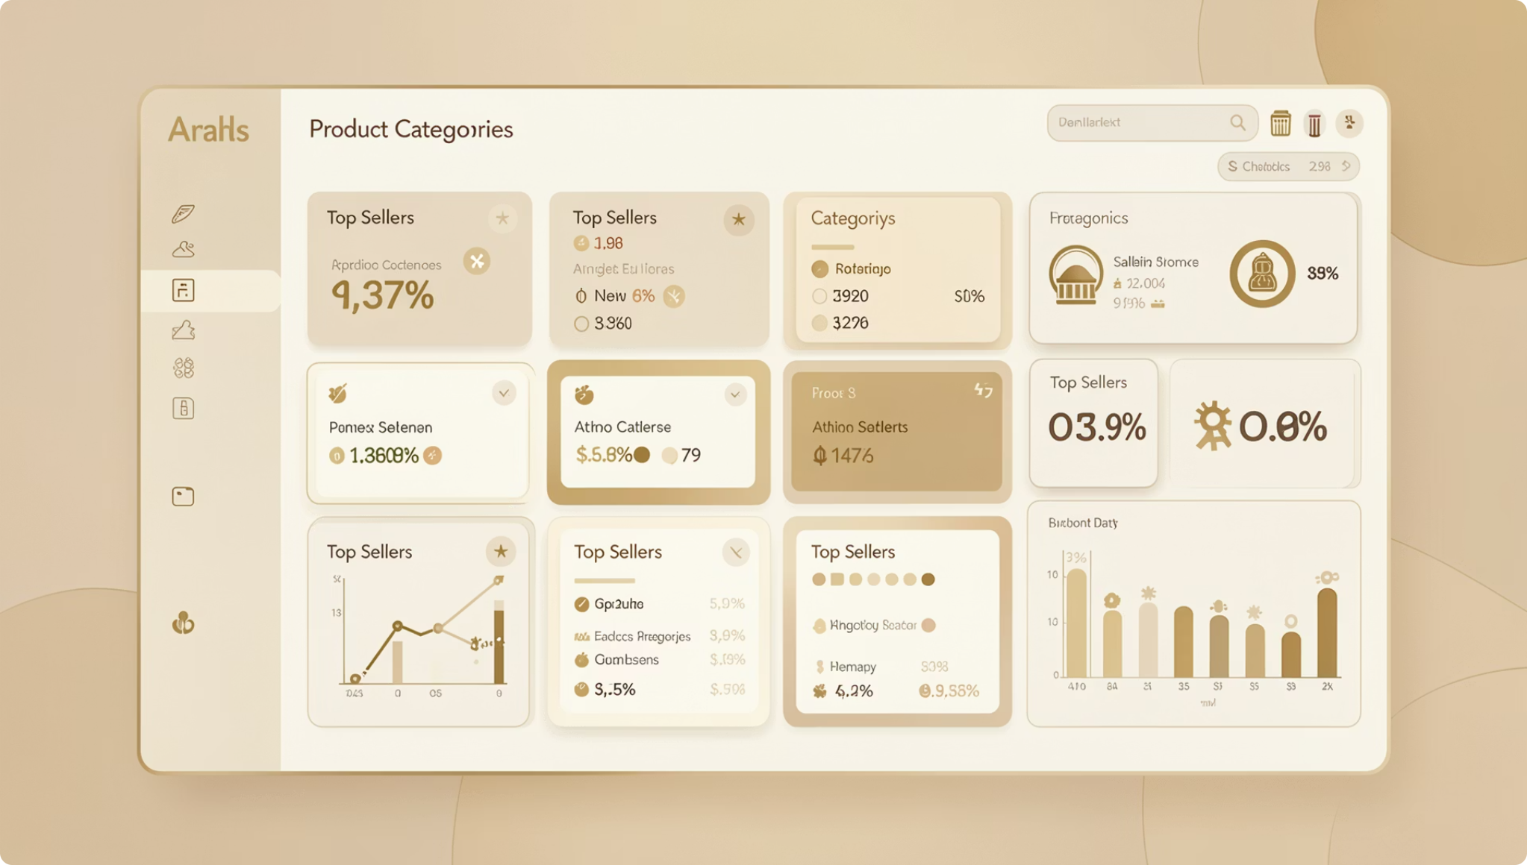
Top Products per Category & Revenue by Age
Revenue by Age Group
Top 3 Products per Category
Total revenue contribution of each age group.
Most purchased products within each category.

Slide 9
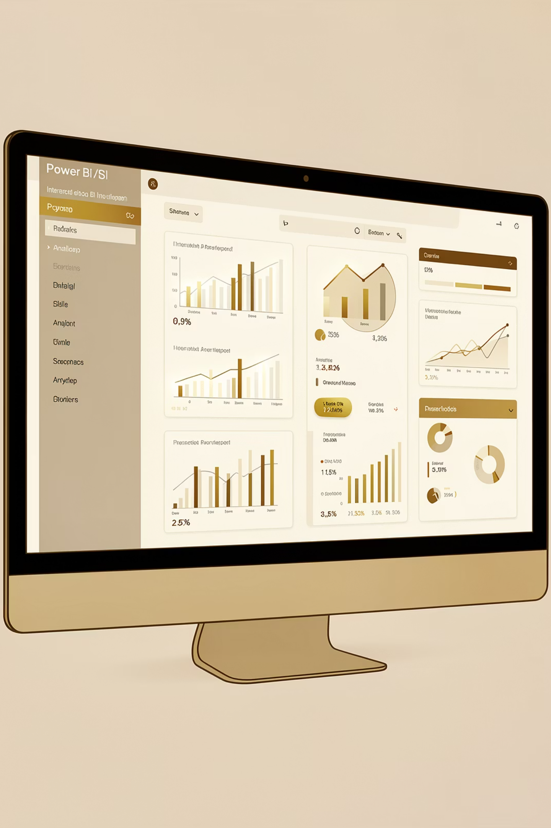
Power BI Dashboard
Interactive dashboard built to present all insights visually — enabling stakeholders to explore data dynamically.

Slide 10

Business Recommendations
Boost Subscriptions
Loyalty Programs
Review Discount Policy
Promote exclusive subscriber benefits
Reward repeat buyers toward "Loyal" segment
Balance sales boosts with margin control
Targeted Marketing
Product Positioning
Focus on high-revenue age groups & express-shipping users
Highlight top-rated and best-selling products

