Slide 1
TOPIC :
VISUAL QUESTION ANSWERING
TEAM MEMBERS :
RUPA KANDULA – CB.SC.U4AIE24122
DHARANI KOLLI – CB.SC.U4AIE24123
LAXMI VIGNESH – CB.SC.U4AIE24124
VARALAXMI KORUPROLU – CB.SC.U4AIE24125

Slide 2
INTRODUCTION :
VQA (visual question answering) is an AI task which takes the image and image related-question and gives the output in the text form.
OBJECTIVE :
Our main objective of our VQA model is to predict the correct output in the text form for the given question related to the given image using deep learning models like CNN (convolutional neural networks ) & RNN (Recurrent neural networks)

Slide 3
METHODOLODY
Training the Dataset:
We have taken the DACQUAR dataset which has several files in it.
test_images_list
train_images_list
all_qa_pairs (images related question and answer)
answer_pairs (possible answers)
2) In the Dataset, images come with 12,468 qa_pairs
Training sample : 6630
Testing sample : 5542
3) Dataset contains 1449 images.
The original resolution of the images is 640 x 480 pixels
We are resizing the image size has 224 x 224 pixels.
We are using pretrained CNN model i.e ResNet which helps in feature extraction in a efficient way.
We are using RNN for text extraction which is used for question processing.
The CNN feature vector (image) and RNN feature vector (text) are combined using concatenation.
The combined feature is passed through to fully connected layer and then classify the image.
For classification we use softmax function which converts the raw scores into probabilities. Thus we get the predicted output .

Slide 4
9) If the predicted output is equal to ground truth that is the actual correct answer then predicted output can be declared as answer.
10) If not we will be finding the loss function using Crossentropyloss function:
L = -∑ yi log(^yi)
(Where yi is 1 for actual correct answer and others are zero.
^yi = predicted probability of each answer)
11) We are using evaluation metric as Exact match accuracy.
EMA = (total no.of exact correct predicted output / total no.of questions) x 100
Thus it gives the accuracy.
From this we can say that our VQA model is trained with accuracy of 91.84% at 71th epoch.

Slide 5
COMPARISON WITH PREVIOUS MODEL:
Earlier they have the taken the evaluation metric has Human VS VQA model and compared them VQA model has given 58% accuracy and humans gave accuracy of 85% this is one of the major drawback that has occurred.
To over come the drawback we have taken the Evaluation metric has Exact Match Accuracy (exact match accuracy : the predicted output only gets considered only if the predicted output is equal to the ground truth(actual correct answer)
Mathematical formula : (total no.of correct predicted output / total no.of of questions ) x 100

Slide 6
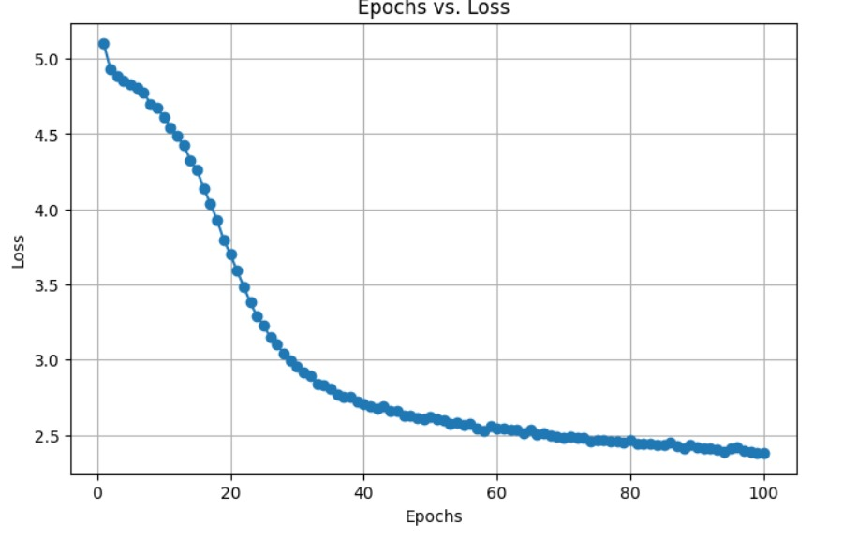
RESULTS (AT PRESENT) :
This is the graph between Epoch and loss function
From this graph we are concluding that as the epoch is increasing the loss function is getting reduced
Lower the loss value higher the accuracy.

Slide 7
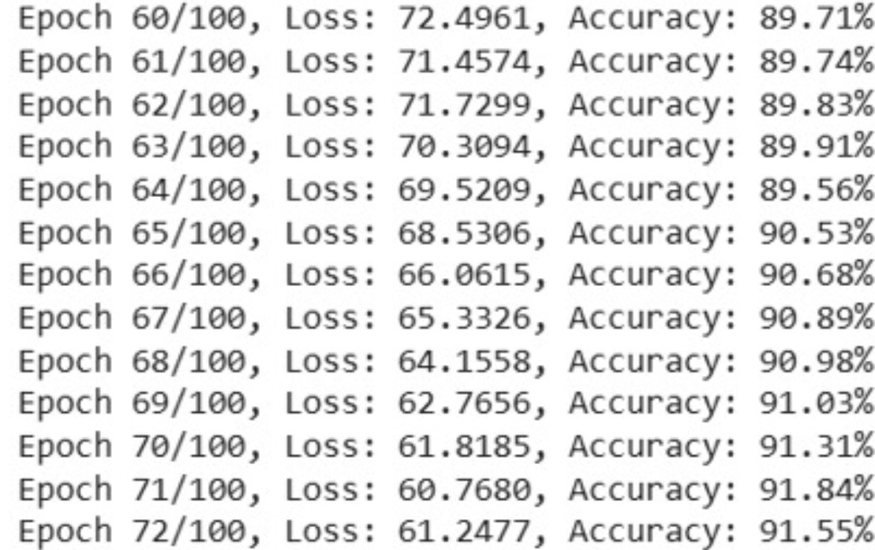
We have taken the number of epochs as 100
At 71th epoch we got the accuracy of 91.84 %
From the accuracy we can say that our model’s predicted answer is almost same to the ground truth that is given in the dataset.

Slide 8
LIMITATIONS OF OUR WORK AT PRESENT:
Couldn’t get the expected outcome while training the model due to more of images.
Unable to run the code efficiently due GPU issue
Due to GPU issue we are unable get the correct accuracy of the model.

Slide 9
WORK TO BE DONE:
After getting the perfect output when tested on the testing samples in the dataset we are planning to test the model on a completely new image which is different from the images in the dataset that we have taken.
And some modifications has to be done to make our VQA model better.

Slide 10
TIMELINE
March final week – We will complete testing our model on the testing samples given In the dataset.
April first week – We will try our VQA model on a complete new image which is not present in the dataset.

Slide 11
THANK YOU

