Slide 1
VISUAL QUESTION ANSWERING
VQA - A Deep Learning Task

Slide 2
GROUP MEMEBERS :
RUPA KANDULA - CB.SC.U4AIE24122 KOLLI DHARANI - CB.SC.U4AIE24123 K LAXMI VIGNESH - CB.SC.U4AIE24124 K VARALASKHMI - CB.SC.U4AIE24125

Slide 3
Table of contents
01
02
03
Introduction
Objective
Literature Review
04
05
06
About our Dataset
Advantages and disadvantages
Model Architecture
Description of the topic
Our goals
Overview
The Blueprint
CLEVR V1.0
Plus and minus points

Slide 4
01. INTRODUCTION:
VQA is a Deep Learning task which works with CNN and RNNs.
It involves answering a question to the image in Human-understandable Language.
What is VQA?
Model that takes an Image and a text-based question as inputs and generates the answer as output in the text form.

Slide 5
02. OBJECTIVE:
To show how our model was built, it’s components and Working of our model.
To give a better Idea of how this can make difference with existing models.
finally , To show the results that this model has achieved so far.

Slide 6
03. LITERATURE REVIEW:
Comparison with previous works
LITERATURE REVIEW | DATASET | MODEL | METRICS USED | ACCURACY
1 | MS-COCO | CNN + LSTM | With relative to human(consensus) | 54.06%
2 | COCO-QA | CNN+GRU | Human based(Consensus) | 57.9%
3 | DAQUAR | CNN+RNN | Classification Accuracy | 38-39%

Slide 7
04. About our Dataset:
The dataset that we have used is CLEVR v1.0. It consists of:
A training set of 70,000 images and 6,99,989 questions {each image is of Dimensions 480x320x3}
A validation set of 15,000 images and 1,49,991 questions
A test set of 15,000 images and 14,988 questions
Answers for all train and validation questions
The answers are of 6 classes namely:
Counting Answers
Color Answers
Shape Answers
Material Answers
Size Answers
Yes/No Answers

Slide 8
05. ADVANTAGES AND DISADVANTAGES
ADVANTAGES :
VQA can answer a given question by looking at a Image .
It is used in many fields like education, medical and many more .
DISADVANTAGES :
It takes a lot of time and more clear data and very powerful systems needed to train the VQA model.
Models trained on simple images might not be well on real world pictures.

Slide 9
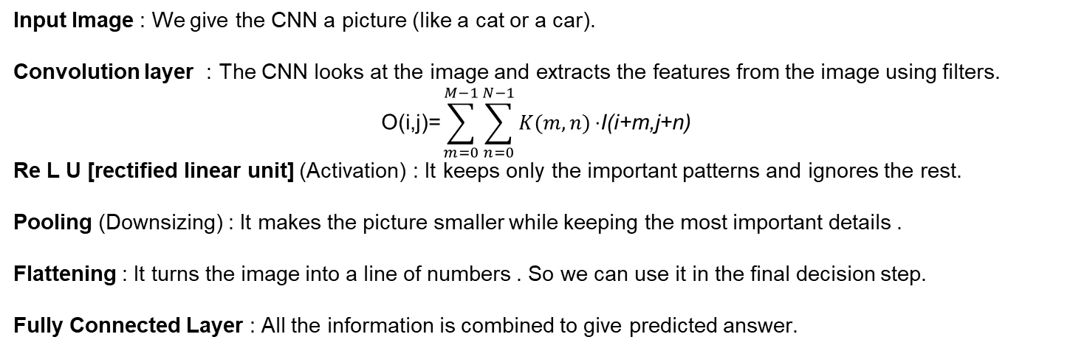
06. MODEL ARCHITECTURE:
This model works with the help of Neural Networks namely, CNN and RNNs.
WHY CNN?
CNNs are used for processing image features by extraction.
Input Image : We give the CNN a picture (like a cat or a car).
Convolution layer : The CNN looks at the image and extracts the features from the image using filters.
$$\text{O}\text{(}\text{i}\text{,}\text{j}\text{)=}\sum_{m=0}^{M−1}{\sum_{n=0}^{N−1}{K(m,n)}}\text{​⋅}\text{I}\text{(}\text{i}\text{+}\text{m}\text{,}\text{j}\text{+}\text{n}\text{)}$$
Re L U [rectified linear unit] (Activation) : It keeps only the important patterns and ignores the rest.
Pooling (Downsizing) : It makes the picture smaller while keeping the most important details .
Flattening : It turns the image into a line of numbers . So we can use it in the final decision step.
Fully Connected Layer : All the information is combined to give predicted answer.

Slide 10
Model in detail
For image feature extraction we are using pretrained model of CNN called R e s Net (residual networks)
As CNN cannot go deep into all the layers (if there were many layers), So we have chosen this model as this model has skip connections where it adds the input to the output of the previous layer which means it preserves the given input and learns what has been changed from the previous layer (change in features)
Formula : output = F(x) + x
F(x) : is the output of the preceding layer
x : given input

Slide 11
WHY RNN?
Sequential Data Processing : RNNs are designed to handle sequential data, making them well-suited for processing sentences where the order of words is crucial for understanding meaning.
Contextual Understanding : By maintaining a hidden state that captures information from previous inputs, RNNs can understand the context and dependencies between words in a question.

Slide 12
07. IMPLEMENTATION:
This involves main steps like:
Dataset Loading
Image processing
Text processing
Combining text and image
Answer prediction
Model Training.

Slide 13
08. METHODOLOGY:
Front-order
Here is the step by step flow…
Dataset Used :
We used the CLEVR dataset, which contains images along with related questions and answers for training and validation set
But in testing we have only images and questions related to it.
It helps in Visual Question Answering (VQA) tasks where a model answers questions based on an image.
Image Processing :
Each image was resized to 200x200 and normalized (dividing pixel values by 255).
We used Res-Net (a pretrained CNN model) to extract image features.

Slide 14
Middle-order
Further more…
Text Processing :
Questions were encoded We use a RNN model where it remembers the past information while remembering the present.
Combining Text and Image:
We concatenated the image features (from CNN) and question features (from LSTM).
This creates a representation (combined understanding of image and text).

Slide 15
Last-order
Finally….
Answer Prediction :
The combined features were passed through a Dense (fully connected) layer .
The output is a probability distribution over all possible answers using soft-max activation.
Model Training:
We used Adam optimizer to train the model.
The loss function was sparse_ categorical -cross-entropy because labels were integers .
We evaluated the model using Top-1 Accuracy and Top-5 Accuracy.

Slide 16
Results
Detailed view
Our VQA Model has given appreciable results

Slide 17
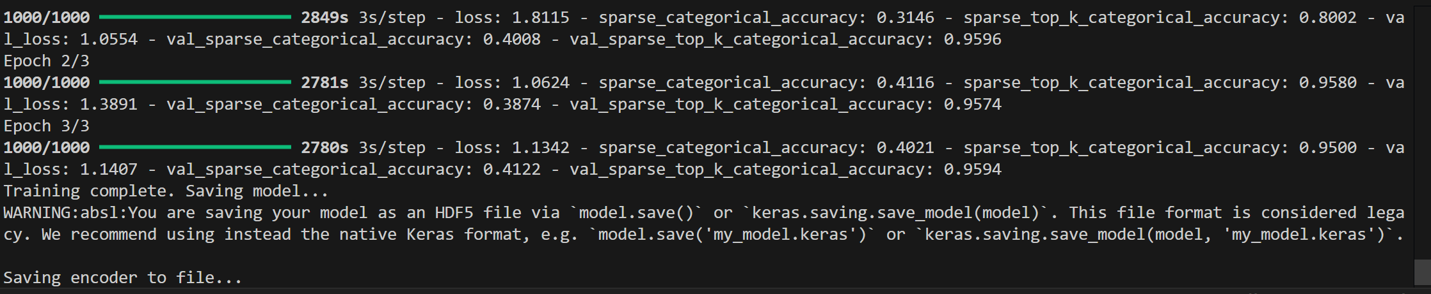
TRAINING AND VALIDATION ACCURACY :

Slide 18
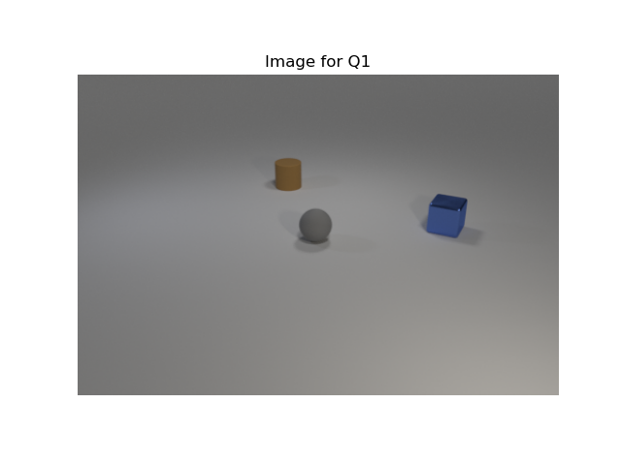
IMAGE FOR TESTING :

Slide 19
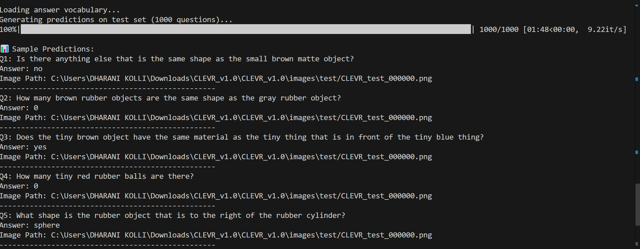
OUTPUT FOR THE CORESPONDING IMAGE :

Slide 20
DISCUSSION ON RESULTS :
We got accuracy of 40.12% on training where as the original paper has got the accuracy of 51%.
We got top-k-accuracy has 95% which the means our correct answer is present in the top 5 predicted answers, Original paper does not it consists this.
Even though we have accuracy a bit less than original paper accuracy our model is correctly predicting the shape, size, material as we tested on the testing image.

Slide 21
LIMITATIONS :
CLEVR_v1.0 is a simple images so our might struggle with real world complex images.
It takes a lot of time and needs powerful computers to train on the whole dataset.
if the question is hard or unclear the model might give a wrong answer.

Slide 22
FUTURE SCOPE:
To extend our model to work on real-world complex images
Voice assistant that can answer visual questions which can be helpful for visually impaired people
Extend the model to answer question based on video frames instead of just single images.
Need to train the model using whole dataset.

Slide 23
THANK YOU

