Slide 1
SMART STREET LIGHTING
BY GROUP – 4 (B BATCH)
Rupa Kandula – CB.SC.U4AIE24122 Dharani Kolli – CB.SC.U4AIE24123
K Laxmi Vignesh – CB.SC.U4AIE24124
K S D Varalakshmi – CB.SC.U4AIE24125

Slide 2
INTRODUCTION :
Smart lighting is used in modern cities for better energy management.
Smart street lights turn on and off automatically.
It is an eco-friendly and efficient solution.
A microcontroller (ESP32) controls the system.

Slide 3
OBJECTIVE :
To save energy by turning lights on only when needed.
To use sensors ( IR, Motion) for efficient lighting control.
To Train an AI Model with Real time data collected from Sensors(Traffic and Pedestrian flow , weather data).
To improve road safety by ensuring proper lighting at night.

Slide 4
METHODOLOGY :
The system operates by continuously monitoring the PIR and IR sensors for any detection events.
When motion or an obstacle is detected, the corresponding sensor outputs a HIGH signal.
The ESP32 reads these signals and responds by turning ON the LED to simulate a street light.
The LED remains ON for at least 5 seconds (Light Delay).
If no further detection occurs during this period, the LED is turned OFF.

Slide 5
SOFTWARE ARCHITECTURE :
Code is written in Arduino IDE.
Uses digitalRead() for sensors and digitalWrite() for controlling the LED.
Implements a millis() function to keep the LED ON for a set duration after motion detection.

Slide 6
COMPONENTS WE HAVE USED :
Jumper Wires
ESP-32
IR Sensor used for detecting Infrared Radiation from Objects.
PIR Sensor for detecting changes in the infrared radiation.
Breadboard.

Slide 7
CONNECTIONS :
ØNO EXTERNAL POWER SOURCE IS USED.
Ø ESP-32 CONNECTIONS :
•3.3V of ESP-32 to VCC of IR SESNOR, VCC OF PIR SENSOR .
•GND of ESP-32 to GND of IR SENSOR, GND OF PIR SENSOR.
ØPIR CONNECTIONS :
• VCC to 3.3V of ESP32
• GND to GND of ESP32
OUT to D4 of ESP32
IR – out to D5 of ESP32

Slide 8
ØLED CONNECTIONS :
POSITIVE (Anode-Longer leg) to D21 of ESP32
NEGATIVE (Cathode- Shorter leg) to GND of ESP32
We are using 330 ohm Resistor to limit the current because LED takes current of 10-15 mA Whereas ESP-32 pins take current of 40mA.
That is why we need to use 330 ohm for limiting the current. where are connecting to GND because if the GPIO pin is low the LED gets on.

Slide 9
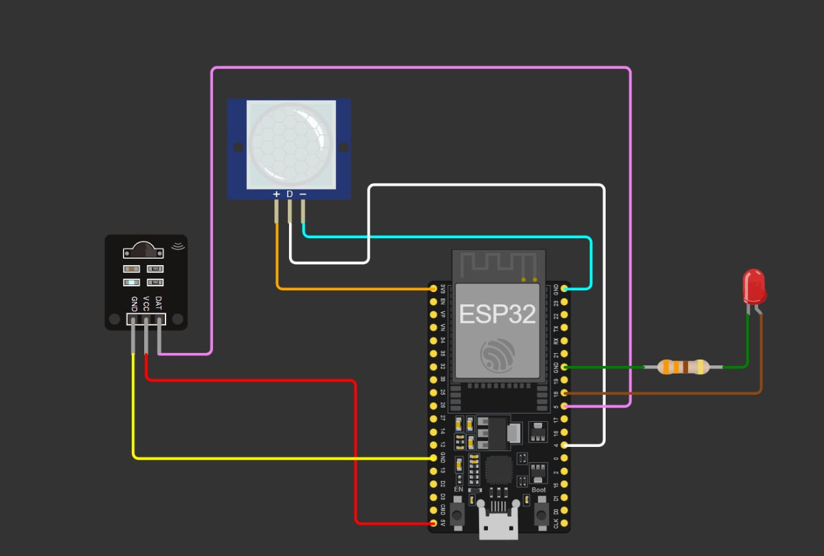
CIRCUIT DIAGRAM :

Slide 10
Integration with AI:
Using AI model for two key tasks:
Traffic Forecasting: Predict vehicle and pedestrian density using historical and real-time data using Models like LSTM.
Weather based Forecasting: Predict fog, rain, or clear skies to adjust brightness accordingly.

Slide 11


STEPS FOR AI ASSISTANCE:
For to just see how it is going to work , we have taken a dataset consisting of both weather and traffic information , with total of 9 features and started training the model using Torch Module.
After Training it we evaluated and the result that we have got are with too minimal loss indicating that our model is learning the relationship between traffic, weather, and motion and making fairly accurate predictions

Slide 12
LIMITATIONS
The code is getting complied and it is getting uploaded into the ESP32 but we are not getting the output.
We are not using LDR sensor, but using it might give better results.
PIR sensors works better at 5v power supply but we are using 3.3v since we are working with ESP32 Nano.

Slide 13
FUTURE WORK:
To get the correct output and make the street lighting system work properly, and to use the sensor readings as the real time data for prediction using AI which helps to adjust the brightness of the lights.
we are planning on designing an app which can control the functioning of the street lighting .
To Convert model for use on ESP-32 and then as ESP-32 runs TensorFlow Lite models, so we need to convert the PyTorch model to ONNX first.
Next to convert the ONNX model to TensorFlow Lite so it can run on the ESP-32
Finally, to Deploy on ESP-32.
Adjust Brightness Using PWM

Slide 14
TIMELINE :
IN THIRD WEEK OF MARCH WE WILL BE SHOWING THE CORRECT WORKING OF OUR SMART STREET LIGHTING.
IN THE APRIL 1ST WEEK WE WILL UPDATING ABOUT AI PREDICTION WITH REAL TIME DATA.
IN THE SECOND 2ND OF APRIL WE WILL BE CREATING PERFECTLY DESIGNED INTERFACE OF OUR SMART STREET LIGHTING SYSTEM REMOTELY.

Slide 15
THANK YOU

