Slide 1


Quantum Compressor
Team:
Abhishek
Siddharth
Rupa
Pranav
Pavan

Slide 2
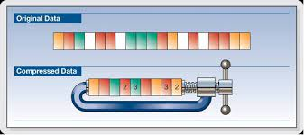
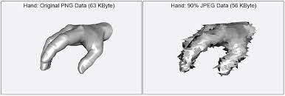
Background
Data compression is the process of encoding information using fewer bits than the original representation.
Lossless Compression
Relies on statistical redundancy to compress data. Ex : LZW Algo in GIF
Lossy compression
Due to Shannon limit we lose some detail after crossing threshold. Ex: JPEG

Slide 3
Problem Statement
In the present times we are seeing growth of classical-quantum systems and networks. But this hybrid model faces two challenges in form of
To resolve this disjunction, we want to propose “Classical Quantum Data Compression” as a way to leverage quantum technologies for classical data processing. The procedure involves:
Encode classical information into quantum bits using methods like Amplitude encoding
Usage of Quantum data compression algorithms like to condense Quantum data which can help in
Reducing storage needs
Less need for larger quantum channels
Low amount of input for further quantum algorithms.
Decoding quantum qubits back to classical data
Exponential classical data growth (Internet users creating 2.5 quintillion bytes each day)
Slow scaling up of quantum hardware (in terms of qubit capacity).
VS

Slide 4
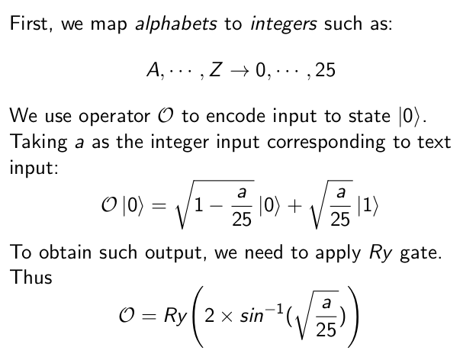
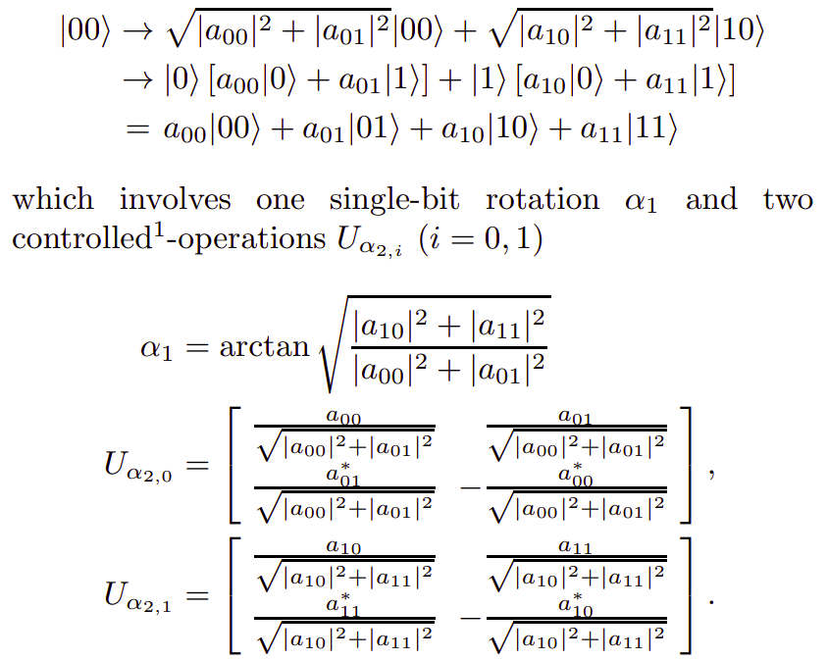
Step 1 : Encoding Classical to Quantum
Angle Encoding 4 letter word to
4 Qubits
Amplitude Encoding 4 letter word to
2 Qubits
Reference : ttps://qiskit.org/documentation/finance/tutorials/00_amplitude_estimation.html
Reference : https://arxiv.org/pdf/quant-ph/0104030.pdf

Slide 5
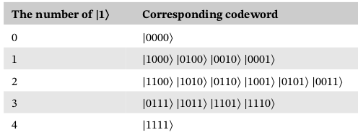
Step 2 : Compression Algorithm
it is not possible to compress the states in the classical manner without measuring the states and disturbing them, laws of quantum mechanics allow to utilize the symmetry of a set of identical states. The dimension of the Hilbert space of four qubits is 2^4 . When the four qubits are all prepared in the identical state |𝜓⟩ = 𝛼|0⟩ + 𝛽|1⟩, they can be expressed in the (4+1)-dimensional fully symmetric subspace. By performing the data compression, the number of codewords reduces from 16 to 5, as shown
Pivoluska, M., Plesch, M. Implementation of quantum compression on IBM quantum computers. Sci Rep 12, 5841 (2022). https://doi.org/10.1038/s41598-022-09881-8

Slide 6
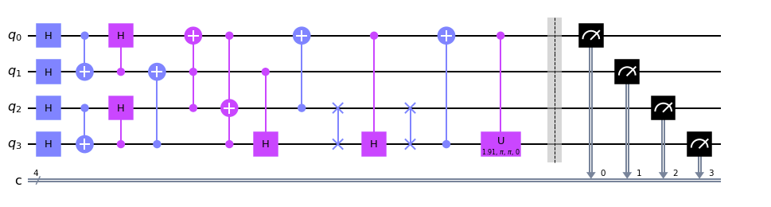
Algorithm Circuit
We can see that the four-qubit ensemble can be mapped reversibly onto log 5 qubits.
The schematic diagram of the quantum circuit implementing the four-qubit compression is shown

Slide 7

Algorithm
After the evolution, we can find that if the four input qubits are prepared in the state |𝜓⟩ = 𝛼|0⟩ + 𝛽|1⟩, the output state will be transformed to
Here we define the parameters 𝛼 = 𝛽 = √1/2 which can make the measurement probability after compression more intuitive. The output state could be expressed as
Fan, C-R, Lu, B, Feng, X-T, Gao, W-C, Wang, C. Efficient multi-qubit quantum data compression. Quantum Engineering. 2021; 3:e67. https://doi.org/10.1002/que2.67

Slide 8
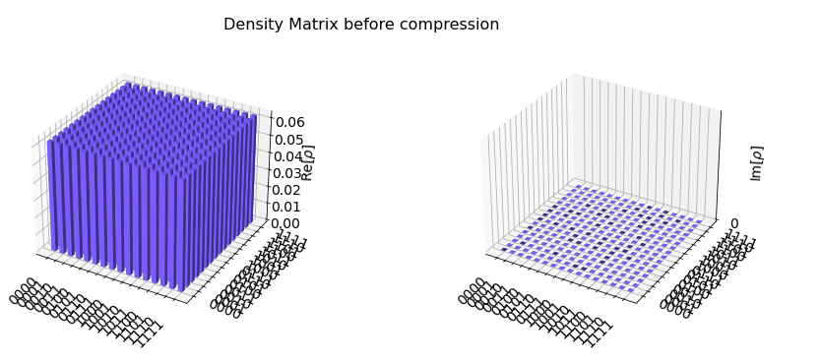
Density Matrices:
The density matrix of the four-qubit system before the compression and after the compression is shown

Slide 9
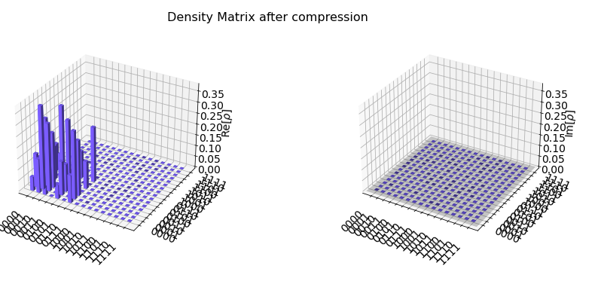

Slide 10
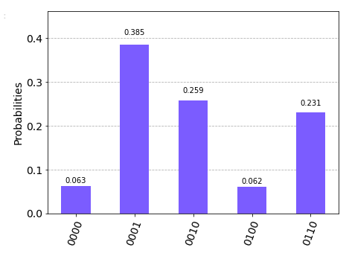
Histogram
Now, we visualize the measurement probabilities as a histogram. The results show that the qubits can be efficiently compressed into less qubits with a high fidelity

Slide 11
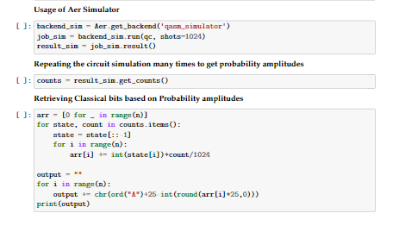
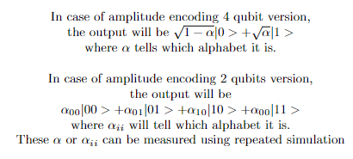
Step 3 : Decoding Quantum back to Classical

Slide 12
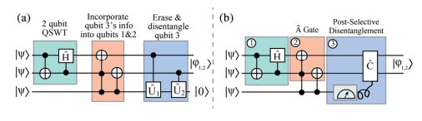
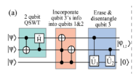
Other Industry Work
Lossless Compression of 3 identical qubits into 2 using Quantum Schur Weyl Transform
Avenues that could be pursued
We could utilise Basis encoding , similar to this diagram, identical qubits could be combined for example |110001〉 to |11𝝋1〉 as done in QSWT transform.
For compression to be applicable to arbitrary non-identical input states, quantum-classical hybrid scheme is required,
Reference : Quantum Data Compression of a Qubit Ensemble Rozema Mahler 2014 PRL

Slide 13
Uses, Future works and Scalability
We believe the compression method could reduce the resources cost for storing quantum information, as it can be used to increase the capacity of quantum memory as multiple identically prepared qubits can be reasonable to compress into fewer qubits.
Uses of data compression :
Used in remote sensing and geographical information systems
Medical images
Intraframe or spatial compression
Big data, data mining and database compression
Future works and scalability:
Our project is scalable in the future. We would like to implement the upgraded compression algorithm on the large datasets in the data mining or real world applications to maintain the same quality of data without any loss, the data sets are scalable so that we can use it on different types of classical data. E.g. text, image, audio, video.

