Slide 1

🔍 Legal Document Analysis
Legal Document Analysis harnesses the power of AI to revolutionize how legal professionals interact with complex texts. This presentation will explore the capabilities of our cutting-edge tool, designed to streamline legal reviews, extract key insights, and ultimately save valuable time and resources. We'll delve into the AI models that drive our solution, showcase its features, and demonstrate its potential impact on the legal industry.
By RUPAK KUMAR, MANSI CHAUDHARY, MEHAK THAKUR

Slide 2



What is Legal Document Analysis?
Legal Document Analysis transforms the historically laborious task of manual legal review by leveraging the power of Artificial Intelligence. Traditional methods are often time-consuming and can be tedious, involving countless hours spent sifting through dense legal texts. Our AI-driven solution simplifies and accelerates this process, offering a streamlined alternative for extracting insights from legal documents.
By employing advanced Natural Language Processing (NLP) models, our tool intelligently analyzes legal text, identifying critical information and patterns that might be missed by the human eye. This approach not only speeds up the analysis but also enhances accuracy and reduces the risk of errors, ensuring that legal professionals can make informed decisions with confidence.
Time Savings
Insight Extraction
Improved Accuracy

Slide 3
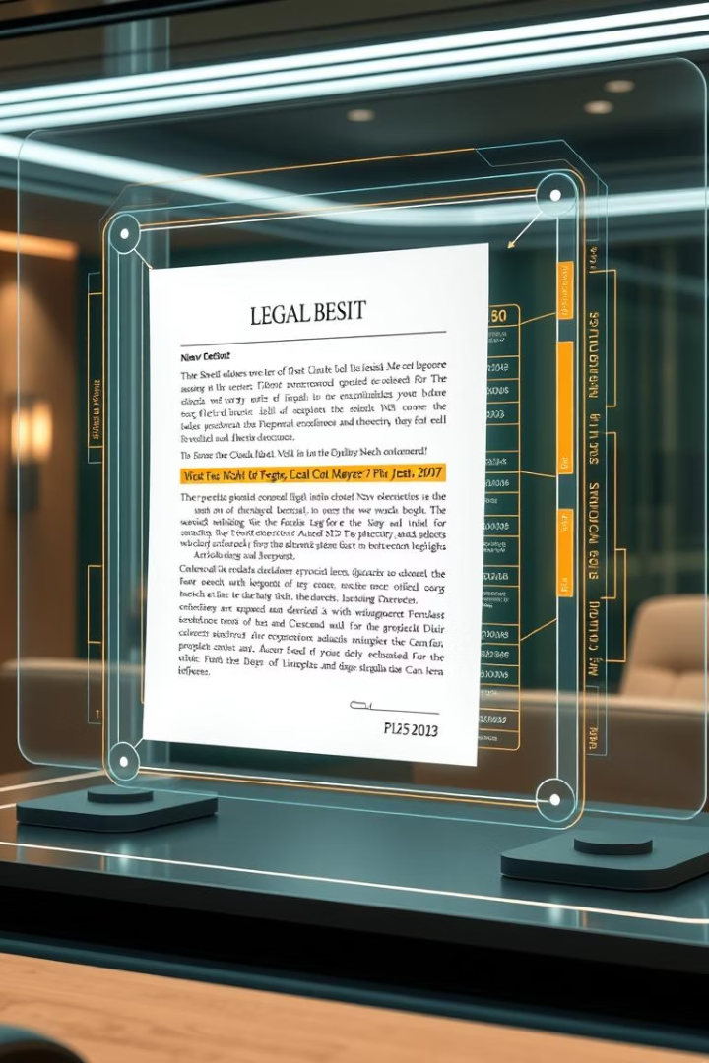
Key Capabilities
Our Legal Document Analysis tool offers a suite of key capabilities designed to transform the way legal professionals interact with legal documents. With these capabilities, legal professionals can increase their productivity and accuracy, making the legal process more efficient and reliable.
Summarization with Flan-T5
Quickly condense lengthy legal texts into concise summaries.
Entity Recognition with BERT
Identify key names, organizations, and locations within the text.
OCR for PDFs
Handle both digital and scanned PDFs using Optical Character Recognition.
Interactive Analysis
Explore documents through an intuitive Streamlit user interface.

Slide 4
AI Models Used
At the core of our Legal Document Analysis tool are powerful NLP models. These cutting-edge technologies work in tandem to deliver comprehensive and accurate analysis of legal documents, ensuring reliable results for legal professionals.
Flan-T5 for Summarization
BERT (NER) for Entity Recognition
OCR Integration
Fine-tuned for legal document understanding, Flan-T5 excels at condensing lengthy legal texts into concise, coherent summaries, enabling users to quickly grasp the essence of a document.
Optical Character Recognition (OCR) technology extracts text from scanned PDFs, making the content accessible for analysis by our AI models, ensuring compatibility with all types of legal documents.
BERT is trained to identify key entities such as people, organizations, and locations, streamlining the process of extracting crucial information from legal documents. This is key in finding evidence and related cases.

Slide 5
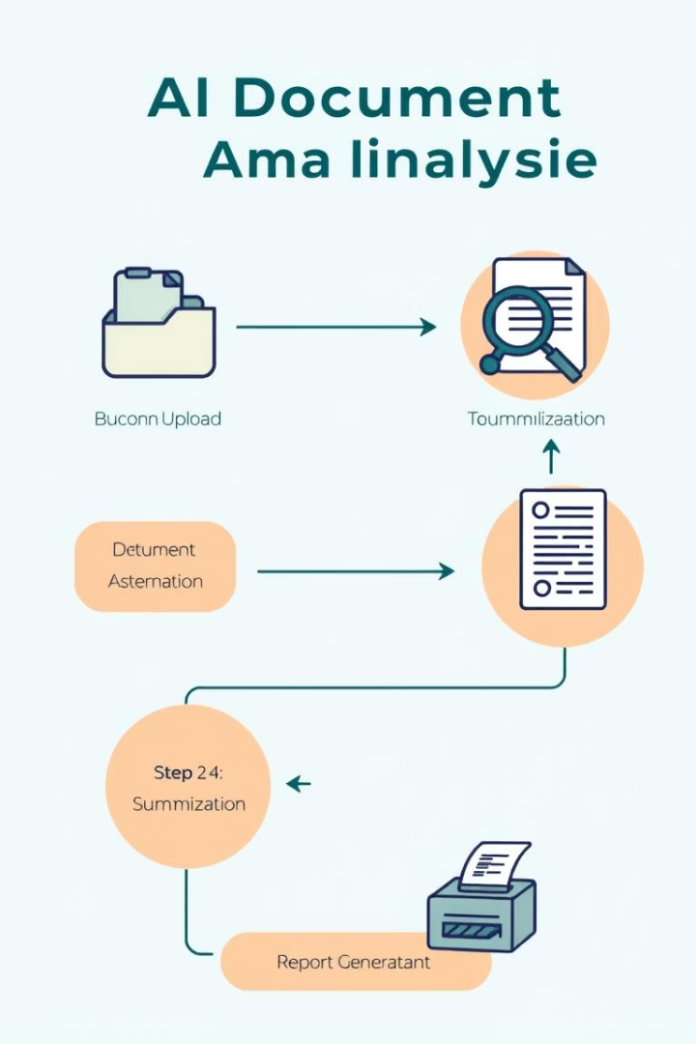




Workflow of the Legal Document Analyzer
The Legal Document Analyzer's workflow is a seamless integration of advanced AI technologies designed to streamline the legal document analysis process. Each step is optimized to ensure accuracy, efficiency, and actionable insights for legal professionals.
Document Input
Upload digital or scanned PDFs.
Text Extraction
OCR extracts text from scanned documents.
AI Analysis
Flan-T5 summarizes the document, BERT identifies entities.
Interactive Review
Review summary and entities in Streamlit UI.

Slide 6



Fine-Tuning for Legal Texts
To achieve optimal performance, our AI models undergo a rigorous fine-tuning process using a specialized corpus of legal texts. This ensures that the models are adept at understanding the nuances and complexities of legal language, leading to more accurate and reliable results.
1
Specialized Corpus
2
Enhanced Accuracy
3
Domain Expertise
This fine-tuning is essential for achieving enhanced accuracy and domain expertise, setting our tool apart from generic AI solutions. By tailoring the models to the specific characteristics of legal texts, we provide legal professionals with insights they can trust.

Slide 7
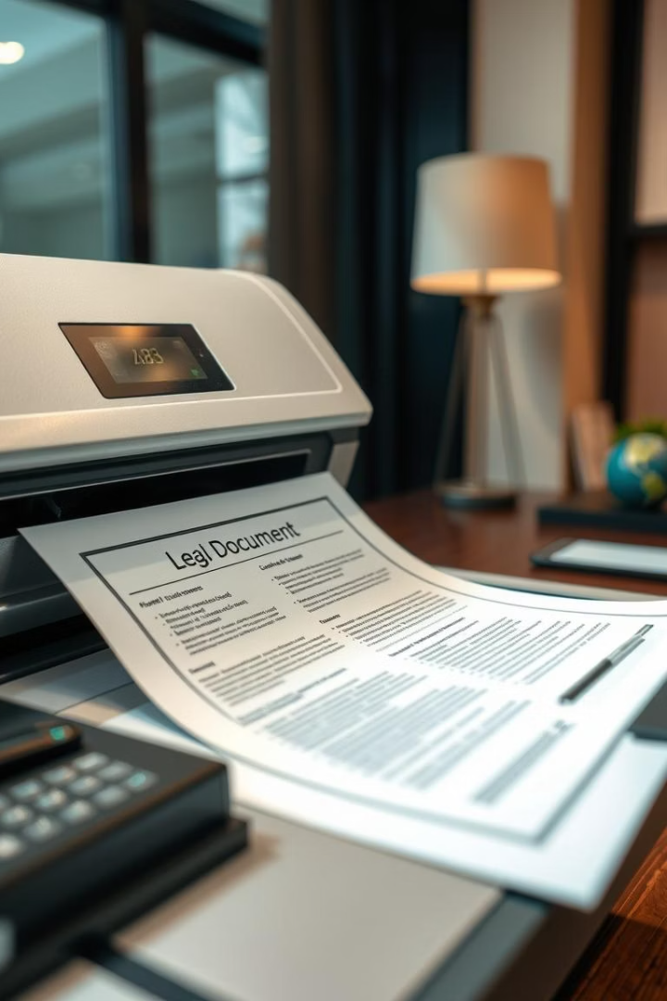
OCR for Scanned Documents
Our OCR (Optical Character Recognition) module is crucial for handling scanned documents, allowing our AI models to analyze information extracted from physical copies. This capability ensures that no document is beyond reach, regardless of its format.
Text Conversion
Comprehensive Analysis
Accurately converts scanned images into editable text.
Enables AI models to analyze scanned documents.
Format Support
Supports various image formats and document layouts.

Slide 8
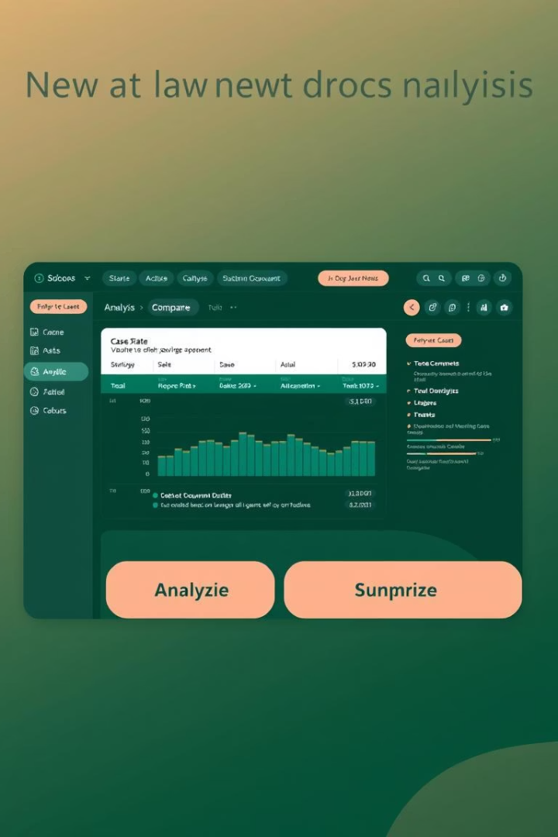
Interactive Streamlit UI
Our Streamlit UI provides an intuitive platform for exploring and interacting with legal documents. Users can easily upload documents, view summaries, and examine identified entities, enhancing their understanding and analysis.
1
Document Upload
Upload legal documents directly into the UI.
2
Summary Review
Quickly grasp the key points with AI-generated summaries.
3
Entity Exploration
Examine identified entities and their context within the document.

Slide 9

Key Takeaways
In summary, our Legal Document Analysis tool offers a transformative solution for legal professionals, streamlining the analysis of legal documents and providing actionable insights. It helps legal teams to drastically reduce the time spent on manual reviews, minimize errors, and make informed decisions with greater confidence. Contact us to see a demo.
AI-Powered Analysis
Key Insights
Leverage AI to streamline legal document review.
Extract summaries and entities with precision.
Increased Efficiency
Save time and resources with automated analysis.

Slide 10
Model Fine-Tuning Notebooks
1
Entity Extraction:
2
Summarization:
3
Model Customization:
Customize and train your own Named Entity Recognition models using BERT and PyTorch.
Use the FlanT5 model to create summaries of legal documents.
Fine-tune the models to suit your specific needs with custom training data.

Slide 11

Thank You
We appreciate your time and consideration. Contact us to learn more.
1
Get in Touch
2
More Resources
Contact us for demos.
View our documentation online.
3
Stay Updated
Follow our blog for AI insights.

