Slide 1
BUBBLE SORT
-Rupa Karella

Slide 2
What is Bubble Sort?
Bubble sort is a sorting technique used to arrange the elements of an list in an order by comparing adjacent elements of the list and swapping them if they are in wrong order.

Slide 3
Algorithm
Start at the beginning of the list.
Compare the first two elements. If the first is greater than the second, swap them.
Move to the next pair of elements (second and third) and repeat step 2.
Continue this process, comparing and swapping adjacent elements until you reach the end of the list.
After the first pass, the largest element will have "bubbled" to the end of the list.
Repeat steps 1-5 for the remaining unsorted elements (excluding the last element since it is already in its correct position).
Continue this process until the entire list is sorted.

Slide 4
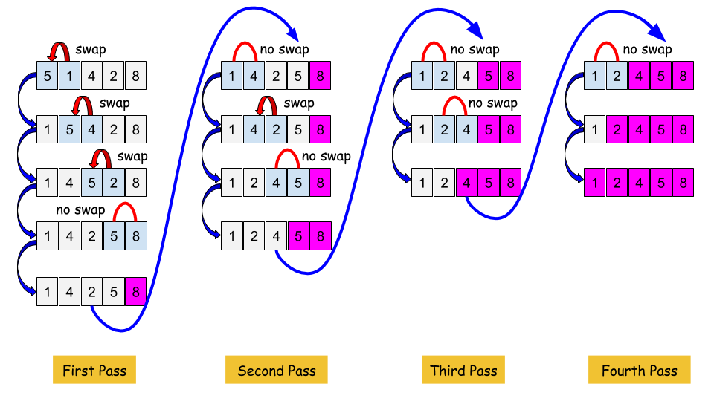
Example for Bubble Sort

Slide 5
Advantages and Disadvantages
Advantages: It is simple and easy to understand
Disadvantages: Inefficient for large datasets

Slide 6
THANK YOU

