Slide 1
Javascript Essentials for ReactJS

Slide 2
Why we need this?
Difference between VanillaJS vs React codes
Understand advance VanillaJS codes
Create a well-architected code

Slide 3
Scope
Global
context in which values and expressions are "visible" or can be referenced
child scopes have access to parent scopes, but not vice versa
function serves as a closure in JavaScript, and thus creates a scope
var x = 5;
parentFunction()
var y = 12;
- can access “x” and “y”
childFunction()
var z = 33;
can access “x”, “y” and “z”
cannot access “z”
can access “x” but cannot access “y, z”

Slide 4

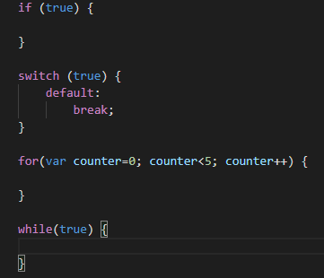
Hoisting & Block Scope
Hoisting – the variable and function declarations are put into memory during the compile phase, but stay exactly where you typed them in your code.
Block scoped - is the area within if, switch conditions or for and while loops

Slide 5
VAR, LET and CONST
 | VAR | LET | CONST
Redeclare variable | Yes | No | No
Hoisting | Yes | No | No
Block scope | No | Yes | Yes
Modify Value | Yes | Yes | No

Slide 6
Let’s play with it!

Slide 7
Logical OR “||” & AND “&&”
Logical OR returns true if 1 of the conditions is true
Logical AND returns true if all the conditions are true
But for javascript it returns the values that you have used in the condition (e.g. 5 || 6 === 5)
Truthy Values – true, {}, [], “0”, “false”, new Date(), Infinity, -Infinity, non zero numbers
Falsy Values - false, 0, -0, 0n, “”, null, undefined, NaN

Slide 8
Let’s play with it!

Slide 9
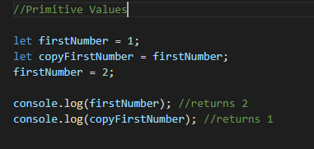
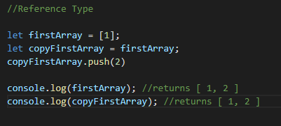
Primitive Values vs Reference Type
Primitive Values – string, number, bigint, boolean, undefined, and symbol
Reference Type – Object and Arrays

Slide 10
Let’s play with it!

Slide 11
How can we copy objects/arrays?
Shallow Copy – we only copy the first layer of the object from the original
Deep Copy –we have copied the object fully and it does not reference any values in the original

Slide 12
Shallow copy
To do a shallow copy, we can use the following.
Object – Object.assign()
Array – Array.slice()
Both – spread operator (…)

Slide 13
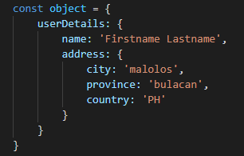
How it works?
Copy Object = Original Object
Original
Object
name
City
Country
province
userDetails
address
Copy Object

Slide 14
Shallow Copy – Object.assign
Original
Object
userDetails
name
City
Country
province
address
Copy Object
userDetails
Shallow Copy and update userDetails (userDetails = { name, address})
name
City
Country
province
Original
Object
userDetails
address
Copy Object
userDetails
name
address
City
Country
province

Slide 15
Deep copy
As the name states it will do a deep copy of the object so that if you change a property of an object, it will not affect the other copy.
JSON.parse(JSON.stringify(object))
bit slow in terms of performance but the easiest to code.
will cause some data loss if your object contains function, new Date(), undefined, etc.
Packages/Libraries
Lodash – cloneDeep function
Jquery – jQuery.extend
Or CREATE YOUR OWN!

Slide 16
Let’s play with it!

Slide 17
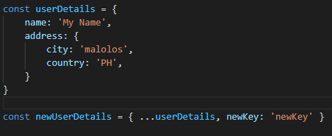

Spread operator
Object
easily create a shallow copy of an object
mostly use if you want to copy an object/array and add/modify values in it.
Array

Slide 18
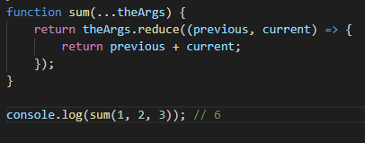
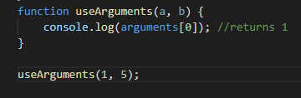
Rest parameters
allows us to represent an indefinite number of arguments as an array.
Compared with “arguments” object, rest parameters can use array functions while arguments cannot

Slide 19


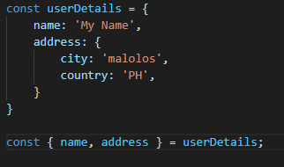

Destructuring
Without Destructuring
JavaScript expression that makes it possible to unpack values from arrays, or properties from objects, into distinct variables
You can also change the name, assign default values and use rest parameters
With Destructuring

Slide 20
Let’s play with it!

Slide 21
Classes
template for creating objects.
encapsulate data with code to work on that data.

Slide 22
What do we have in Classes?
Constructor – executed when you initialize the class
Functions – methods you can use using that class
Public variables – can be access when you instantiate the class
Private variables – can only be access inside the class
Static variables – can be called without the need to instantiate the class
“this” object – reference the class itself
Inheritance – use “extends” to get the attributes of a parent class
Super – calling base class attributes

Slide 23
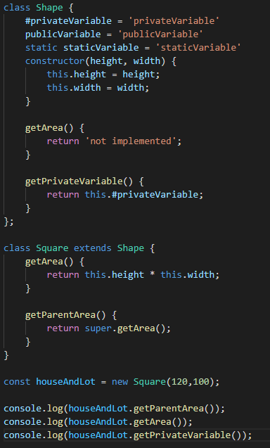
Classes Example

Slide 24
Let’s play with it!

Slide 25
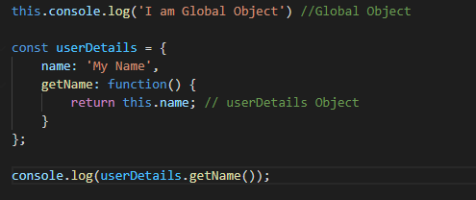
Who is “this” object?
In most cases, the value of this is determined by how a function is called
In simple terms this object refers to the parent object where you call the function unless you use “binding”

Slide 26
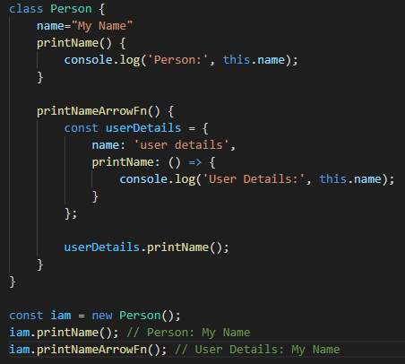
Arrow functions
is a compact alternative to a traditional function expression, but is limited and can't be used in all situations.
Limitations
Does not have its own bindings to this or super.
Does not have arguments object.
Not suitable for call, apply and bind methods
Can not be used as constructors.
Can not use yield, within its body.
do not default this to the window scope, rather they execute in the scope they are created

Slide 27
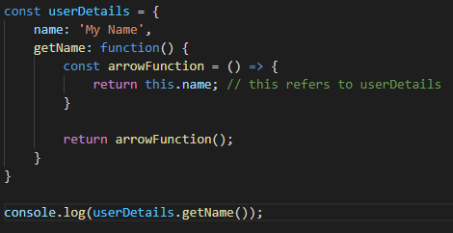
Simple terms
Standard Function
“this” object refers to the parent object of the function where it has been executed
Arrow Function
it retains the “this” where it was created

Slide 28
Let’s play with it!

Slide 29
How Javascript works?
Javascript is single threaded and has a synchronous execution model
Synchronous – one command/code is being executed at a time
Asynchronous – codes are executed in the background and will give way for others to be executed (e.g. setTimeout)
Long running function will block your code and your user – USE ASYNCHRONOUS

Slide 30
Runtime Concept
Heap
Web APIs
Stack
DOM
AJAX
Timeout
return money;
var money = 500;
getMoney()
Queue
onClickCb
onLoadCb
timeoutCb
Event Loop

Slide 31
Example: setTimeout(cb, 5000)
Web APIs
Stack
timer(cb)
setTimeout()
Queue
cb
cb
Event Loop

Slide 32
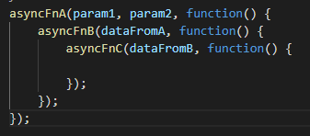
Callback Hell
Asynchronous JavaScript, or JavaScript that uses callbacks, is hard to get right intuitively.

Slide 33
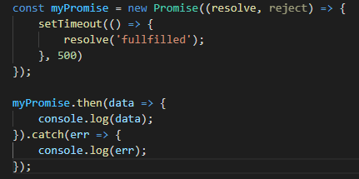
Promise
used to handle asynchronous invocations nicely
Has 3 different states
Pending
Fulfilled
Rejected

Slide 34
Promise API
Constructor – Promise(paramFn) - used to wrap functions that do not support promises
paramFn(resolve, reject) - resolve if fulfilled, reject if rejected
Promise.resolve(value) - returns a new Promise object that is resolved with the given value
Promise.reject(reason) - returns a new Promise object that is rejected with the given reason
Promise.all(iterable) – wait for all promises to be resolved, or for any to be rejected

Slide 35
Promise.allSettled(iterable) - wait until all promises have settled (each may resolve or reject)
Promise.any(iterable) - as soon as one of the promises in the iterable fulfills, returns a single promise that resolves with the value from that promise
Promise.race(iterable) - wait until any of the promises is resolved or rejected

Slide 36
Instance Methods
then(onFulfilled, onRejected) – called after the promise is done executing
onFulFilled – function that will be called when Promise is fulfilled
onRejected – function that will be called when Promise is rejected
catch(reason) – called when the promise is rejected when onRejected in then is not present
this will also catch errors when an error occurs in onFulFilled and onRejected
finally() – called either promise is fulfilled or rejected
does not have any parameters. If you want to do something with the data returned by then or catch, then just use “then” after the catch

Slide 37
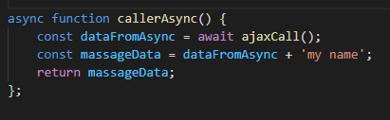
Async/await
use to make a function asynchronous
can use “await” keyword so you can wait for an asynchronous invocation to finish before executing next codes
cleaner style than Promise as you do not need to do chaining that much
returns a Promise

Slide 38
Let’s play with it!

Slide 39
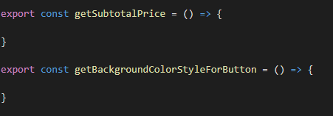
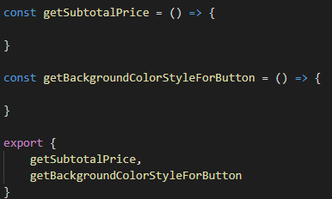
Export & Import
Export functions before declarations
Export apart from declarations
To import them, use the code below

Slide 40
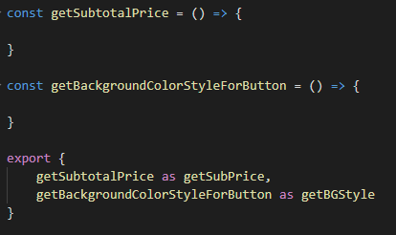

Export “as”
Import “as”

Slide 41
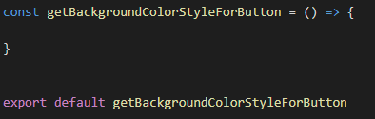


Export default
Importing default export

Slide 42
Summary
Scope – hierarchy on how we can access variables
Hoisting – declaration of variables are added to memory first before execution
Block Scope - is the area within if, switch conditions or for and while loops (let and const)
Logical OR, AND – returns the value in the conditions, not just true/false
Primitive Values – stores the value
Reference Type – stores the reference to the memory (object/arrays)
Shallow Copy – copies only the first layer of an object/array
Deep Copy – copies all the layer of an object/array
Spread – creates a shallow copy of an object/array
Rest Parameters – put all the parameters in an array, use this instead of arguments obj
Destructuring – get keys/data efficiently from object/array

Slide 43
Classes - template for creating objects and encapsulating data
this object - refers to the parent object where you call the function unless you use “binding”
Arrow Functions – it retains the “this” where it was created
Asynchronous code – executed in the Web API and it’s non blocking
Callback Hell – hellish way of adding callback functions to asynchronous invocations
Promise – handle async codes nicely using chaining (then, catch, finally)
Async/await – handle async codes nicely using “await” keyword, async function returns Promise
Export/Import – to create reusable functions that can be used anywhere in your codebase

