Slide 1


P-183 GROUP-6 Presenting
Project Mentor
Mr Madishetti Rajashekar
Real Estate - Data Analysis
( 99 Acres.com )
Presented By
Mr Sourav chittaranjan parui
Mr Rupak Dipak Mondal
Miss. Urmila Subhash Vanjare

Slide 2

Content
.com
Introduction
Business Problem
Project Architecture / Project FLow
Tools Used
Data
Feature Engineering
EDA
Model Building
Template for Model Result Presentation
Model Prediction
Model Result
Model Deployment

Slide 3
Introduction
99Acres.Com Is An Internet Portal Dedicated To Meet Every Aspect Of The Consumers Needs In The Real Estate Industry.
Started In September 2005.
Pan India Listing Of Properties.
Sell, Purchase And Rent.
Connects Builders, Brokers, Dealers And Interested Buyers /Sellers Online.

Slide 4
Business Objective:
Business Objective:
Customer personality analysis helps a business to modify its product based on its target customers from different types of customer segments.
Finding the potential customers by analysing the behaviour of them is useful to understand the targeted customers.
For example, instead of spending money to market a new product to every customer in the company’s database, a company can analyse which customer segment is most likely to buy the product and then market the product only on that particular segment.

Slide 5



Data Preprocessing
Exploratory data analysis (EDA)
Project Architecture / Project Flow
Model Deployment
Model Building/ Evaluation
Web Scrapping
Understanding Data

Slide 6






Tools Used In Our Project

Slide 7
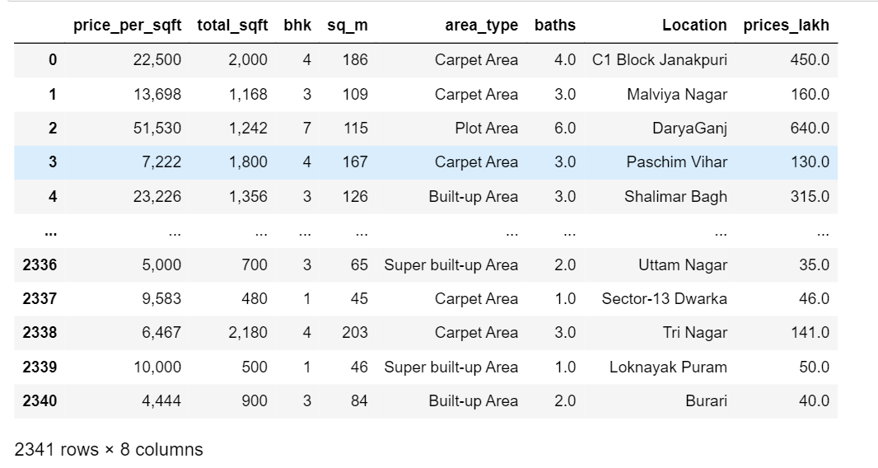
DATA
Here is data of web scrapping the 99acres.com website.
We have listed all the properties such as number of bedrooms, prices, area.
There are 2341 observations and 8 variables in our dataset.

Slide 8
Data set details
Information On Data
Dataset contains total 8 columns ( 0 to 7 )
df.columns
Index ( ['price_per_sqft', 'total_sqft', 'bhk', 'sq_m', 'area_type', 'baths', 'Location', 'prices_lakh'],
dtype='object')
df.info()
<class 'pandas.core.frame.DataFrame'>
Data columns (total 8 columns):
# Column Non-Null Count Dtype
--- ------ -------------- -----
0 price_per_sqft 2341 non-null object
1 total_sqft 2341 non-null object
2 bhk 2341 non-null object
3 sq_m 2341 non-null int64
4 area_type 2341 non-null object
5 baths 2339 non-null float64
6 Location 2341 non-null object
7 prices_lakh 2341 non-null float64
dtypes: float64(2), int64(1), object(5)
memory usage: 146.4+ KB
Dataset having 2341 entries starting of 0 to 2340
Data doesn’t have any null values .
Datatypes of our data is in float64(2), int64(1), object(5)

Slide 9


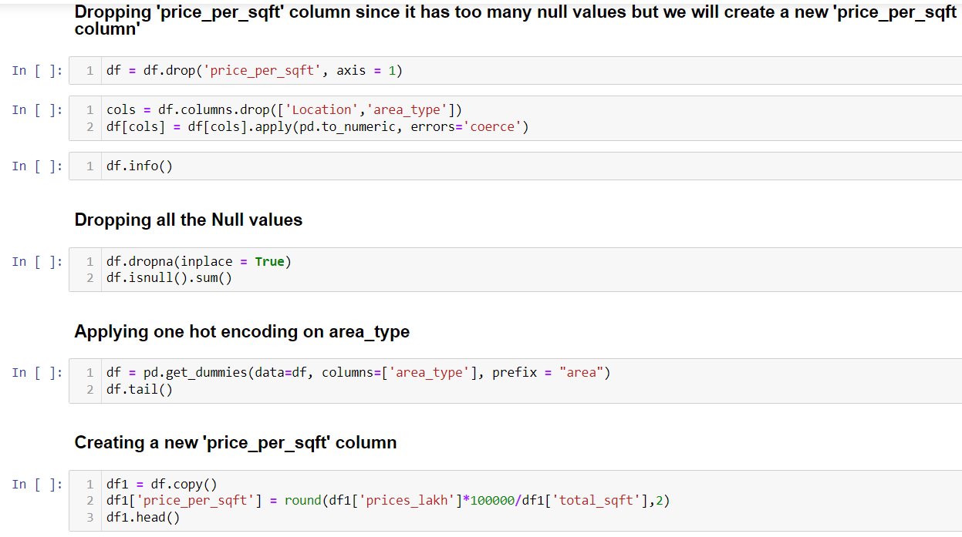

Feature Engineering

Slide 10



Exploratory Data Analysis (EDA)

Slide 11
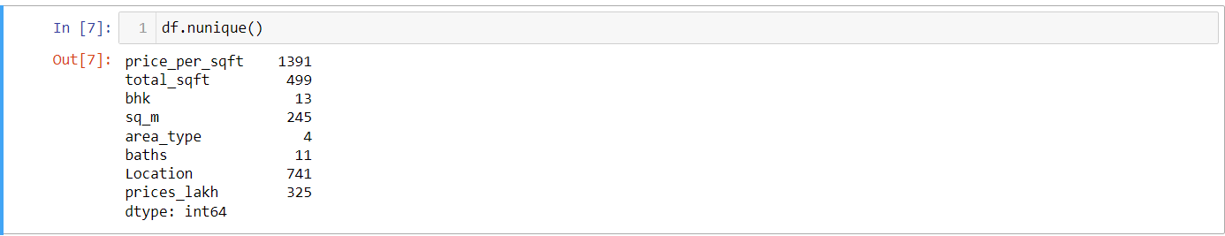
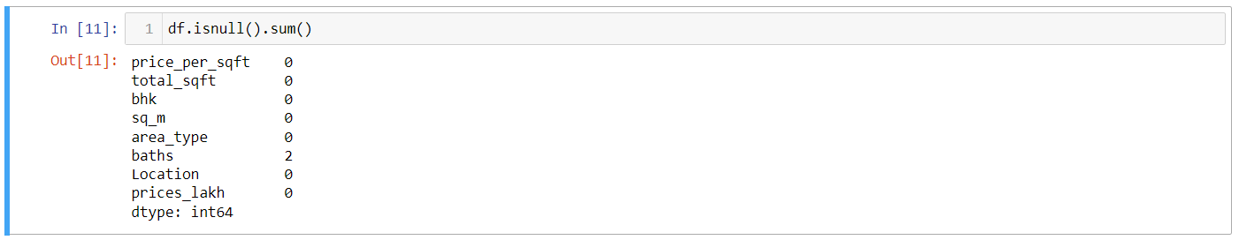
EDA
Details of Data ( Rows & Columns )
Unique Values in Data
Null Values in data

Slide 12
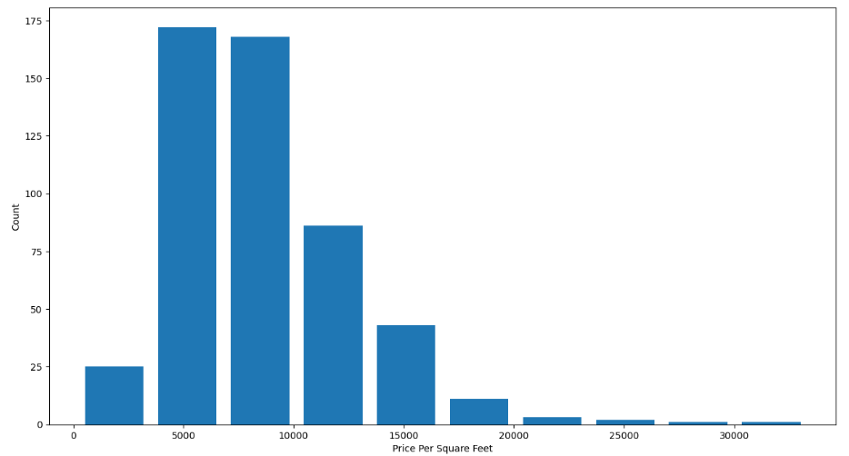
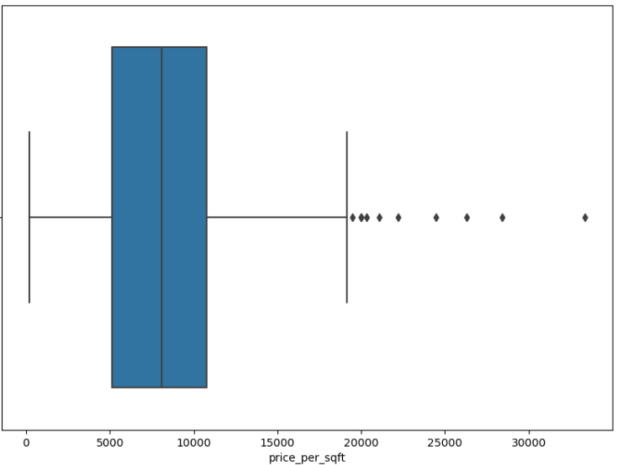
EDA
Histogram Representation of
Count of the Number of flats by price per square feet
Box-plot Representation of
Count of the Number of flats by price per square feet

Slide 13



Model Building
As this is a supervised machine learning, we have applied some regression models like
SLR ( Simple linear Regression )
Decision Tree
Lasso
We have used K-fold validation to measure Accuracy of our Simple liner regression Model & we have used GridSearchCV for finding best Model

Slide 14
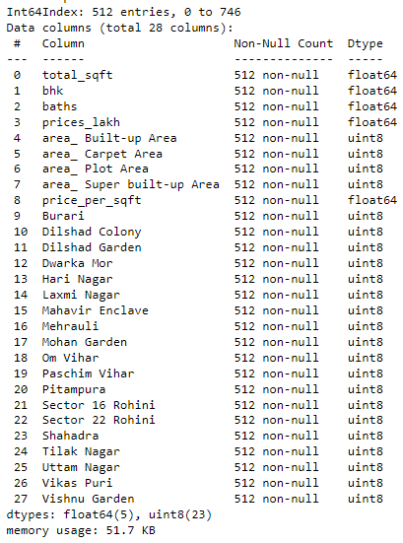
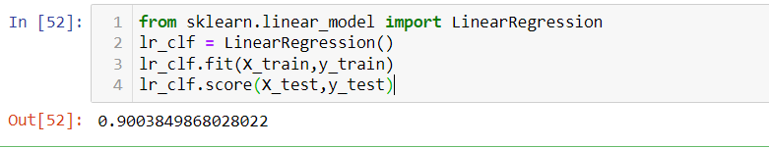

Template for Model results presentation
Model – SLR (simple linear Regression)
Data Partition details
Dataset details
Model details
Model Accuracy With Best Parameters
Simple Linear Regression = 95%

Slide 15
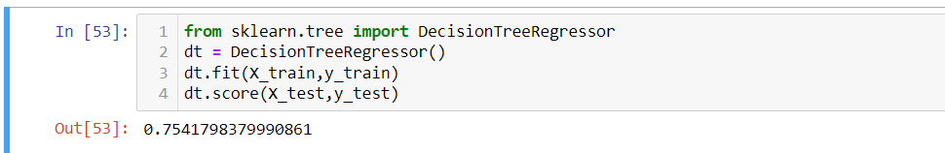
Template for Model results presentation
Model – DecisionTree Regressor
Data Partition details
Dataset details
Model details
Model Accuracy With Best Parameters
DecisionTree Regressor = 97%

Slide 16
Template for Model results presentation
Model – Lasso
Dataset details
Data Partition details
Model Accuracy With Best Parameters
Lasso = 95%

Slide 17
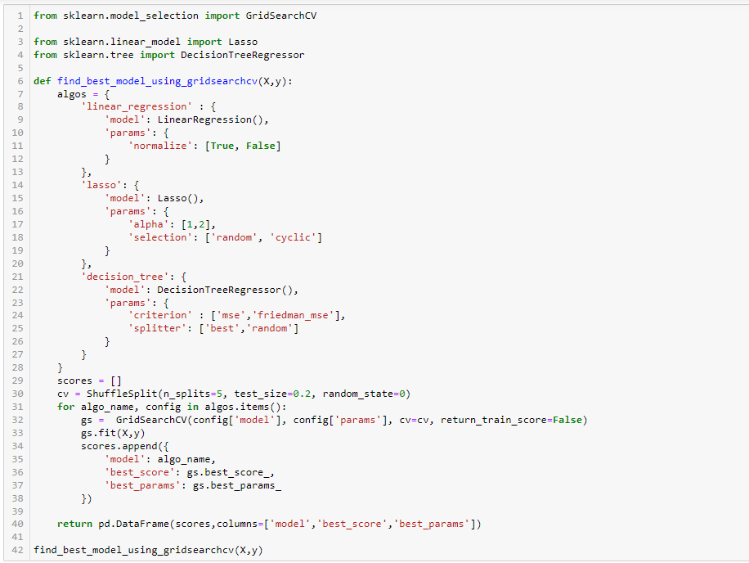
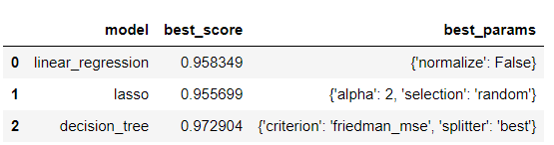
We Have Used Gridsearch CV For Finding Best Model with Best_Params
OUTPUT

Slide 18
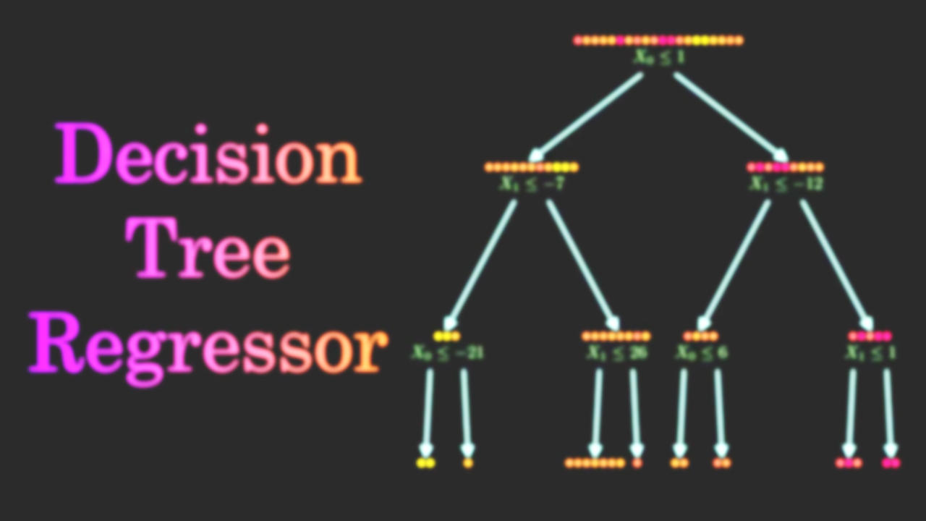
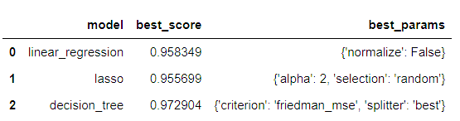

Based On The Above Results We Can Say That Decision Tree Gives The Best Score With 97% Accuracy.

Slide 19
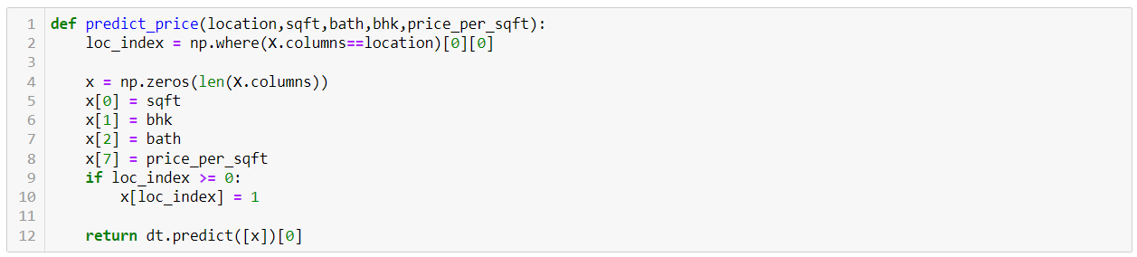
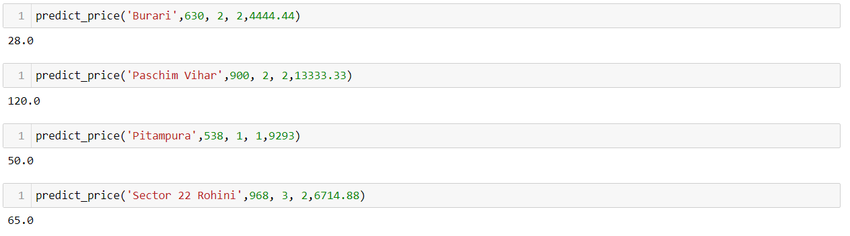
Model Predictions
Testing The Model For Few Properties
Predicting Some Of Locations

Slide 20
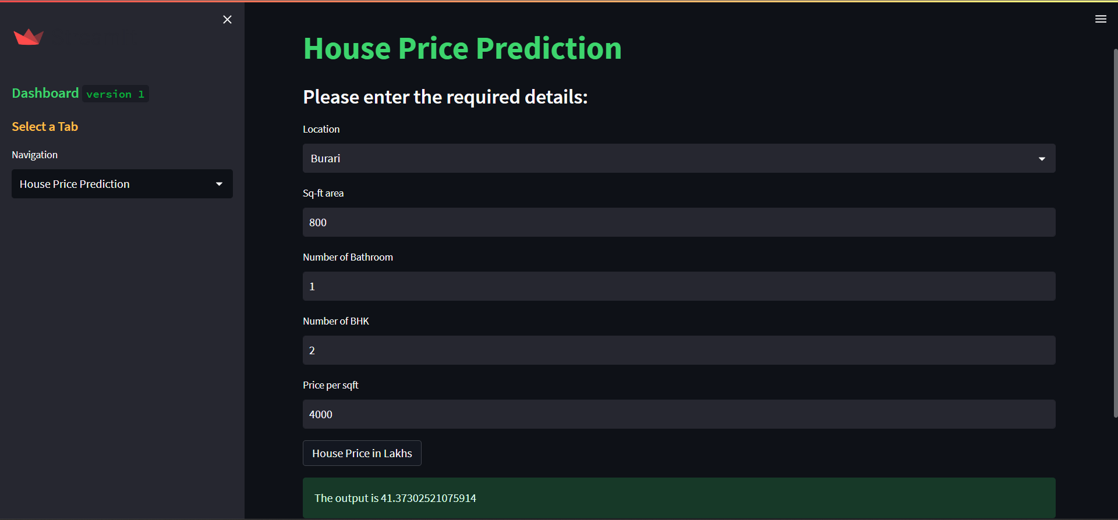
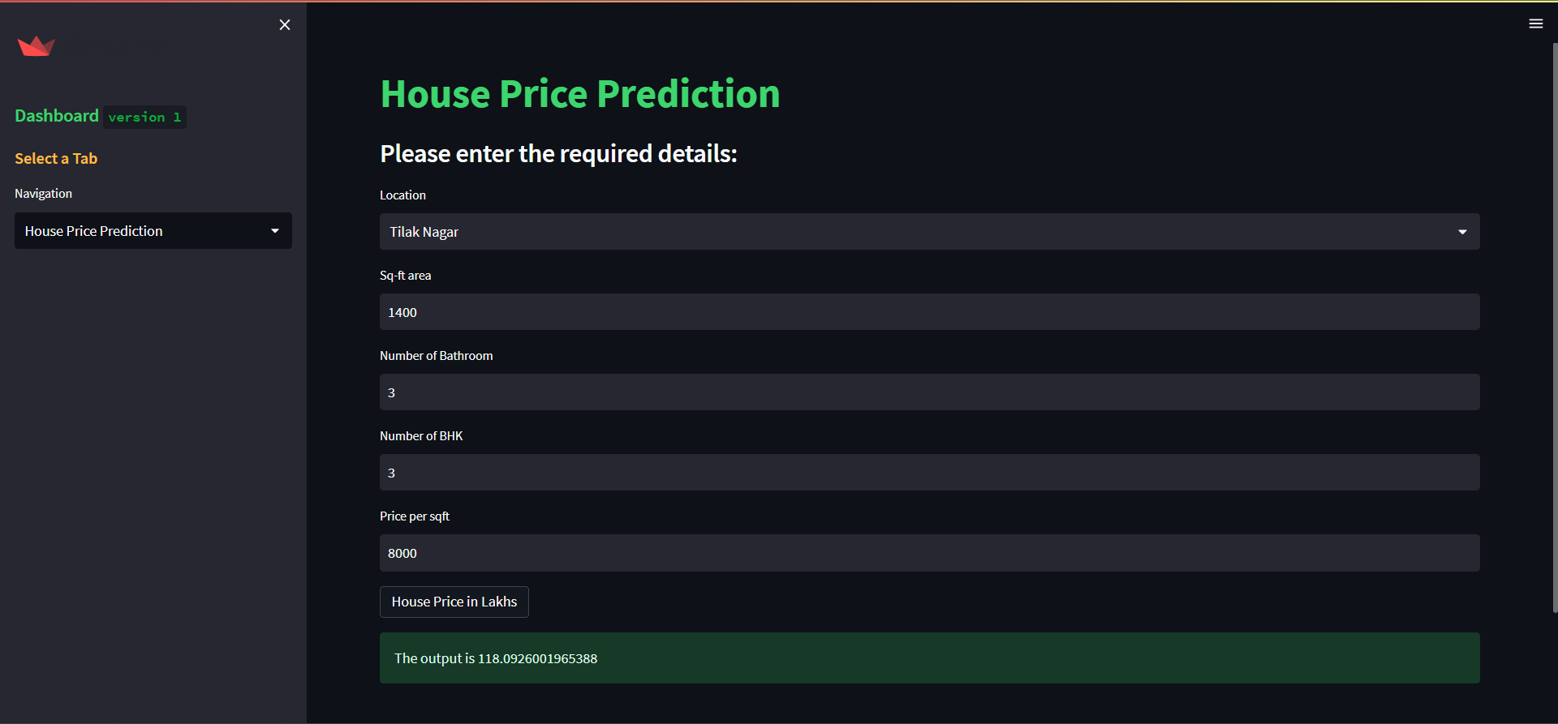
Model Deployment using Streamlit.
Price Prediction of 2 BHK flat in BURAI of 800sqft having 1 Bathroom & Price_per_sqft is of 4000
Getting Predicted Price as 41.37Lakhs
Price Prediction of 3 BHK flat in Tilak Nagar of 1400sqft
having 2 Bathroom & Price_per_sqft is of 8000
Getting Predicted Price as 118.09Lakhs ( i.e 1.18cr )

Slide 21
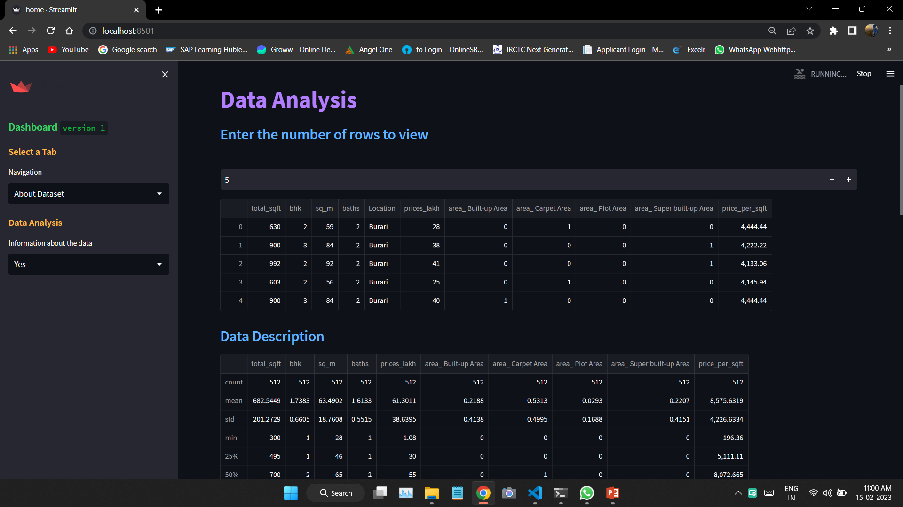
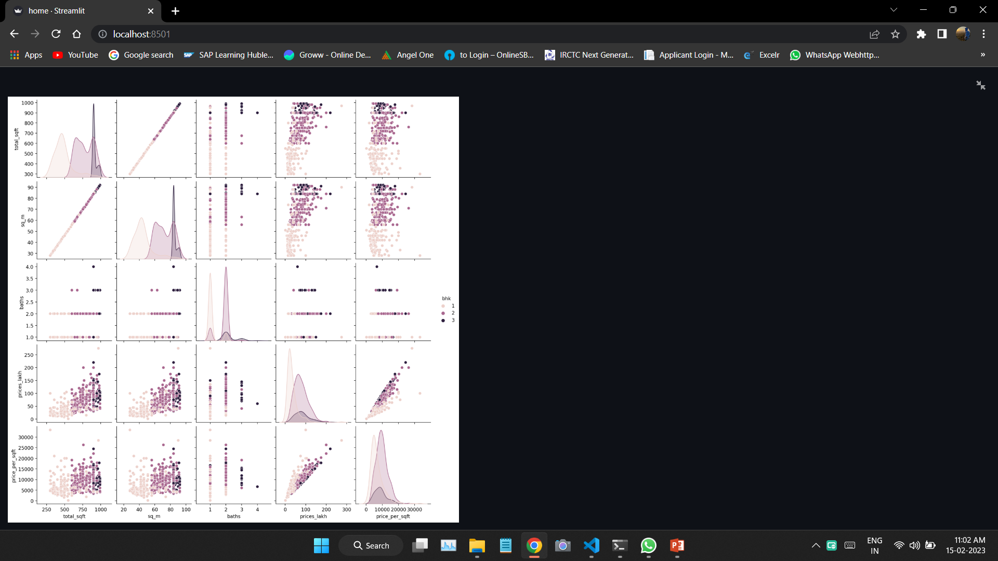
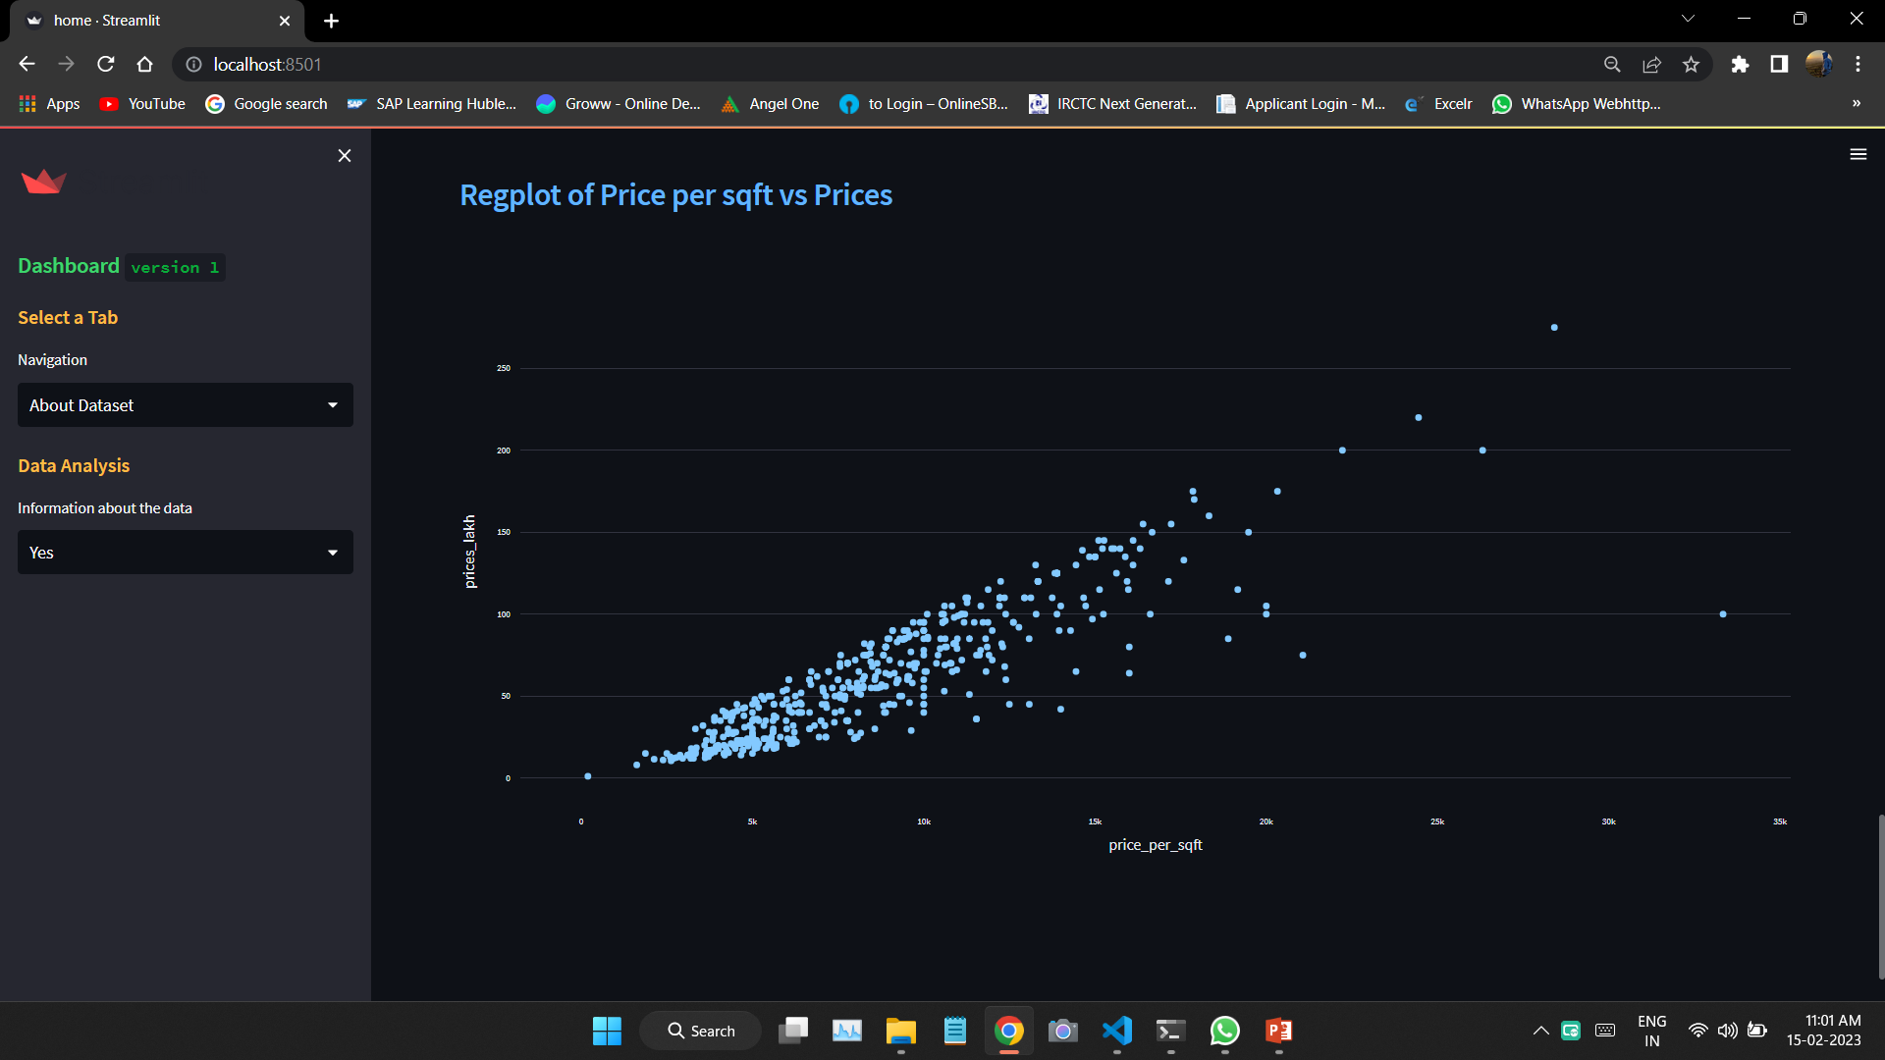
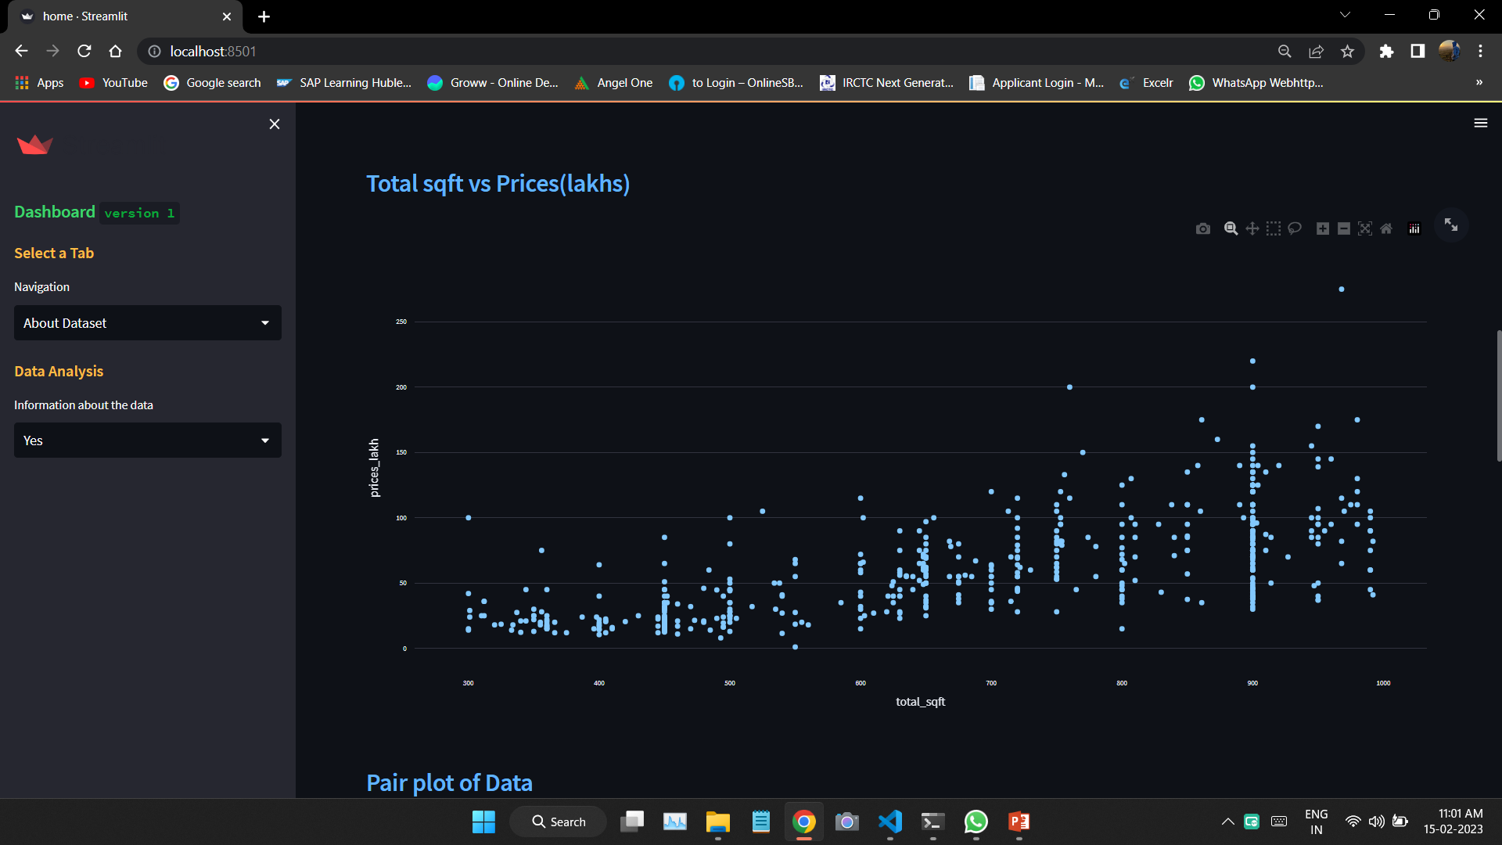
Model Deployment using Streamlit.
Data Analysis

Slide 22
Challenges faced?
Got Many Errors & Difficulties In Web Scrapping.
We Faced Visualization Problems While Performing EDA.
We Even Faced Certain Issues While Deploying.
There Were Certain Error Dialogue Box Which Were Popping Up, But At The End We Were Successful In Resolving Them.
How did you overcome?
We Overcome All This Challenges By Discussion In Group Meeting & Taking New Ideas From Team Members.

Slide 23
Thank You

