Slide 1
Rupak Mohanty
Network Traffic Control using SDN

Slide 2
Contents
Scope
Tech Stack
SDN
Traditional vs SDN Network
RYU
Design & Architecture
Testbed
Result Comparision
References
Questionaries

Slide 3
Scope
The main scope of this project is to demonstrate the effective approach to implement load balancing and traffic control using SDN as compared to traditional Networking
Creating a simple SDN network topology using a virtual network testbed called as Mininet
Program two controller application based on RYU framework to implement the function of network traffic forwarding and redirection, respectively.

Slide 4
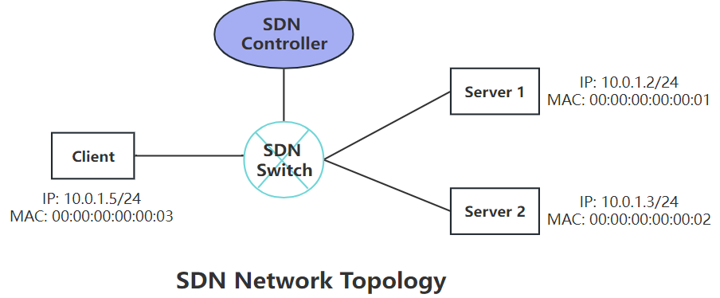
Scope
The project utilizes Mininet, a powerful tool for emulating SDN (Software Defined Network), to construct a simple SDN network topology (see the following figure) and simulate traffic control within the Mininet-emulated environment
Creating a simple SDN network topology using a virtual network testbed called as Mininet
Program two controller application based on RYU framework to implement the function of network traffic forwarding and redirection, respectively.
The controller application that implements traffic forwarding directly forwards network traffic from Client to Server 1, while the other one redirects the traffic to Server 2 without the awareness of Client.
Wireshark is used to test the respective performance of two controller application developed and compare the testing result

Slide 5
Tech stack
Linux environment (Ubuntu 22.04)
Python3
Mininet (2.2.2)
Ryu (4.34)
Xterm (353)
Wireshark

Slide 6
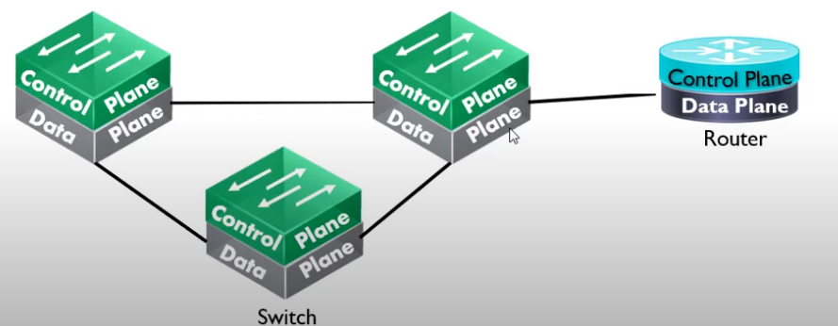
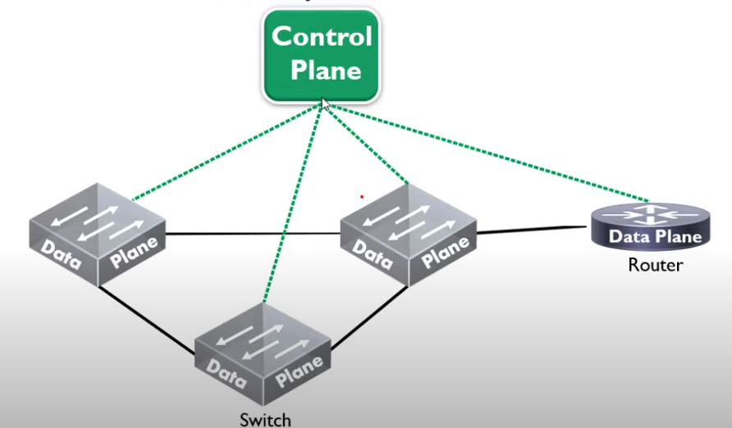
Traditional VS SDN networking approach
Network consists of switches, routers etc. Each devices has its own architecture .
This architecture is based on control plane and Data plane
Control Plane : Managing and drawing Network topology and makes decisions about where traffic is sent .It also define the routing flow and managing out routing protocol topology and based on this topology it gives instruction how packets flow . This is the brain of the network .
Date Plane : It is also called as forward plane and based on control plane instruction forward packets/frame from one interface to other
We have to configure every device separately ?
So think about a network topology where we have around 1000 device to manage ?
SDN :
Separate the Control Plane from the Data Plane and make Control Plane to manage all devices ..

Slide 7
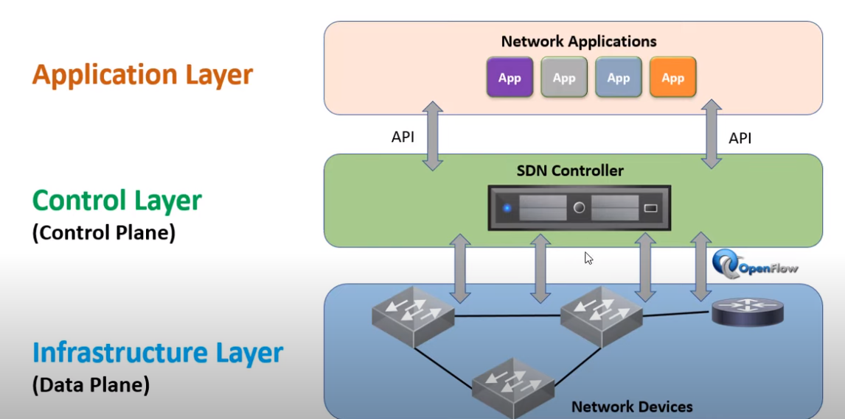

SDN
A typical SDN architecture consists of three layers
Application layer: It contains the typical network applications like intrusion detection, firewall, and load balancing
Control layer: It consists of the SDN controller which acts as the brain of the network. It also allows hardware abstraction to the applications written on top of it.
Infrastructure layer: This consists of physical switches which form the data plane and carries out the actual movement of data packets.
The layers communicate via a set of interfaces called the north-bound APIs(between the application and control layer) and southbound APIs(between the control and infrastructure layer).

Slide 8
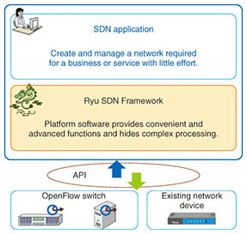
What is RYU?
Ryu is a component-based software defined networking framework. Ryu provides software components with well defined API that make it easy for developers to create new network management and control applications. Ryu supports various protocols for managing network devices, such as OpenFlow, Netconf, OF-config, etc
The network configuration function is divided into a data plane for handling data transfers and a control plane for handling control of the data plane. In the conventional approach, the two planes are tightly linked within individual network devices, so interworking between the control planes of the devices is necessary when constructing a single network with multiple network devices.

Slide 9
Design
&
Architecture

Slide 10
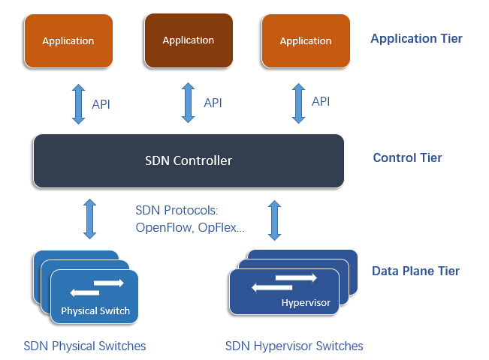
How does a sdn switch work?
Whether it is a virtual (hypervisor-based) switch or a physical switch, an SDN switch only keeps the data plane (packet forwarding) in itself.
The control plane (high-level routing) is decoupled from the SDN switch hardware but implemented in the SDN controller (an application running on the server or somewhere), which lies between network devices and applications.
An SDN switch consists of ports and tables. Packets arrive and leave the switch through ports. Tables consist of rows containing a classifier and set of actions.
In a SDN network when a switch receives a packet for which it can not find a match in its flow table, it will forward this packet to the controller. The controller will decide about this packet and will forward this packet to the sender switch for further actions.
The controller can download a flow to the switch, which includes the first classifier that best matches the packet and the actions. Actions administer the treatment of the packet, which can be forwarding it to the port(s), encapsulating and forwarding it to the controller, dropping the packet, or sending it to the normal processing pipeline.
Once the flow is downloaded to the switch table, it will switch similar packets at wire speed.

Slide 11
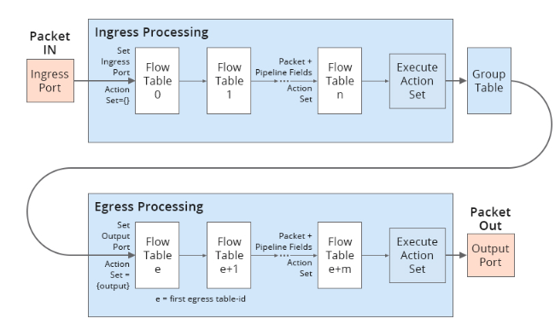
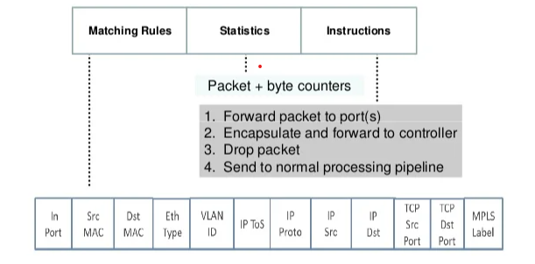
Flow table
SDN flow tables are the data structures that store the rules for packet processing in SDN switches.
Each flow table entry consists of a match field and an action field.
The match field specifies the criteria for matching packets, such as source and destination addresses, port numbers, protocol types, etc.
The action field specifies what to do with the matched packets, such as forward, drop, modify, or send to the controller.
When a packet arrives at an SDN switch, it is compared with the flow table entries in order of priority. The first matching entry determines the action to be taken on the packet. If no entry matches, the switch can either drop the packet or send it to the controller for further instructions.
SDN flow tables enable flexible and dynamic control of network devices by allowing the controller to install, modify, or delete rules remotely

Slide 12
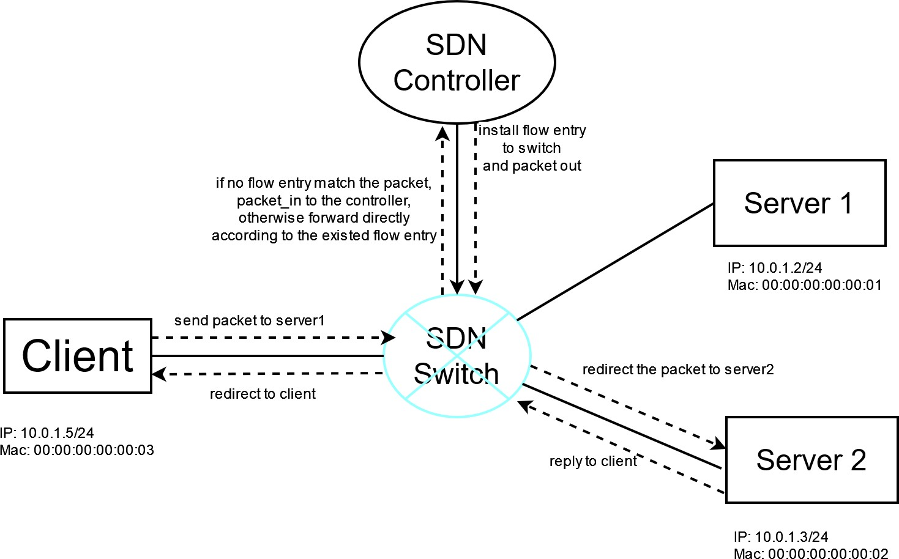
Design – network Redirection
We can abstract the components of the SDN network into four classes: client , server, SDN switch and SDN controller.
The two servers are connected with client through a single switch and SDN switch can communicate with SDN controller through a specific data path.
The controller could determine the actions of each packet going through SDN switch by flow entries installed in the switch which will control the whole network traffic.
In addition, each host connects with switch through a specific interface and a port number is allocated to each interface.
The actions of SDN controller can be distilled into two functions: Adding flow entry
Handling packet_in packet.

Slide 13
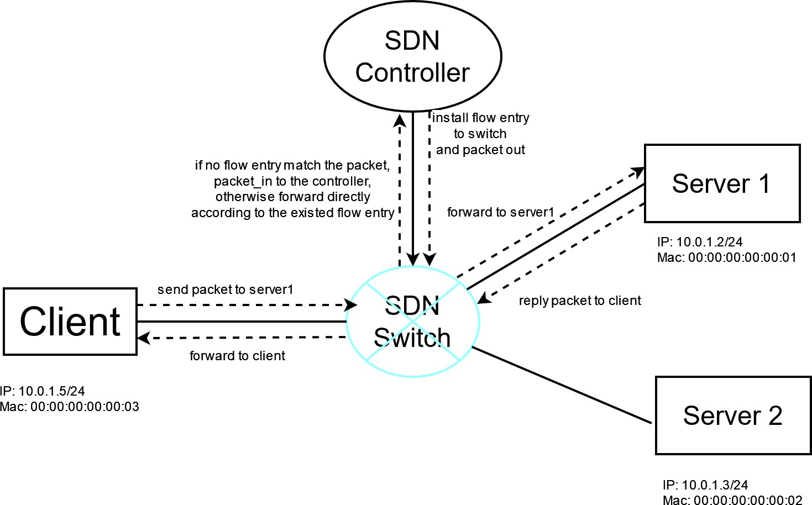
Design – network forwarding

Slide 14
Implementation
Initialization to ensure normal running of SDN network.
Creating the Flow entry .
Installing the flow entry

Slide 15
Initialization
Initialization:
The SDN controller is allocated with a data path id through which controller can send message to switch.
A table-miss flow entry should be installed to the switch in order to match packets that should be sent to the controller.
An empty mac to port table should be defined to record the mapping relationship between the port number of SDN switch and MAC address of each host.
What is table-miss flow entry?
A table-miss flow entry is a special entry in the flow table of an SDN switch that specifies what to do when no other entry matches an incoming packet. It is required by the OpenFlow protocol and can have different actions , such as dropping the packet, forwarding it to another table or sending it to controller for further processing.
What is mac to port table?
A MAC to port table in SDN is a data structure that maps the MAC addresses of devices on the network to the ports of the SDN switch that they are connected to. It is similar to the MAC address table of a traditional switch, but it is managed by the SDN controller instead of the switch itself. The SDN controller can use the MAC to port table to install flow entries on the switch that specify how to forward packets based on their MAC addresses.

Slide 16
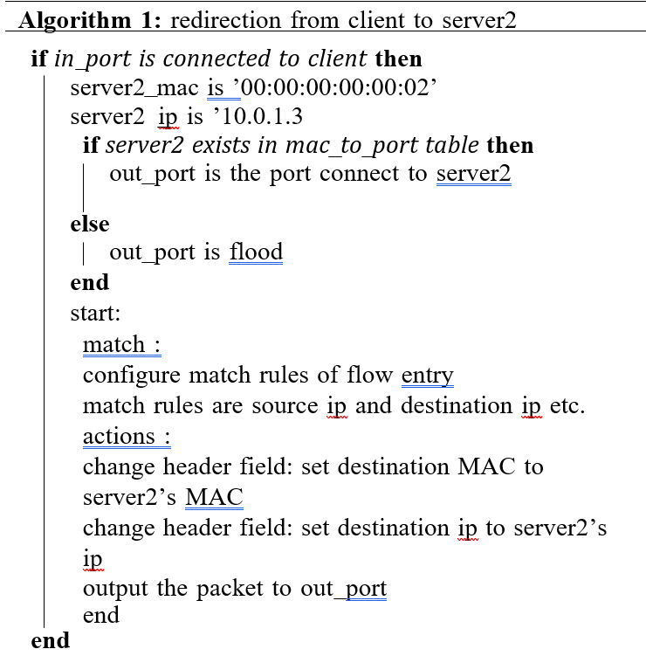
Creating the flow entry
Redirection from Client to Server2
The first TCP packet sent from client to the switch, its original destination is server1. Since there are no flow entries matching the packet, it will be sent to the controller according to the table-miss flow entry.
Once the packet enters into the SDN controller the information in network protocol of this packet will be extracted including source ip, destination ip and protocols above the network layer.
After the controller determines the packet as a TCP packet and the in port is the port connecting to client, it will define the port connecting to server2 as out port and set an action including changing packet fields of out port, source ip and source mac which helps instruct such kind of packet to redirect to the correct direction.
The match field will also be set to help switch recognize such kind of packets. In addition, the priority should also be set since all the flow entry should have higher priority than table-miss flow entry.
Finally, the controller will create a flow entry which includes match, action, priority and data path.

Slide 17
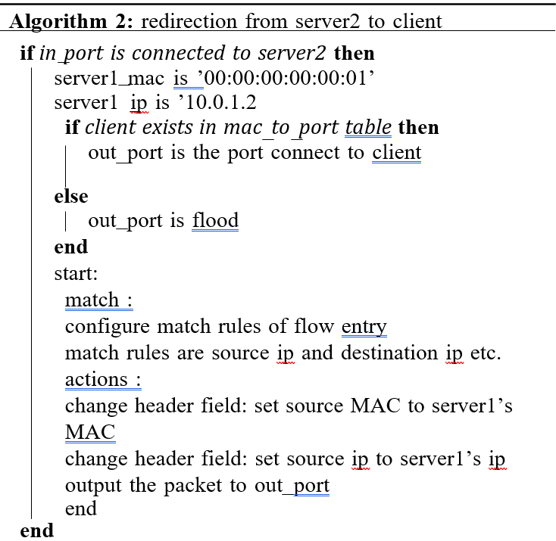
installing the flow entry
Redirection from Server2 to Client
After the creation of flow entry, the controller will install it to switch through data path which is a bridge between switch and controller. However, an idle time should be added as a field of flow entry which helps remove useless flow entry. Once the flow entry has been installed to switch, packets with the same properties will be redirected directly without triggering packet in event

Slide 18
Creating the flow entry
Redirection from Server2 to Client
The process of creating flow entry of TCP packet from server2 to client is quite similar to the previous one. However, the source ip and source mac should be server1 since TCP is connection-oriented protocol. Actually, the SDN switch deceives the client that it is connected with server1

Slide 19
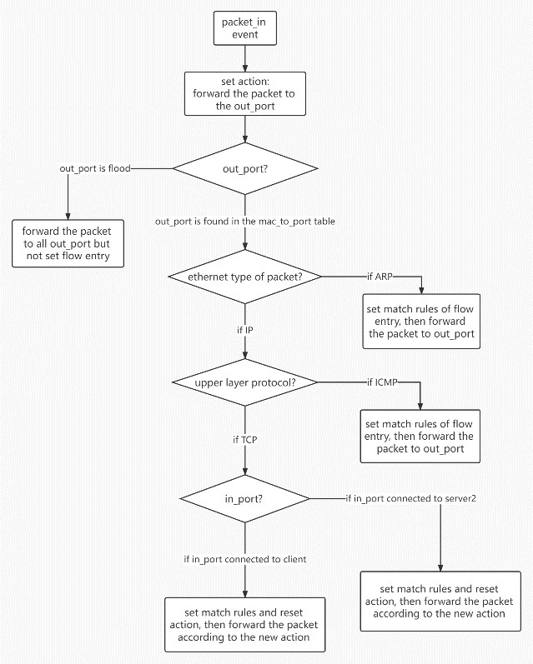
Steps of implementation

Slide 20
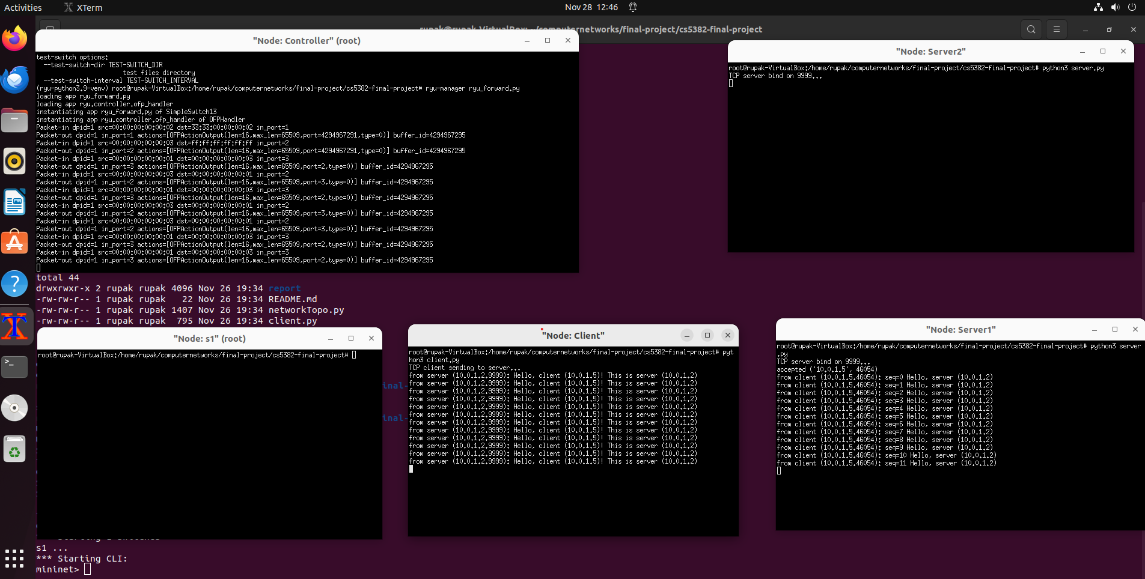
Steps of implementation

Slide 21
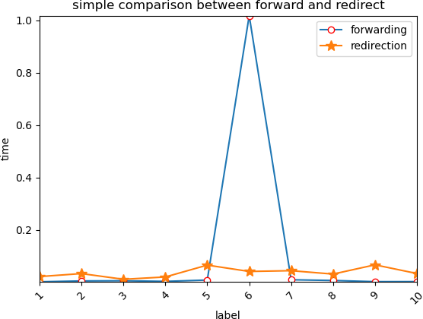
Comparison : forward vs redirection
The test run redirection and forwarding controller applications 10 times each and latency is calculated caused by TCP 3-way handshake (from the first SYN till the last ACK). Finally, the below curve diagram below to help us make a comparison.
According to the diagram, except the sixth time, the time consumed of traffic redirection is larger than simple forward-ing. However, the only exception is caused by packet loss of SYN. Overall, the traffic network redirection will cause larger latency

