Slide 1
CS-5279-50 Rupak Mohanty
Software Engineering Projects

Slide 2
Workflow Engine
The proposed workflow-engine is a custom built embeddable technology that provides a runtime environment for long-lived business processes. The main features, and the meaning of life, of the engine are:
Execute and manage long-lived automatic business processes (workflows)
Support for executing business logic within the process.
Support for complex event processing . Processes can be driven from signals received from external systems.
Support for error handling, transaction management, scalability and transparency.
Support for automated testing for workflows

Slide 3
MOTIVATION (WHY ANOTHER WORKFLOW ENGINE)
The available open-source offerings like (Activiti,JBPM,Bonita etc) were mostly based on drag and drop visual design, lots of XML files and the BPMN standard, which is great if you are building workflows with less than 10 elements and with increased no of elements it becomes complex and awful to manage.
Learning curve for the developers as each one of the technology having their own way of implementing the workflow
Challenges in integrating these workflows to mainstream applications
Heavy lifetime costs (license fees, Vendor specific technologies which is difficult to be updated)

Slide 4
GOAL
At least 10% time saving when developing applications which work based on automated workflows.
Easy integration with mainstream application
performance
low lifetime costs (no licence fees, open technologies which can easily be updated)

Slide 5
Technology stack
Java 8
Spring Framework 5.2.1
Spring Web MVC 5.2.1
Spring Security 5.2.1
Hazelcast 3.12
Expression Language 3.0
Apache Commons
Slf4j, Logback
JUnit, Mockito, Spring test
Maven, Git
PostgreSQL 9.4 (managed with Liquibase scripts, easy to support other DB engines)
Apache Tomcat 8.0.x web server
Atlassian JIRA

Slide 6
Tech Vision
The engine implementation can be divided into three main parts:
core - provides the runtime environment for workflow execution
API - interface (DSL) for writing your workflow definitions and plugins,
web - web console, REST services and JMX interface for monitoring and interacting with the running engine

Slide 7
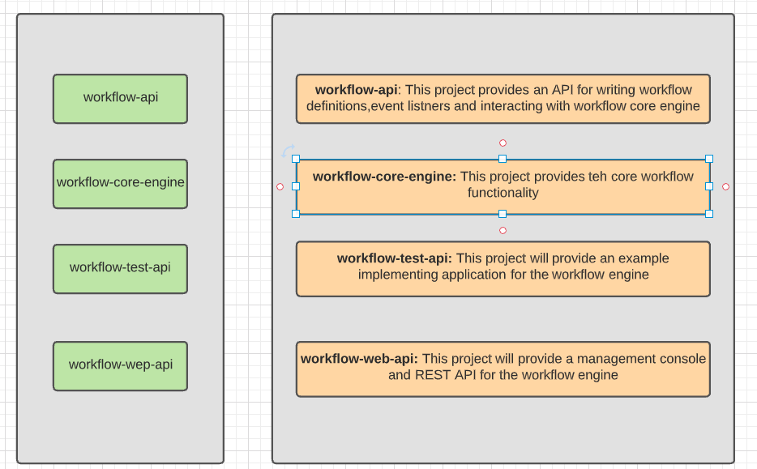
Project components

Slide 8
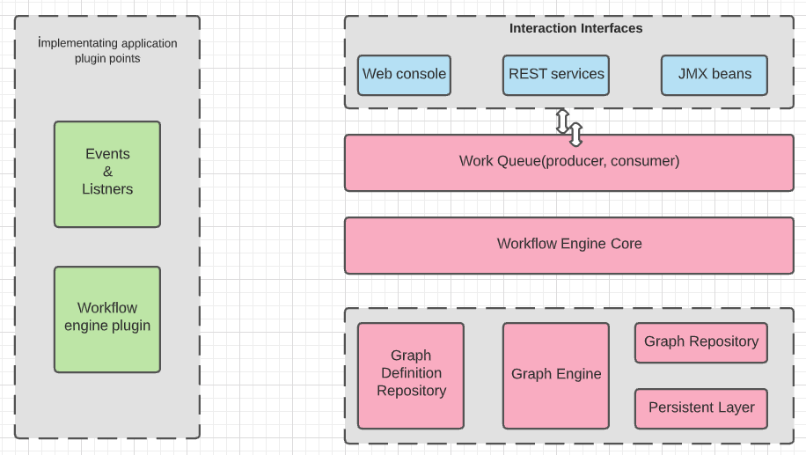
Component diagram

Slide 9
Deployment view
The workflow engine itself is an empty framework and only has value together with workflow definitions and plugins to outer world (business logic services, event listeners, etc.).
The workflow engine itself can not be deployed and started separately.
The workflow engine build a JAR artifact and must be deployed inside the “implementing application” s “WAR” file
A minimal "implementing application" (such as the workflow-test-api module) would need to define one WorkflowDefinition and a web.xml and must build a WAR file which includes the workflow engine JAR artifacts.
The resulting WAR archive can then be deployed into an Apache Tomcat 8.0.x web server (just a standalone server is fine for a minimal deployment).
The workflow engine also requires a PostgreSQL database connection where it can persist its state. That's it, now when the Tomcat is started, the engine spools up and waits for your command to create a workflow instance based on the deployed WorfklowDefinition
.

Slide 10
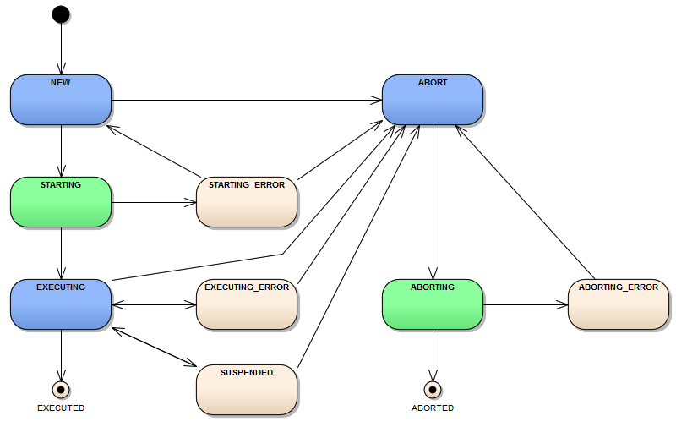
State diagrams
Green Status : are intermediate statuses and are only persisted to the database as long as it takes to start or abort the workflow .
Blue Status : are the states the poller is looking for.

Slide 11
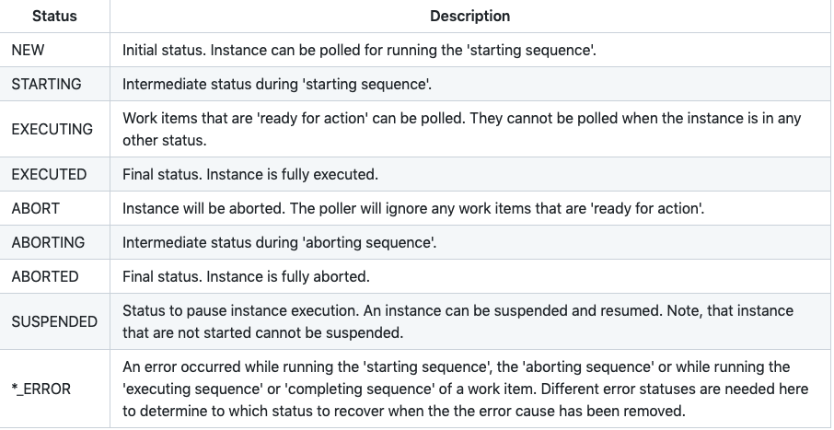
State diagrams

Slide 12
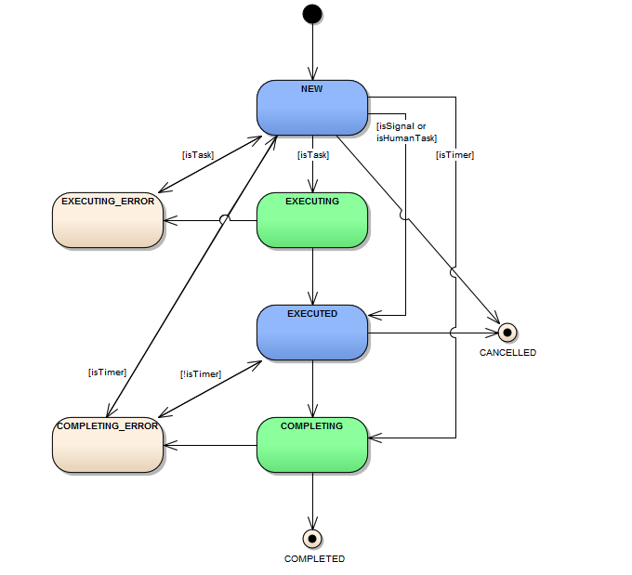
Workitem statuses
Green Status : are intermediate statuses and are only persisted to the database as long as it takes to start or abort the workflow .
Blue Status : are the states the poller is looking for.

Slide 13
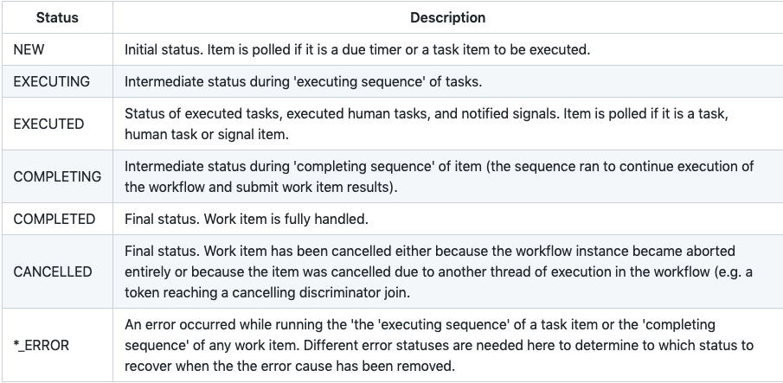
Workitem statuses

Slide 14
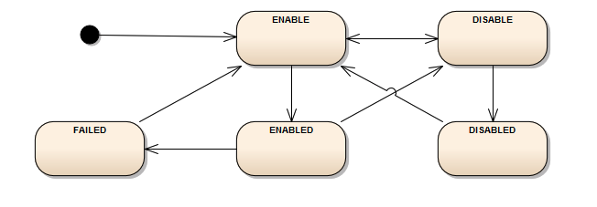
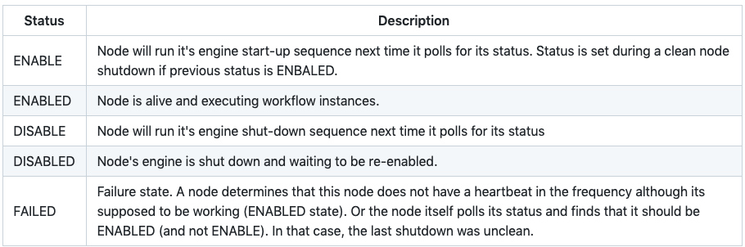
Node statuses

Slide 15
workflow core engine
Software Engineering Projects

