Slide 1
RULE MANAGEMENT SYSTEM
CS-5279-50
Rupak Mohanty

Slide 2
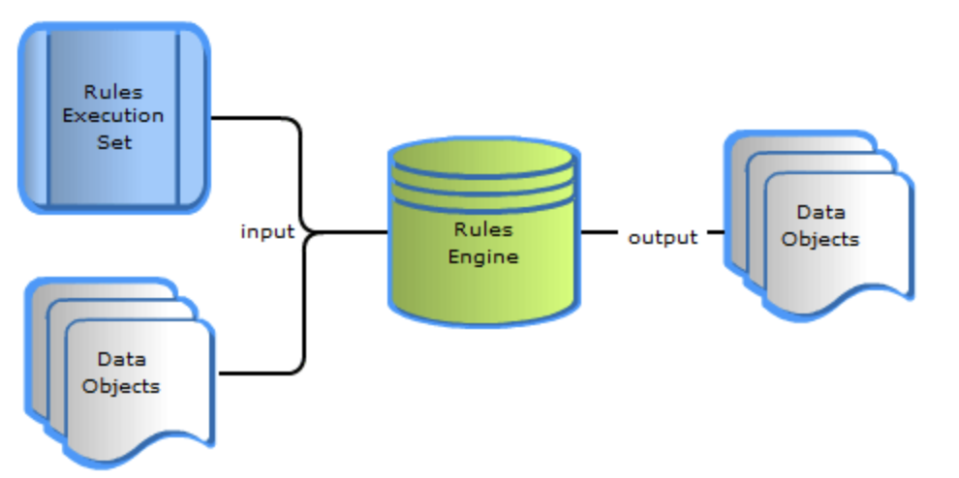
What is a Rule Engine ?
“A rule engine is a piece of software that executes rules according to some algorithm. A rule engine combines a set of facts that are inserted into the system with its own Rule Set to reach a conclusion of triggering one or several actions.”

Slide 3
Why another Rule Engine ?
Open-source rules engines are memory hungry. It provided performances in terms of memory.
Supports for static rule but limited supports for dynamic rule.
Meant for tech savvy audience and limited support for business product owner’s who define rule to test .
Various Symantec’s and learning curve
Heavy lifetime costs (license fees, Vendor specific technologies which is difficult to be updated)

Slide 4
Features (MVP)
Estimated half a million dollar save of licensing cost
Support for Product Owners/ Business Analyst to define execute and test rules without learning tech symantics
Support for dynamic rule binding
Although vastly designed for trade platform flexible enough to support any domain specific rule

Slide 5
Technology Stack
Java 8
Spring Boot Release 2.0.5
Spring Web MVC 5.2.1
MVEL 2.4
Spring Data JPA
Expression Language 3.0
Apache Commons
Slf4j, Logback
JUnit, Mockito, Spring test
Gradle, Git
PostgreSQL 9.4 (managed with Liquibase scripts, easy to support other DB engines)
Apache Tomcat 8.0.x web server
Atlassian JIRA
AWS RDS/EC2/ELB

Slide 6
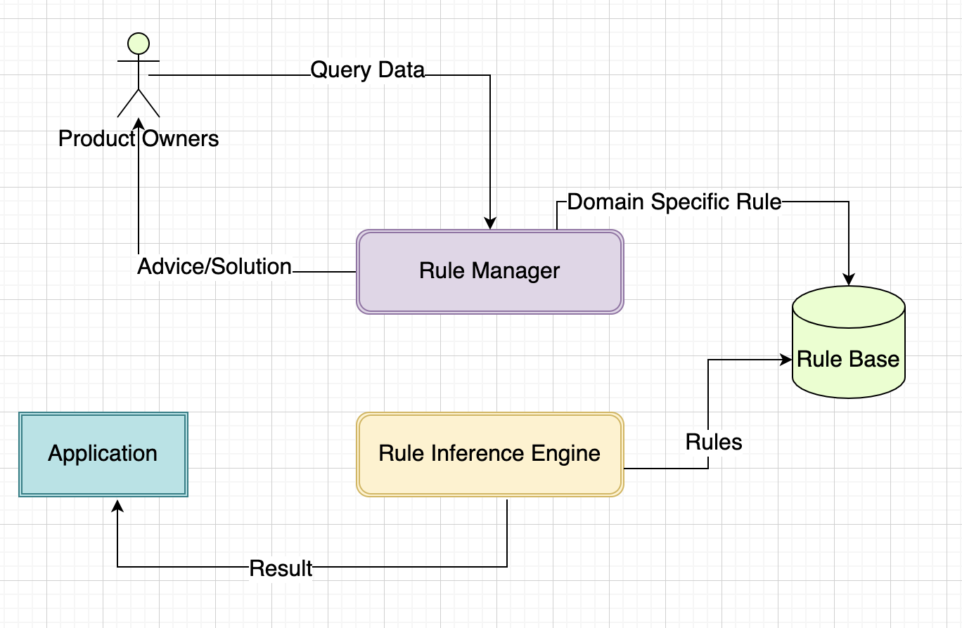
System Interaction Diagram

Slide 7
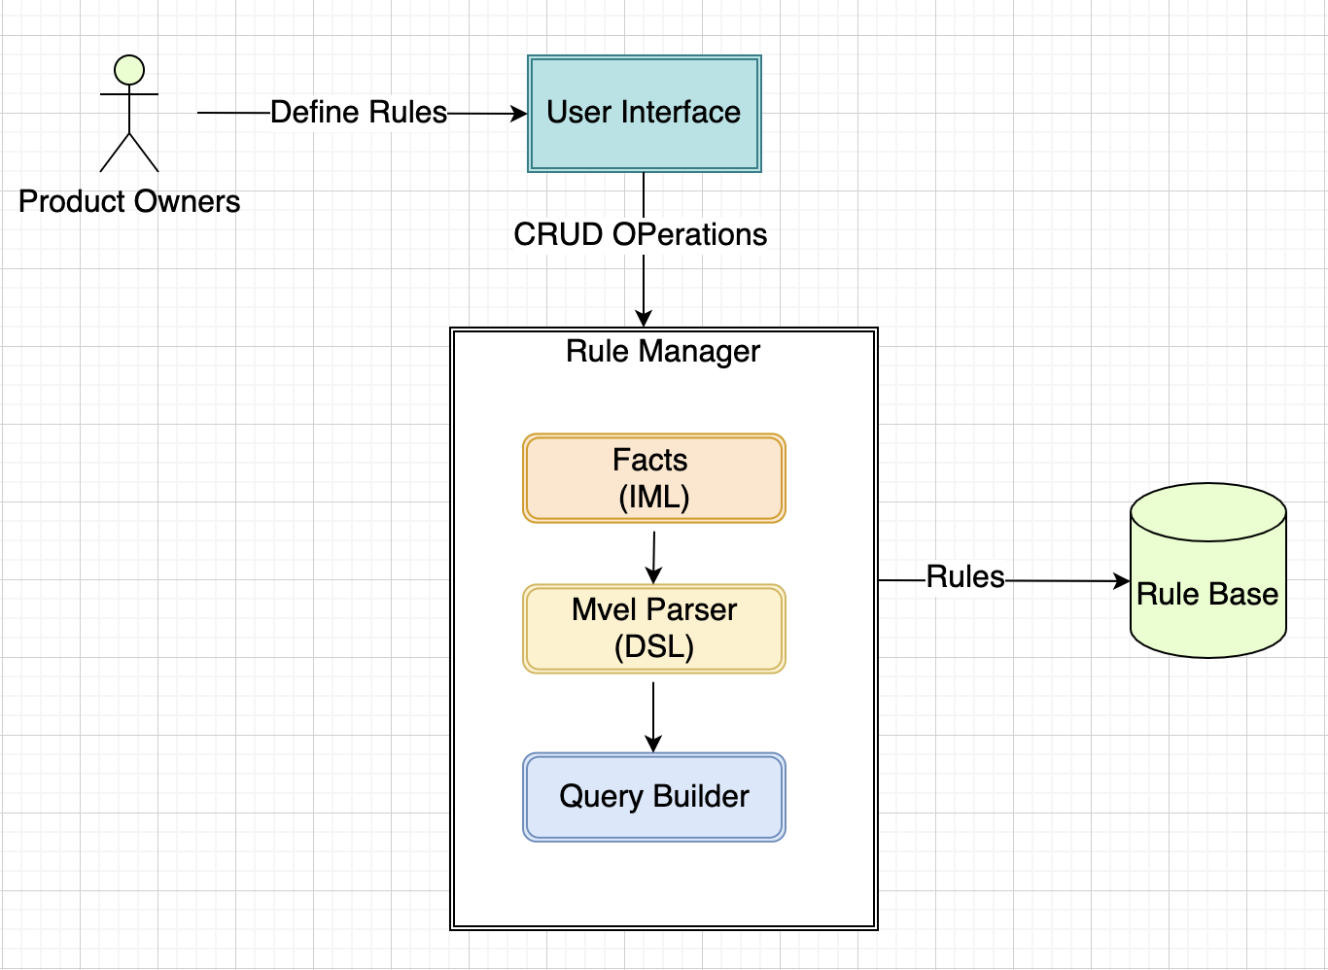
Rule Manager

Slide 8
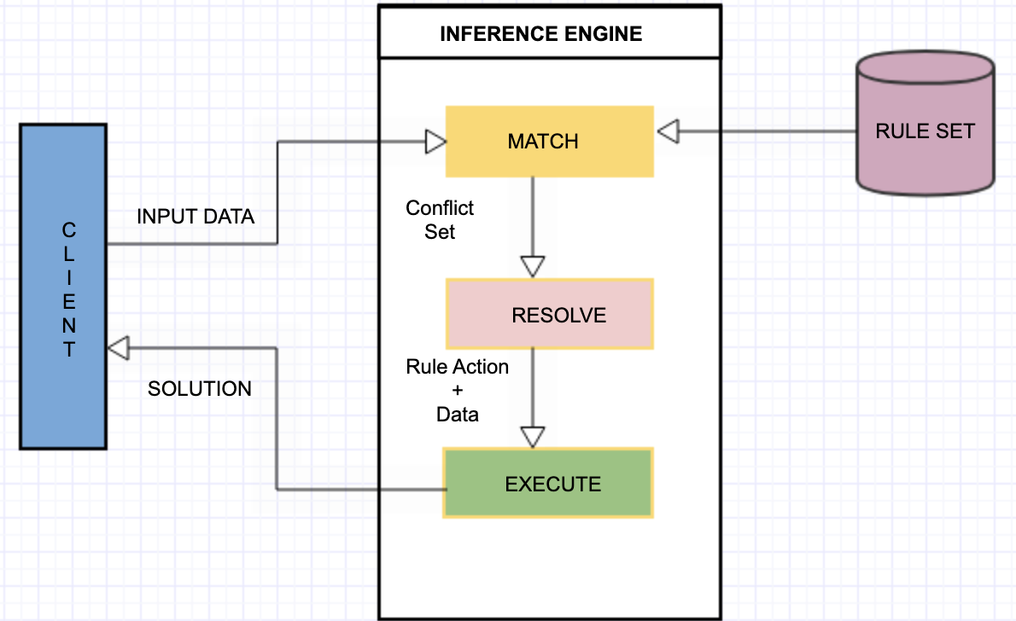
Rule Inference Engine
Phase 1 — Match: In this phase, the inference engine matches the facts and data against the set of rules. This process called pattern matching.
Phase 2 — Resolve: In this phase, the inference engine manages the order of conflicting rules. It resolves the conflict and gives the selected one rules.
Phase 3 — Execute: In this phase, the inference engine simply runs the action of the selected rule on given data and return the output/result to the client.

Slide 9
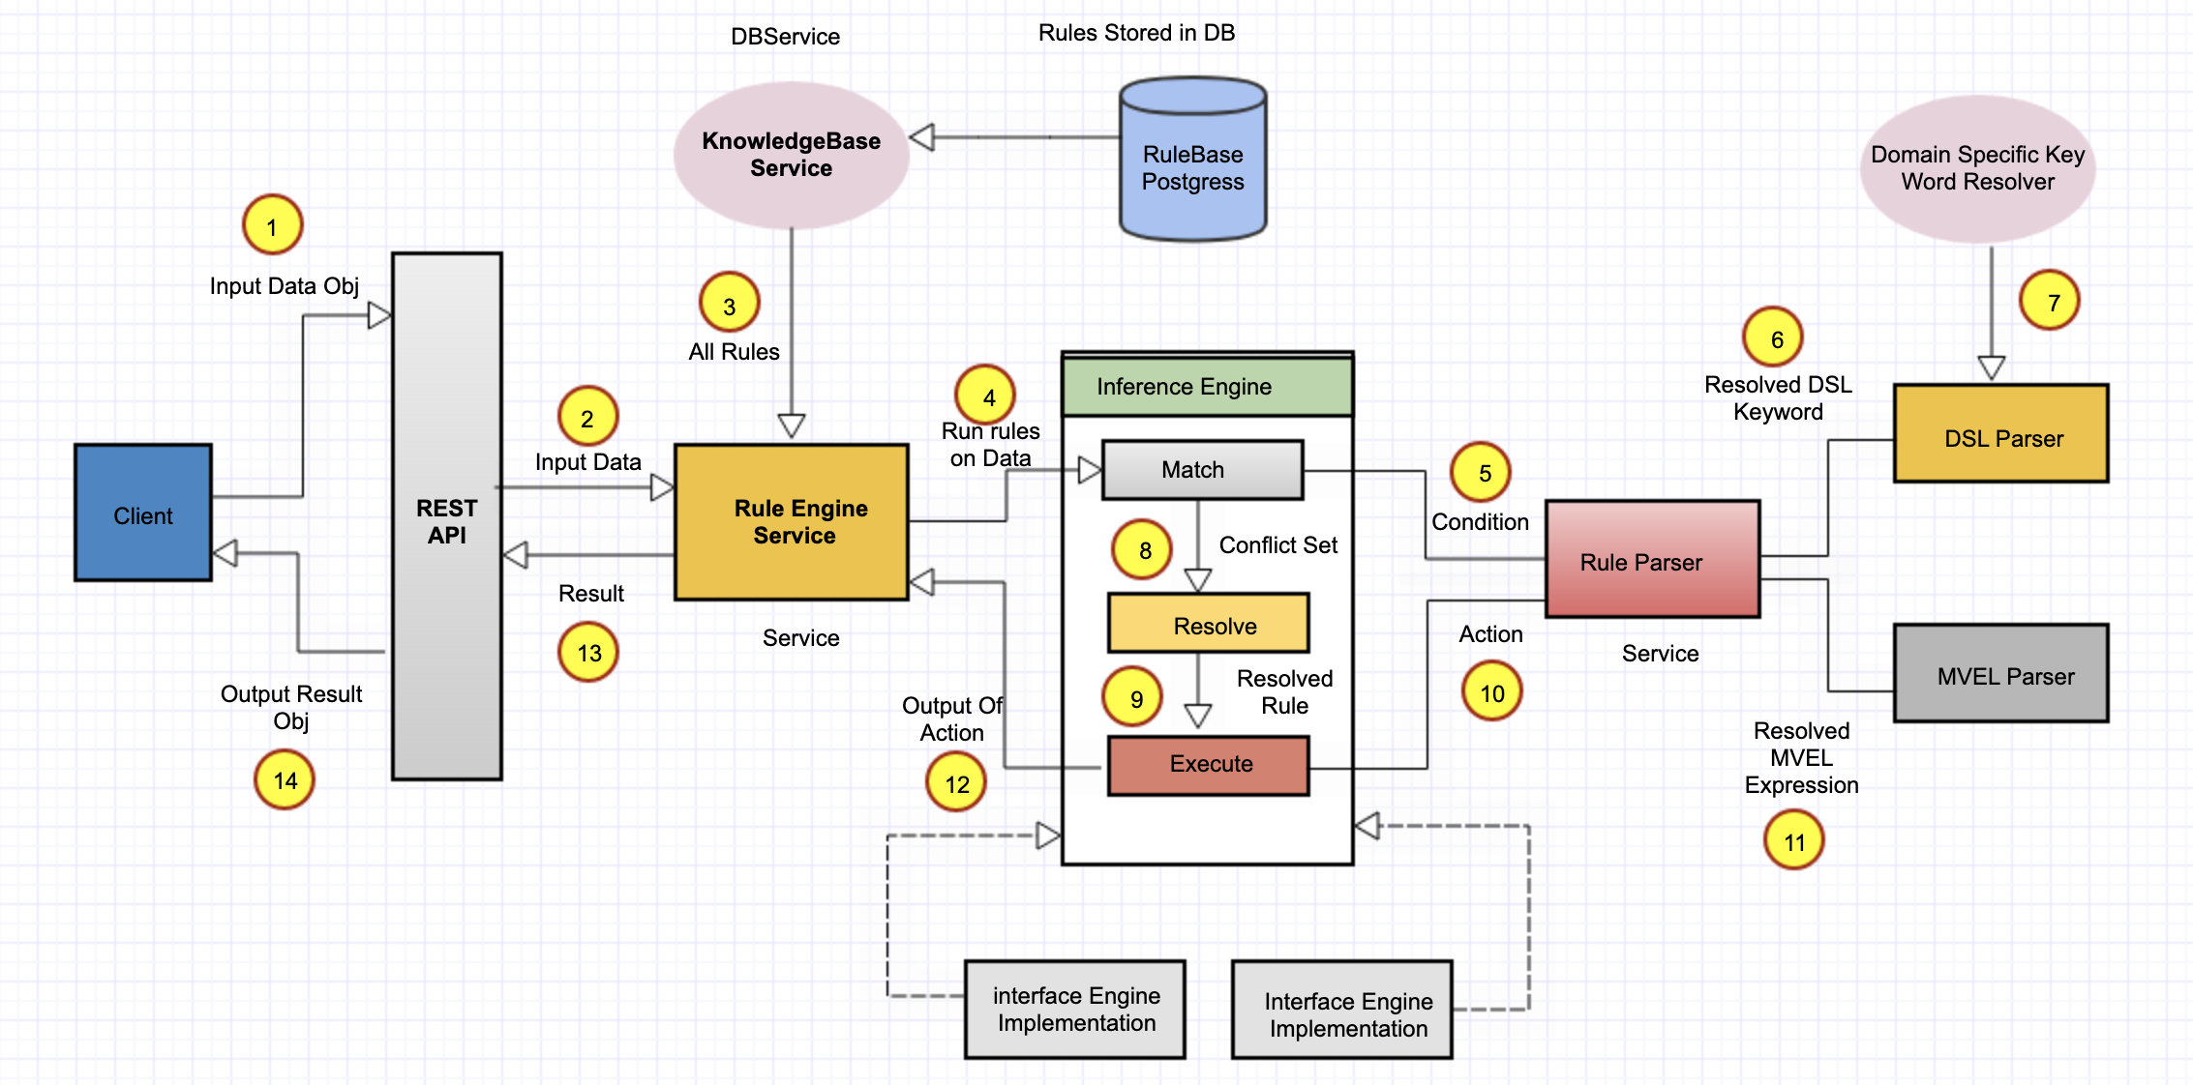
System Interaction

Slide 10
Interaction Description
Rule-engine implemented as a REST API PI with SpringBoot and Maven framework.
Rules are written using expression language (MVEL) and some domain-specific keywords.
Rules are stored in the Postgress database
We implement an abstract Inference Engine, which use to implement the different domain-specific Inference Engine. For example, we can write both the Loan and Insurance related rules engine in one application.
Keyword resolver implemented to resolve all domain-specific keywords.
Two parsers has been implemented .One for parsing MVEL expression and one for DSL.
The testing to be done by postman for API test.

Slide 11
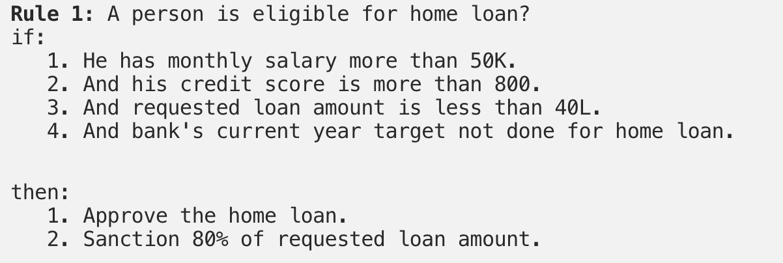
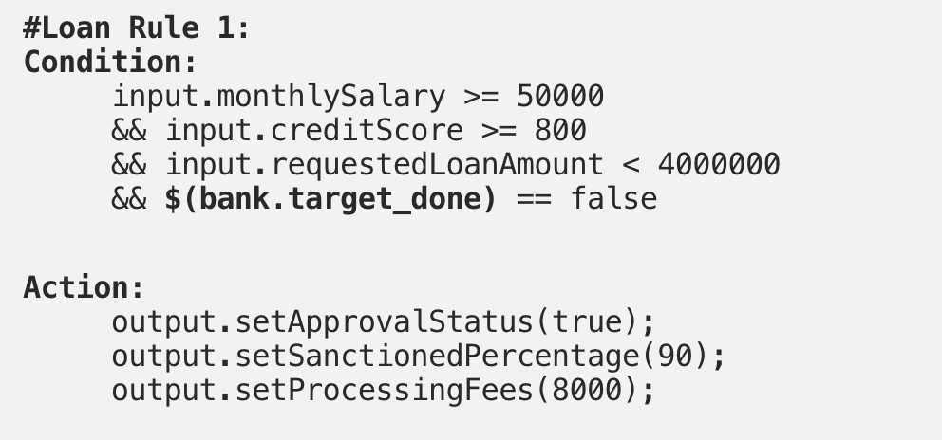
Sample Rule Language
The rule is a set of the condition followed by the set of actions. The rules are mainly represented in the if-then form.
In this implementation, for writing the rules, we use the MVEL expression language + Domain Specific Language.
Rule’s Language = MVEL + DSL

Slide 12
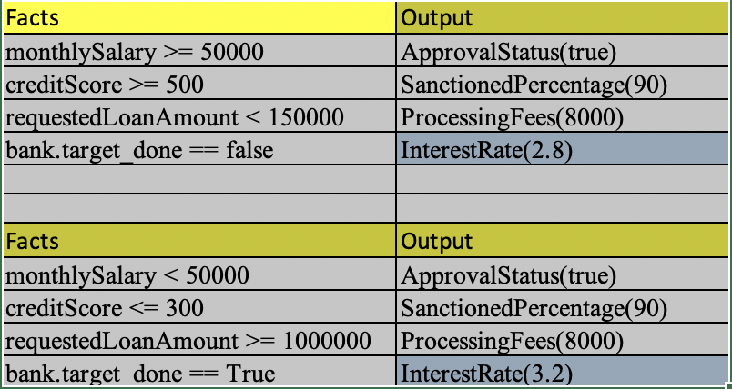
Sample Rule Language

Slide 13
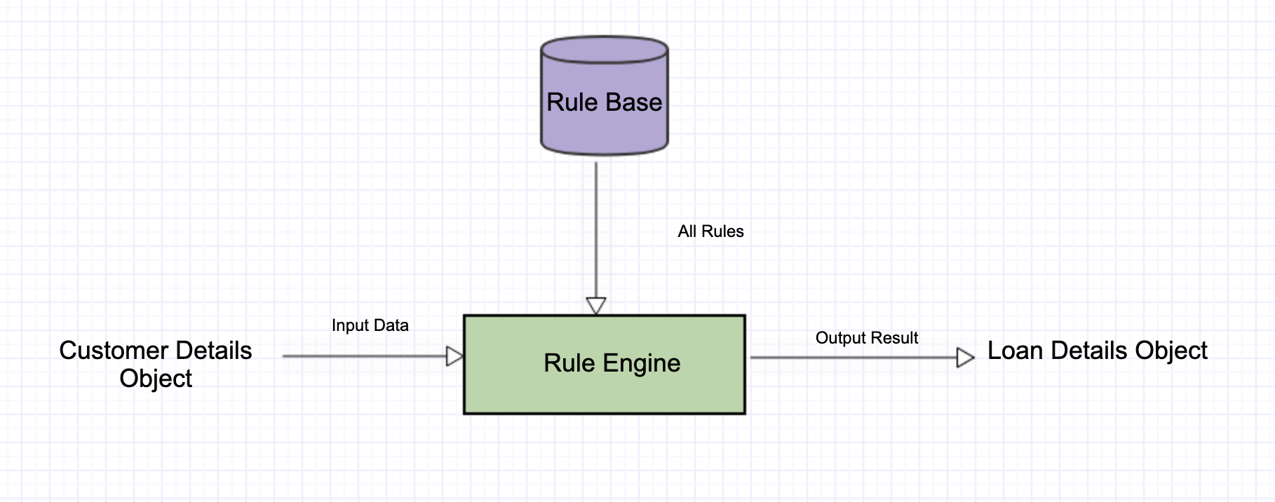
DEMO

