Slide 1
Intel® oneAPI Analysis Tools
Cory Levels – Technical Consulting Engineer
Rupak Roy– Technical Consulting Engineer

Slide 2
Agenda
1
Intel® Advisor Overview
GPU Roofline Analysis, GPU Offload Modeling
2
VTune™ Profiler Overview
Work Scheduling Balancing, Data Transfer, GPU Occupancy
3
Lab
Run your own Advisor and VTune Analysis

Slide 3
Intel® Advisor
Notes:
Add offload advisor result
Add new roofline result

Slide 4
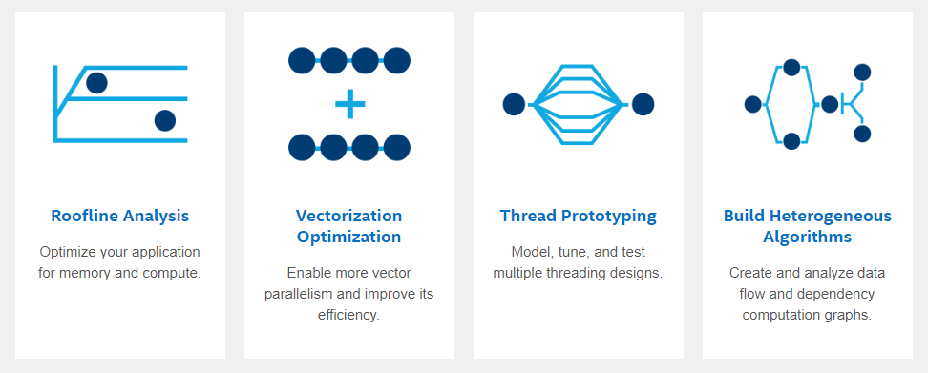

Intel® Advisor
Offload Advisor
Automated Roofline Analysis
Design your code for efficient GPU offload, even before you have the hardware
See performance headroom against hardware limitations. Get insights for an effective optimization roadmap.
Model, tune and test multiple threading designs
Create and analyze data flow and dependency computation graphs
Enable more vector parallelism and improve its efficiency
Learn More: software.intel.com/advisor
Notes:
Intel Advisor Key Features (SLIDE 6)
Intel Advisor is a design and analysis tool that is capable of doing a lot of different things for your applications. What we have on this slide is a high level outline of the key features we will talk about that fall underneath that Advisor umbrella.
Offload Advisor
Identify the portions of a code that would be profitable to offload to GPU, and can even predict the code’s performance if you were to run on a GPU, and allows you to experiment with accelerator configuration parameters.
Roofline Analysis
Ultimately the roofline analysis offers a very efficient way to characterize your kernels and visualize how far you are from ideal performance.
Vectorization Optimization
tells you which places of your code are vectorized or not, how efficiently they are vectorized, and for the regions that were not vectorized it will tell you exactly why the compiler was unable to vectorize.
Thread Prototyping
Is able to analyze which pieces should be threraded and can predict performance
Building Heterogenous Algorithms- Flow Graph Analyzer
Allows you to visualize data flow graphs, and can create depency graphs.

Slide 5
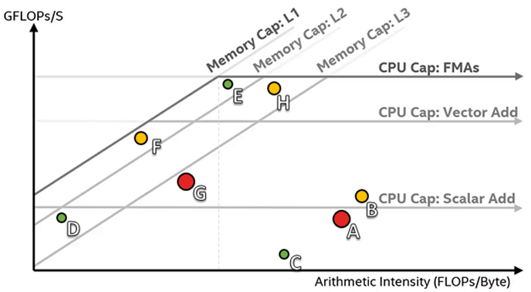
Identifying Good Optimization Candidates
Focus optimization effort where it makes the most difference
Large, red loops have the most impact
Loops far from the upper roofs have more room to improve
Additional roofs can be plotted for specific computation types or cache levels
Notes:
A Roofline Chart is a method of visually overlaying actual application performance onto representations of hardware limitations.
The chart can be used to identify not only where bottlenecks exist, but what’s likely causing them, and which ones will provide the most speedup if optimized.
So this is charting the applications achieved performance and arithmetic intensity against the systems maximum achievable performance.
X-axis is the arithmetic intensity
Y-axis is the Performance
Diagonal lines represent the memory bandwidth limitations that are preventing loops and functions from achieving better performance.
Memory speed ( how fast can you pull data from cache into processor registers)
Lower level caches are faster
the difference here is with each memory roofline you are doing more calculations on one set of data or fit everything into that cache.
Horizontal Lines indicate the compute capacity limitations
speed of instructions/ calculations per second
vector add is doing more than scalar add and FMA is doing more than Vector
A dot cannot exceed the topmost roofline as this represents the maximum capabilities of the machine.
The greater the distance between a dot and the highest achievable roofline, the more opportunity there is for improving performance.
we also want to note that the sizes of the plotted loops and functions correspond with their levels of impact. So the large red dots are going to be where Advisor is saying “Hey- this is where you want to spend your time, this is where you will get the most return with your optimization efforts” Yellow dots may be useful to optimize, green dots are considered to have very little impact.
What is your primary bottleneck?
-Roofline you are closest to is your primary bottleneck

Slide 6
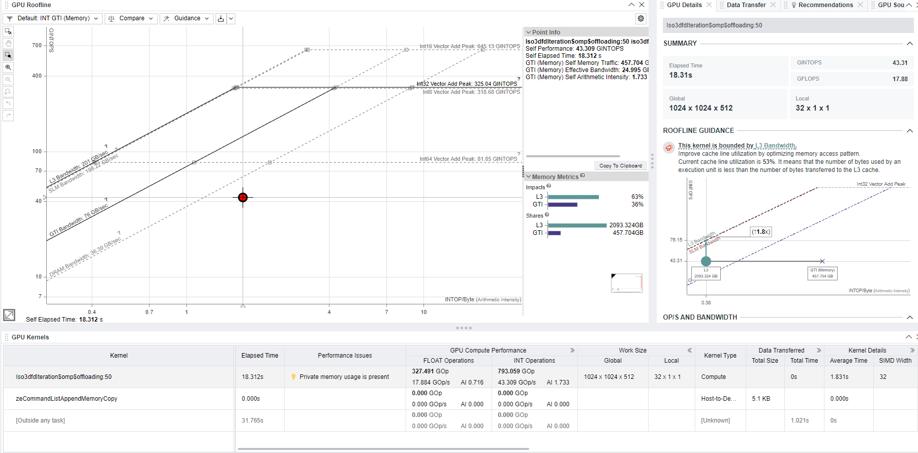
GPU Roofline Chart Intel® Advisor
View GPU Details, Data Transfer, GPU Source ans Assembly info
Customizable GPU Roofline Chart
View Details, GPU Source, and GPU Assembly info
GPU performance of compute tasks
Notes:
GPU ROOFLINE
this is charting the applications achieved performance and arithmetic intensity against what advisor determined as the maximum achievable performance.
X-axis is the arithmetic intensity
Y-axis is the Performance
Diagonal lines represent the memory bandwidth limitations that are preventing loops and functions from achieving better performance.
Horizontal Lines indicate the compute capacity limitations
GPU Details
Roofline Guidance
this roofline is built for that specific kernel.
Determine if specific kernel is memory or compute bound, and what specifically the kernel is bounded by based on the roofline model, and give you some hints.
Amount of data transferred for each cache memory level.
The exact roof that limits the kernel performance. The arrow points to what you should optimize the kernel for and shows the potential speedup after the optimization in the callout. If the arrow points to a diagonal line, the kernel is mostly memory bound. If the arrow points to a horizontal line, the kernel is mostly compute bound. Intel® Advisor displays a compute roof limiting the performance of your kernel based on the instruction mix used.
double click the kernel in the big roofline to compare with the roofline guidance.
OP/S and Bandwidth
Review how well your kernel uses the compute and memory bandwidth of your hardware,
Memory Metrics
How much time the specified kernel spends processing requests for each memory level in relation to the total time.
Shares: how much data is passing through each memory level.
Instruction Mix
Reporting the instruction types that the specified kernel is executing.
Drop down shows details of the instruction count for each category.
Performance Characteristics
Review how effectively the kernel is using GPU resources
*Brief Description of chart tabs* GPU Kernels/Recs/GPU Source/GPU Assembly
GPU Kernels
A breakdown of the Kernels that are being executed on the GPU.

Slide 7
GPU Analysis Flow Intel® Advisor
Survey Analysis
#1 app run
GPU Kernels list, timings
MDAPI collection (hardware counters)
GPU Roofline Perspective
Performance Metrics
Roofline
Kernel Details
Guidance
Recommendations
Characterization Analysis
#2 app run
Measure GPU hardware maximum capabilities
Binary instrumentation with GTPIN collection
Performance Modeling
No run
Analyze performance metrics
Notes:
How GPU analysis metrics and rooflines are determined.
3 different analysis being done, but the target application will be executed twice for the first two analysis being done.
#1 run (what is called a Survey Analysis): runs the target application to measure the hardware limitations of your machine and collect OpenCL™, OpenMP*, oneAPI Level Zero (Level Zero) and SYCL timings for Kernels.
#2 run (Characterization Analysis): Trip Counts and FLOP analysis to collect FLOP and integer operations data and memory traffic data.
#3 (Performance Modeling): New analysis that is included in roofline analysis. Uses the results of the previous analysis to model the current behavior and understand the bottlenecks. This will be used a lot to generate the user recommendations to optimize the execution on the GPU.
all these analysis will be used to put together one result. So for one kernel you will get result metrics from all 3 of these analysis

Slide 8
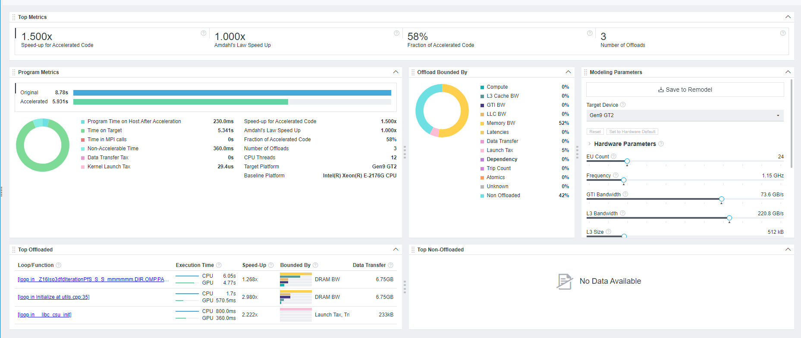
Offload Advisor Intel® Advisor
Offloading is Memory BW Bound
Run on CPU or GPU – Predict for GPU
Helps to define which section of the code should run on given accelerator
Provides performance projection on accelerators
Offloading is GTI BW Bound
Not Profitable for offloading
Not Profitable for offloading
Recommended for offloading
Notes:
Offload advisor is a tool for a couple of different scenarios- 1. if you have optimized for CPU and now you say “Okay, I have optimized for CPU- now I want to get the projected performance on a specific GPU. Or For code already running on a GPU, you can get an estimation of potential speedup from running it on a different target device before getting a hardware.
Because the idea with offload Advisor is that you are able to measures your applications performance and compare it with its modeled performance on a selected target GPU so that you can decide what parts of your application would be optimal to execute on the target device.
So for these results I am working with an iso3dfd sample that is running strictly on the CPU and I am wanting to see the projected performance for the target device I specified which is a gen11 GT2.
Top Metrics and Program Metrics​
-View the main performance metrics of your program, such as the projected speedup of the accelerated code (Read comment), the overall projected speedup of the application, the fraction of accelerated code and the number of identified loops or functions.
-The bar chart above visually compares the original execution time spent on a base platform (for example, on a CPU) with the estimated execution time on a target device.
So running offload advisor on our optimized CPU results, we can see that the original execution time is 750ms seconds, and if we were to offload that "iso3dfditeration" loop, we can expect a speed up of approximately 16.365x
The chart below breaks down the estimated time by specific task.
Offload Bounded By:
this section is really breaking down those specific factors that prevent your code from achieving a better performance if it were executed on a target device
So we cans see here our offloaded performance is going to be capped by how much memory L3 Cach BW there is
Top Offloaded:
We are going to focus on offloading this top loop here iso3dfditeration because it is taking up the majority of the execution time.

Slide 9
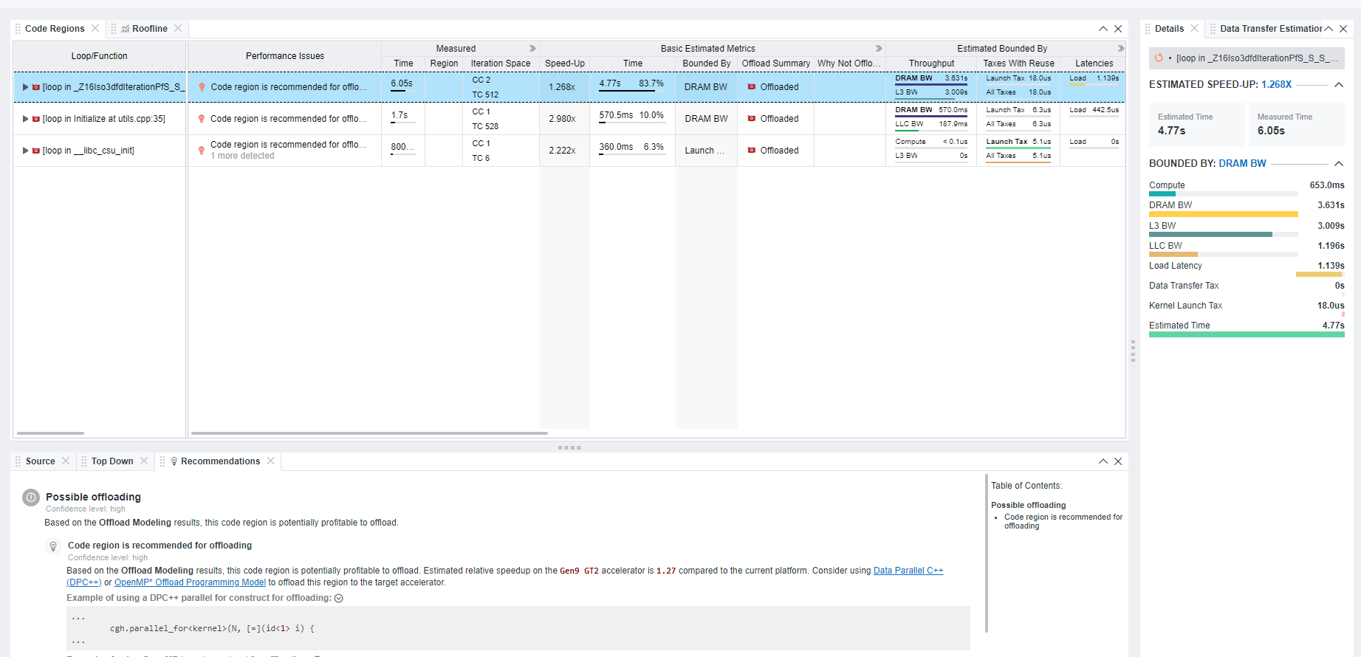
In-Depth Analysis of Top Offload Regions Intel® Advisor
Loop recommended for offloading
DRAM BW Bound
Estimated to run on GPU in 4.77s
Notes:
"accelerated regions” page, and here is where you are going to find a nice break down of the memory usage and data transfers for all of the loops and functions that offload advisor has identified as top candidates for offloading.
Because as you port your application to a discrete GPU, it is important to consider how much of your data will be transferred from your CPU to your GPU and also back to your CPU. This data transfer cost can often dictate whether GPU offload is worthwhile for your application. Offload Advisor gives the data transferred and uses this in addition to other metrics in determining whether you should offload based upon your GPUs characteristics.​
So in this table you are going to see things like a review of the amount of data that is read and written to that specified target platform if the code is offloaded, and how well you application is using resources from all the memory levels.

Slide 10
Intel® VTune™ Profiler

Slide 11
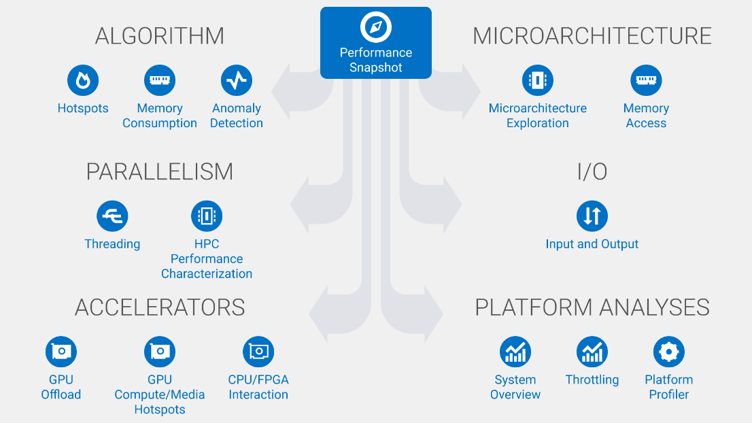
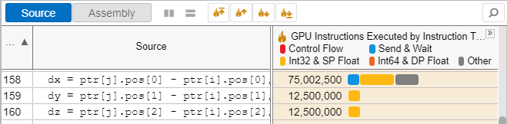
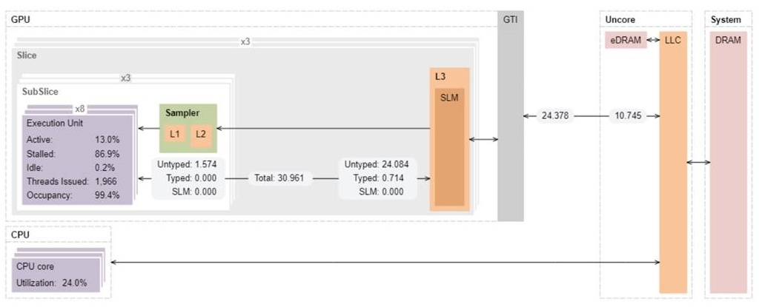
Optimize Performance Intel® VTune™ Profiler
Get the Right Data to Find Bottlenecks
A suite of profiling for CPU, GPU, FPGA, threading, memory, cache, storage, offload, power…
Application or system-wide analysis
DPC++, C, C++, Fortran, Python*, Go*, Java*, or a mix
Linux, Windows, FreeBSD, Android, Yocto and more
Containers and VMs
Analyze Data Faster
Collect data HW/SW sampling and tracing w/o re-compilation
See results on your source, in architecture diagrams, as a histogram, on a timeline…
Filter and organize data to find answers
Work Your Way
User interface or command line
Profile locally and remotely
GUI (desktop or web) or command line

Slide 12
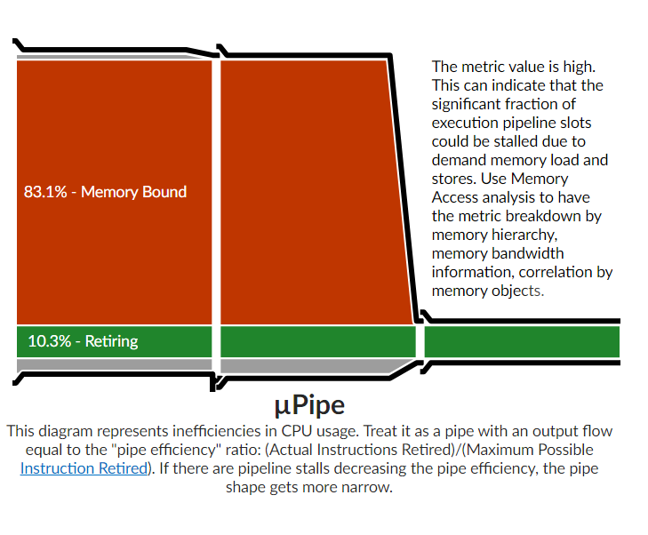
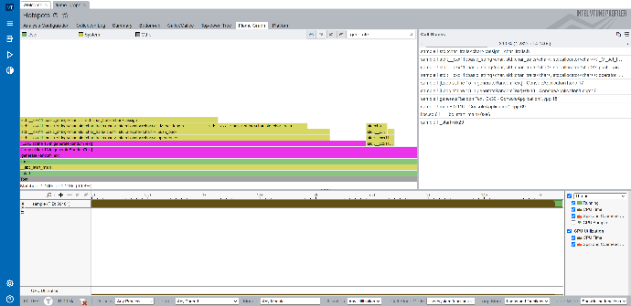
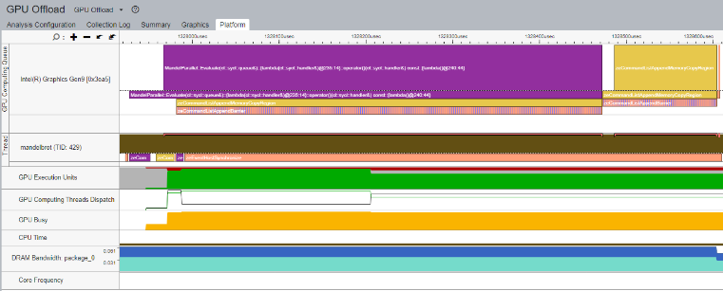
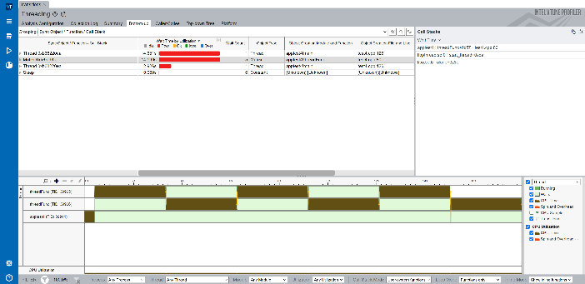
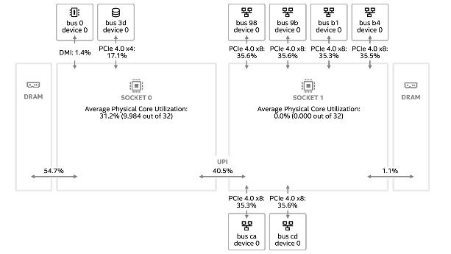
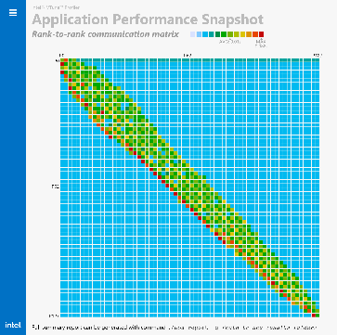
Rich Set of Profiling Capabilities Intel® VTune™ Profiler
Algorithm Optimization
Hotspots Anomaly Detection Memory Consumption
Microarch.&Memory Bottlenecks
Microarchitecture Exploration Memory Access
Accelerators / xPU
GPU Offload GPU Compute / Media Hotspots CPU/FPGA Interaction
Parallelism
Threading HPC Performance Characterization
Platform & I/O
Input and Output System Overview Platform Profiler
Multi-Node
Application Performance Snapshot

Slide 13
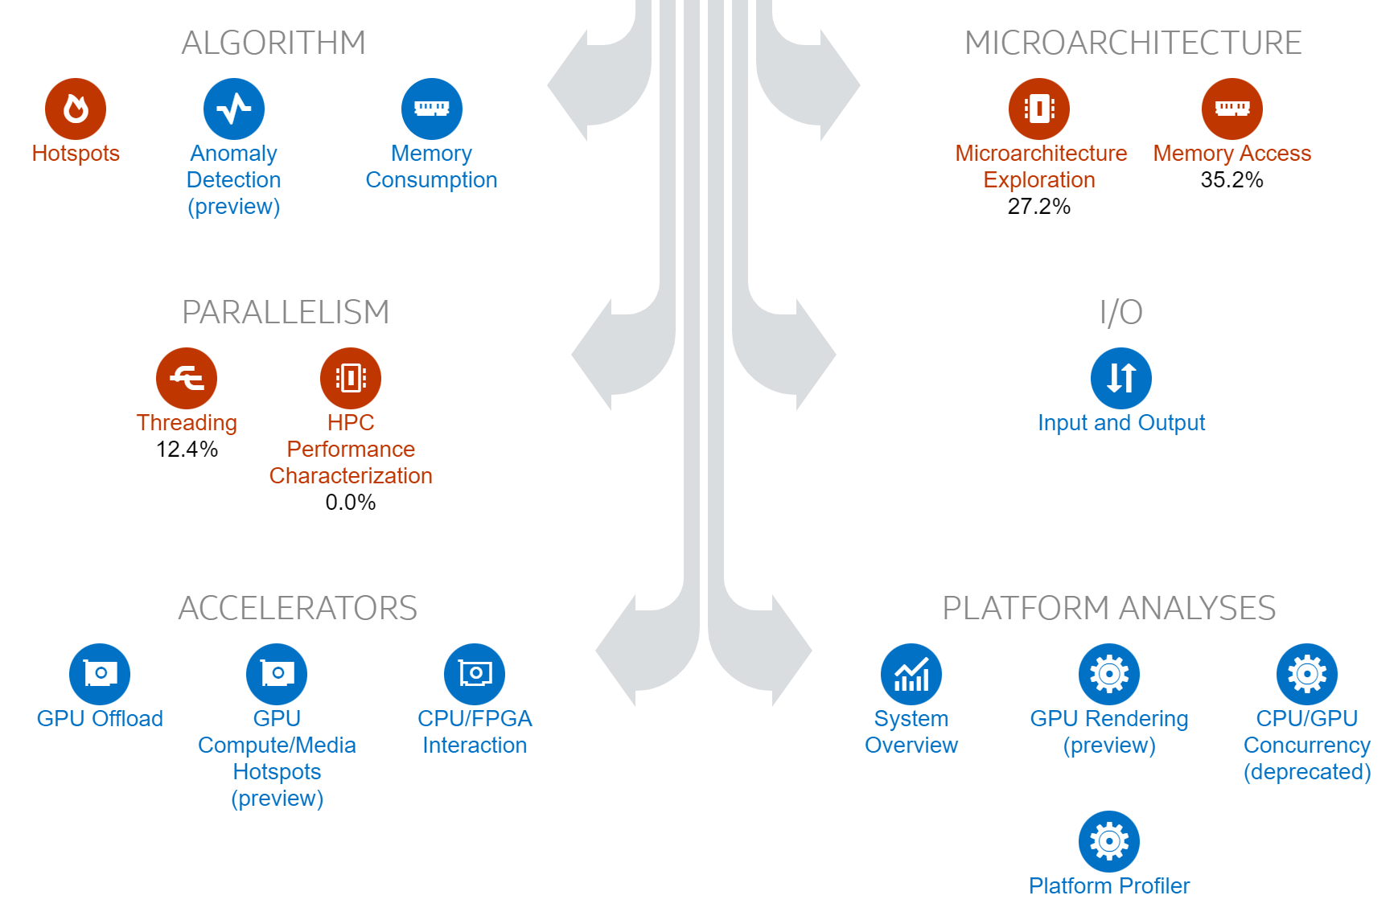
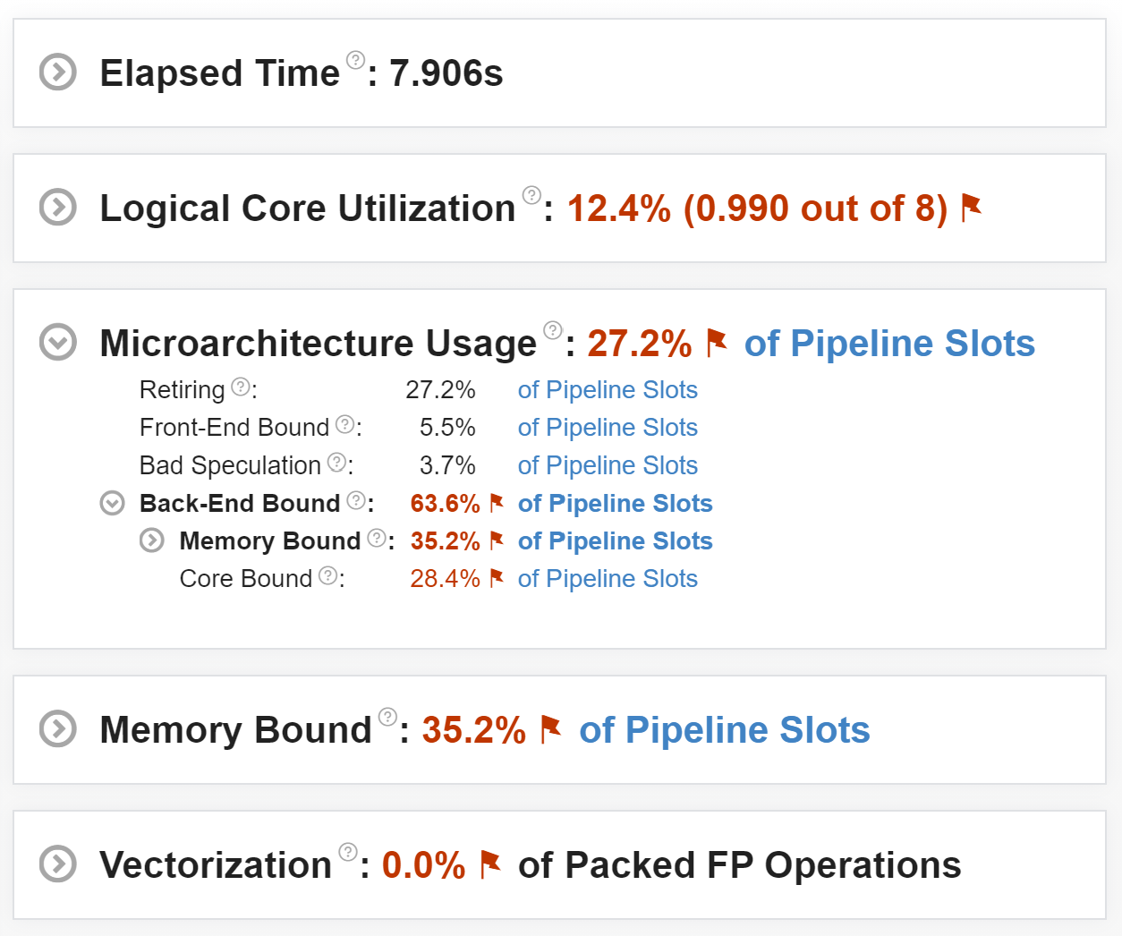
Quickly Identify Untapped Performance Intel® VTune™ Profiler - Performance Snapshot Analysis
Choose your next analysis:
Characterize high-level aspects:

Slide 14
Recommended Workflow

Slide 15
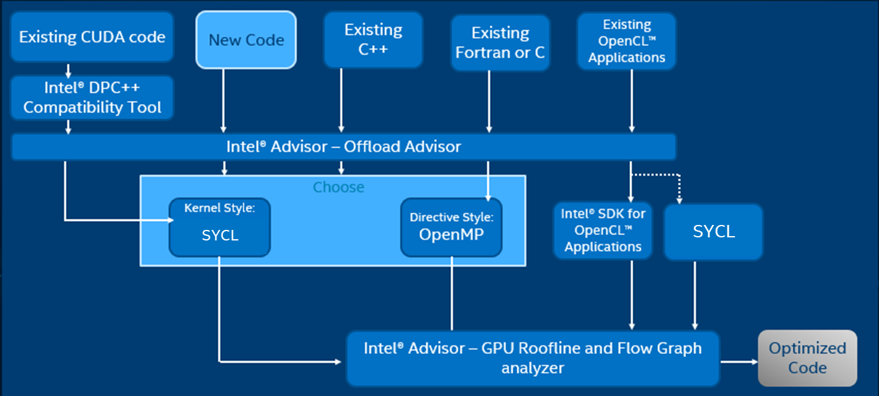
Using Intel® Analyzers to increase performance
Use Offload Advisor to find kernels to offload
Optimize your kernels
With Advisor and VTune

