Slide 1
MACHINE LEARNING WITH PYTHON
Name : KOTRA RUPAK SRINIVAS
Regd.no : Y23ACS485
Department : COMPUTER SCIENCE & ENGINEERING
Section : ‘B’

Slide 2
Table of Contents :
Abstract
Existing System
Proposed System
Flowchart
Code
Screenshots
References

Slide 3
Titanic-Survival Predictions
Abstract :
Introduction to Machine Learning , Definitions, Importance & Applications of Machine Learning.
Types of Machine Learning
Supervised, Unsupervised and Reinforcement Learning. These Three types of Learning Method help in Training A Machine.
Supervised Machine Learning has two types Regression and Classification and its Algorithms are of Two types.

Slide 4
Finally My Project in Internship Training is on the Topic “Titanic-Survival Prediction.”
This Titanic-Ship Prediction Project is based on Calculating the Survival of Each Passenger in the Titanic Ship and their Survival Outcome. In this outcome according to the Pivot Table ,females in first class had a survival rate of 96.8% meaning that majority of them Survived. Males of Third class had the lowest Survival rate about 13.54% meaning the majority of them did not Survive.
Overall I can Conclude that in My Project i.e. Titanic-Survival Prediction Undergoes Logistic Regression model.

Slide 5
Existing System :
My Project Topic : Titanic-Survival Prediction is many operated by using the algorithm in Supervised Machine Learning i.e; Classification.
In that Classification Algorithm we used “LOGISTIC REGRESSION” Model for predicting the Survived or not survived data of the passengers travelled in the Ship.
Alternative ways to Titanic Survival Prediction are:
Tree Based Methods(Random Forest Method)
Neural Networks
Support Vector Machines
Because we want survival people value that means probability ratio . So among all the other algorithms for binary classifications we use logistic regression . So I and our team we prefer logistic regression.
The reason for using Logistic Regression is that this Regression model is used for predicting the Categorical Dependent variables of given Independent variables.
That means it gives an output of either 0 or 1 / Yes or No. Here in this project the outcome comes as either the passenger is predicted to be survived or not to be survived.

Slide 6
Proposed System :
In our Project we used Classification Algorithm in Supervised Machine Learning because in this algorithm the Target will represent whether a particular data has defaulted (normally represented by 1 or 0/ True or False / Yes or No)
Logistic Regression is a popular algorithm in machine learning for binary classifications tasks.
By fitting a logistic function to the training data, logistic regression estimates the relationship between the inputs and particular outcomes

Slide 7
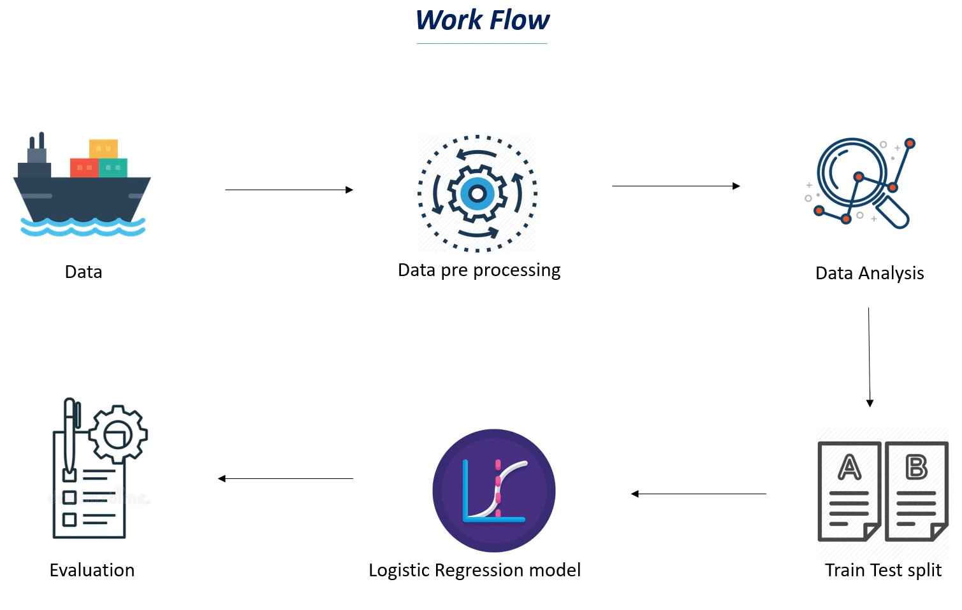
Flow Chart :
This is the Flow chart on the Project ‘Titanic-Survival Prediction’.

Slide 8
Project Code :
Titanic-Survival Prediction is a project based on “LOGISTIC REGRESSION” model i.e; It is used for Predicting Categorical Dependent Variables using a Given set of Independent Variables.
Titanic-Ship Predictions will predict the values of the Passengers Travelled in the Ship are Predicted to be Survived Or Not Survived.
We have to gather the Dataset of Titanic Prediction from “KAGGLE” to Import the data before executing the Code.

Slide 9
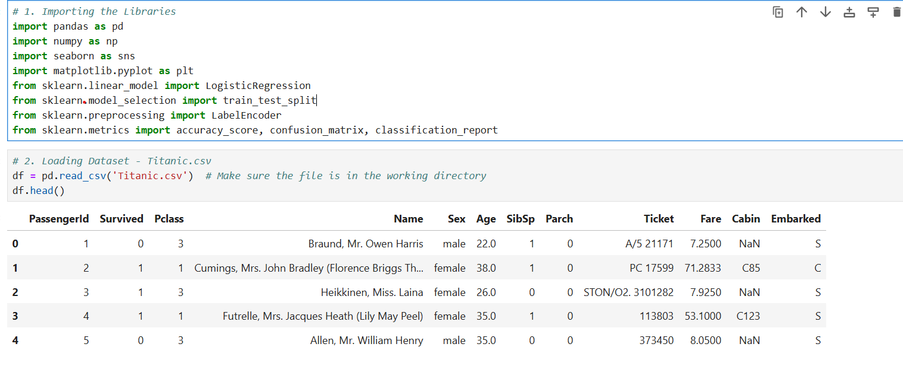

Slide 10
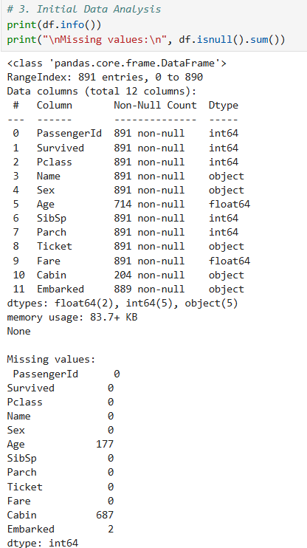
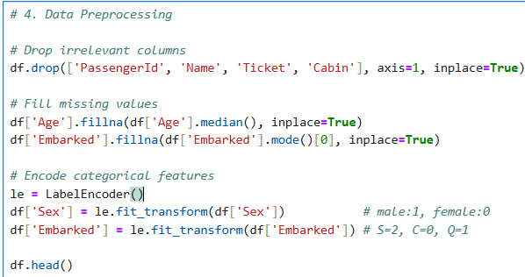
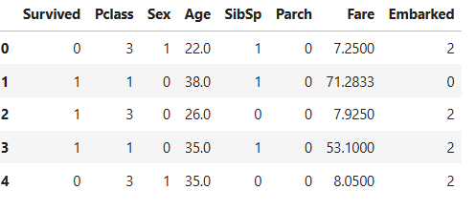

Slide 11
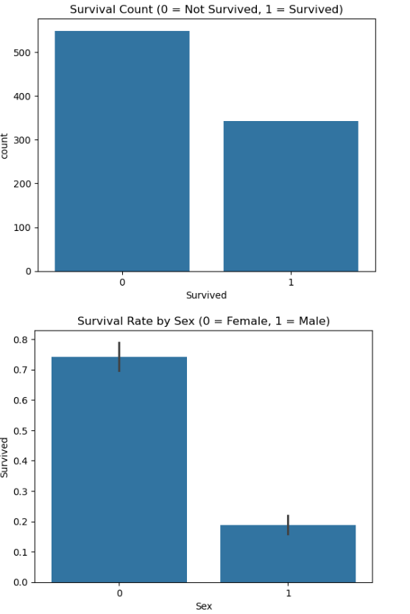
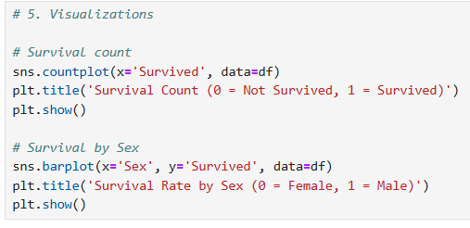

Slide 12
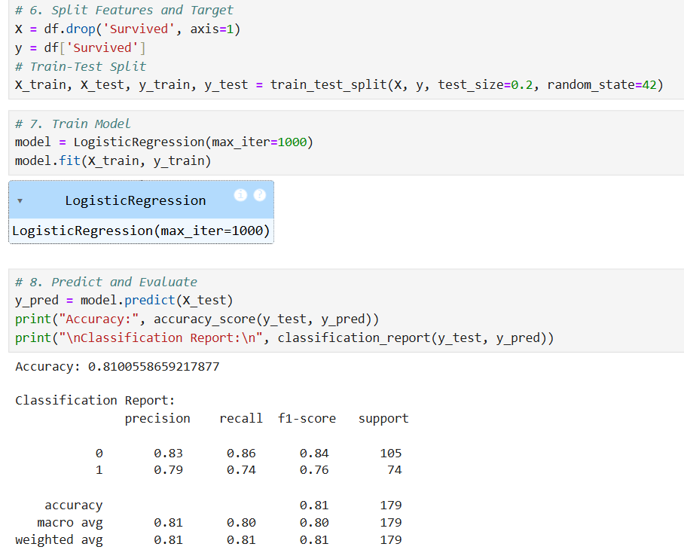

Slide 13
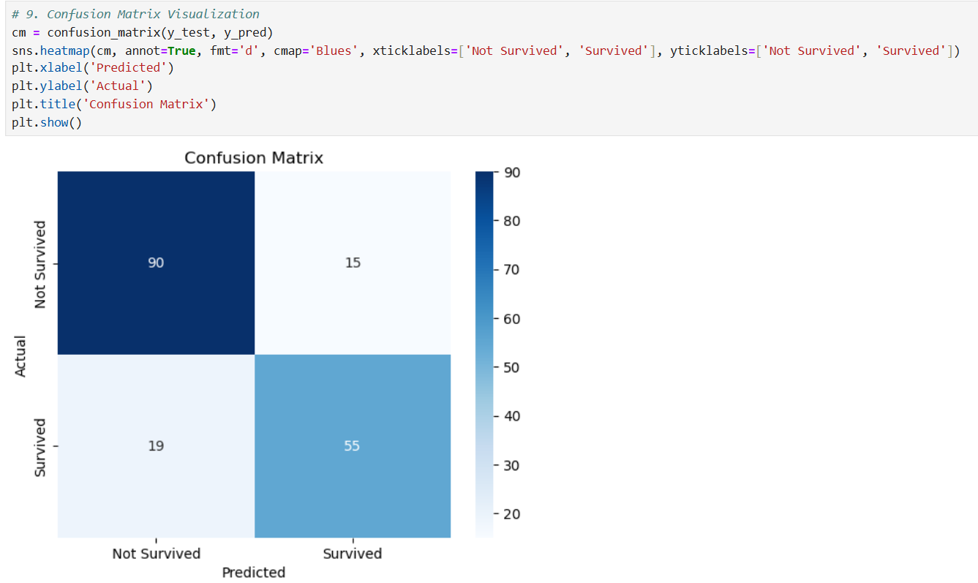

Slide 14
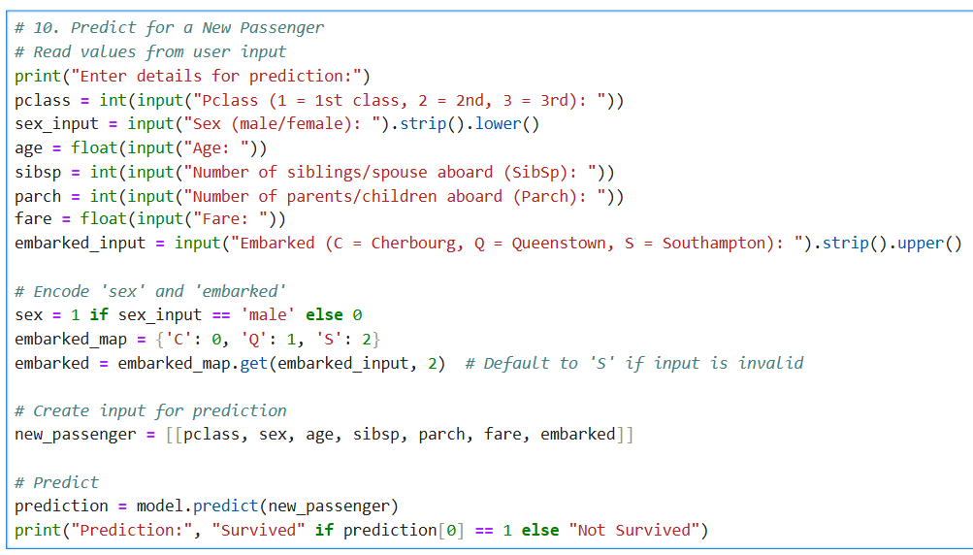

Slide 15
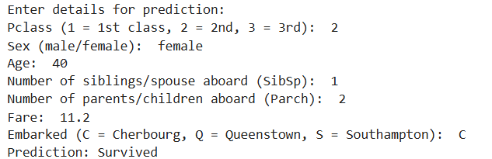
OUTPUT:
→ Based on the given Input Data the Passenger is Predicted to be SURVIVED.

Slide 16
References :
→ Consulting my mentor and lecturers
→ https://www.kaggle.com/code/nadintamer/titanic-survival-predictions-beginner
→ I use the above website for the reference to clarify my doubts

Slide 17
THANK
YOU

