Slide 1
Project: Aegis – Real-time Transaction Fraud Detection
8.1 Batch – Group 4
Team Member:
Rupali Chavan
Sadiq Ali

Slide 2
Problem Statement
Develop a system to detect and block fraudulent financial transactions in real-time, overcoming delays and limitations of traditional batch-based detection methods.

Slide 3
Use Case
A user makes a high-value transaction in another country soon after a local purchase. The system evaluates the live stream of transactions, scores the new one as 99% fraudulent, blocks it instantly, and alerts the user in real-time.

Slide 4
Key Modules
  Data Stream Ingestion (Kafka / AWS Kinesis)
  Real-time Feature Engineering
  Anomaly Detection Models (Isolation Forest, Autoencoder)
  Model Deployment API (FastAPI/Flask)
  Online Learning / Model Retraining Pipeline
  Live Alerting & Visualization Dashboard

Slide 5
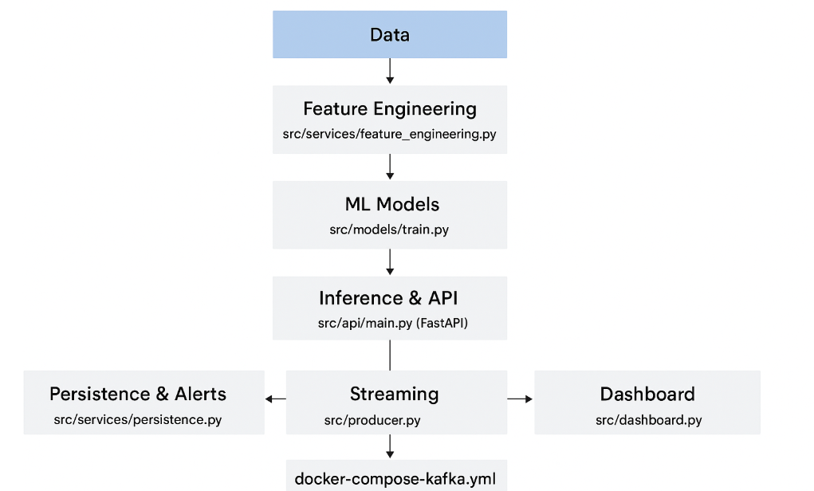
System Architecture

Slide 6
Project Flow
Kafka Producer -> Generates live transactions
Kafka Topic
Kafka Consumer -> Reads real-time stream
Historical CSV Generator -> Training data
ML Pipeline -> Feature engineering + fraud mode

