Slide 1

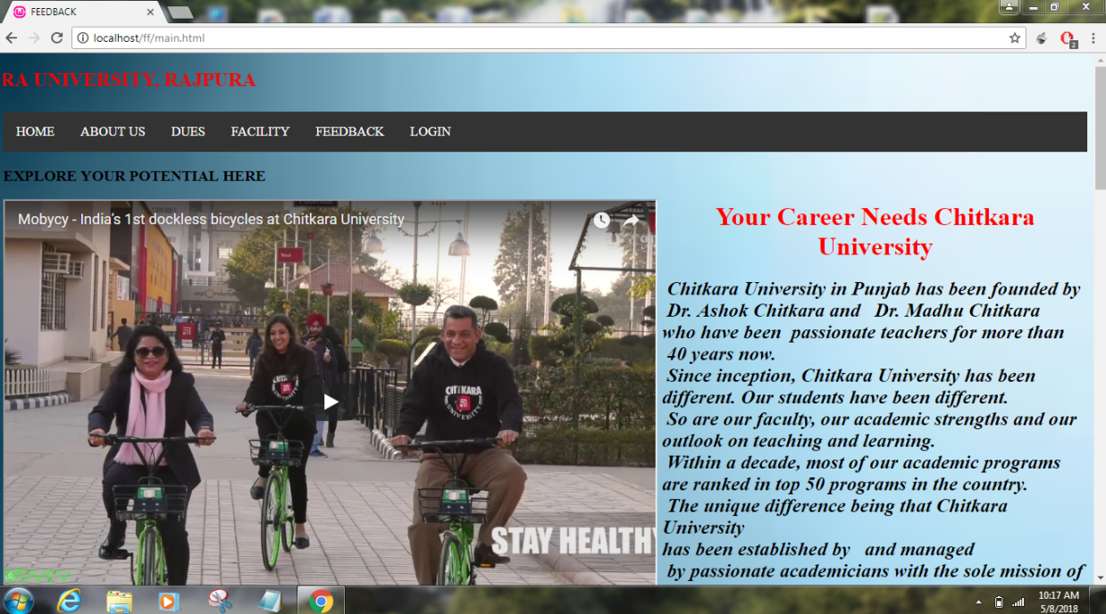
STUDENT ISSUES, FEEDBACK & SOLUTION SYSTEM
Developed By:
Robin Gupta: 1610991720
Rohan Arora: 1610991724
Rudra: 1610991736
Rupali : 1610991737

Slide 2
Problem statement
STUDENT ISSUES, FEEDBACK & SOLUTION SYSTEM
We had to design a working solution system for student feedback.
Where students can raise their issues and get satisfactory reply as soon as possible.
So we made this portal where they can easily raise their issues.

Slide 3
Technology Used
STUDENT ISSUES, FEEDBACK & SOLUTION SYSTEM
Front end programming:
Sublime: Html , CSS
Back end programming
Database: PhpMyAdmin
Local Server
WAMP

Slide 4
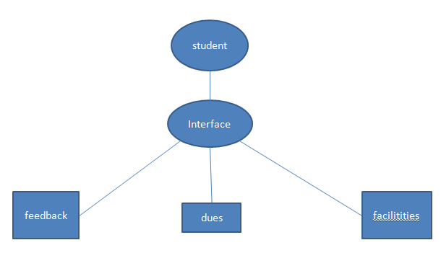
Flow Diagram
STUDENT ISSUES, FEEDBACK & SOLUTION SYSTEM

Slide 5

Snapshots
STUDENT ISSUES, FEEDBACK & SOLUTION SYSTEM
(Main Page)

Slide 6
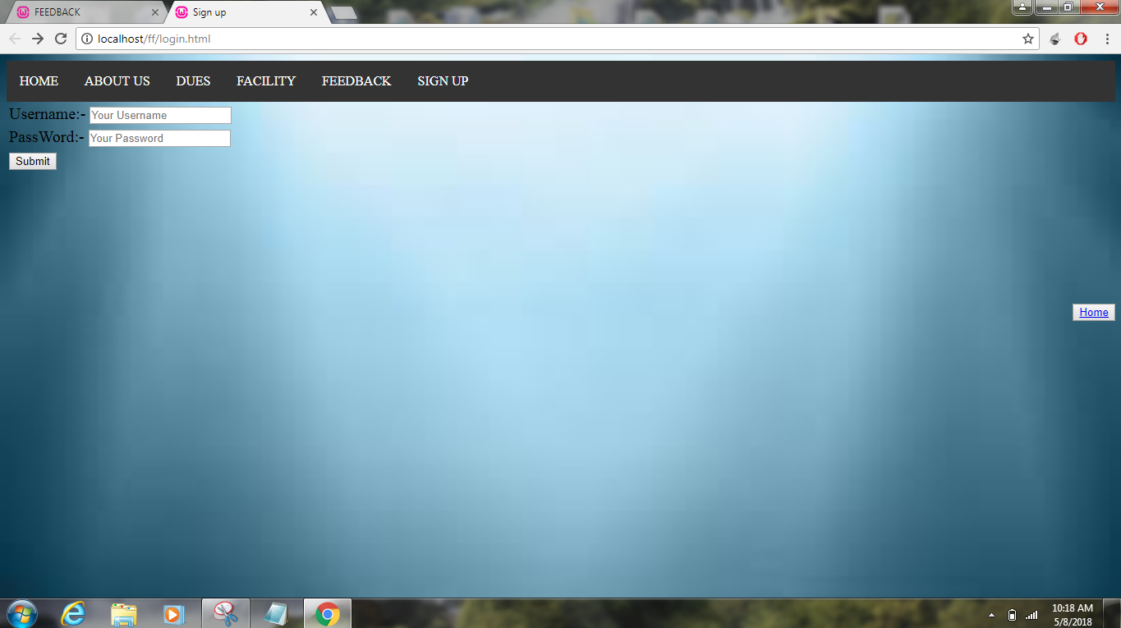
STUDENT ISSUES, FEEDBACK & SOLUTION SYSTEM
(Login Page)
Admin will login over this page to access the submitted data.

Slide 7
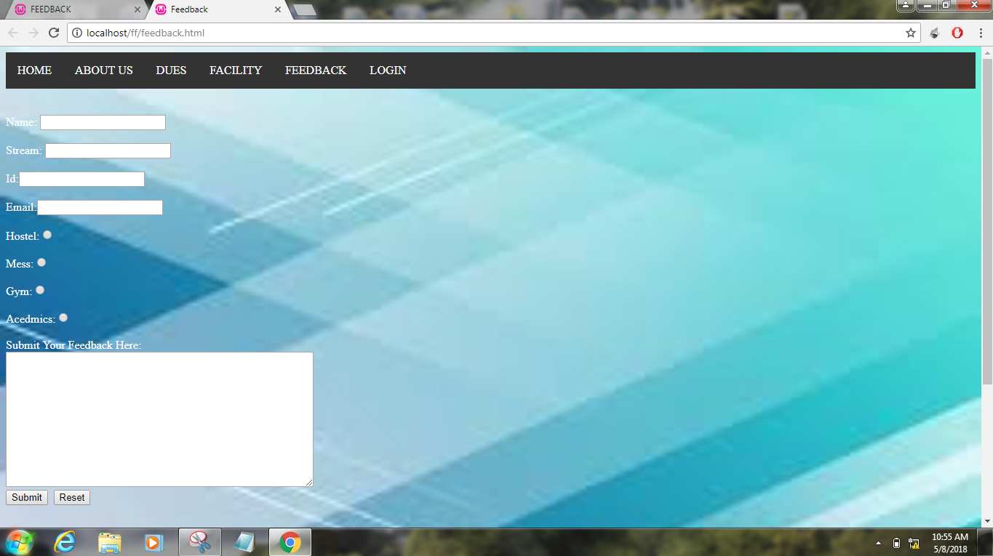
STUDENT ISSUES, FEEDBACK & SOLUTION SYSTEM
(Feedback form)
Student can enter his/her details and feedback on this page.

Slide 8
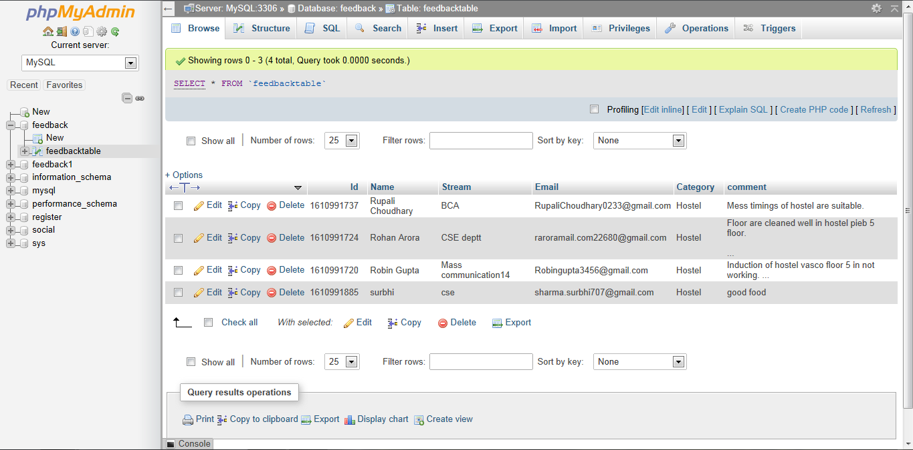
Database(feedback table)
Data will be stored in this table and data will fetched from this table using sql commands.

Slide 9
Future Scope
STUDENT ISSUES, FEEDBACK & SOLUTION SYSTEM
Minimizes the hassle for students in order to raise their issues.
Ensures that every issue is reported to the concerned department.
Provides a systematic and easy way of communication between students and departments.
Can be used to get a quick glance at student issues.

