Slide 1
Forest Cover Type prediction
Rupali(MT19095)
Indraprasth Institue of Information and Technology
rupali19095@iiitd.ac.in

Slide 2
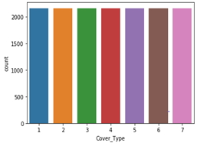
Data
Consists of 56 attributes with some binary data attributes
7 Cover Types need to predict
Each Cover Type contains equal number of records.

Slide 3
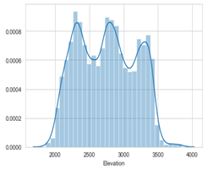
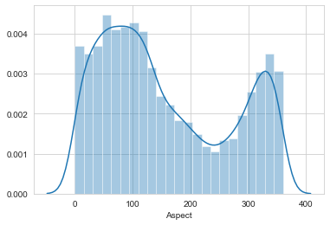
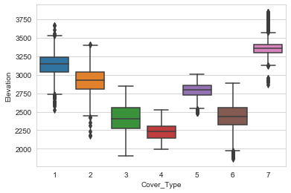
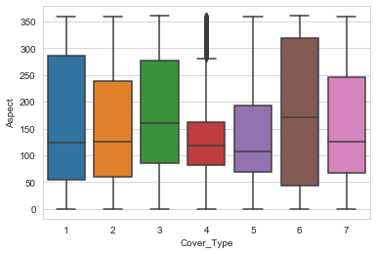
Visualization
Univariant Analysis:
Bivariant Analysis:

Slide 4
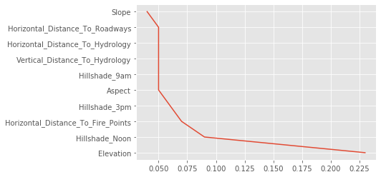
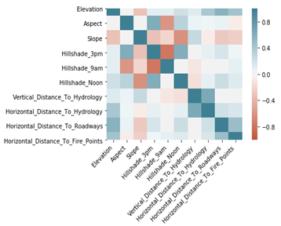
Feature Selection & Correlation
Random Forest is used for feature Selection
Elevation is most important feature wtih accuracy score 0.225
None of the attributes are highly correlated.

Slide 5
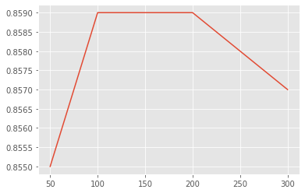
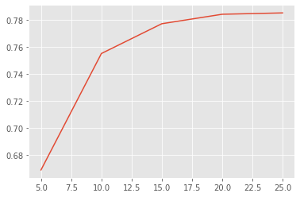
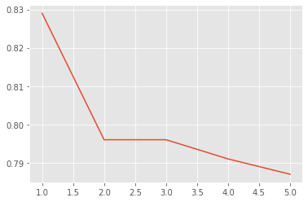
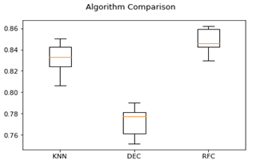
Different Classifiers and their Comparision
Decision Tree
Random Forest
KNN Classifier

