Slide 1
अनुवादिनी
Offline Multilingual Translation
HSBC x BAIF Hackathon
AI-powered offline translation for Text, Audio & Video
Supports English, Hindi & Marathi

Slide 2
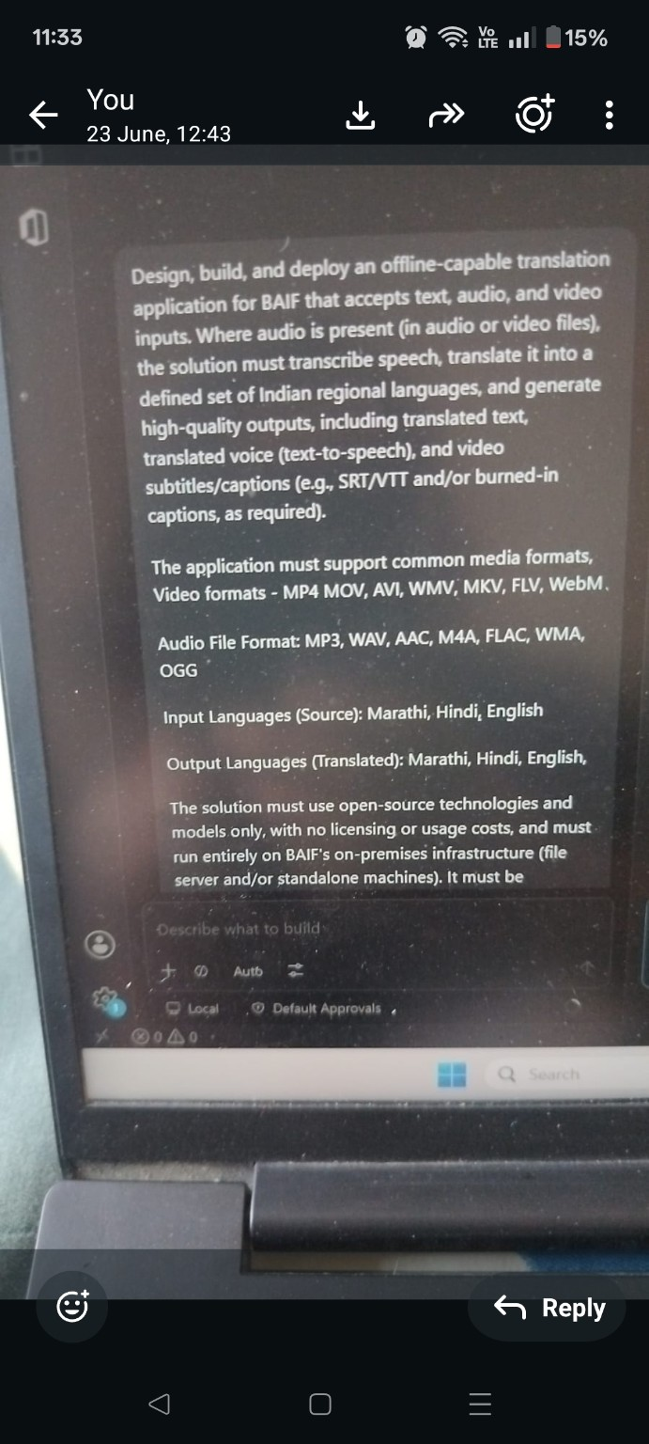
Problem Statement
Build an offline-capable translation system.
Accept Text, Audio and Video inputs.
Transcribe speech, translate regional languages, generate translated speech and subtitles.
Run fully on BAIF on-premise infrastructure.
Open-source only with zero licensing cost.

Slide 3
Solution Architecture
Streamlit UI
Speech Recognition → Faster-Whisper
Language Detection
Translation → NLLB-200
TTS → eSpeak NG
Subtitle & Video Rendering → FFmpeg
FastAPI modular backend

Slide 4
Technology Stack
Frontend: Streamlit
Backend: FastAPI
ASR: Faster-Whisper
Translation: NLLB-200
TTS: eSpeak NG
Video: FFmpeg

Slide 5
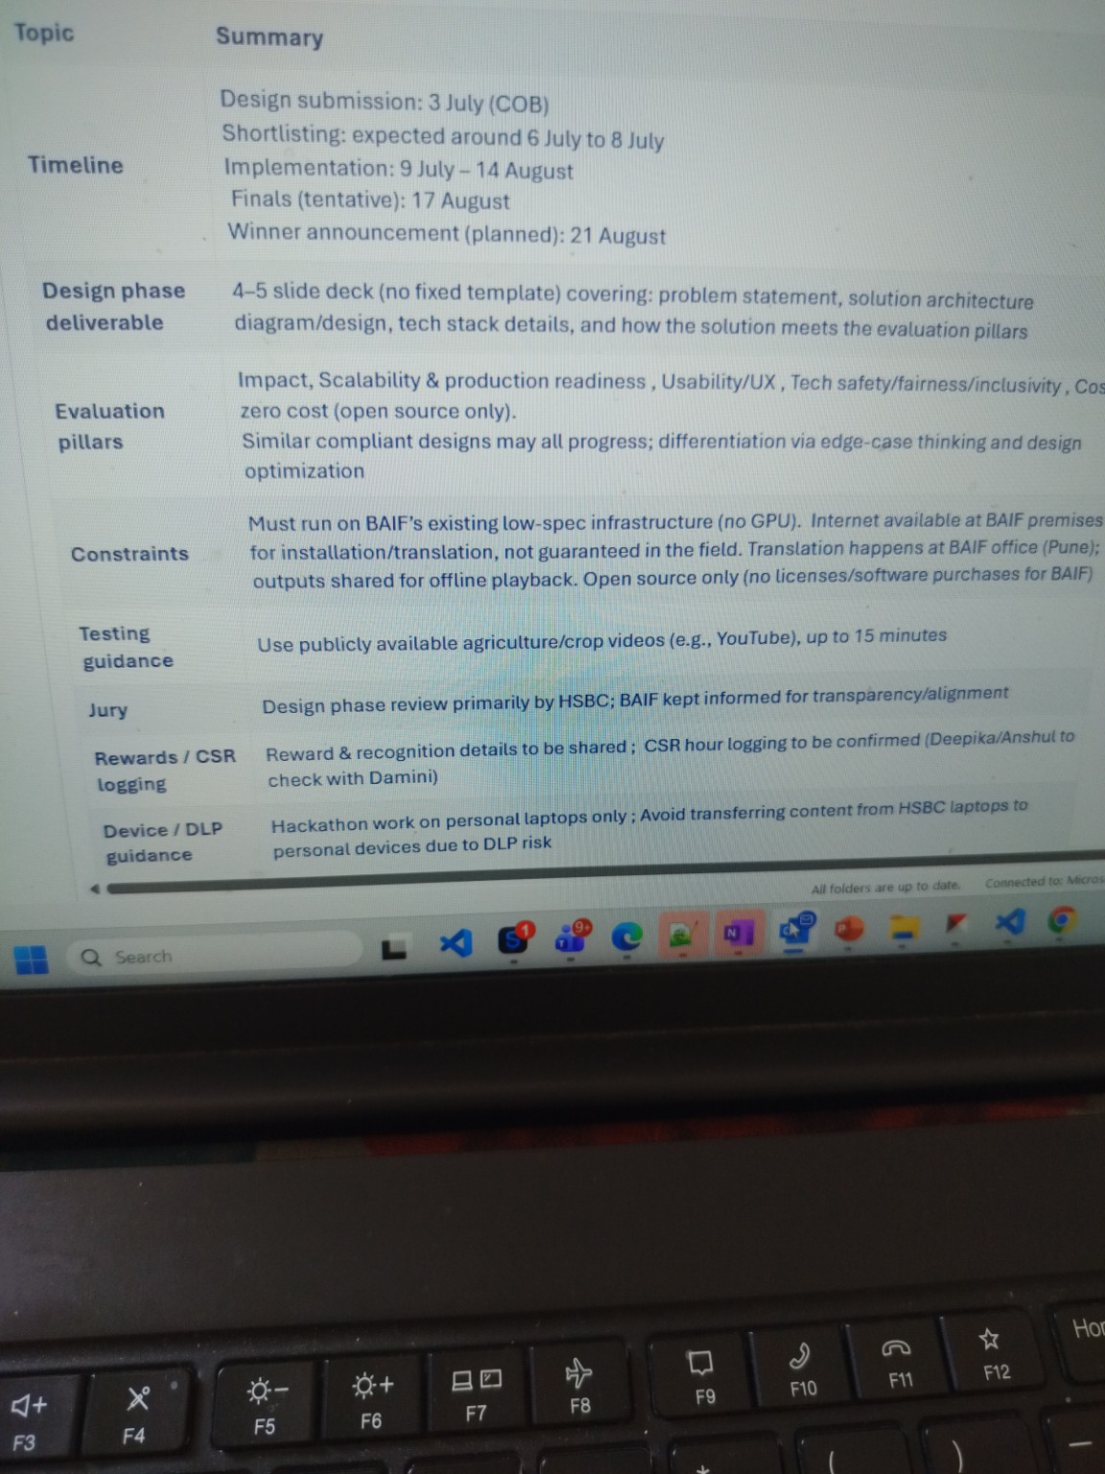
Evaluation Pillars
Impact: Enables farmers & field workers to access multilingual content offline.
Scalability: Modular architecture, FastAPI-ready, future GPU/queue support.
Production Readiness: CPU fallback, 2GB uploads, multiple media formats.
Usability/UX: Single-click workflows, clean interface, downloadable outputs.
Tech Safety, Fairness & Inclusivity: Local processing, privacy-first, multilingual support.
Cost: 100% Open Source, ₹0 API/licensing cost.

Slide 6
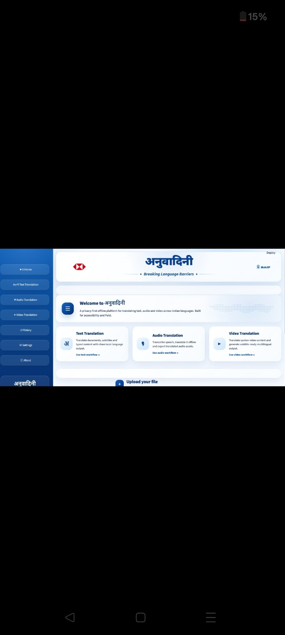
Application Demo
Home screen and translation workflow

Slide 7
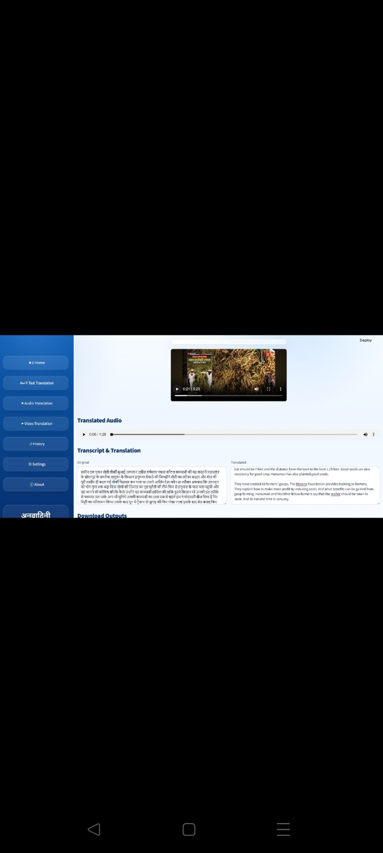
Translated Output
Transcript, translated audio, subtitles and translated video

Slide 8
Why Anuvadini Wins
Fully Offline
Privacy First
Zero Cost
Open Source
Supports Text, Audio & Video
Built for low-spec CPU machines
Designed for future scalability

