Slide 1
QlikView
Presented by: Suraj Shukla

Slide 2
Agenda
Overview
Architecture
Salient features of QlikView
Using QlikView
Script
Loading data into Qlikview
Sheet and sheet objects

Slide 3
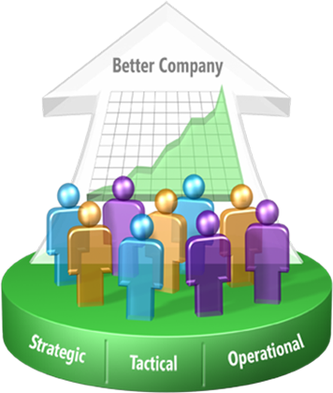
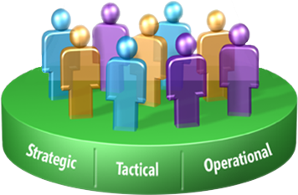
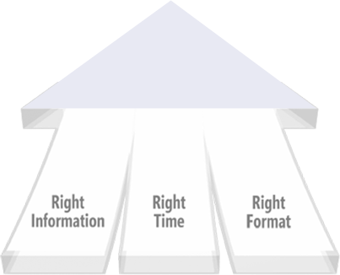
What is BI ?
Provide business insights to all employees
Better, faster, more relevant decisions

Slide 4
Benefits of BI Reporting
Improve Management Processes
Planning, controlling, measuring, Changing
Results in increased revenues and reduced costs
Improve Operational Processes
Order processing, purchasing.
Results in increased revenues and reduced costs
Predict the Future

Slide 5
How Traditional BI tools works
Traditional OLAP/cube technologies show pre-aggregated “measures”.
A data warehouse or data mart is a pre-requisite.
Associations between dimensions are not compute.

Slide 6
QlikView’s Associative Experience Puts Users in Control
Traditional
Associative
Region
Region
State
Sales
Person
State
Product
Sales
Person
Product
IT Driven
Linear, pre-defined thinking
Insights missed in hidden data
Months to change
User Driven
User decides where to start
All data, always visible
Minutes to change
Notes:
QlikView’s associative experience is totally different from the traditional BI experience.
Traditional BI is linear and hierarchical.
It pre-packages data and only gives users what’s been pre-determined by IT.
It requires the user to tunnel through the data and make links based on guessing.
In contrast, QlikView offers an associative experience enabled by our in-memory technology.
It’s a totally unique approach that turns the traditional BI model upside down.
It makes connections between data and systems to draw a big picture for the users.
For instance, if a user searches on sales data, it’s automatically linked and mapped to region, state, salesperson and product data.
There’s no digging around.
QlikView makes that data instantly available to generate real insight and trace dependencies like never before.
It’s a key reason why business users are so extraordinary successful with our product.

Slide 7
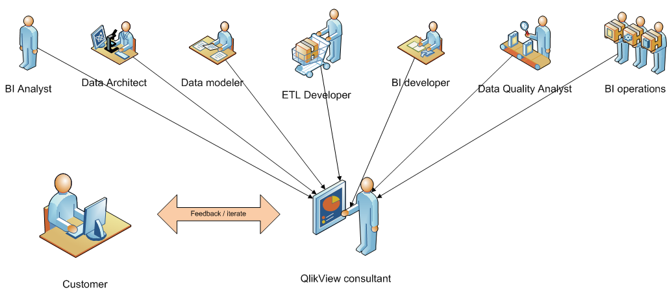
QlikView workflow

Slide 8
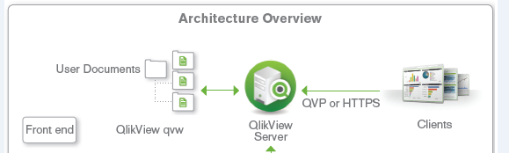
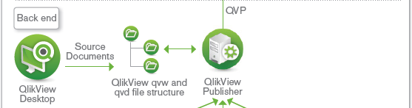
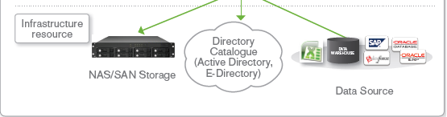
Architecture Overview
.

Slide 9
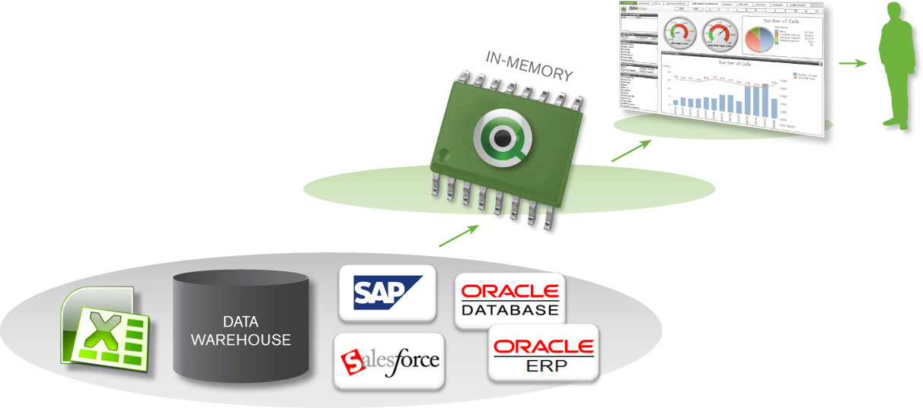
QlikView’s Core Technology: The Basics
Easily consolidates multiple data sources
Loads all data into memory (millions of rows)
Massive (10-to-1) data compression
Enables real-time associative search and analysis
Connectors to SAP, Salesforce.com and Big Data etc.
Notes:
QlikView compresses data to 10% of its original size.
QlikView achieves a significant reduction in the size of the data used for analysis using a data dictionary (a hash table) and by using only the number of bits required.
For example, the “day of the week” field has only seven possible field values, and these values are stored only once in memory, regardless of how many records contain each value.
As a result, QlikView can scale to handle very large data sets without driving up hardware investment costs just to move an entire data set into memory.
QlikView holds data in memory for multiple users, for a super-fast user experience.
QlikView holds all the data needed for analysis in memory, where it is available for immediate exploration by users.
Users experience zero wait time as QlikView performs the calculations needed to deliver the aggregations users request.
The “rocket science” is in getting the calculations done quickly.
QlikView is a multi-user, distributed environment; it stores common calculations and shares them among users, so the calculations don’t have to be redone every time someone needs them.
QlikView optimizes the power of the processor.
QlikView distributes calculations across all available cores to maximize the performance experienced by the user.
Unlike technologies that simply “support” multi-processor hardware, QlikView is optimized to take full advantage of all the power of multi-processor hardware, thereby maximizing performance and the hardware investment.

Slide 10
Schema
Consists of DB objects such as tables, views, indexes.
Types of schema.

Slide 11
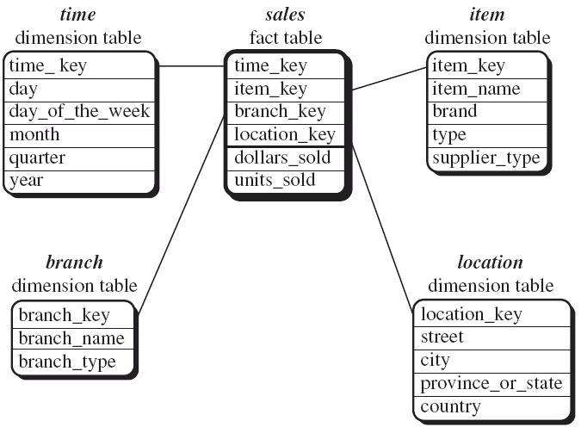
Star Schema

Slide 12
Advantages of Star Schema
Dimension tables are relatively static
Data is loaded into fact table
Easy to write queries

Slide 13
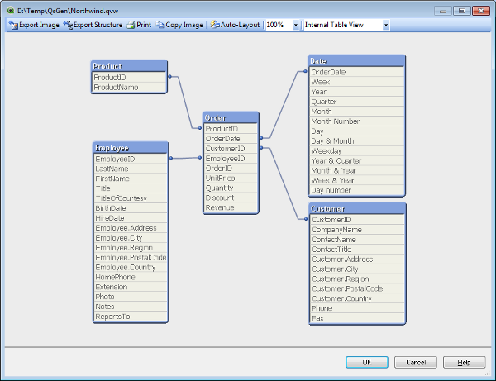
QlikView’s Core Technology: The Secret Sauce
Maintains associations in the data.
Calculates aggregations on the fly.
Notes:
Maintains associations in the data automatically.
QlikView’s inference engine enables the green / white / gray associative experience.
This engine automatically maintains the associations among every piece of data in the entire data set used in an application — neither developers nor end users have to maintain the associations.
Gray = not associated
Green = user’s selections
White = associated
As a result, users aren’t limited to static reports, pre-determined drill paths, or pre-configured dashboards.
Instead, they can navigate their data up, down, and sideways, exploring it any way they want to.
Calculates aggregations on the fly as needed.
QlikView’s inference engine calculates aggregations on the fly based on selections the user makes (which we call the “state” of the app).
As a result, users aren’t limited to predefined calculations (and hence preconceived insights based on data joins made by IT).
Users can define whatever view or type of insight they want and QlikView dynamically calculates the answer.
QlikView only calculates the aggregations the user asks for; it does not pre-calculate aggregations the old queries-and-cubes way. It processes calculations instantaneously, as they are needed.

Slide 14
What can you do with QlikView?
Create flexible end user interface for DW.
View on relations between data.
Create dynamic graphs and tables.
Perform statistical analysis.
Link descriptions and multimedia to data.
Merge information from different sources.

Slide 15
Using QlikView
Starting QlikView.
Basic Layout and Navigation.

Slide 16
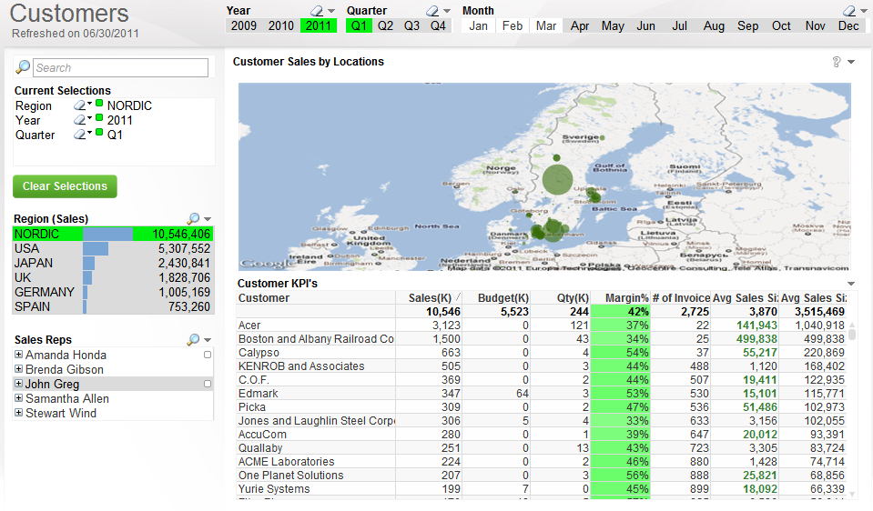
QlikView Shows You What’s Associated — and Not
Associated: white
Selections: green
Unassociated: gray
Notes:
With QlikView, users can literally see relationships in the data.
They can see not just which data is associated with their selections — they can just as easily see which data is not associated.
How? The user’s selections are highlighted in green. Field values related to the selection are highlighted in white. Unrelated data is highlighted in gray.
As an example, when a user clicks on a product sub-category (say, bagels) and a region (e.g., Japan), QlikView instantly shows everything in the entire data set that is associated with these selections — as well as the data that is not associated.
The result is new insights and unexpected discoveries.
In this example, the user might see that no bagels were sold in Japan in January, April, or June, and begin an investigation into why.

Slide 17
Script

Slide 18
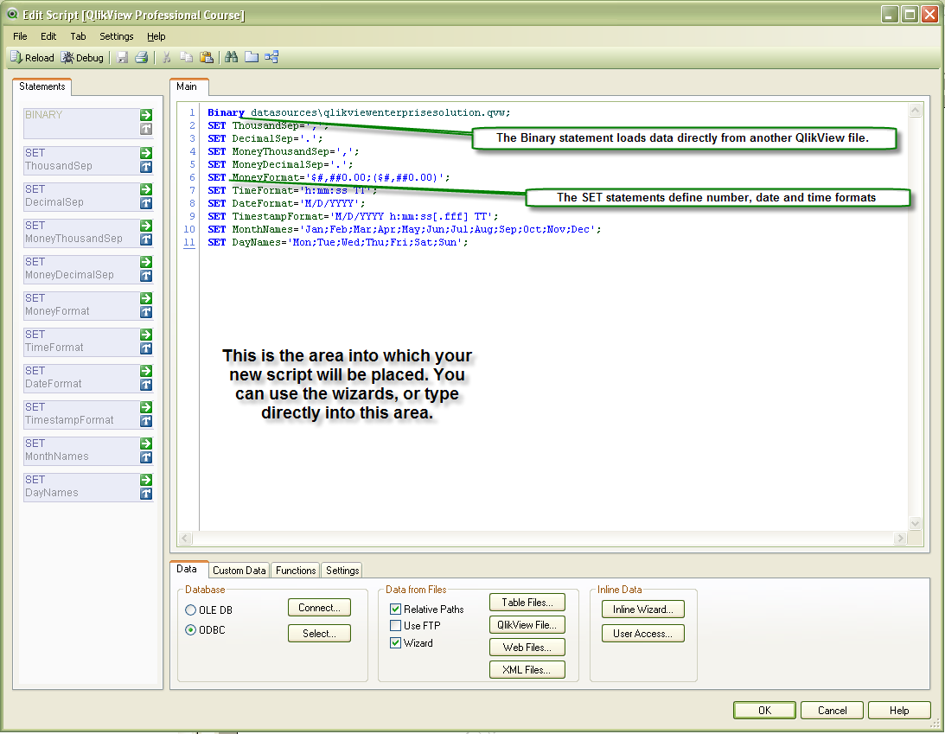
Edit Script Dialog

Slide 19
Loading Data

Slide 20
Types of Load
Inline load
Loading data from Excel file
Incremental load
Binary load
Buffer load
Loading data from database

Slide 21
Types of Load (cont.)
Loading data from QVD files
Add load
Resident load
Loading data from generated data
Partial Reload

Slide 22
Sheets and Sheet Objects

Slide 23
Drilldown
Chart with product drilldown, region drilldown, etc
Powerful!

Slide 24
Questions?

Slide 25
Thank you!

