Slide 1

AI Power Legal Assistant
By Rupali Badkar, AI Product Manager
Notes:
Open with the one-line promise. ContractLens does not sign or approve anything; it shows Karandeep, with the exact clause quoted, what a draft collides with, what is buried in it and what is missing.

Slide 2
Table of Contents
Company Overview & Business Context
Need for AI Based Assistant
Product Details
Benefit with the New AI based Assistant
Launch Plan
Inputs from Founders
Q&A

Slide 3
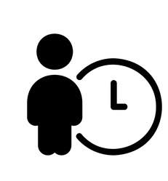


Company Overview & Business Context
Business: Custom software, data platforms & AI solutions
Global Reach: India, US, Middle East & Europe
Two Entities: AtliQ Inc. (US) & AtliQ Technologies Pvt Ltd (India)
Contracting Roles: Supplier, buyer, strategic partner,freelancers
Contract Ecosystem: Client MSAs/SOWs, vendor agreements, partnership agreements & NDAs
Dhaval (Founder, Sales)
Karandeep CEO
Bhavin (Founder, Sales)
Pranav (CTO)
Jay (Sales)
Team Members

Slide 4
Need for AI based Legal Assistant
After 10pm
½ page
0 person in legal
Brightwater
Losses
3–4 hrs
700K deals(15 deals in queue)
Review Queue
Karandeep (CEO) is the only signatory for both AtliQ entities. He reads each draft end to end between sales calls, sometimes on his phone at an airport.
He has to remember what AtliQ already promised other clients: non-competes, exclusivity, most-favoured pricing, IP handed over. None of it is written down in one place.
Sellers (Bhavin, Dhaval, Jay) can't close until he finishes, and can't tell which of their deals is risky.
Value of CEO time =Infinity$/hour
What happened | Cost
Brightwater: AtliQ Inc signed under English law, at an airport | $9,000 settlement credit + $14,200 legal fees + ~2 weeks of senior time
ShopSwift: SOW sat 9 days in the queue | Client's budget slipped a quarter
Outside counsel for each complex review | ≈ ₹1,20,000($1350) and 5–7 working days
Today's queue (tracker, 28 Sep 2026) | 15 drafts, about $700k of deals, most due in early October

Slide 5

Visit URL
https://atliqcontractlens.vercel.app/

Slide 6
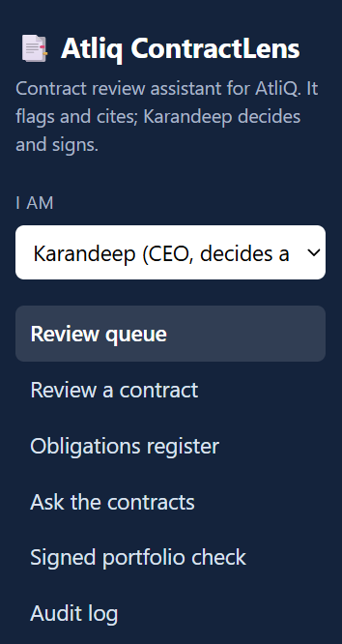
Visit URL
https://atliqcontractlens.vercel.app/
Provides the review queue as per the Persona with inputs from contract source(RAG)
Review the contracts, shows the blocker,option to accept or sent to outside consel, brief email to share for negotiation
Obligation register
Option to ask the contracts what Atliq as already promised
View of the signed portfolio
Audit log of reviewed document with date

Slide 7
WORKFLOW (LANGGRAPH)
How a review runs
code
AI
code
code
RAG
Personal-data gate
Extract fields
Rule checks
Register check
Retrieve
stops before any model call
parties, law, locations
entity, law, deal bundle, NDA, annexes
recall-first triggers
draft passages + precedent
AI
AI
code
run in parallel
AI clause scan
AI conflict check
Citation check
playbook rules, JSON with quotes
explains; cannot clear a flag
quote must be in the contract verbatim
code
human
Brief
Karandeep decides
verdict, flags by severity, deal checklist, "could not check"
accept · dismiss · counsel, then the outcome email is drafted
Atliq ContractLens · Capstone 2 · Rupali Badkar
7
Notes:
Read left to right then back. Green = deterministic code, purple = model, red = human. The model only does what needs reading and judgement; anything with a right answer is code. The citation check sits between the model and the brief, so nothing invented reaches Karandeep.

Slide 8
High Low Medium & Blocker basis
Severity | Rule | Meaning | Source file
Blocker | LD-UNCAPPED | Damages with no cap | negotiation_notes.md
Blocker | LIAB-UNLIMITED | Unlimited liability | negotiation_notes.md
Blocker | PHI-OFFSHORE | Patient data leaves the US | negotiation_notes.md
Blocker | ENTITY-MISMATCH | Wrong AtliQ entity | rules.py (code check)
Blocker | BUNDLE-MISSING | BAA/DPA/NDA missing | rules.py (code check)
Blocker | R-01 | Al Noor non-compete | 2025-03-15_al_noor_hospitality_msa
Blocker | R-03 | Crestline lowest-price clause | 2024-08-01_crestline_retail_msa
Blocker | R-04 | PipeKit IP given to Northwind | 2025-06-20_northwind_logistics_msa
Blocker | R-05 | CloudSpan exclusivity | 2025-09-01_cloudspan_strategic_partnership_agreement
Blocker | R-07 | Harrington data shared before BAA | 2026-08-20_harrington_health_mutual_nda
High | IP-BACKGROUND-ASSIGNED | AtliQ's tools handed over | negotiation_notes.md
High | NDA-NOT-MUTUAL | One-sided "mutual" NDA | negotiation_notes.md
High | IND-CLIENT-NEGLIGENCE | Covers client's own negligence | negotiation_notes.md
High | LD-ABOVE-STANDARD | Damages above 0.5%/week or 5% cap | negotiation_notes.md
High | NEW-RESTRICTION | New non-compete or exclusivity | negotiation_notes.md
High | INS-ABOVE-COVER | Insurance above $1M cover | Harrington huddle notes
High | R-08 | Intercompany BAA covers CareBridge only | 2025-10-06_atliq_intercompany_subcontractor_baa
Medium | PAY-SLOW | Payment slower than 45 days | negotiation_notes.md
Medium | LIAB-ABOVE-1X | Liability cap above 1x fees | negotiation_notes.md
Medium | IND-ONE-SIDED | Indemnity not mutual | negotiation_notes.md
Medium | TERM-ASYMMETRIC | One-sided termination | negotiation_notes.md
Medium | R-09 | Freelancer kept Acme IP | 2025-04-28_rohan_iyer_contractor_agreement
Low | OTHER | Other minor point | not recorded
Low | R-10 | Meridian 24-month no-hire | 2026-07-16_meridian_healthcare_nda
Info | ONLY-LOOKS-RISKY | Looks risky, within standard | not recorded
Info | R-02 | Al Noor waiver, Seaside only | 2026-02-10_al_noor_waiver_letter
Info | R-06 | Expired Orbit non-compete | 2022-07-01_orbit_travels_msa_scanned

Slide 9
Benefits with
After 10pm
to
To same day signoff
½ page to
to
full contract and updated checklist
0 person in legal
to
Legal check every deal
Brightwater Losses
to
0 losses/
misses
3–4 hrs
to
Minutes, not hours and ready brief for negotiation
700k deals (15 deals queue)
to
All deals unblocked
Review Queue
To
Zero backlog
Final decision lies with Karandeep
Other teams can have review status instead of reaching out and consuming theirs and Karandeep time
No stress of remembering things
74% savings over existing cost incurred in losing Karandeep manhours & losses incurred
More contracts means more business
RAG based solution so data stay within
74% Savings & savings on CEO manhours

Slide 10
LAUNCH PLAN
Launch in four phases, each one earned by passing three checks
0
Pilot
1
Sales team
2
Full portfolio
3
Scale
Weeks 1–4
16 Nov – 11 Dec 2026
Months 2–3
Jan – Feb 2027
Months 4–6
Mar – May 2027
Month 6+
Jun 2027 onward
Karandeep + Dhaval
Run on live deals next to today's manual review. Vercel free tier; real contracts only on the no-training model.
Bhavin, Dhaval, Jay
Every new contract goes through the review queue and outcome brief. Karandeep reads red-flag deals in depth.
Karandeep, Jay
Load all signed contracts, confirm each register entry, turn on obligation register and renewal alerts.
Founders
Connect email or CRM intake, add other contract types, report savings to the CEO every quarter.
›
›
›
Gate: Matches Karandeep on every red flag
Gate: Review under 15 min, queue under 24 h
Gate: Every signed contract in the register
Gate: Savings report each quarter
Every phase must pass before the next starts: no missed red flags · review time under 15 minutes · sellers actually using it. Karandeep signs off every contract; ContractLens never signs or sends.
~$33 per month in production
< 1 month payback (0.7 months)
57 / 57 offline tests passing
Vercel free tier for the pilot
Notes:
Four phases. Phase 0 pilot with Karandeep and Dhaval in shadow mode for four weeks. Each gate checks: no missed red flags, review under 15 minutes, sellers using it. Kill switch returns to manual review at any time.

Slide 11
NEXT STEPS
What I need from the founders
Karandeep
Two hours to turn the 2024 checklist into the playbook, and an answer key for the 15 drafts so we can measure flag precision.
Jay and Dhaval
Collect the 13 signed contracts the tracker lists but nobody can find (DataNest, ShopSwift, CareBridge MSA…). Until then they're shown as "could not check".
Pranav
Pick the production model API for real contracts (no training, no retention) with reference to the cost estimate given
Everyone
Agree to start Pilot mode on the live queue in mid-November.
Atliq ContractLens · Capstone 2 · Rupali Badkar
17
Notes:
Close on concrete asks. The prototype already runs on the real dataset; what remains is the playbook owner's input, the missing contracts and the production model choice.

Slide 12

Thank you
For any queries reach out to
Rupali Badkar
Rupalibadkar24@gmail.com

Slide 13
Technical Information

Slide 14
SUCCESS METRICS
How we'll know it worked
Layer | Metric | Target
North Star | Signed contracts with zero conflicting commitments or unresolved high issues | 100% of signed contracts
Output | Time to a reviewed brief · contracts a month · queue wait | 3–4 hrs → 5 min · 9 → 15 · ≤ 2 working days
Trust | High and blocker flags Karandeep accepts | ≥ 70%
Guardrail | Missed high-severity issues found later · unsupported citations | Zero · zero
Experience | Counsel spend per month | Down 50%: counsel only for flagged contracts
Atliq ContractLens · Capstone 2 · Rupali Badkar
15
Notes:
Eval criteria decide whether we launch; these metrics decide whether it worked after launch.

Slide 15
SAFETY
Guardrails
Personal-data gate
No approve / sign / send
SSNs, MRNs, dates of birth, diagnosis codes stop the review before any model call
Human is the final approval
Citation check
Completion gate
A model finding whose quote is not in the contract is dropped and counted
"Review complete" stays locked until every blocker and high flag has a decision
Honest failure
Audit log
If the model call fails, it says "review not completed", never "checked"
Each step and decision with IDs and counts only, no contract text
Atliq ContractLens · Capstone 2 · Rupali Badkar
13
Notes:
The two highest-risk failure modes are missing a real conflict and the tool acting as an approver. The register design and the absence of any approve action address those directly.

Slide 16
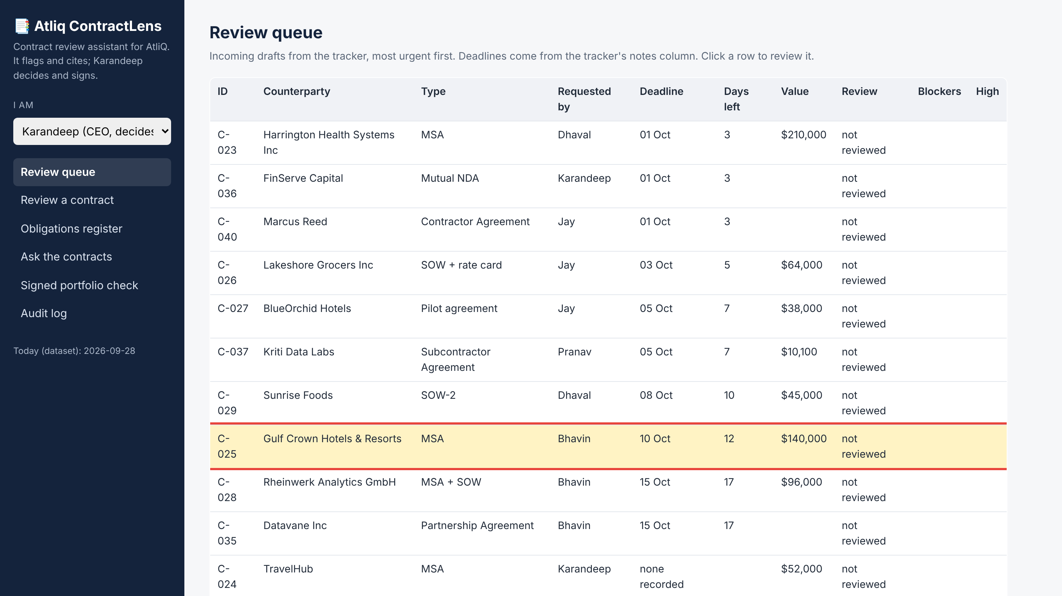
DEMO · TAB 1 OF 6 · REVIEW QUEUE
Gulf Crown is in the queue, flagged as urgent
Gulf Crown
• Gulf Crown Hotels & Resorts MSA, $140,000, requested by Bhavin
• Due 10 Oct, 12 days left
• Sorted by deadline from the contract tracker, so Karandeep sees what is urgent first
Atliq ContractLens · Capstone 2 · Rupali Badkar

Slide 17
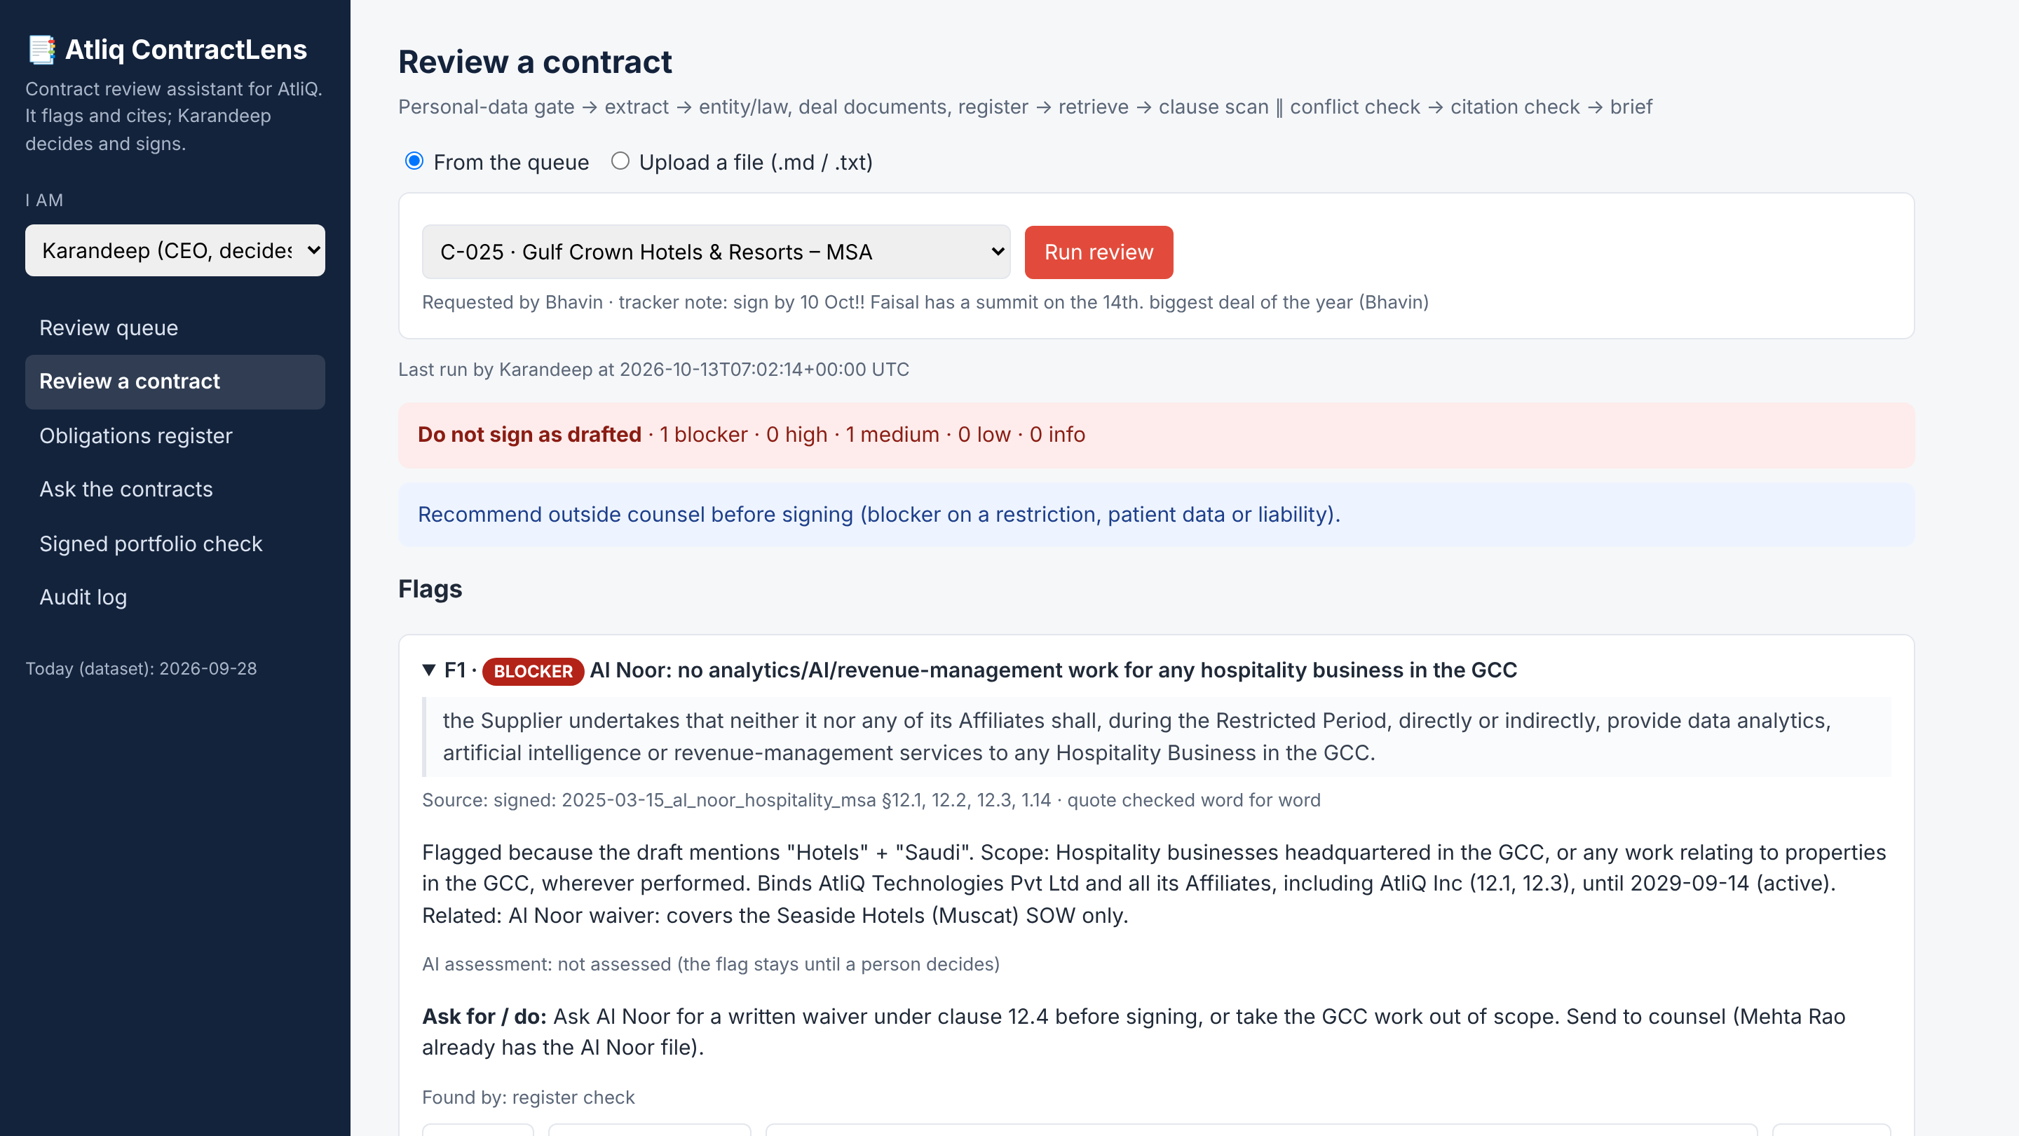
DEMO · TAB 2 OF 6 · REVIEW A CONTRACT
One blocker: the draft collides with Al Noor
Gulf Crown
• Verdict: “Do not sign as drafted”, 1 blocker and 1 medium
• Al Noor's 2025 MSA quoted word for word: no analytics or AI work for any hospitality business in the GCC until 2029
• Karandeep sends it to counsel, then the outcome brief is drafted for email or WhatsApp without naming Al Noor
Atliq ContractLens · Capstone 2 · Rupali Badkar

Slide 18
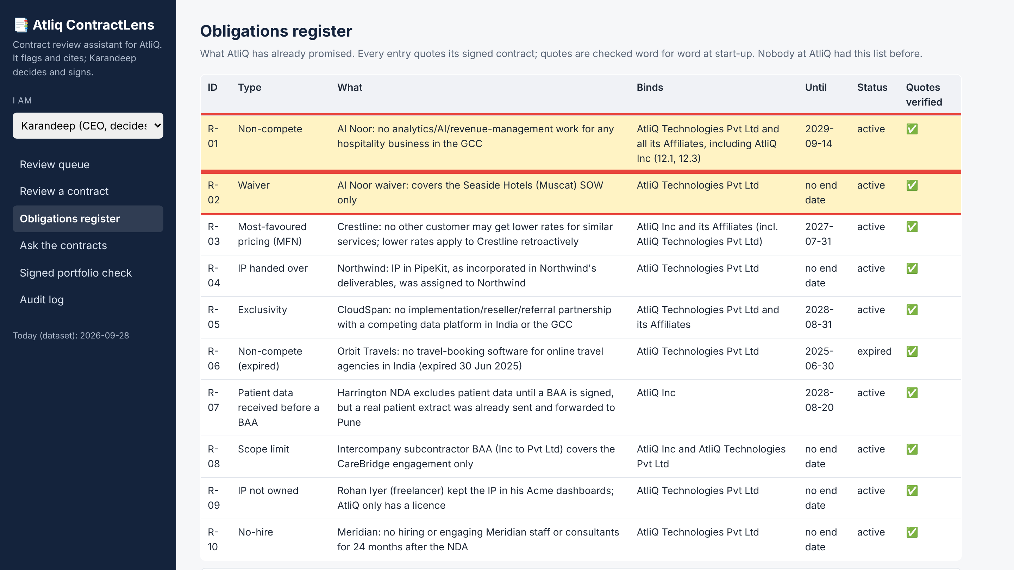
DEMO · TAB 3 OF 6 · OBLIGATIONS REGISTER
Why it was caught: what AtliQ already promised Al Noor
Gulf Crown
• R-01: Al Noor non-compete, active until 14 Sep 2029, binds both AtliQ entities
• R-02: the waiver covers only the Seaside Hotels (Muscat) SOW
• Every quote is checked word for word against the signed contract
Atliq ContractLens · Capstone 2 · Rupali Badkar

Slide 19
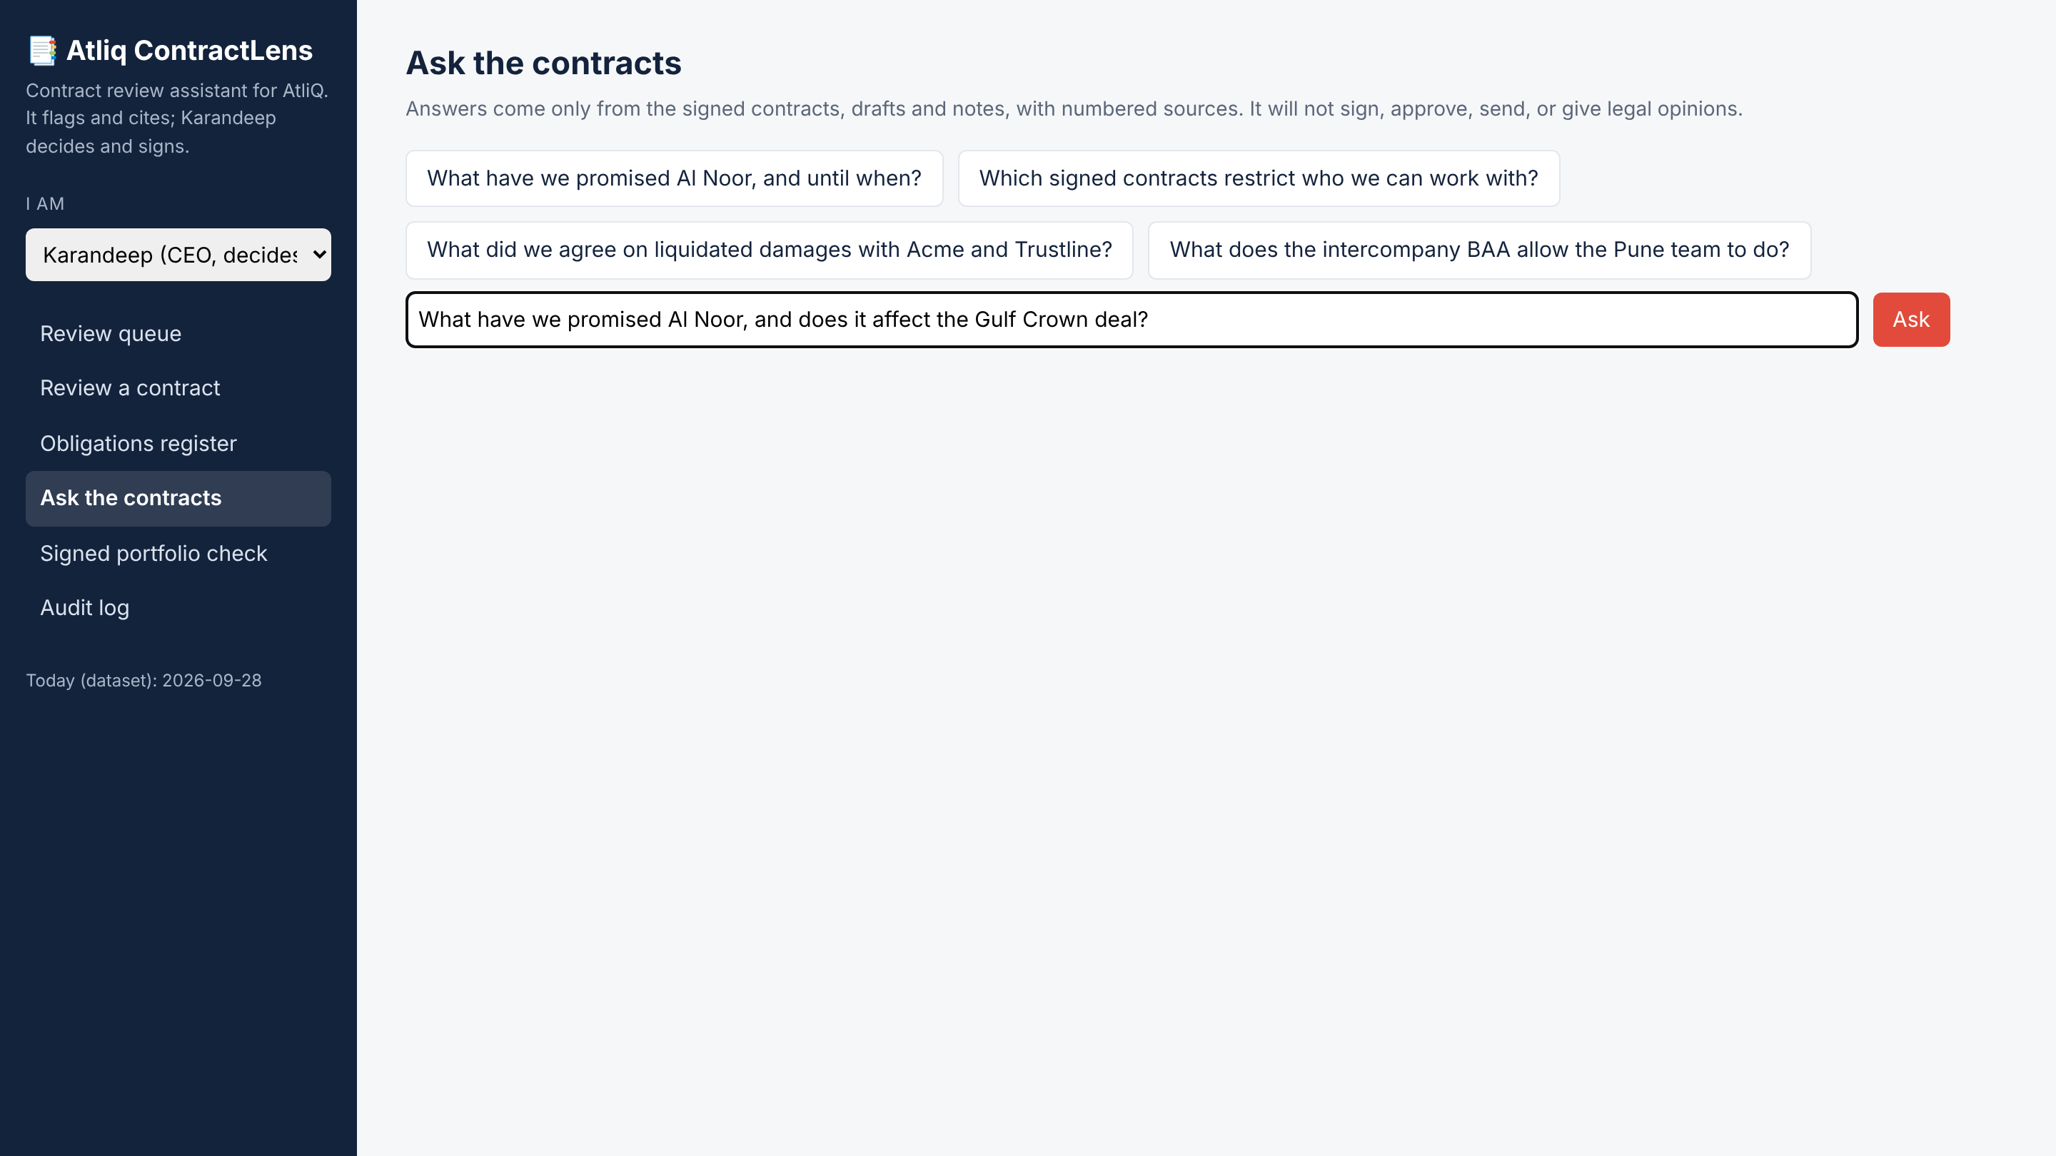
DEMO · TAB 4 OF 6 · ASK THE CONTRACTS
Karandeep can ask about Al Noor in plain English
Gulf Crown
• Question: “What have we promised Al Noor, and does it affect the Gulf Crown deal?”
• The answer comes only from the signed contracts, with numbered sources
• It will not sign, approve, send or give legal opinions
Atliq ContractLens · Capstone 2 · Rupali Badkar

Slide 20
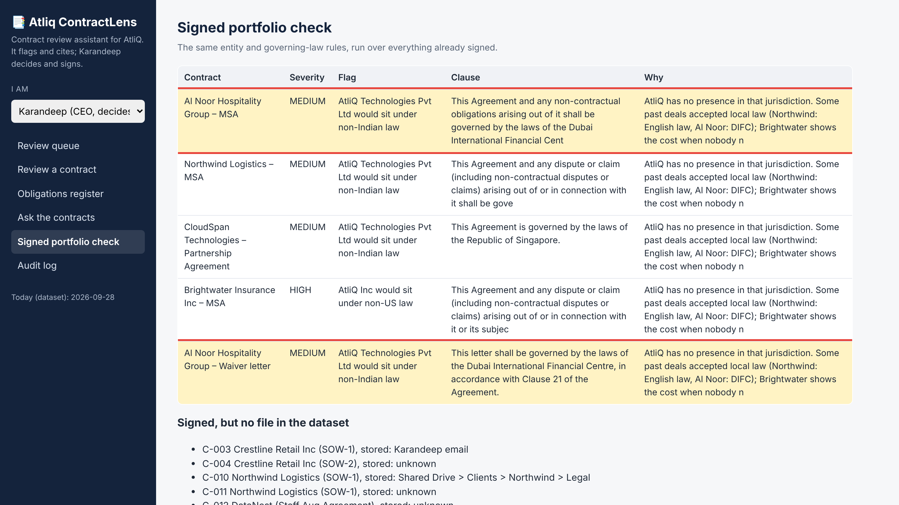
DEMO · TAB 5 OF 6 · SIGNED PORTFOLIO CHECK
The Al Noor contracts themselves are checked too
Gulf Crown
• Al Noor MSA and waiver letter are both under Dubai (DIFC) law
• Flagged medium: AtliQ Technologies Pvt Ltd sits under non-Indian law
• The same rules run on everything already signed, not just new drafts
Atliq ContractLens · Capstone 2 · Rupali Badkar

Slide 21
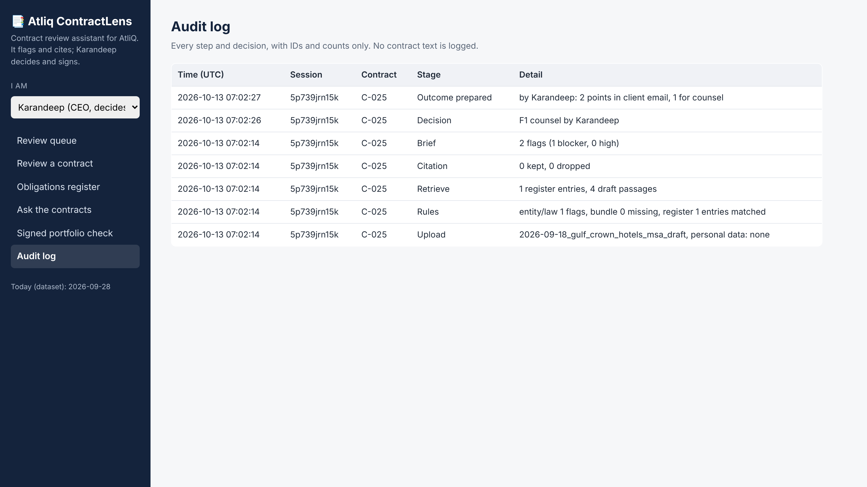
DEMO · TAB 6 OF 6 · AUDIT LOG
Every step of the Gulf Crown review is recorded
Gulf Crown
• Upload → rules → retrieve → citation check → brief → decision → outcome
• IDs and counts only, no contract text is logged
• Shows that Karandeep, not the tool, made the decision
Atliq ContractLens · Capstone 2 · Rupali Badkar

Slide 22
EVALUATION
Eval results: 56 of 56 offline checks pass
Eval dimension | Threshold | Prototype result
Conflict recall (register) | 100% | 6 / 6 known conflicts
Entity, law and deal bundle | 100% | TravelHub, Marcus Reed, Brightwater, Harrington, Kriti: all correct
False alarm control | No blocker on clean drafts | Sunrise SOW-2 and LoopMart: no blocker or high
Citation faithfulness | 100% | Invented quote dropped in test
Safe refusal | 100% | 5 / 5 refusals, 3 / 3 normal questions answered
High-severity recall (AI clause scan) | ≥ 95% | Pending live model run
Flag precision | ≥ 80% | Needs Karandeep's answer key
Run with python test_contractlens.py (offline, uses a fake model for the AI steps); --live adds the Groq checks.
Atliq ContractLens · Capstone 2 · Rupali Badkar
14
Notes:
Be honest here: everything deterministic is proven on the real dataset. The AI clause scan has been tested with a fake model for the plumbing (citation check, severity lookup), but its recall and precision need a live run and Karandeep's answer key.

