Slide 1
Stress Causes and Outcomes
Statistical Analysis

Slide 2
INTRODUCTION and BackGround
We are today in a mental health crisis, number are staggering
About 33 percent of people report feeling extreme stress
Costs due to crisis in US ~ $300 B yearly
Stress impacts various aspects of our life, broadly categorized into personal, professional and health
Notes:
https://www.apa.org/news/press/releases/stress/2020/report-October
https://www.stress.org/daily-life
https://www.therecoveryvillage.com/mental-health/stress/related/stress-statistics/

Slide 3
PrOject OVErVIEW
Start with “Why”
Identifying stress triggers can help improve lifestyle, emotional and mental health
Identify business communities that impact stress influencers
The “Objective”
What are the sources of stress and how to manage them for a purposeful impact?
The “How”
Statistical Analysis on lifestyle
Heatmap to derive co-relation within data elements

Slide 4
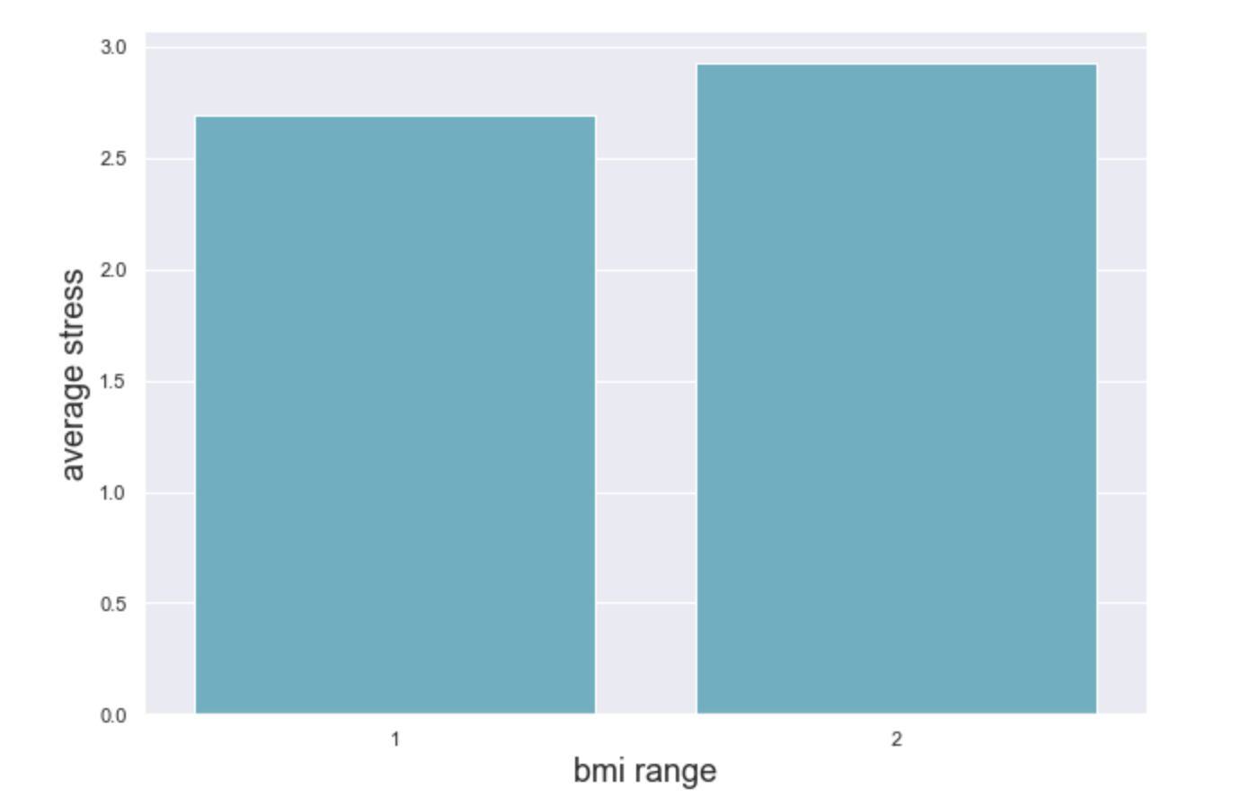
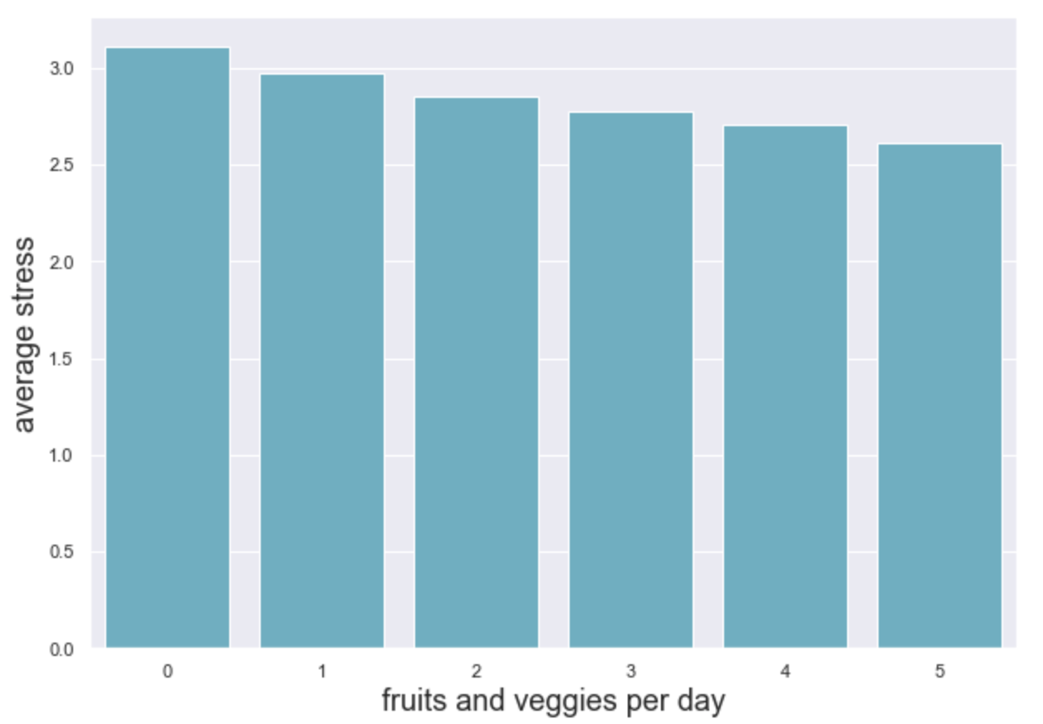
Statistical Analysis
1 – BMI less than 25
2 - BMI greater than 25

Slide 5
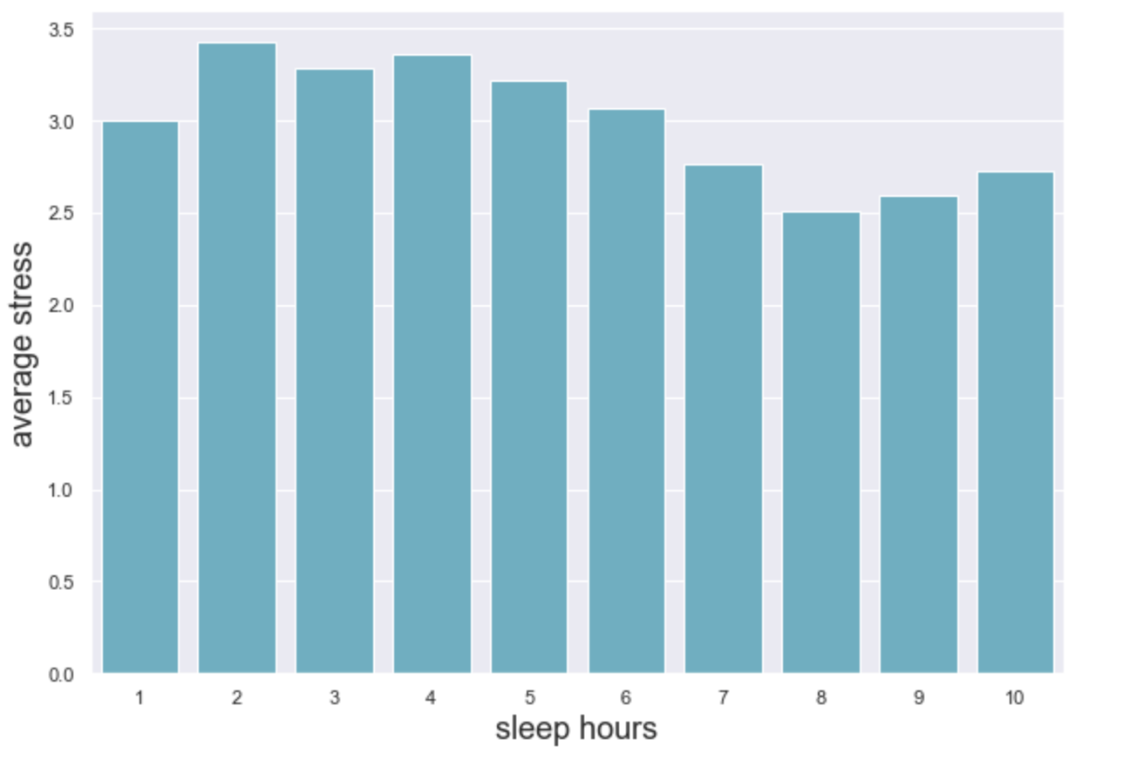
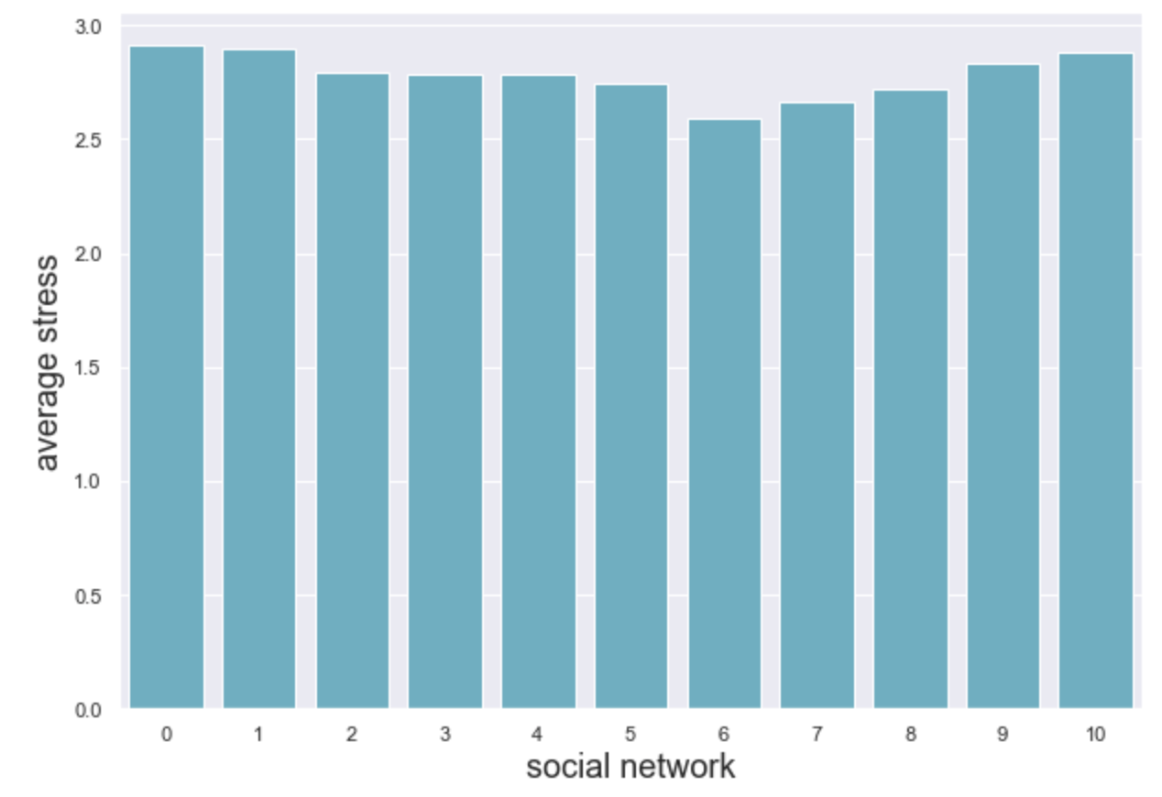
STATISTICAL ANALYSIS

Slide 6
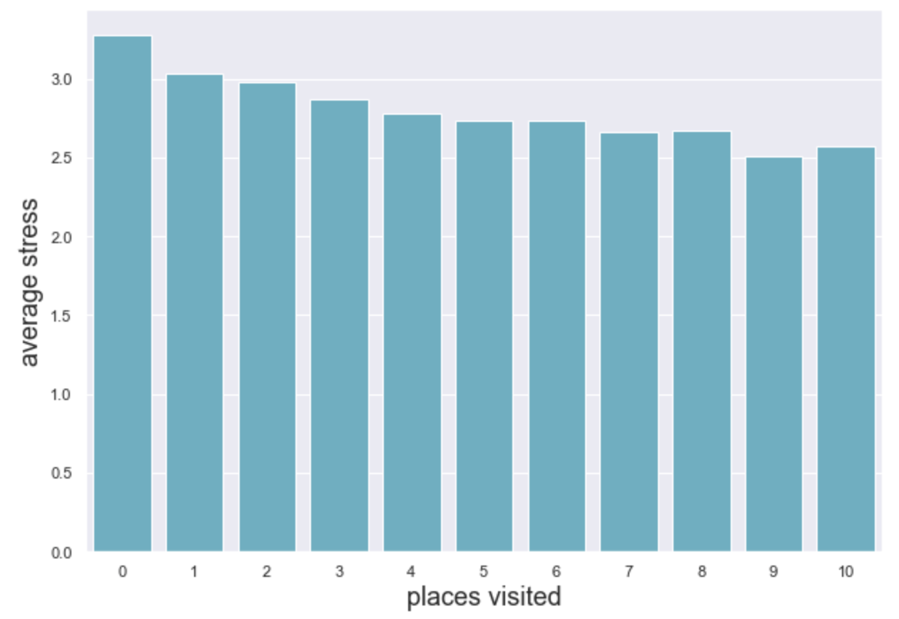
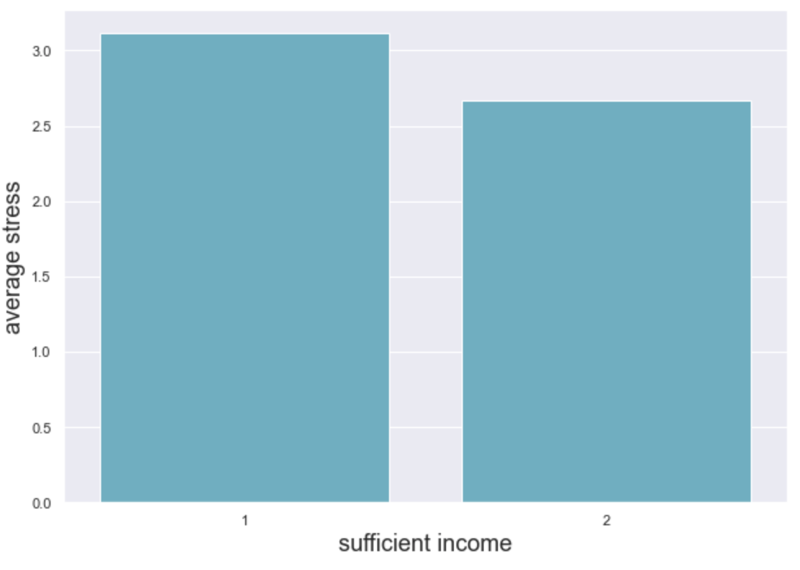
Statistical Analysis
1 – Hardly Sufficient
2 - Sufficient

Slide 7
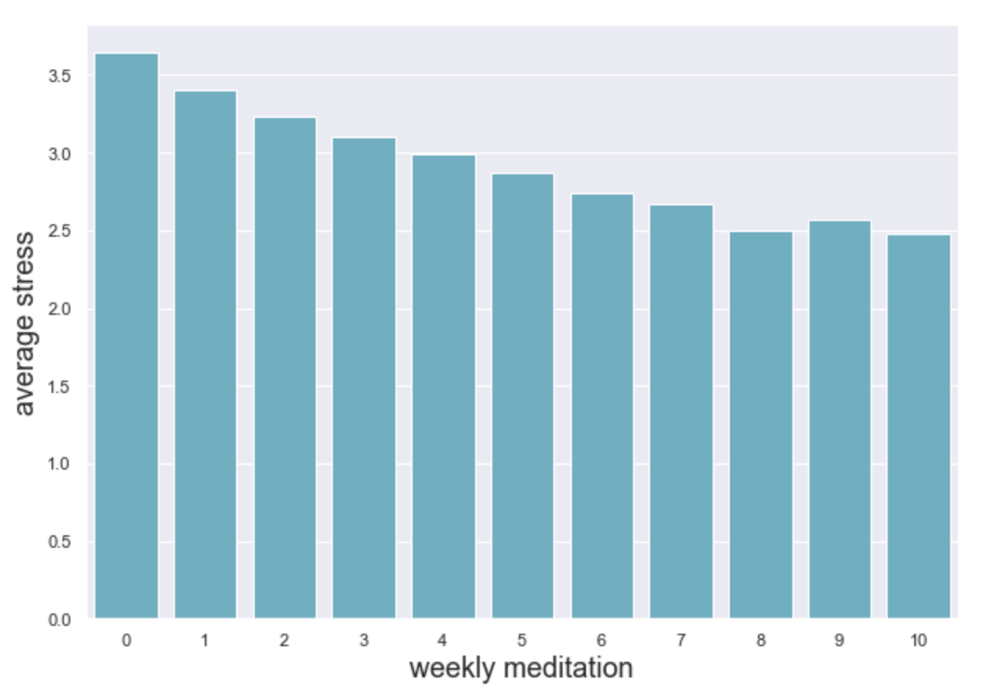
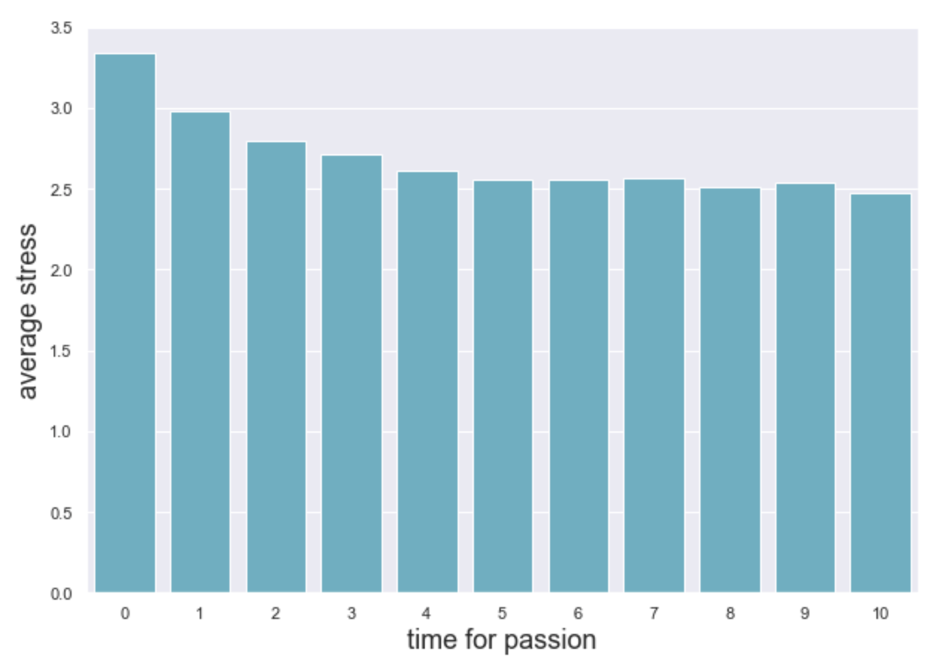
Statistical Analysis

Slide 8
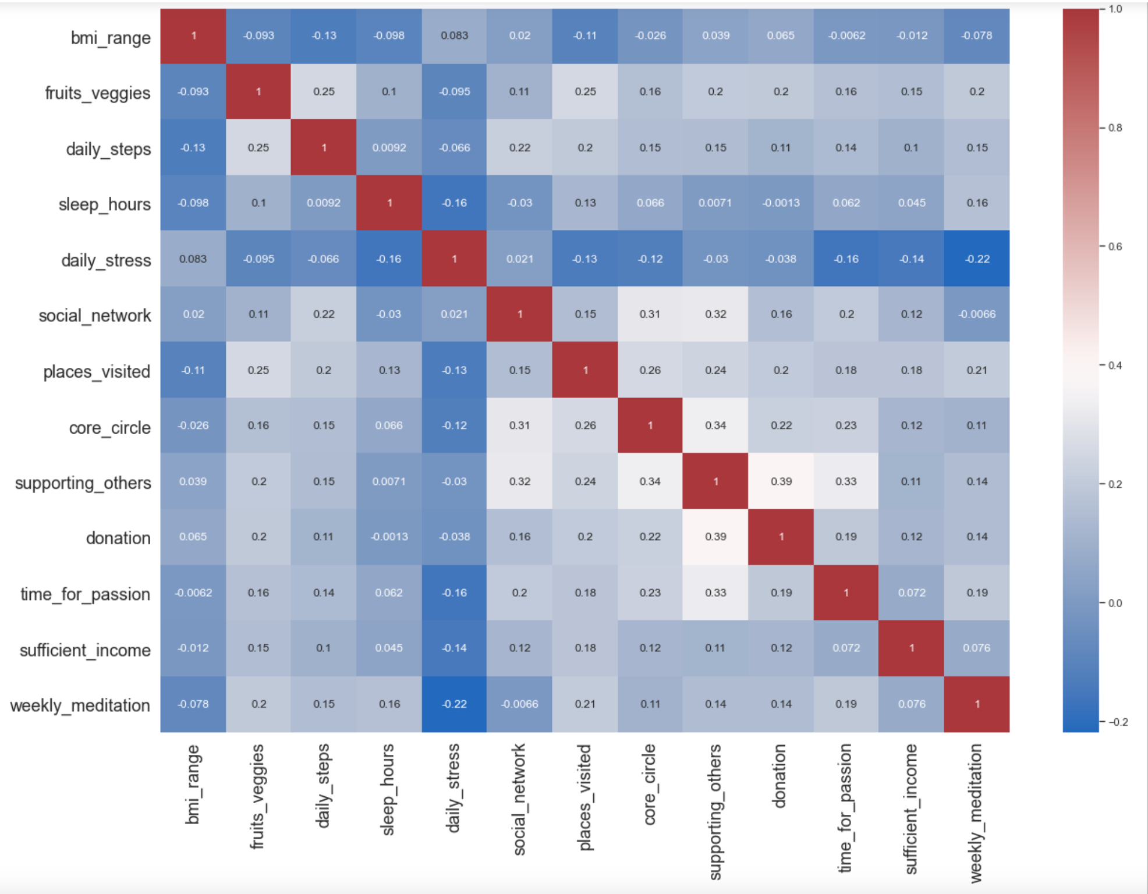
Correlation heatmap

Slide 9
Conclusion
Upon analysis over 10 attributes in various dimensions we can conclude the following:
Based on the given data BMI has the strongest positive correlation with stress (coefficient = 0.8)
Weekly meditation and time for passion have the strongest negative correlation ( coefficient= 0.21, 0.15)
Hours of sleep, exercise and good nutrition can help lower stress reasonably.
Correlation of stress with people supporting others or donating is not very significant.

Slide 10
Conclusion contd…
This analysis could also be helpful to certain businesses in promoting product innovations to targeted customer segments:
Health and Wellness Centers (Fitness Studios, Meditation and Yoga facilities)
Sports Wearable Market
Health Insurance Companies

Slide 11
Learning
Analyzing stress causing factors in different age groups could be meaningful
More data evidence on how this statistical analysis could help business innovations
Impact of COVID-19 on stress levels

Slide 12

Eat well, sleep right, move often and don’t forget TO MAKE some time for yourself TO ENJOY A stress free LIFE.

