Slide 1

Investigation of wattpad stories
Rupali Mayekar
David Richter
Luke Pharr
Andrea Karaffa

Slide 2
Background
Hypothesis
Motivation
Summary & Outcome
Wattpad is a good source to explore the increasing trend of creating and consuming stories on-the-go.
Desire to understand the users—readers and writers—and wattpad’s global footprint.
The ability to answer these questions using the wattpad api was very unsatisfactory after reviewing the data.
Notes:
Define the core message or hypothesis of your project.
Describe the questions you asked, and why you asked them
Describe whether you were able to answer these questions to your satisfication, and briefly summarize your findings
-WattPad is an application improving accessibility to publishing and reading stories on the go, but the API is still under development and is not reflective of the actual app usage yet.

Slide 3
Questions & Data
Research Questions | Data Required
What types of stories are popular? | Story ID, Vote Count, Read Count, Comment Count, Categories, Tags
How many stories are published annually? | Story Id, Created Date
What is the average time to complete a story? | Story ID, Created Date, Modify Date
What is the average number of chapters in a story? | Story ID, Number of Parts
Does story length correlate to number of readers? | Story ID, Read Count, Number of Parts
Does the sentiment analysis provide a link to the story tags? | Story ID, description, tags
Average popularity by story rating? | Story ID, rating
All data acquired from api.wattpad.com

Slide 4
Data Clean-Up & exploration
3. Pulling Data into DataFrame
2. Connect to the API
1. Document Research Questions
6. Export to CSV
5. Remove unwanted data
4. Run script daily, merge and remove duplicates**
** Process Step Added to Address the following difficulties:
Quantity of data records lower than expected Data changed daily
Notes:
Describe the exploration and cleanup process
Discuss insights you had while exploring the data that you didn't anticipate
Discuss any problems that arose after exploring the data, and how you resolved them
Present and discuss interesting figures developed during exploration, ideally with the help of Jupyter Notebook

Slide 5
Data Analysis
1. Pull CSV to create Visualizations
2. Create Plots
3. Standardize Plot Formatting
4. Adjust Research Questions
Data Difficulties
User data was not available Focus became story data Data all belonged to 1 random category and all in English Used Story tags instead of categories to gain insights All stories were not rated as mature Numeric rating had to be used
Notes:
Describe the exploration and cleanup process
Discuss insights you had while exploring the data that you didn't anticipate
Discuss any problems that arose after exploring the data, and how you resolved them
Present and discuss interesting figures developed during exploration, ideally with the help of Jupyter Notebook

Slide 6
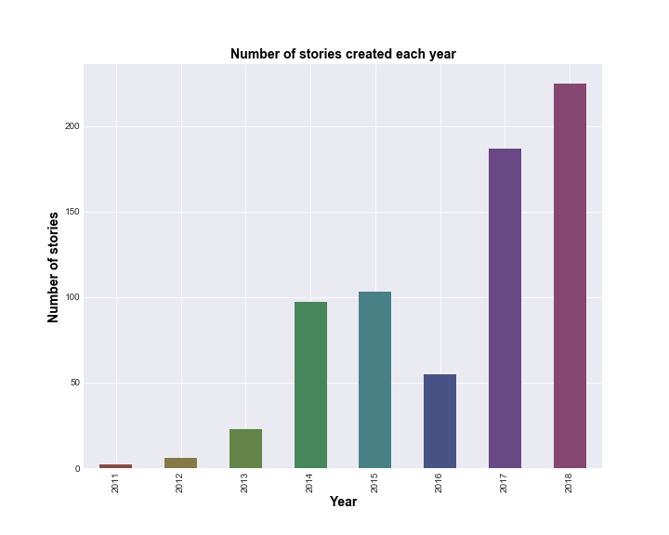
Story Trends
244
12
75
244
Average days to complete story post
12
Average number of chapters in a story
Average number of words in a story
Story length does not appear to relate to story popularity
75,265
Stories posted annually generally have increased since 2011, with the exception of decrease in growth during 2016.

Slide 7
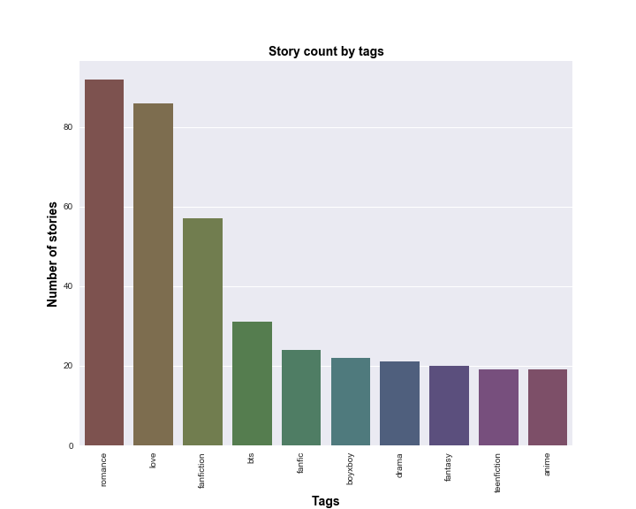
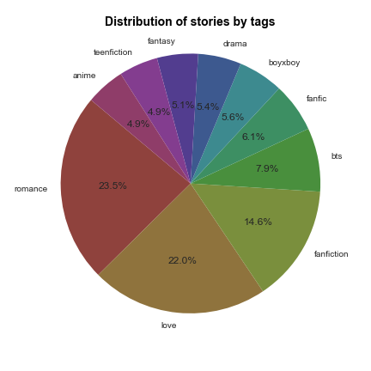
Story Tag Popularity
Most popular tags are Romance, Love and Fanfiction

Slide 8
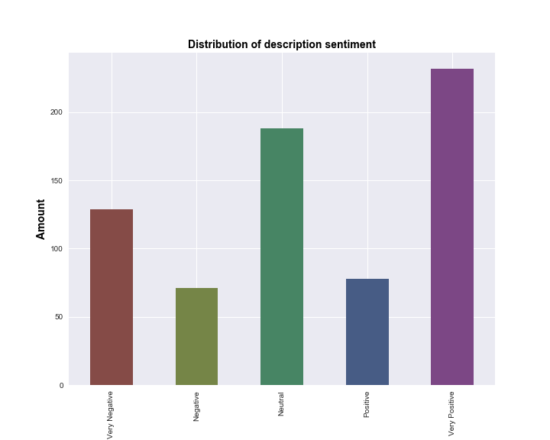
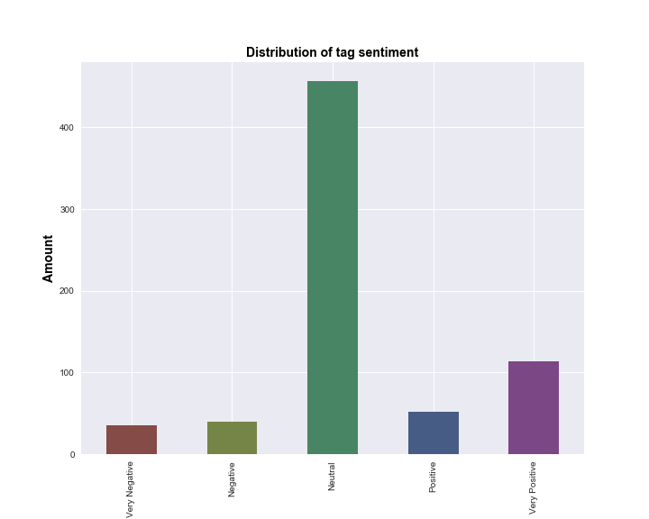
Tag and Description Sentiment
Sentiment between story tags and description is not consistent
Description sentiment is likely more representative of the story because the averaged tag sentiment causes multiple sentiments to be averaged out

Slide 9
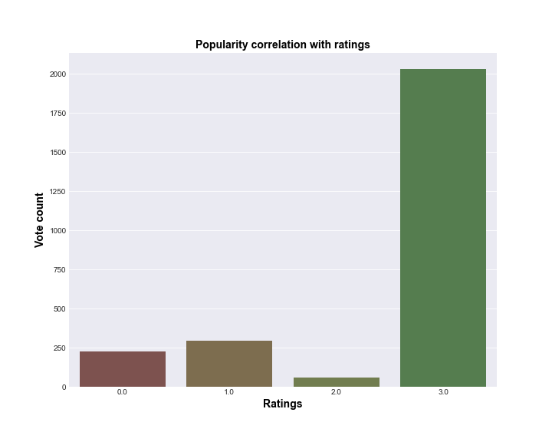
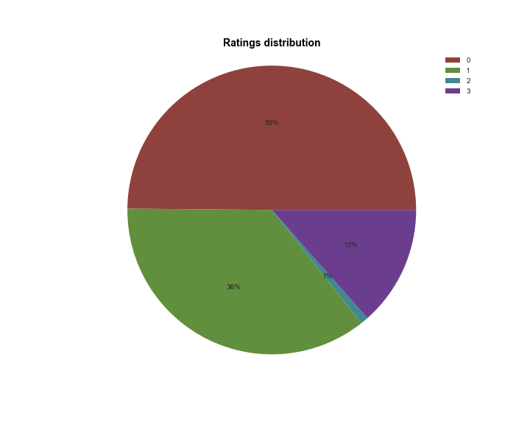
Story Ratings
Popularity based on vote count appears to be a factor in wattpad’s assigned ratings, but is not the only factor

Slide 10
Discussion
Discuss your findings. Did you find what you expected to find? If not, why not? What inferences or general conclusions can you draw from your analysis?
Notes:
Discuss your findings. Did you find what you expected to find? If not, why not? What inferences or general conclusions can you draw from your analysis?

Slide 11
Lessons Learned
Difficulties
API not well documented, difficulty with pagination
Unanswered questions
Number of users globally and locally?
If We Had More Time…
Datasets do not appear to represent app as a whole
Which markets and languages are most widely read?
Research better sources to understand mobile reader trends
Query API daily and continue to build existing dataset

Slide 12
Q & A

