Slide 2
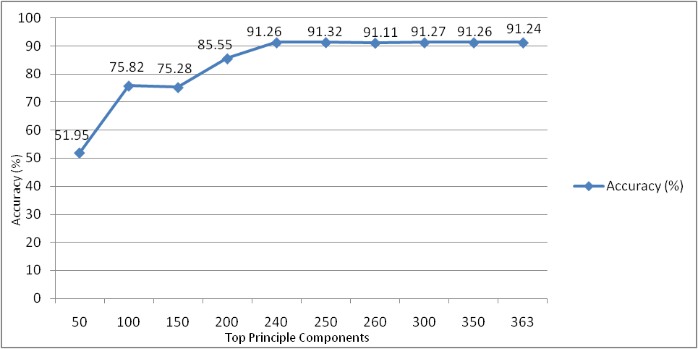

Slide 6
Accuracy (%)
Top Principle Components

