Slide 1
Team 9
{Rupali,Sowmya}

Slide 2
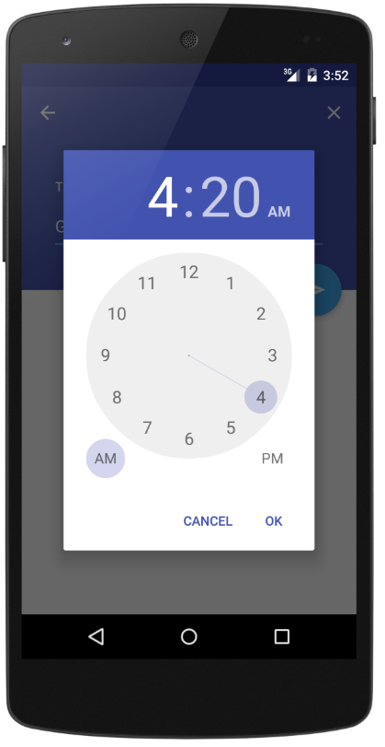
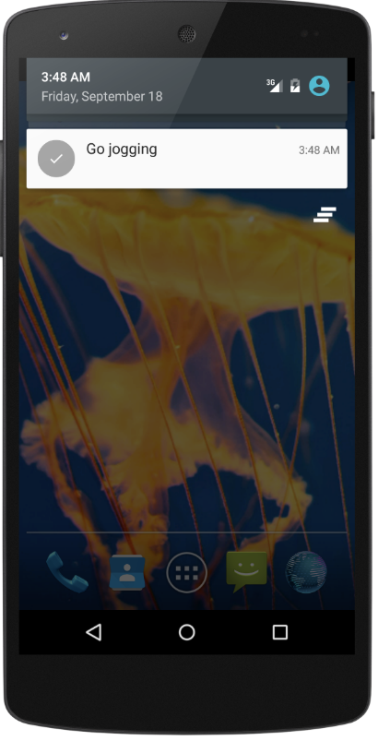
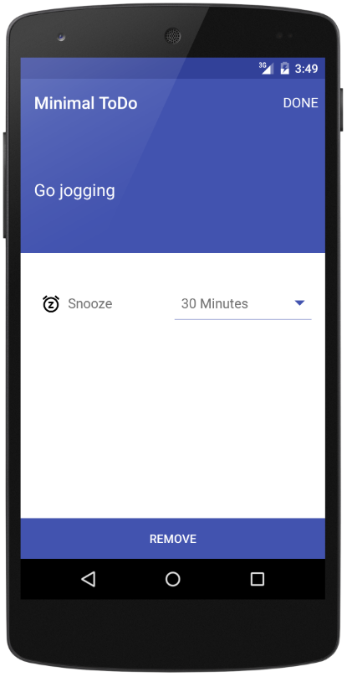
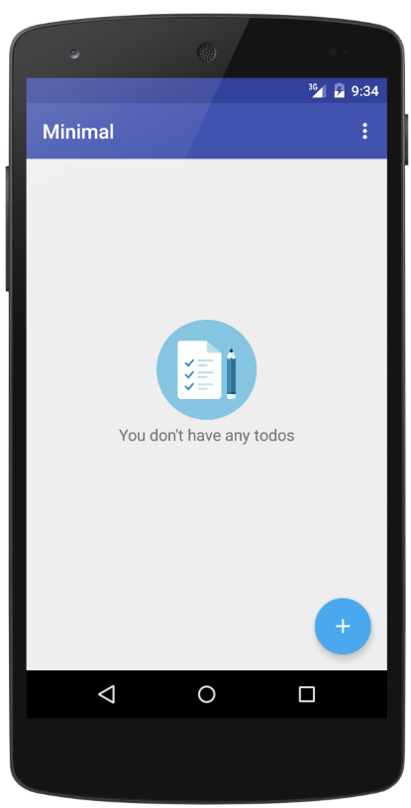
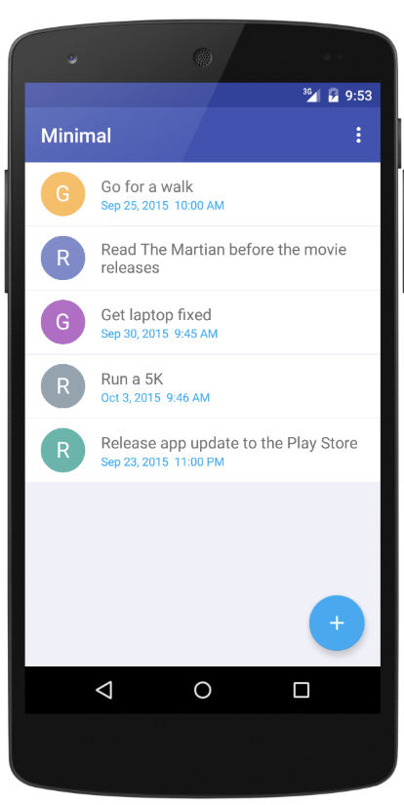
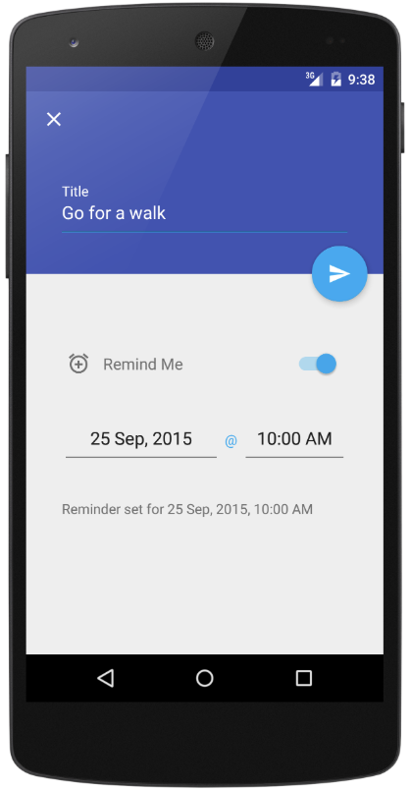
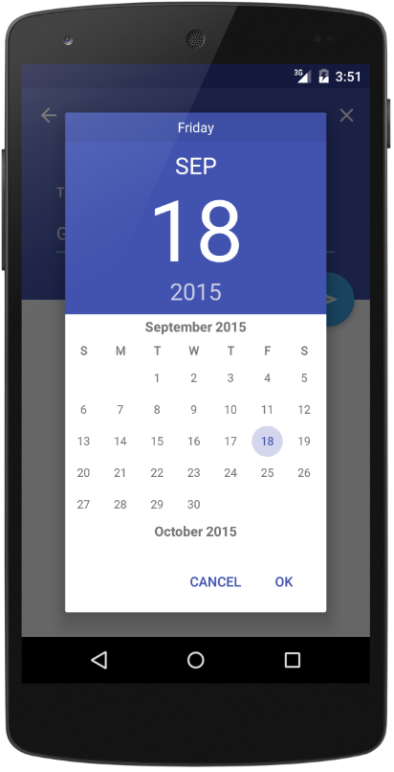
Android Minimal - TODO
https://github.com/avjinder/Minimal-Todo

Slide 3
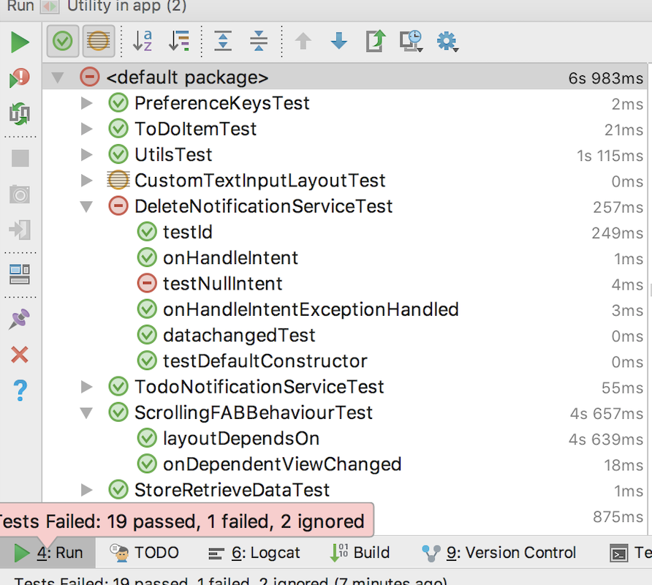
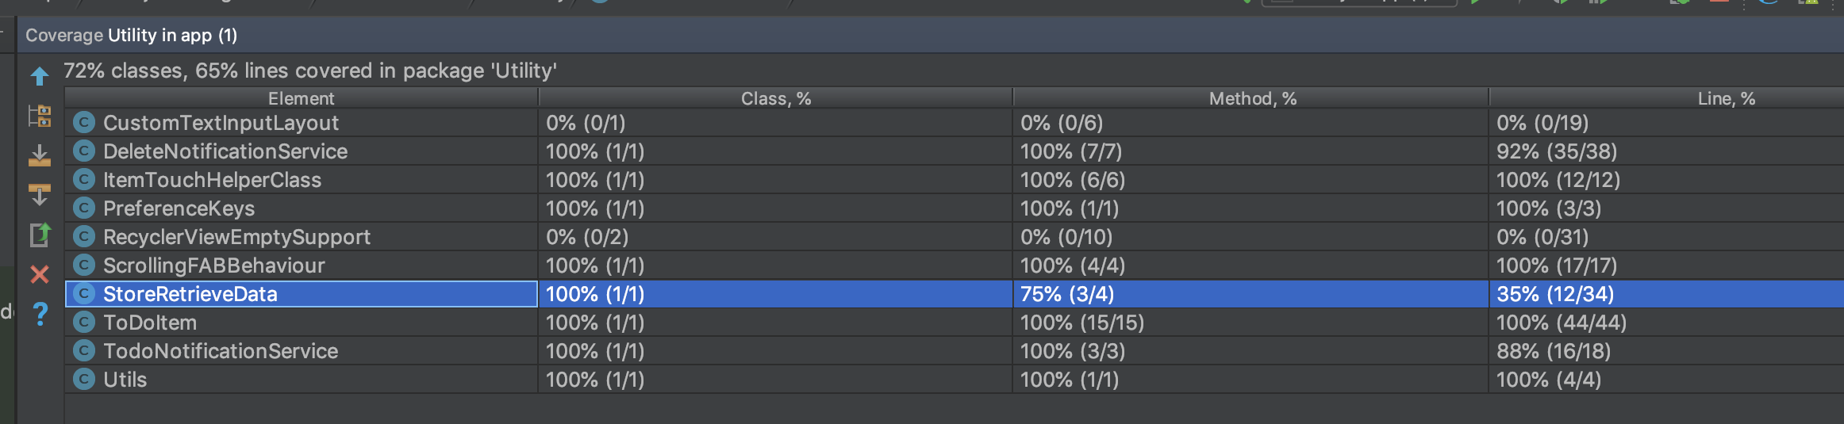
Unit Testing and Code Coverage

Slide 4
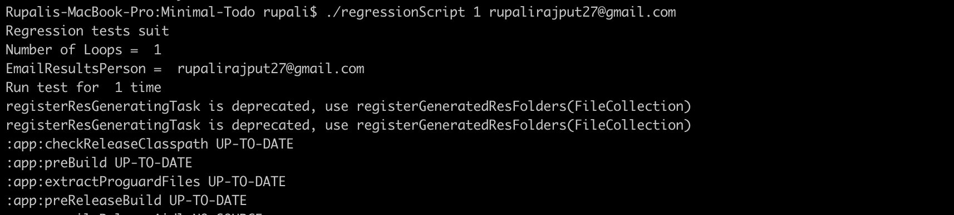
Regression Testing

Slide 5
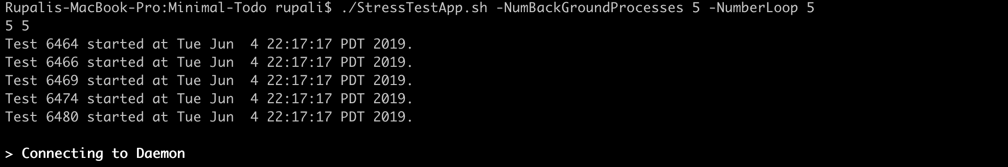
Stress Testing
Stress testing is the process of determining the ability of a computer, network, program or device to maintain a certain level of effectiveness under any conditions.
In our app, we have done stress testing for 100 Processors and 100 loops. It takes around 115mins to complete the entire activity.
./StressTestApp.sh -NumBackGroundProcesses 5 -NumberLoop 5

Slide 6
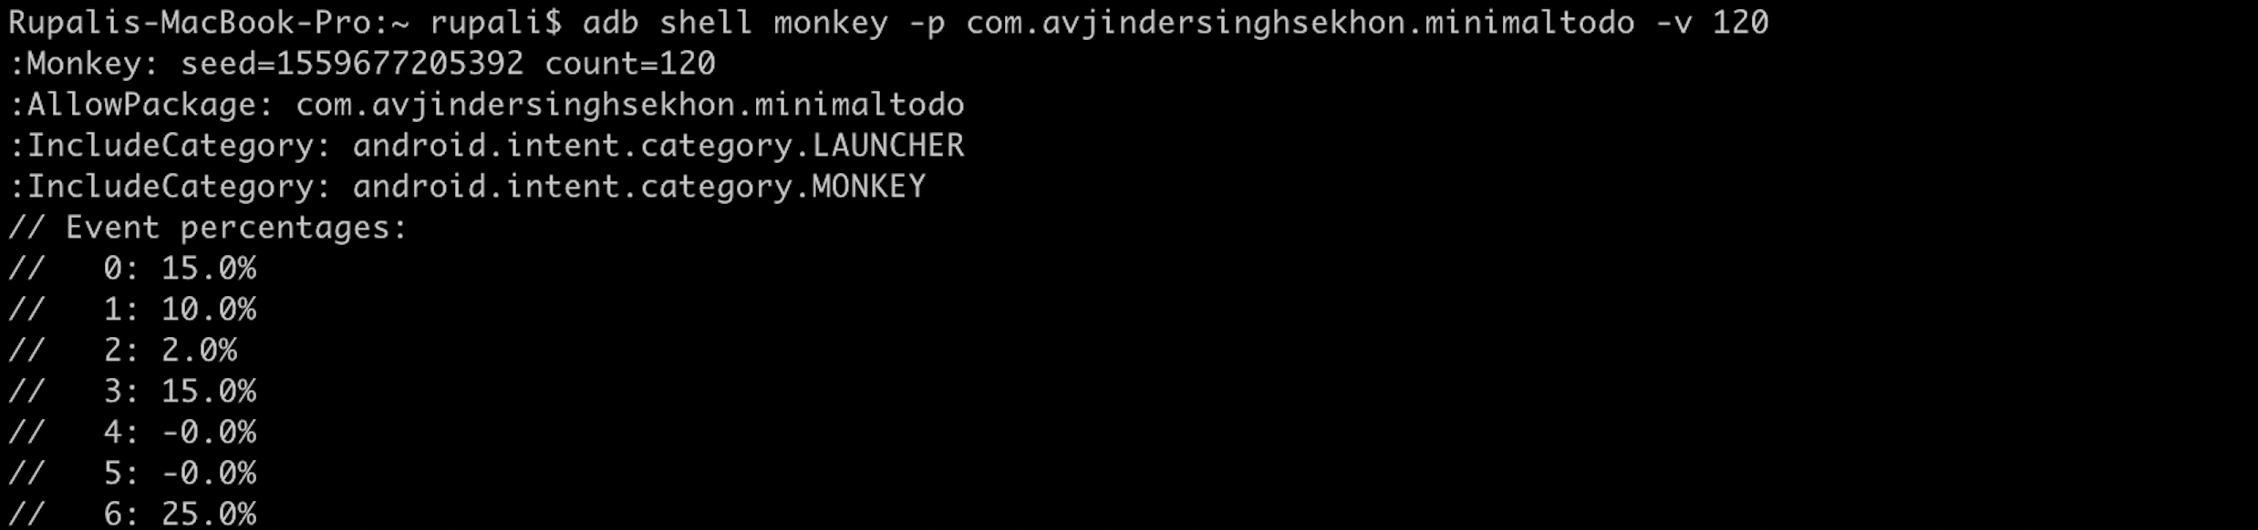
Monkey Testing
The Monkey is a command line tool that runs on your emulator or device and generates random streams of user events such as clicks, touches, or gestures.
You can run monkey command from shell environment: $ adb shell monkey [options] <event-count>

Slide 7
Experiences and Lessons Learned

