Slide 1


Consumer Goods
Ad_hoc Insights

Slide 2
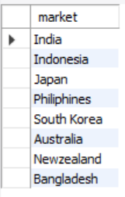
REQUEST 1 : Provide the list of markets in which customer "Atliq Exclusive" operates its business in the APAC region. OUTPUT :
INSIGHTS :
Atliq Exclusive customer operates its business in the APAC region in 8 markets. They are India, Indonesia, Japan, Philippines, South Korea, Australia, New Zealand, and Bangladesh.

Slide 3

REQUEST 2 : What is the percentage of unique product increase in 2021 vs. 2020? The final output contains these fields, unique_products_2020 unique_products_2021 percentage_chg OUTPUT :

Slide 4
Conversion of Output to Visualisation
INSIGHTS
Based on results comparing fiscal years 2020 and 2021, the number of products increased in 2021 is 89.
The percentage of unique products increased in 2021 v/s 2020 is 36.33%.

Slide 5
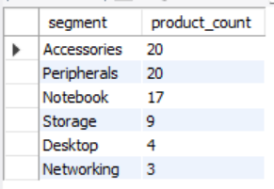
REQUEST 3 : Provide a report with all the unique product counts for each segment and sort them in descending order of product counts. The final output contains 2 fields, segment product_count OUTPUT :

Slide 6
Conversion of Output to Visualisation
INSIGHTS
There are 6 segments in Atliq Hardware based on the results. They are Accessories, Peripherals, Notebook,Storage, Desktops and Networking.
Among the 6 segments, Accessories and Peripherals contributed the most for unique product count, i.e. 20; the lowest contributing segment is Networking, which has a unique product count of 3.

Slide 7
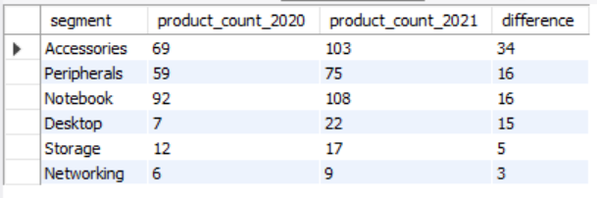
REQUEST 4 : Which segment had the most increase in unique products in 2021 vs 2020? The final output contains these fields, segment product_count_2020 product_count_2021 difference OUTPUT :

Slide 8
Conversion of Output to Visualisation
INSIGHTS
From the results, we can see that there is an increase in the unique product count in each segment in the fiscal year 2021 as compared to 2020.
Segment Accessories have the maximum increase in the unique product and Networking has the minimum increase in the unique product.

Slide 9
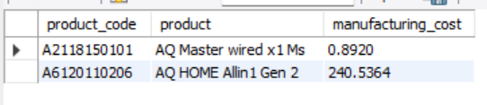
REQUEST 5 : Get the products that have the highest and lowest manufacturing costs. The final output should contain these fields, product_code product manufacturing_cost OUTPUT :
INSIGHTS :
We have product “AQ HOME Allin 1 Gen 2 ” having the highest manufacturing cost of 240.5364 and product “AQ Master wired x1 Ms” having the lowest manufacturing cost of 0.8920.

Slide 10
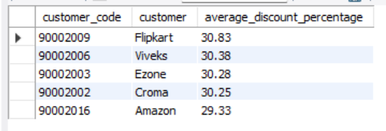
REQUEST 6 : Generate a report which contains the top 5 customers who received an average high pre_invoice_discount_pct for the fiscal year 2021 and in the Indian market. The final output contains these fields, customer_code customer average_discount_percentage OUTPUT :

Slide 11
Conversion of Output to Visualisation
INSIGHTS
The top 5 customers who received an average high pre_invoice_discount_pct for the fiscal year 2021 and in the Indian market are Flipkart, Viveks, Ezone, Croma and Amazon.
For the fiscal year 2021, the top 1 Indian customer who received an average high pre_invoice_ discount_pct is Flipkart with a 30.28% share.

Slide 12
REQUEST 7 : Get the complete report of the Gross sales amount for the customer “Atliq Exclusive” for each month. This analysis helps to get an idea of low and high-performing months and take strategic decisions. The final report contains these columns: Month Year Gross sales Amount OUTPUT :
Month | Year | Gross sales Amount
September | 2019 | 9092670.34
October | 2019 | 10378637.6
November | 2019 | 15231894.97
December | 2019 | 9755795.06
January | 2020 | 9584951.94
February | 2020 | 8083995.55
March | 2020 | 766976.45
April | 2020 | 800071.95
May | 2020 | 1586964.48
June | 2020 | 3429736.57
July | 2020 | 5151815.4
August | 2020 | 5638281.83
September | 2020 | 19530271.3
October | 2020 | 21016218.21
November | 2020 | 32247289.79
December | 2020 | 20409063.18
January | 2021 | 19570701.71
February | 2021 | 15986603.89
March | 2021 | 19149624.92
April | 2021 | 11483530.3
May | 2021 | 19204309.41
June | 2021 | 15457579.66
July | 2021 | 19044968.82
August | 2021 | 11324548.34

Slide 13
Conversion of Output to Visualisation
INSIGHTS
The Gross sales report for the “Atliq Exclusive” for each month and year-wise is given in the table.
From the graph, the highest gross sales for the “Atliq Exclusive” is in the month of November 2021.
There is a drop in sales in and after March 2020 because of Covid.

Slide 14
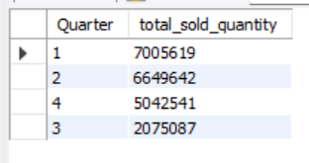
REQUEST 8 : In which quarter of 2020, got the maximum total_sold_quantity? The final output contains these fields sorted by the total_sold_quantity, Quarter total_sold_quantity OUTPUT :

Slide 15
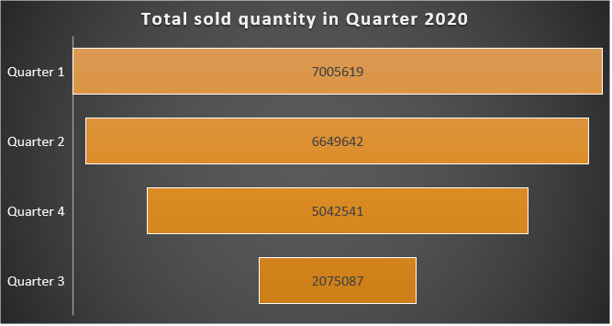
Conversion of Output to Visualisation
INSIGHTS
The maximum total_sold_quantity occurred in Quarter 1 which accounts for 7005619.
The minimum total_sold_quantity occurred in Quarter 3 which accounts for 2075087.

Slide 16
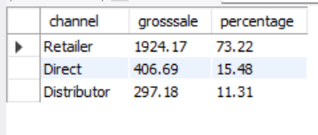
REQUEST 9 : Which channel helped to bring more gross sales in the fiscal year 2021 and the percentage of contribution? The final output contains these fields, channel gross_sales_mln percentage OUTPUT :

Slide 17
Conversion of Output to Visualisation
INSIGHTS
Retailer channel helped to bring more gross sales in the fiscal year 2021 and the percentage of contribution is 73.22%.
Distributor channel helped to bring more gross sales in the fiscal year 2021 and the percentage of contribution is 11.31%.

Slide 18
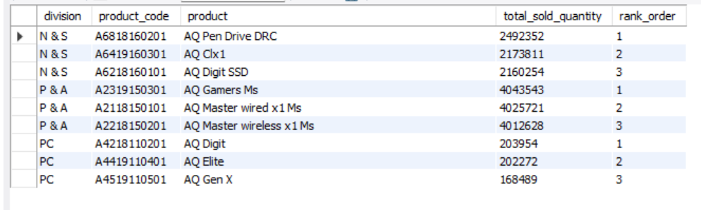
REQUEST 10 : Get the Top 3 products in each division that have a high total_sold_quantity in the fiscal_year 2021. The final output contains these fields, division product_code product total_sold_quantity rank_order OUTPUT :

Slide 19
Conversion of Output to Visualisation
INSIGHTS
As we can see, there are 3 divisions – N&S, P & A and PC.
In N&S division AQ Pen Drive DRC, in P & A AQ Games Ms and in PC AQ Digit are one in Rank order.

Slide 20
THANK YOU

