Slide 1
Smart Thermostat / Air Purifier
Jasjeet Kaur, Rupal Jain
January 12, 2017

Slide 2
Internet of Things (IoT) & Application Development
What
Turn ON in-house devices such as thermostat / air-purifier before stepping in the house
Why
Do away with device warm up duration/delay
How
Switch ON/OFF in-house devices using user’s location
Sensor To be used: GPS Sensor from User’s mobile device
Concept for prototype : Location co-ordinates are readily available
nowadays since GPS Sensors are present in our smart mobile
Devices. Hence for prototype, we are using Location co-ordinates
directly as perceived by any mobile device.

Slide 3
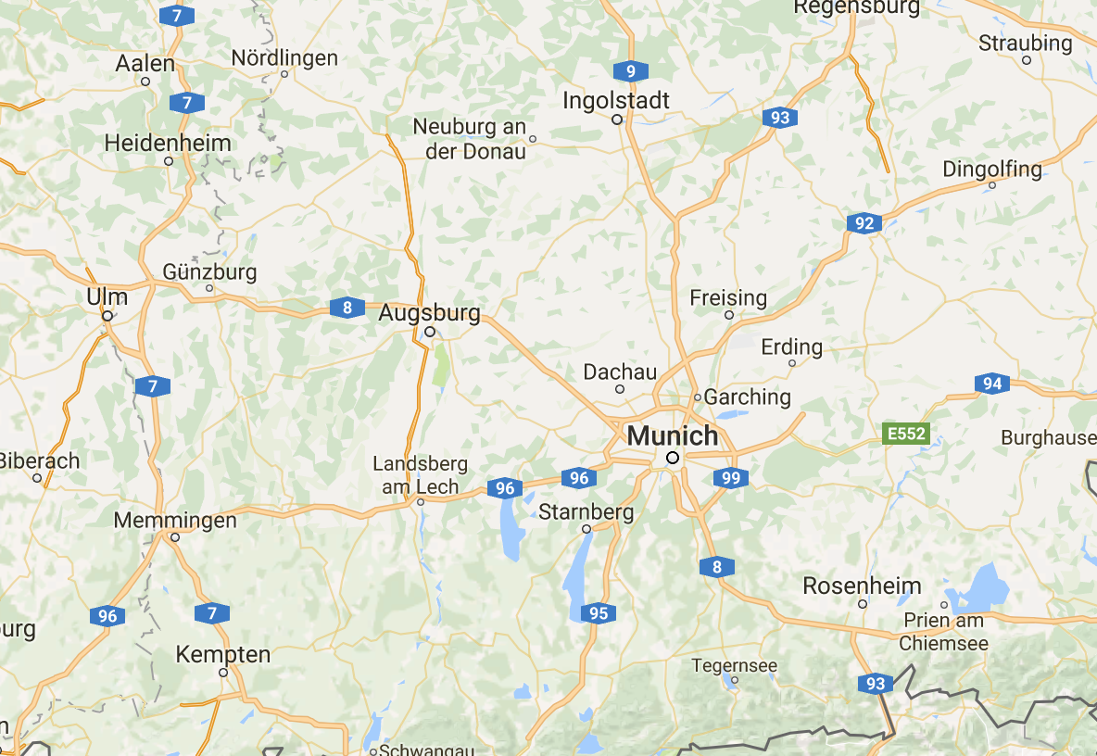





Main Idea of Prototype
Rupal might be reaching home!
App
Rupal is reaching home!
Time to turn on the heater
LOCATION
Point from which
Time to reach home = Time to switch on in-house device

Slide 4
Conceptual Approach
Information Required:
Time take by in-house system to switch ON or OFF and do its intended task (T₁)
Time take by Raspberry pi to relay the signal to the in-house system (T₂)
User’s house location (H)
[Total delay, T₀ = T₁ + T₂]
Concept :
Calculate maximum distance ,D, user can travel starting from H in time (T₀ )
Mark the circle, C, of radius ‘D’ with centre ‘H’
When user enters ‘C’, calculate the time to reach home (T)
When T = T₀, send signal to in-house device through raspberry pi
Implementation Highlights:
NodeRed along with Javascript for application mashup
OverviewPathPoints of google’s direction API used for getting points on a path to simulate a GPS sensor.
Moving marker used to simulate a moving car
Raspberry for sending signal to in-house system

Slide 5

Thank You!
Questions
Thoughts

