Slide 1

ChatGPT Vs Gemini SQL Case Study Analysis
Presented By Rupal Hiwarkar

Slide 2
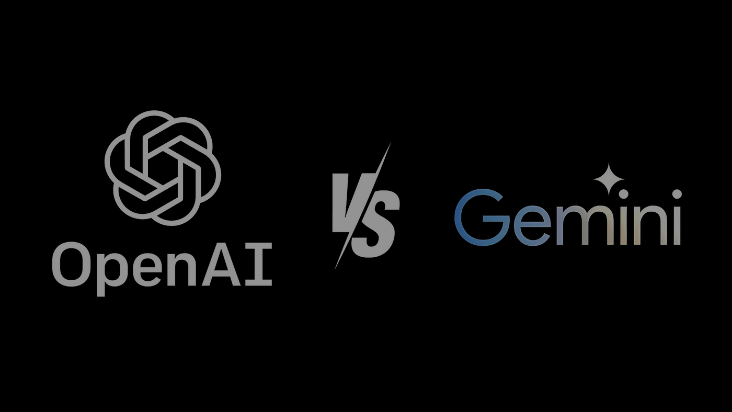
CHALLENGE
The challenge is to craft SQL queries to extract insights from the Gemini Vs ChatGPT database.

Slide 3
Table Of Contents
Capabilities
Models
Benchmarks

Slide 4
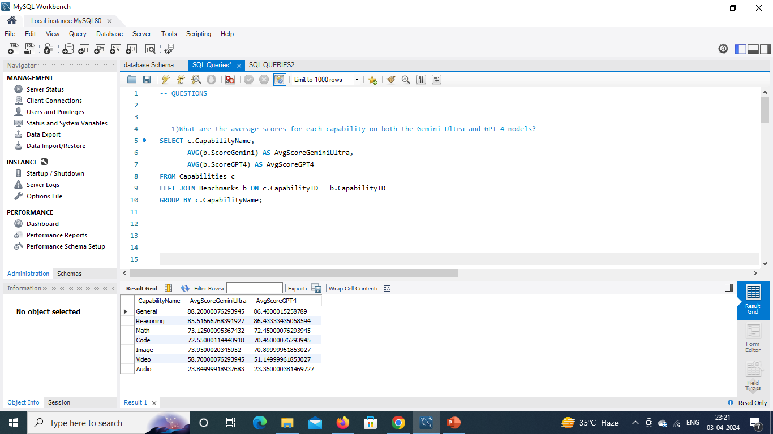
1)What are the average scores for each capability on both the Gemini Ultra and GPT-4 models?

Slide 5
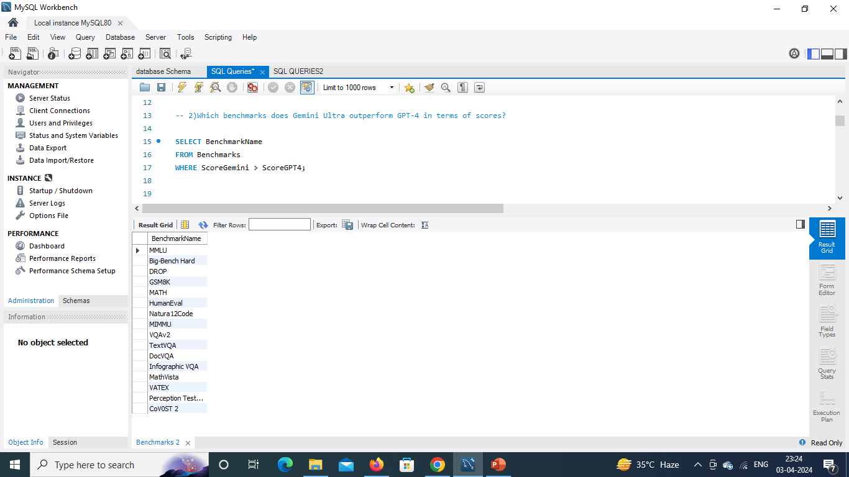
2)Which benchmarks does Gemini Ultra outperform GPT-4 in terms of scores?

Slide 6
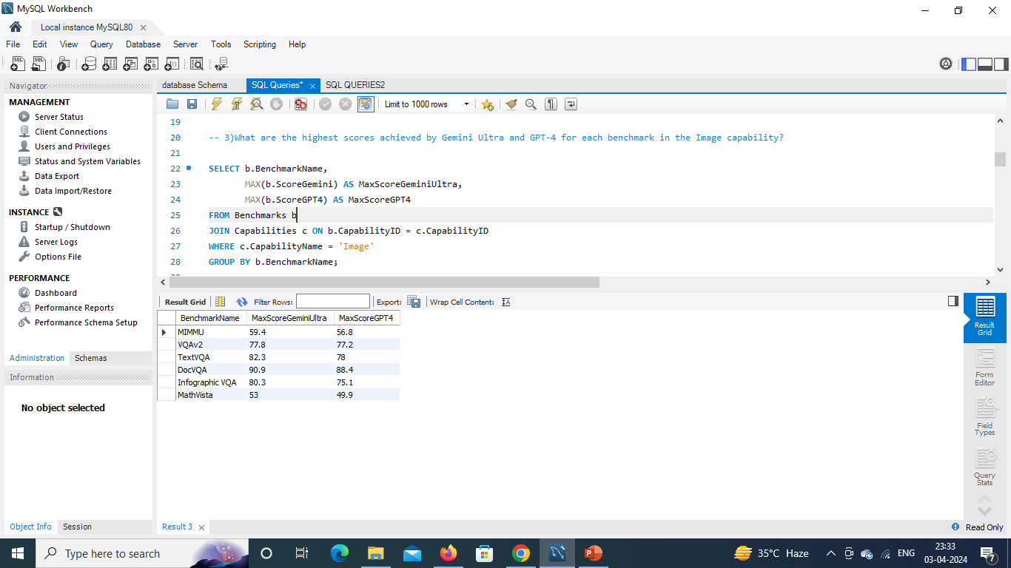
3)What are the highest scores achieved by Gemini Ultra and GPT-4 for each benchmark in the Image capability?

Slide 7
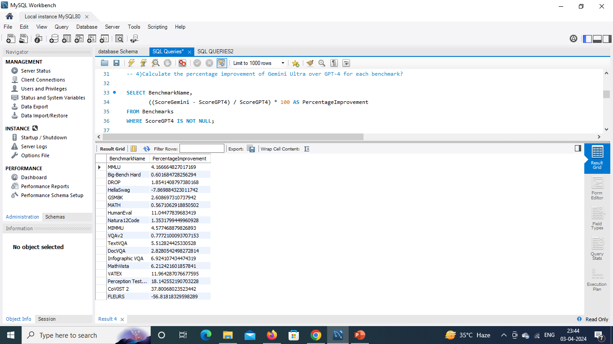
4)Calculate the percentage improvement of Gemini Ultra over GPT-4 for each benchmark?

Slide 8
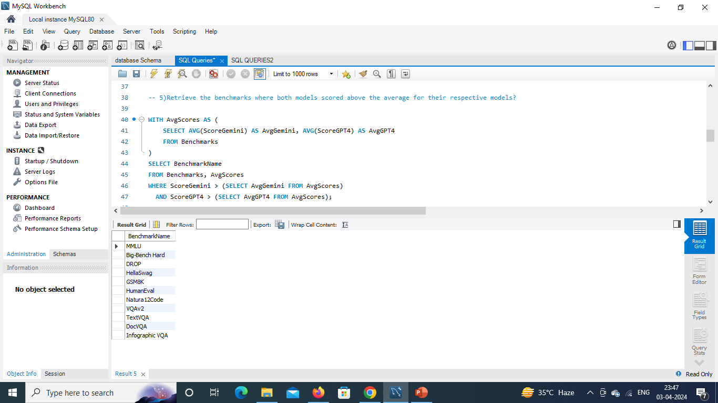
5)Retrieve the benchmarks where both models scored above the average for their respective models.

Slide 9
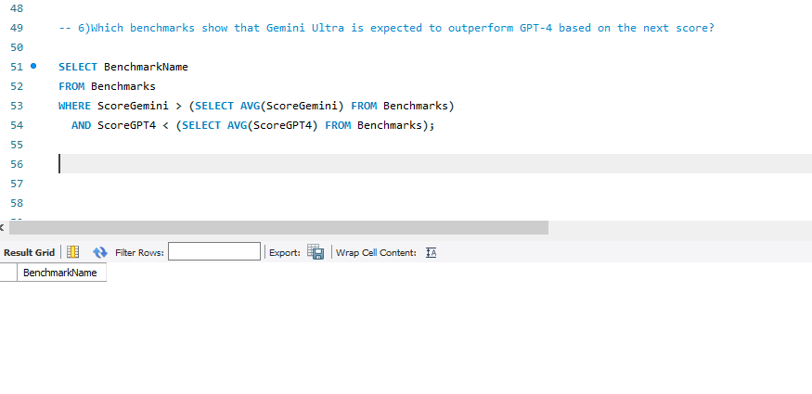
6)Which benchmarks show that Gemini Ultra is expected to outperform GPT-4 based on the next score?

Slide 10
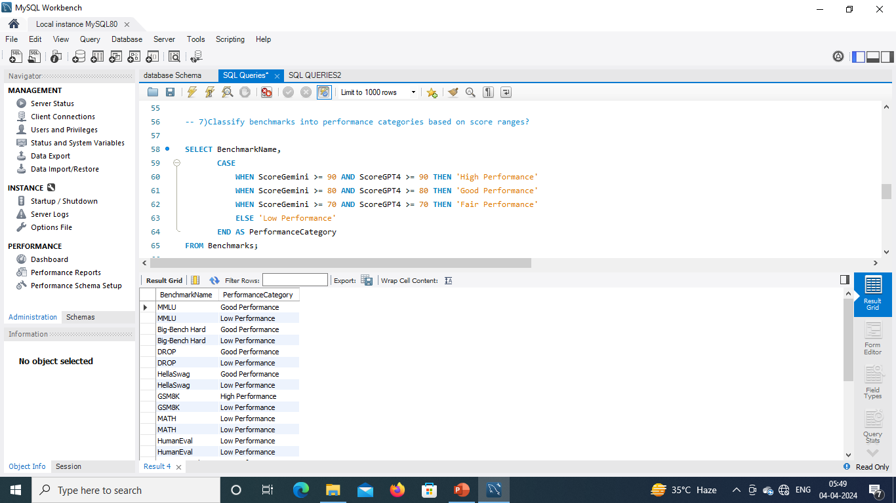
7)Classify benchmarks into performance categories based on score ranges?

Slide 11
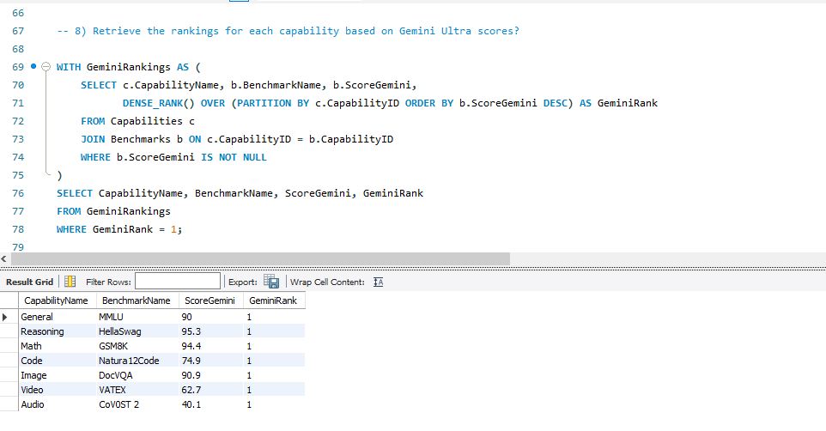
8) Retrieve the rankings for each capability based on Gemini Ultra scores?

Slide 12
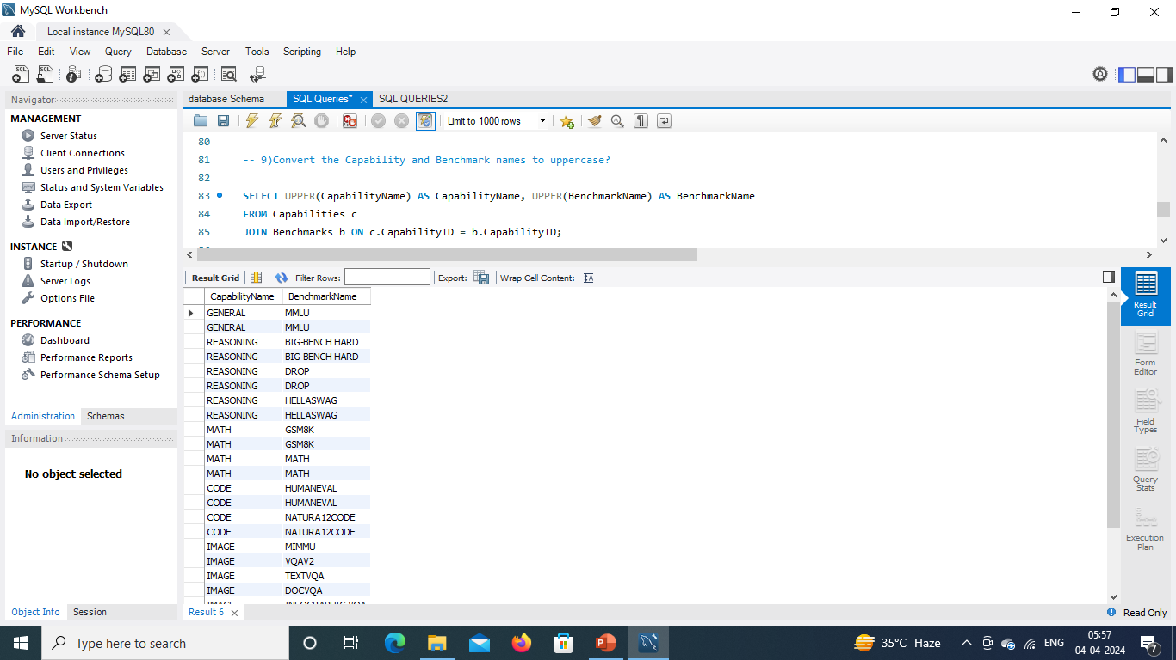
9)Convert the Capability and Benchmark names to uppercase.

Slide 13
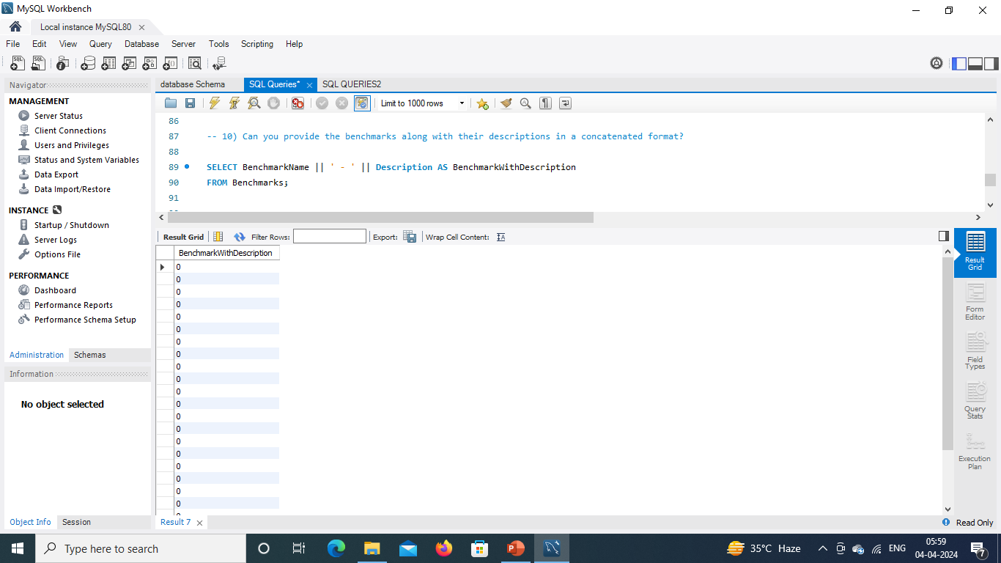
10) Can you provide the benchmarks along with their descriptions in a concatenated format?

Slide 14
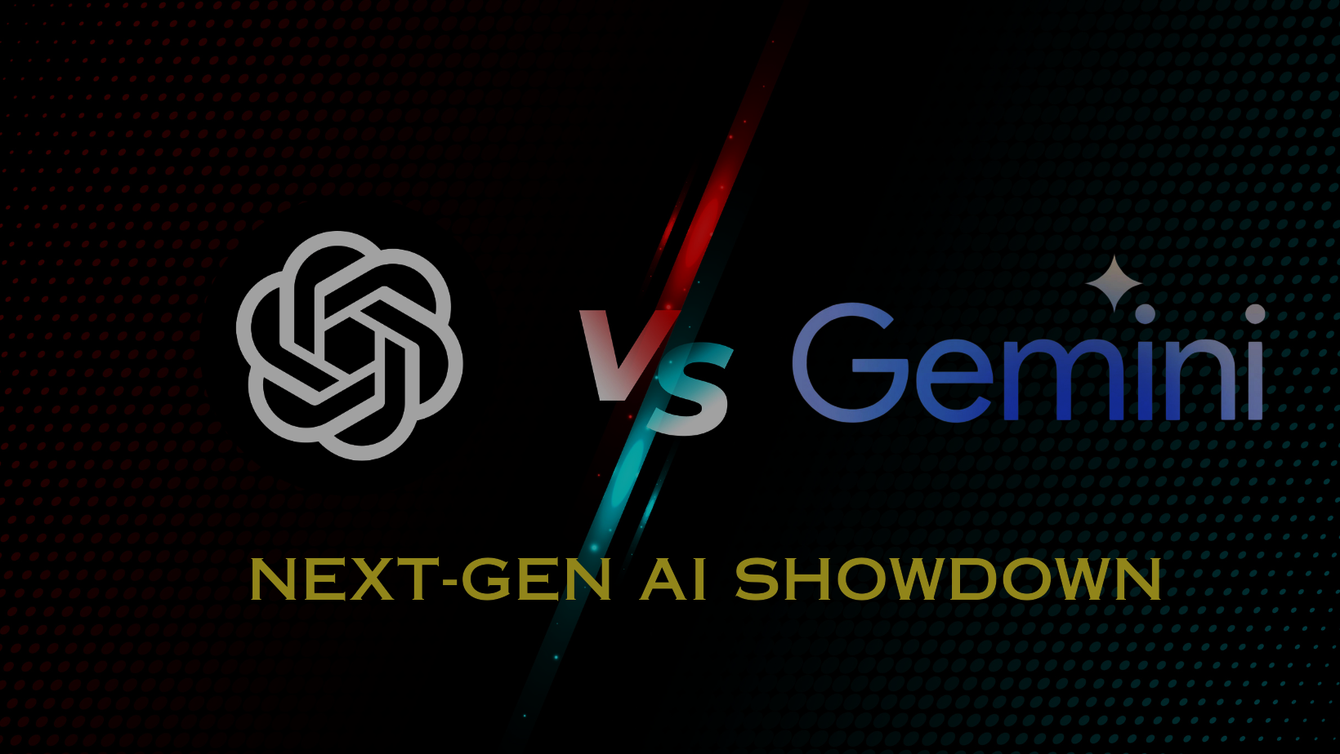
Thank You

