Slide 1
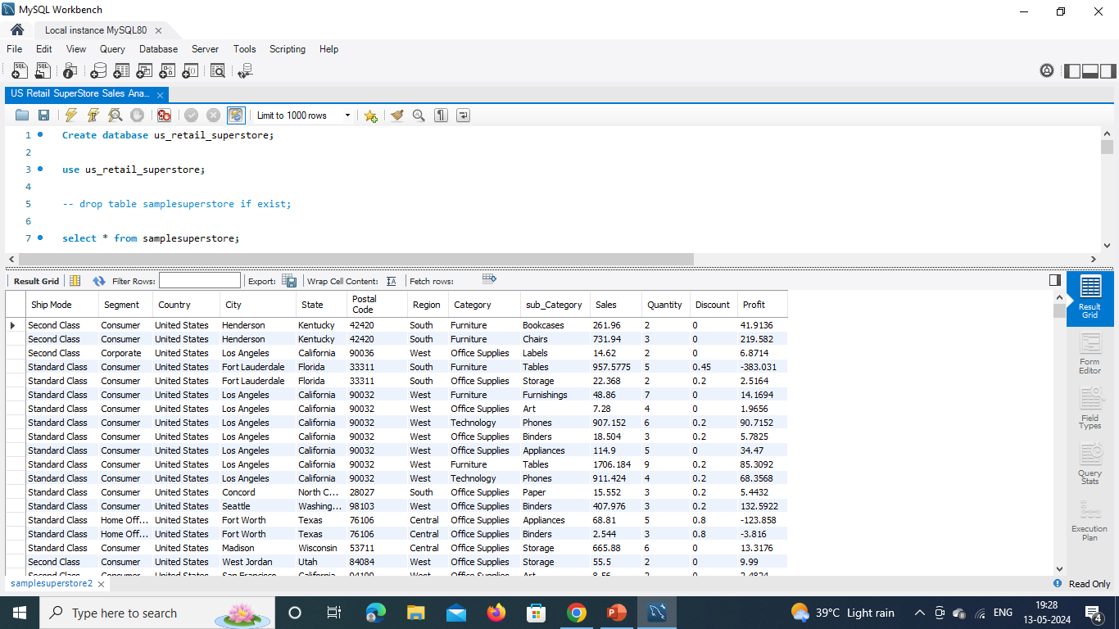
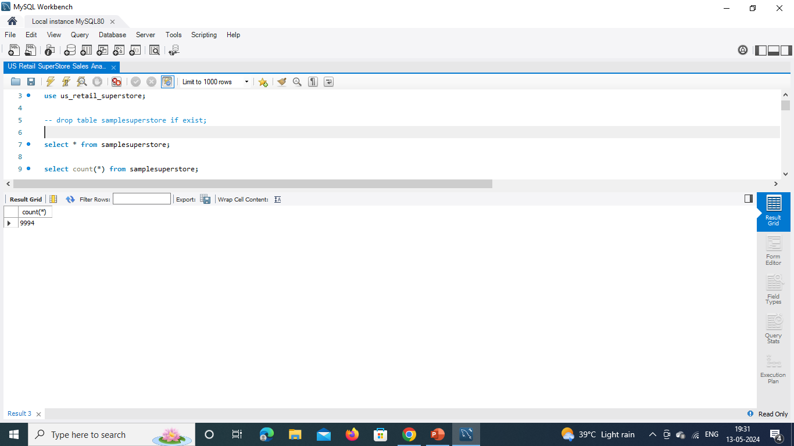
US Retail Superstore Sales SQL Case Study Analysis Using MySQL Workbench
Create database us_retail_superstore;
use us_retail_superstore;
select * from samplesuperstore;
select count(*) from samplesuperstore

Slide 2
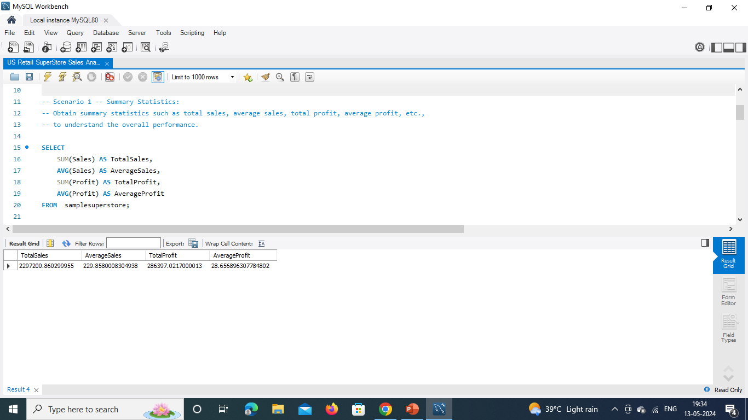
Scenario 1
-- Summary Statistics: -- Obtain summary statistics such as total sales, average sales, total profit, average profit, etc.,
-- to understand the overall performance.
SELECT SUM(Sales) AS TotalSales,
AVG(Sales) AS AverageSales, SUM(Profit) AS TotalProfit,
AVG(Profit) AS AverageProfit
FROM samplesuperstore;

Slide 3
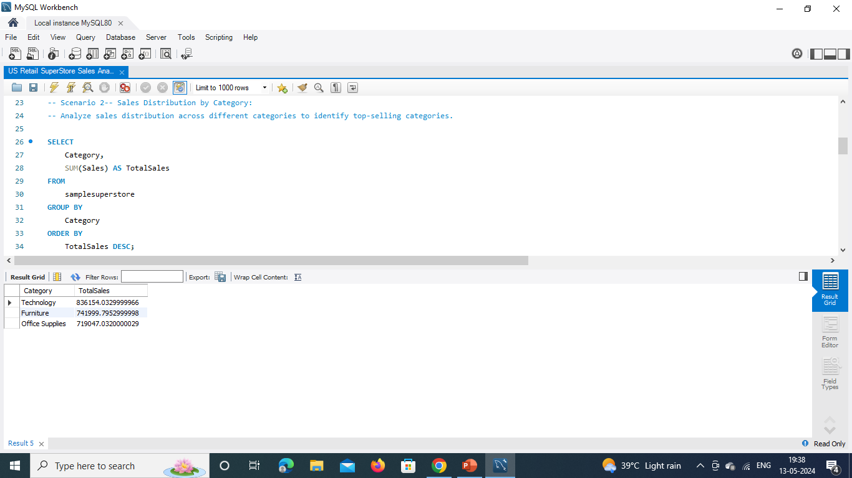
Scenario 2
--Sales Distribution by Category
--Analyze sales distribution across different categories to identify top-selling categories.
SELECT Category, SUM(Sales) AS TotalSales
FROM samplesuperstore
GROUP BY Category
ORDER BY TotalSales DESC;

Slide 4
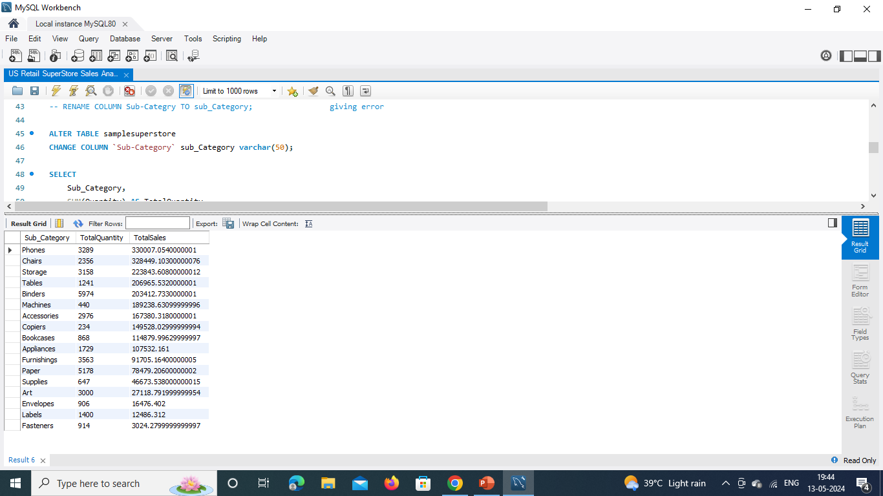
Scenario 3
-- Top Selling Products:
--Identify the top-selling products based on sales quantity or revenue.
desc samplesuperstore;
--Scenario 4
ALTER TABLE samplesuperstore-- RENAME COLUMN Sub-Category TO sub_Category;
--giving error
ALTER TABLE samplesuperstoreCHANGE COLUMN `Sub-Category` sub_Category varchar(50);
SELECT Sub_Category,
SUM(Quantity) AS TotalQuantity,
SUM(Sales) AS TotalSales
FROM samplesuperstore
GROUP BY Sub_Category
ORDER BY TotalSales DESC;

Slide 5
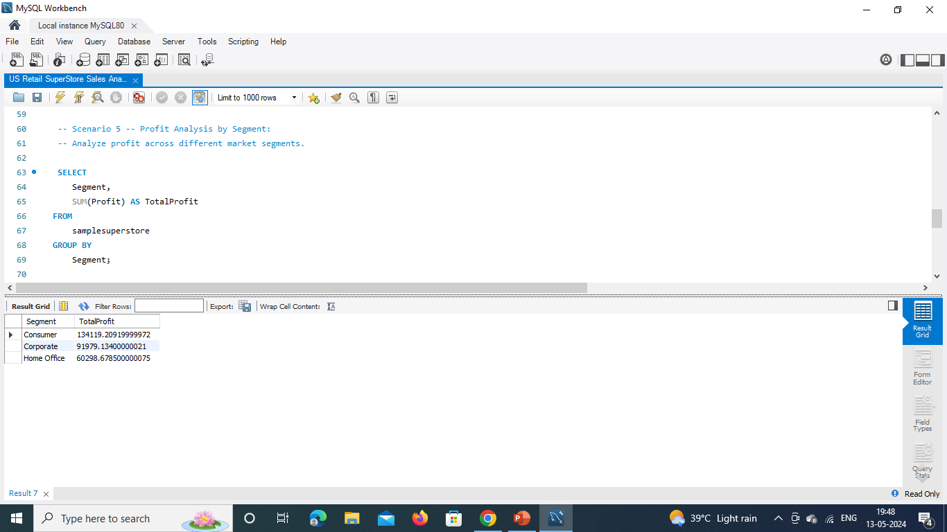
--Scenario 5
-- Profit Analysis by Segment:
-- Analyze profit across different market segments.
SELECT Segment,
SUM(Profit) AS TotalProfit
FROM samplesuperstore
GROUP BY Segment;

Slide 6
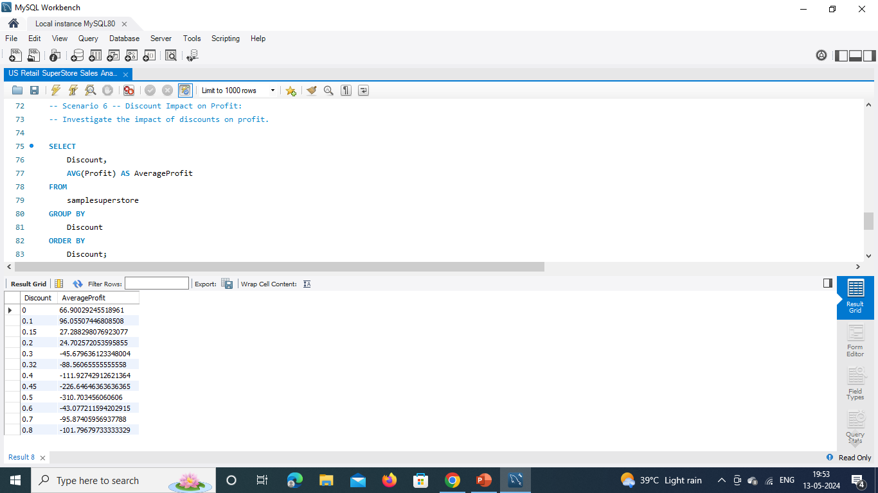
-- Scenario 6
-- Discount Impact on Profit:
-- Investigate the impact of discounts on profit.
SELECT Discount, AVG(Profit) AS AverageProfit
FROM samplesuperstore
GROUP BY Discount
ORDER BY Discount;

Slide 7
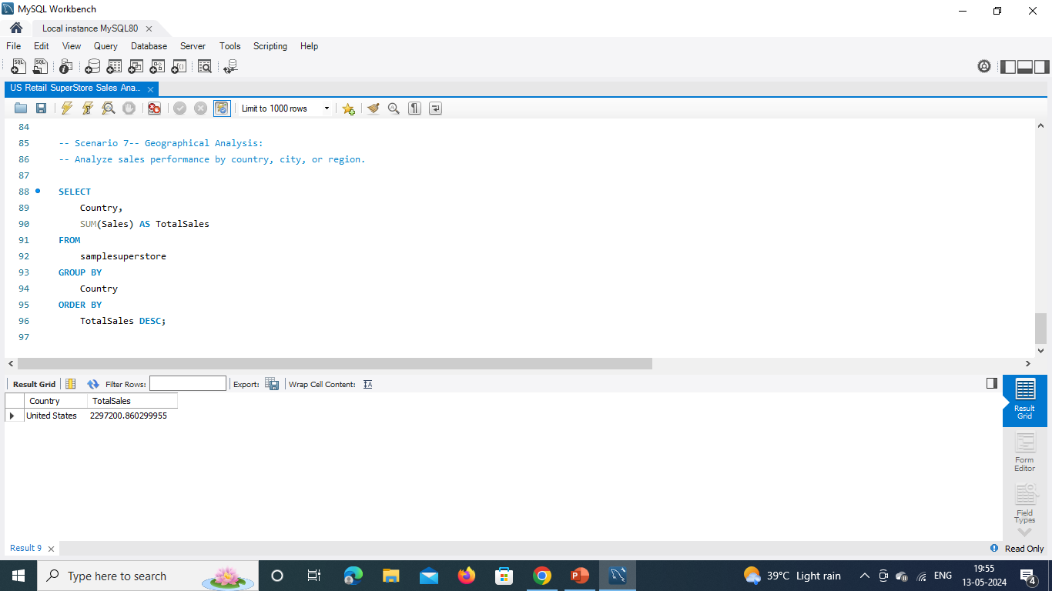
-- Scenario 7
Geographical Analysis:
-- Analyze sales performance by country, city, or region
SELECT Country,
SUM(Sales) AS TotalSales
FROM samplesuperstore
GROUP BY Country
ORDER BY TotalSales
DESC;

