Slide 1

Introduction
Introduction to App Development: Lesson 1

Slide 2
What is this course?
Our intention here is to teach you how to code.
More accurately, we want to invite you to see code at work, to understand how a machine looks at the world.
Computational thinking is useful in a long list of new fields
Virtual Reality, Smartphones, Internet, Microcontrollers, Data Cloud, etc.
Programming is the new literacy.
“I have a dream that all University graduates can code”

Slide 3
Our goals.
Value
Applicability
Engagement
Value:
Core computer science concepts.
Essentials of coding
Engagement:
Approachable: Beginner oriented
Creativity focused
Applicability:
The skills taught can be immediately applied use computer skills in your own field.

Slide 4
Some caveats:
This course covers a wide range of topics
While the first few lectures may seem simple, as we layer topics on top of each other, we will be able to build some impressive apps as we go along.
Last month, we made an app to track a space station
This course is incremental
It is important to attend lectures or catch up with missed content.
Each lecture builds on previous material
This course will challenge you.
Questions will be asked that you may not know the answer to.

Slide 5
Why you shouldn’t worry:
Each topic is carefully explained.
You are given plenty of room to explore if you are ahead.
Less than 10:1 instructor ratio to help you if you are stuck.
Slides are available online.
Email us if you are behind. We’re willing to help.
Answering questions you don’t know, even if you are wrong, is a great way to learn.

Slide 6


Our approach:
Making Apps
Visual Programming

Slide 7
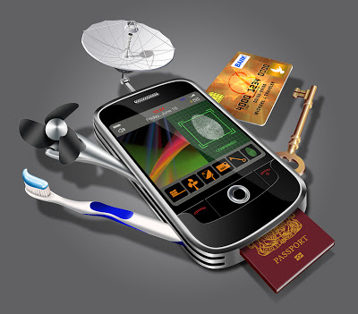
What is an app?
An App is one tool of many on a smartphone.
An App specializes on accomplishing one goal.
An App is like a single tool in a Swiss army knife.

Slide 8
Canadian Smartphone Adoption

Slide 9
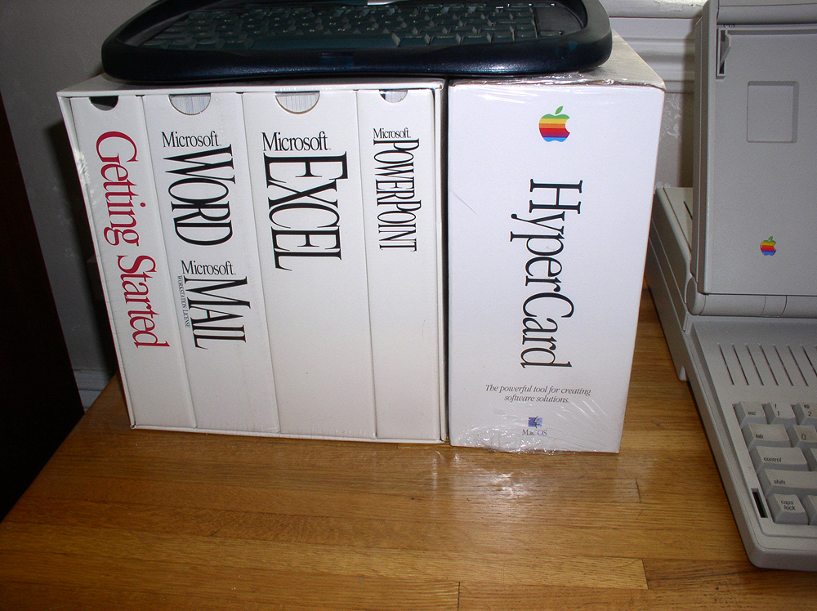
Application Software
Applications are computer programs that accomplish a specific group functions.
e.g. Microsoft Word, Adobe Photoshop, etc.
Some of these Applications were very complex and engineered.
Sometimes came with huge manuals

Slide 10
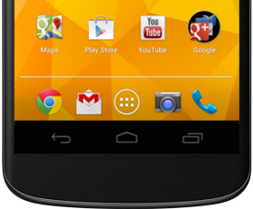
App is short for Application …And not just in name!
Apps are the new standard, proliferated by smartphones.
They are now making their way to PCs, TVs and even fridges!
Key characteristics of apps include:
Intuitive
Minimalistic
Short use time
Only one purpose
Experience over Function

Slide 11
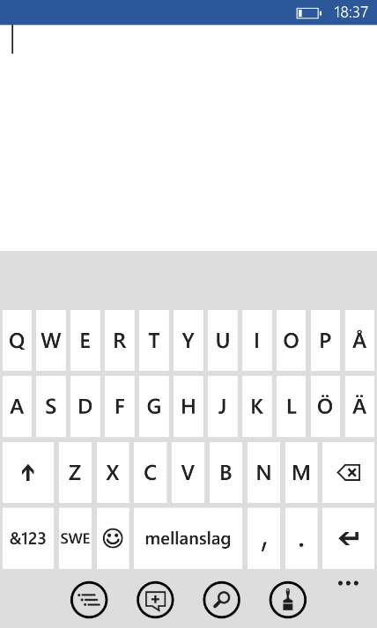
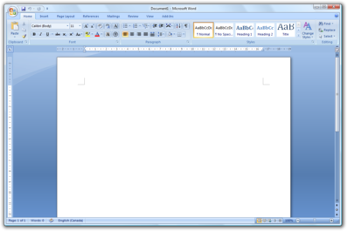
Microsoft Office Mobile App
Microsoft Office For Desktop

Slide 12
Why make an app?
Do you need to keep track of your Exercise routines?
Make an app!
Do you want to be alerted when you’re driving towards a traffic jam?
Make an app!
Do you have an idea for a fun game?
Make an app!

Slide 13
Ok, so we’re making apps, but how?

Slide 14
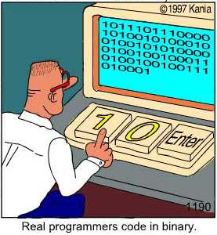
How to make computer programs:
All computer programs are made up of 0s and 1s
This is the machine’s language
Otherwise known as binary
You just need to find the right arrangement of 1s and 0s and type them into your computer
Clearly this can be very tedious

Slide 15
There must be an easier way!
If you think so too… then you are already thinking like a programmer!
Even though computers talk in binary, for the last few decades, programmers built tools that can help them express their thoughts more clearly and naturally.
Programmers write programs in Code that is closer to a natural (human) way of saying things.

Slide 16
Computer:
Add 1 to 2.
What is the result?
int R1, R2, R3;
R1 = 1;
R2 = 2;
R3 = R1 + R2;
MOV R1,#01;
MOV R2,#02;
ADD R3,R1,R2;
0110 0000 1100 0001 0110 1101 0010 1001 1100 1101 1110
Source Code
English
All of these codes do the exact same thing.
As a beginner, which one would you choose?
Binary Code
Assembly Code

Slide 17
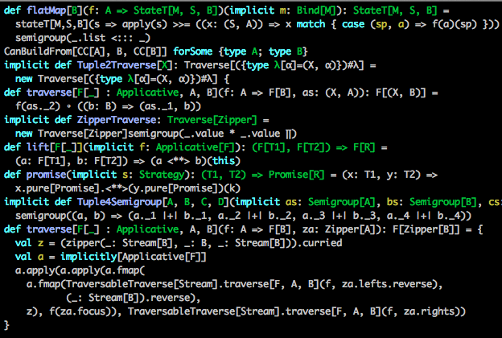
To code or not to code?
Unfortunately, we can’t program in English (yet).
And while Source code is what is mainly used by professional programmers, it can be very nuanced.
Learning the syntax of a programming language can distract you when trying to understand the concepts needed to program.

Slide 18
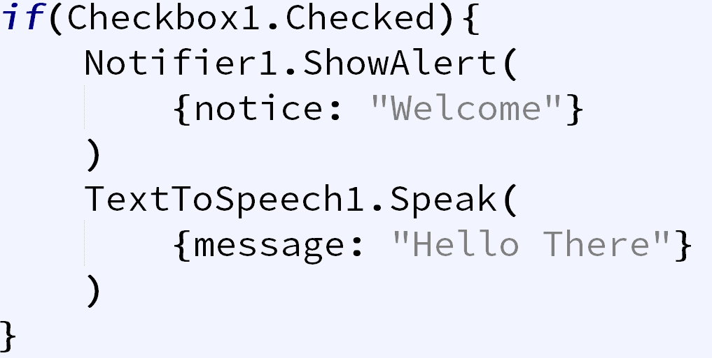
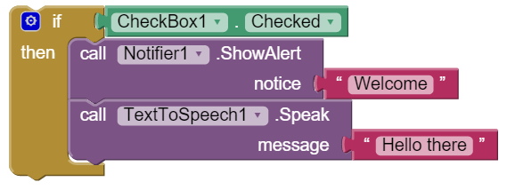
Visual Programming
Instead of Source Code, we’ll be using block based visual programming.
As you can see, it is very similar to code.
Great preparation for learning a programing language (JavaScript, C#, Python, Java)

Slide 19
Visual Programming
Learning to program using visual programming will give you the same high-level skills as text-based programming
It will allow us to focus on the concepts behind how our apps will work without getting caught in small details
We will prototype apps in a matter of minutes.

Slide 20
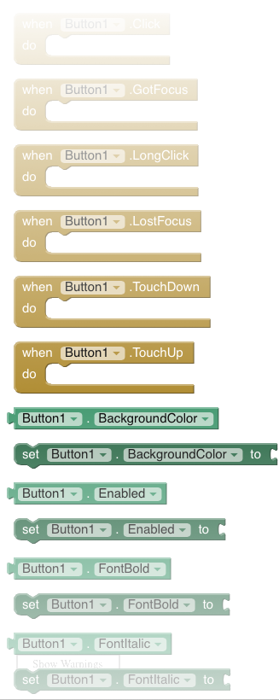
MIT App Inventor
App Inventor is a Visual Programming system that uses Blocks to represent the logic behind apps.
Browser based (No installer needed!) and open source!
Developed by MIT and Google Engineers.

Slide 21
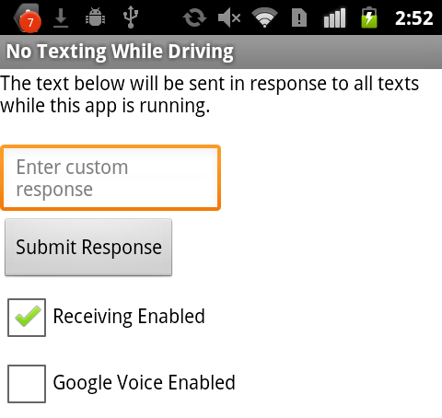
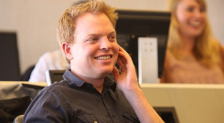
No Texting While Driving
Daniel Finnegan used App Inventor in 2009 to create an App that would automatically reply to text messages when the user was driving.
The idea was so popular, State Farm Insurance utilized it and distributed it to their clients the following year.
Software, after all, affects almost everything we do. Pick any major problem and clever software is part of the solution.

Slide 22
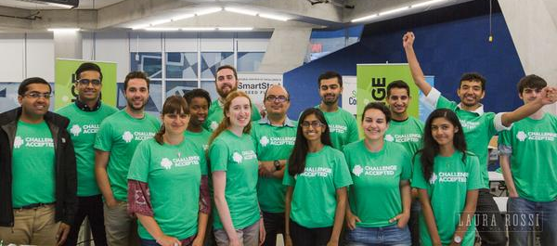
First iteration of Challenge Accepted:
Last month we ran our first iteration of this course.
By the end of the course, students were making apps that surpassed our expectations.

Slide 23
Are you ready? Let’s get started.

Slide 24


Before we start, requirements:
Laptop and Charger.
Modern Browser
Please use (preferably) Google Chrome or Mozilla Firefox
Be wary that browser extensions may cause problems with AppInventor
If you do not have a laptop or if you run into problems, the Ryerson Library has a laptop loan program (for Ryerson students).

Slide 25
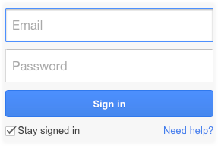
Getting Started
Course website:
mydmz.ryerson.ca/learntocode/
Click the link in the top right:
Current Students
Click “Sign in”
Sign in using a Google account
(Your Ryerson account works too)
Create a google account if you don’t have one.

Slide 26
Course Website
Fill in the information on the Sign Up webpage.
Bookmark this page.→
Slides, links and announcements will be placed here.

Slide 27
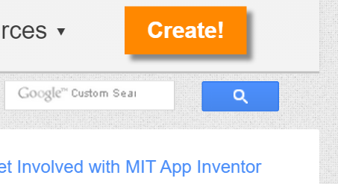
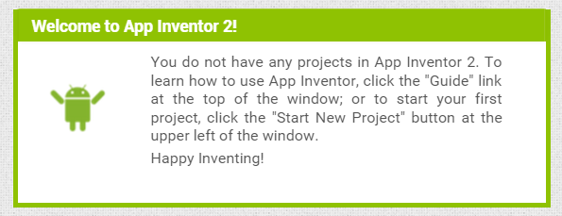
Open AppInventor.
Click on the link at the top that says AppInventor:
appinventor.mit.edu
Click on the orange button that says: Create!
Log in with your google account.
Accept the terms of service.
Dismiss the survey.
Dismiss the Popup (Continue).

Slide 28
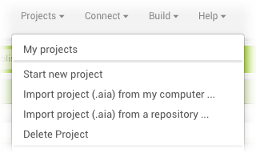
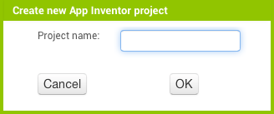
A New Project
Click Projects at the top
Select ‘Start new project’
Set Project name:
HelloWorld
Click OK
Hello World

Slide 29
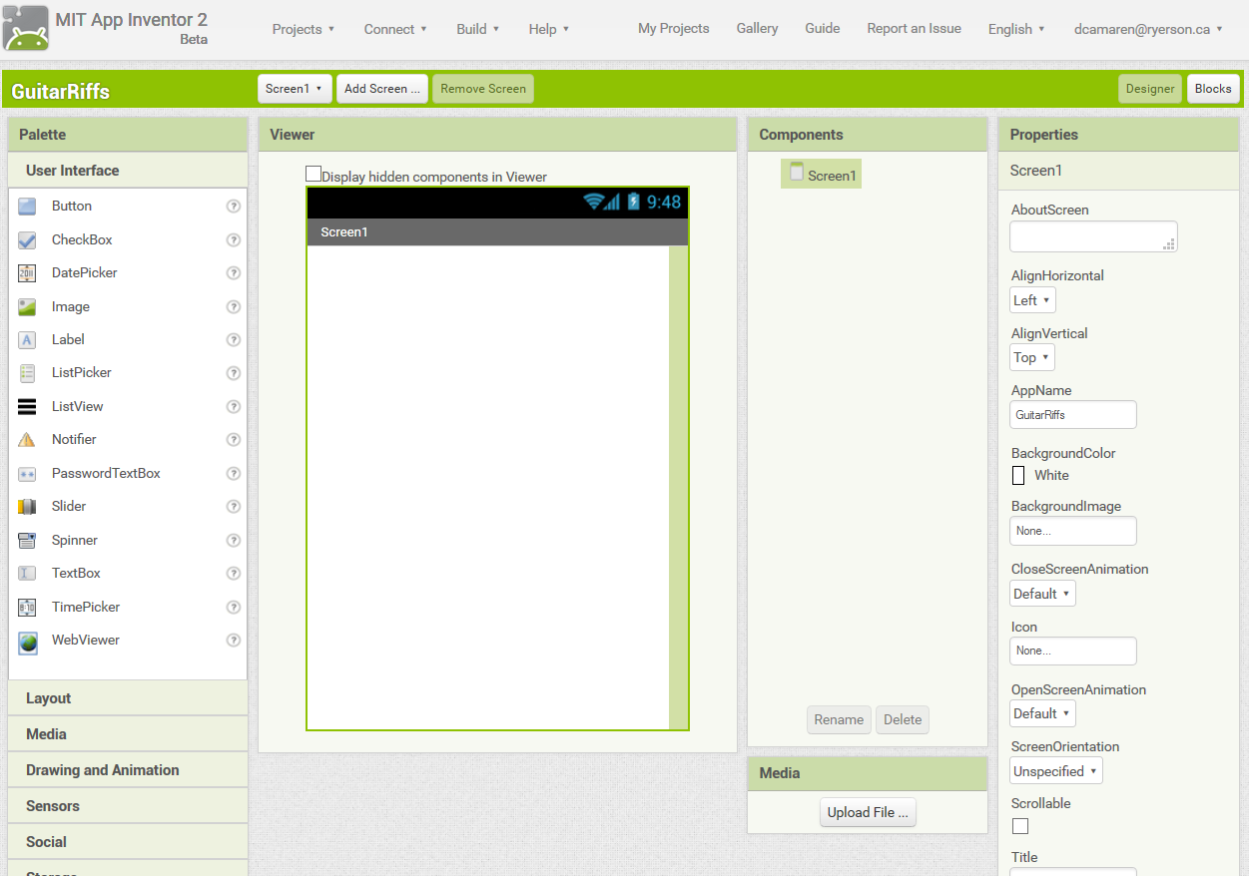
App Inventor – Designer View
Palette
View switch
Components
List
Viewer
Properties

Slide 30
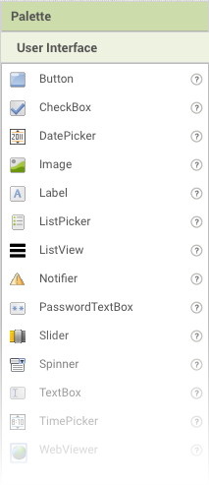
Designer View - Palette
The palette shows all of the components available for building the UI or adding functionality to your app
In order to add a component to your app, drag it from the palette to the viewer.
Notes:
. In orde

Slide 31
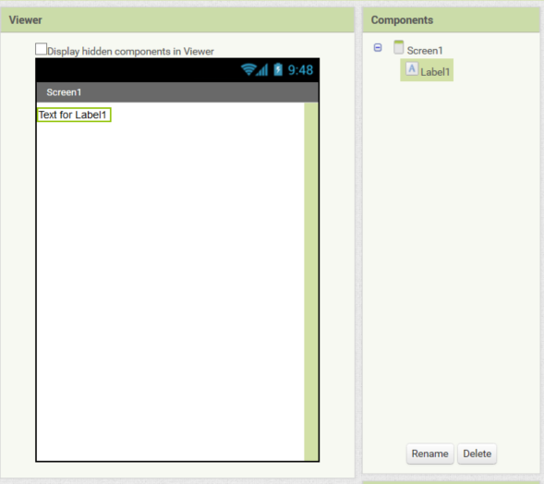
Designer View – Viewer & Components
The viewer displays the layout of your app’s screen. This is what the app will look like to the user.
The Components Panel is a list of the components that are in use, this may include invisible components
Drag a label component into your Viewer.
Notes:
. In orde

Slide 32
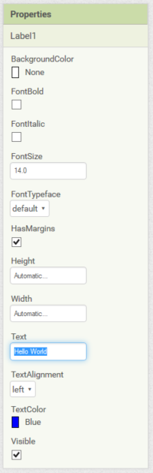
Designer View – Properties
The properties bar lets you change features of the component you’ve currently selected
You can select the component by clicking on it in the viewer or on the components list
Select the label you’ve added and change the text to ‘Hello World’, and the TextColor to Blue
Notes:
. In orde

Slide 33
Ok, let’s test the app.

Slide 34
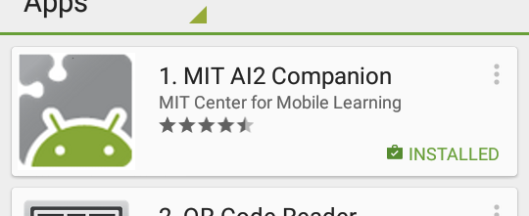
Obtaining a device:
If you don’t have an Android device, we can lend you one.
On the course website, click on the link that says “Borrow a phone”
After you fill out the forms, You can pick up a device from the front
You will need one piece of ID
If you have your own Android device:
Open the Google Play store
Search for MIT AI2 Companion
Select the Result with this icon:
Download the app

Slide 35
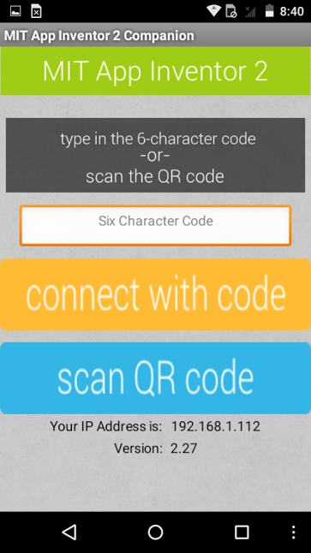
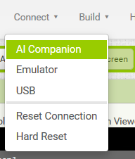
Testing the app
To run the app:
On AppInventor
Go to the connect menu
Click AI Companion
On the phone:
Open the AppInventor App
Click Scan QR code or enter the code.

Slide 36
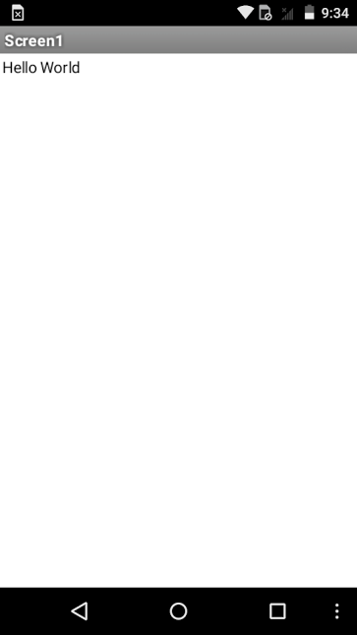
This is what you should see:
If you see the this screen → on your device, you’ve successfully Run your first app.
While it may not do much, it is still an important part of learning:
Wikipedia: Hello World
Let’s wait a few minutes to make sure we all have this running.

Slide 37
A New Project
Projects
Start new project
Project name
HelloRyerson
Click OK
HelloRyerson

Slide 38
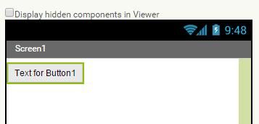
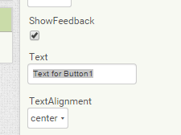
First Button
Grab a button
Drag it into the screen
Change the Text property to “Speak”

Slide 39
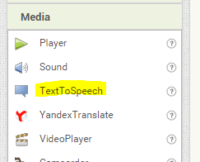
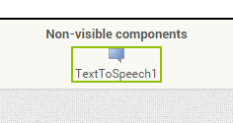
Text to Speech
In the Palette (under Media), drag a TextToSpeech Component onto the Screen.

Slide 40

Switching views
You can switch between Designer and Blocks View by pressing the buttons on the top right.
The Designer view is where we change the appearance of our app.
The Blocks view is where we change the logic.

Slide 41
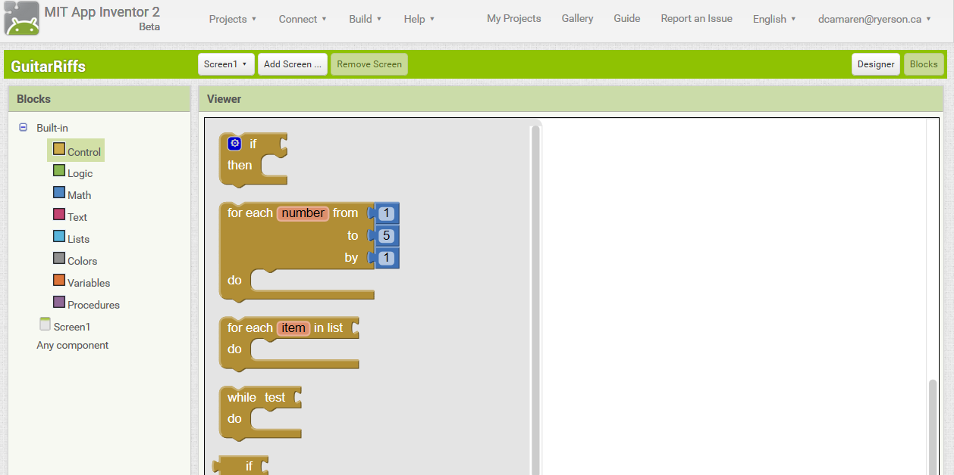
App Inventor – Blocks View

Slide 42
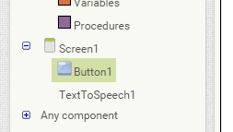
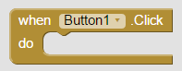
Blocks!
Switch to the Blocks View
Click Button1
Drag in the Button1.Click Yellow Block

Slide 43
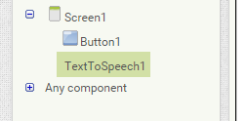

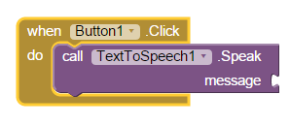
Text To Speech
Click The TextToSpeech1 Component
Drag in a
block onto the screen
Snap it into the Yellow Event block.

Slide 44


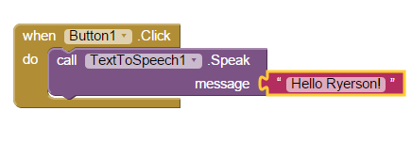
Write a message!
Click the Text Category
Drag in a block.
Click the space inside and write:
Hello Ryerson!
Snap it into the purple function block.

Slide 45
Try to test the app.
Does the sound play?
For some android phones, You’ll have to restart the app.

Slide 46
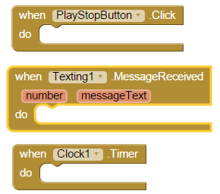
Events!
Concept #1
Events are the starting point of your code.
Your app (an INTERACTIVE app) reacts to things that happen in the user’s world
For example:
The user presses a button
The user receives a text message
The clock strikes 12.
Can you think of another type of event?
Notes:
Think of your app as a person. When something happens (the user clicks a button, for example), he needs to look up what to do. For example, when the user clicks button1, it will look at the instructions inside the button1.click and do them.

Slide 47
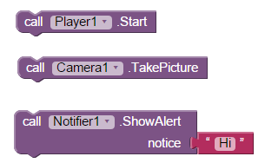
Function Calls!
Concept #2
Function Calls allow us to tell the phone what to do
Start playing a music file
Take a picture
Show a Message to the user
We’ll learn more about these in a later lecture.

Slide 48

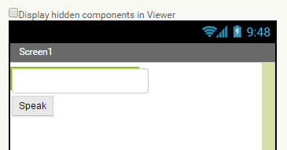
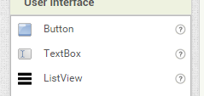
Adding a TextBox
Go into Designer view.
From the Palette (under User Interface), drag a TextBox onto the screen.

Slide 49
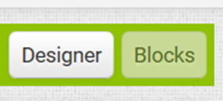
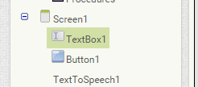

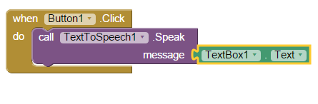
Saying custom messages
Go into Blocks View.
Click on TextBox1.
Drag the light green getter block to set the property (in this case, setting the Text property).
Snap it into the Purple function Block and Replace the Pink “Hello Ryerson!” block.

Slide 50
Try to test the app.
Does the sound play?
For some android phones, You’ll have to restart the app.

Slide 51
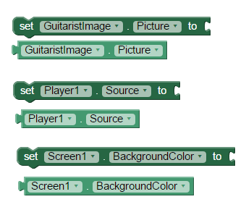
Properties!
Concept #3
Properties define the characteristics of components.
They are available by clicking on the component in the Blocks list
You can change (set) a property or use (get) its values
Some examples of properties:
The picture in an Image component
The song in a music player
The color of the Screen’s background

Slide 52




Getter and Setter blocks
To access and use the value of a property, use a Getter Block.
To change the value of a property, use a Setter Block.
Getter
Setter

Slide 53
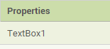
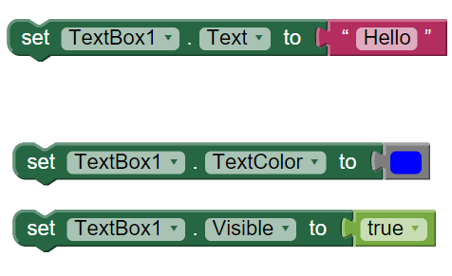
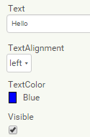
Properties – Designer vs Blocks
Properties in the designer are the same as those in the Blocks
Blocks let you change them on the fly

Slide 54
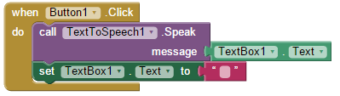
Clearing on play
If we want an our app to clear the textbox after saying the message, we have to change the textbox’s text
Use a setter block to set the textbox’s text to empty:

Slide 55
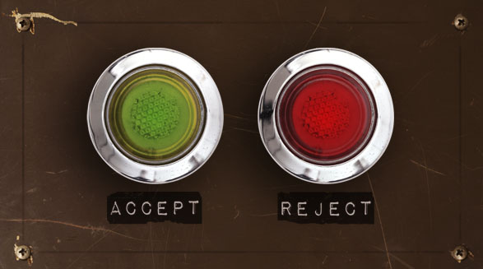

Challenges ahead.
Test your app and take a break

