Slide 1

Health care for Non-Residents

Slide 2
Content
Problem Statement
Solution
Important Use Cases
Screenshots

Slide 3
Problem Statement
According to the 2013 census, the USA has 41 million Non-Residents (Immigrants).
These people do not have the same medical coverage from the government as American citizens do.
Also, the usual process for treatment requires one to have previous medical records or a primary care physician, if it’s not an emergency.
So, for a non-resident it becomes a tedious job to find immediate medical service that is also cost effective.
Consequently, they end up having very expensive medical bills which can even be unaffordable.

Slide 4
Solution
Developing an application to give non-residents a platform to find cost effective medical services.
The application will provide information regarding participating hospitals as well as the, earliest appointments, and prerequisites (medical history, referral required, etc.).
Many services provided by community hospitals or remote hospitals remain unused. They can use our platform for those services.

Slide 5
Actors
System Admin
Hospital Appointment Scheduler
Consumer
Hospital Operation
Government Operation
Embassy Operation
Admin

Slide 6
Object Model
Disease Catalog
Disease
Offer
Network Directory
EcoSystem
Slot Range Directory
Health Issues
Appointment Directory
Network
Test Catalog
Medicines
Encounter Record
Diagnosis
Hospital Enterprise
Consumer Enterprise
Government Enterprise
Test
Allergies
Test Results
Third Party Hospital
(Organization)
Government Organization
Embassy Organization
Hospital Appointment Third party Organization
Doctor Catalog
Department Catalog
Recommended test lab
Doctor
Department
Consumer Organization
Person Directory
User Account Directory
Person
User Account
Work Queue
Appointment Directory
Role
Work Request
Appointment
Bills
Discount

Slide 7
Use Cases:
System Admin creating Networks and Enterprises.
Consumer Signing up for the application.
Third Party Hospital Operation Admin adding Department, Doctors and Tests.
Appointment Scheduler adding doctor's appointment time slots for consumers.
Consumer booking an appointment from the available time slots and viewing his medical history.
Government viewing Statistics(Disease-wise) for non-residents.

Slide 8
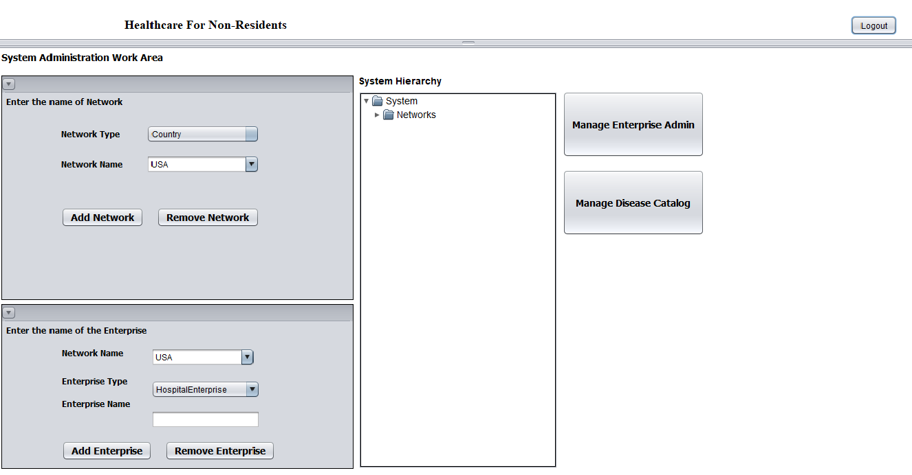
Screenshots
System Admin Work Area

Slide 9
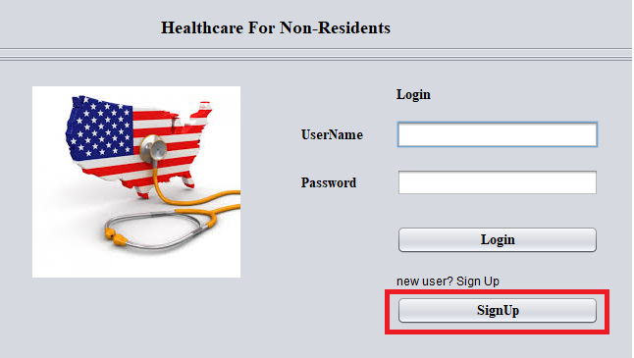
Screenshots
Consumer Sign-up in the application

Slide 10
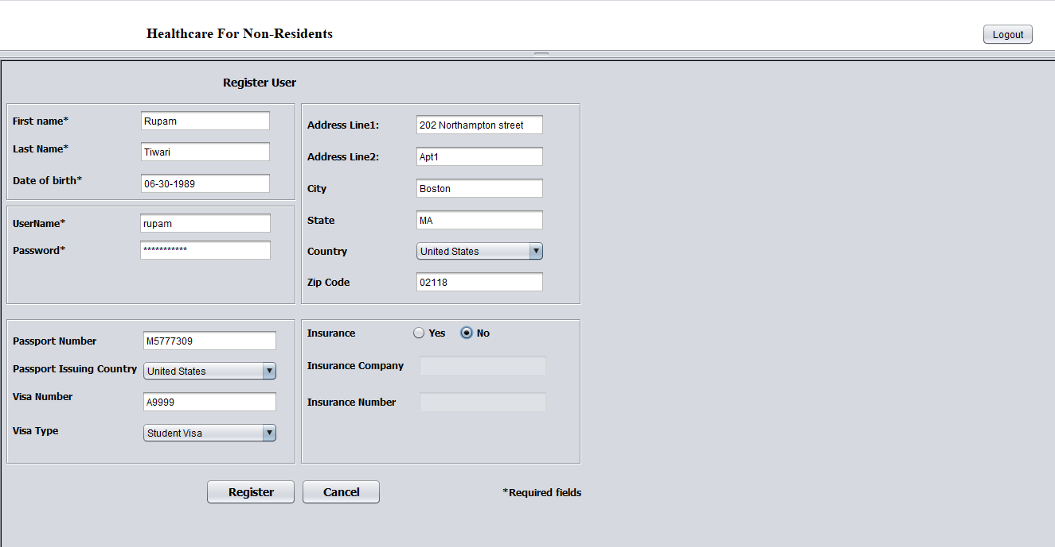
Use cases

Slide 11
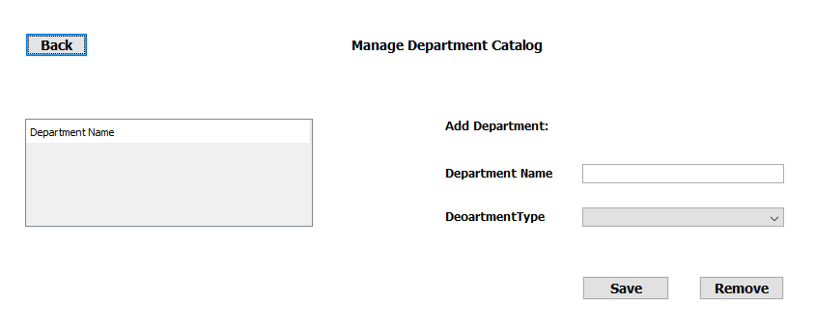
Use Cases Adding Department to Department Catalog

Slide 12
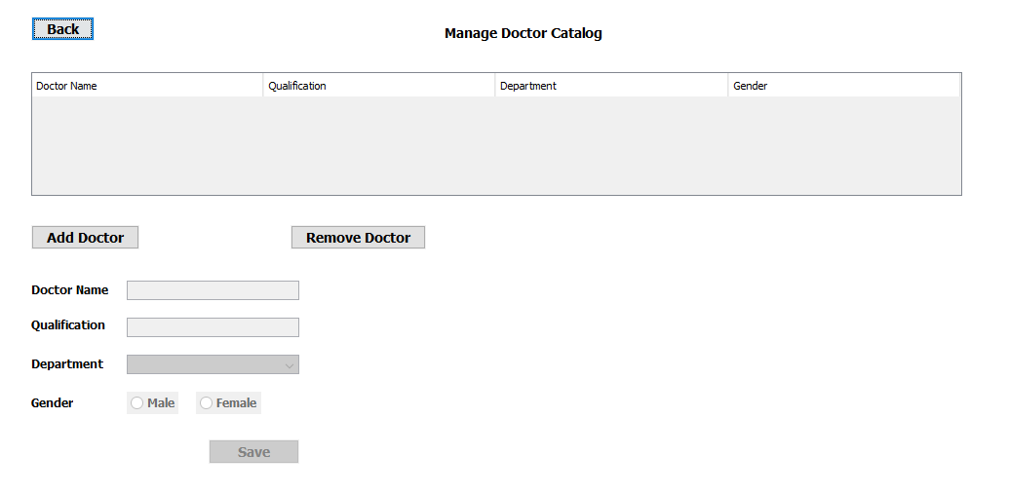
Screenshots
Adding Doctor for Department.

Slide 13
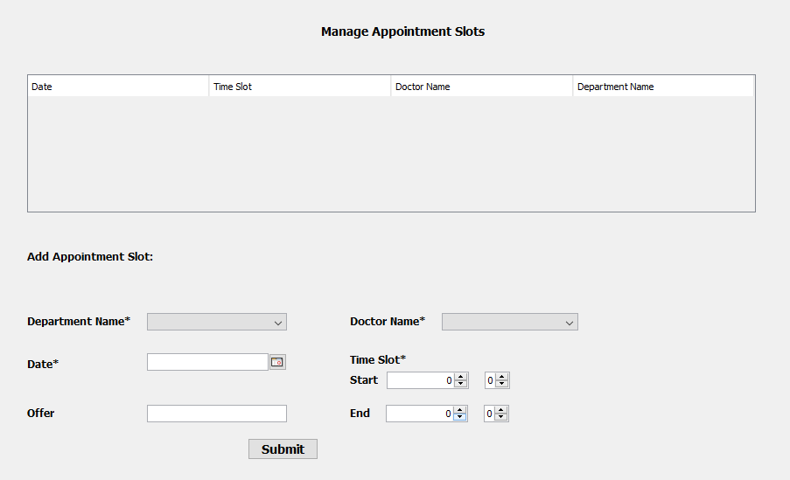
Screenshots
Adding appointment slots

Slide 14
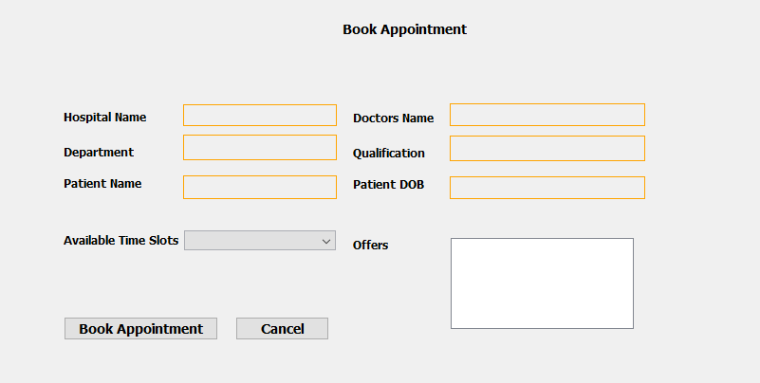
Screenshots
Consumer booking appointment.

Slide 15
Team members: Balaji Mudaliyar, Chetan Mistry & Rupam Tiwari
Thank You

