Slide 1

CarboLess https://carboless.netlify.app

Slide 2

Presented By : Team dhariTREE
Jyotishmita Bhagawati
Ajay Mahato
Karan Das
Rupam Jyoti Das

Slide 3

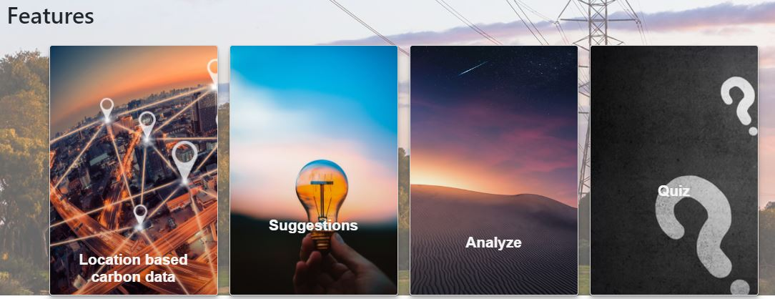
Solution-Project HighLights
CarboLess
Location based carbon Data
Analyze
Suggestions
Quiz

Slide 4
CarboLess
Location based data:
In this section we will collect users location data in Lattitude and Longitude coordinates. And show them an estimation of Carbon emission data in their locality.
This will help the users to have an idea about how carbon affecting their locality so that they can “Take Action”.
Analyze
In this section user can view Carbon footprint data of a Country or State or a local area in a statistical plot

Slide 5
Suggestions
CarboLess
We take suggestions from user about how they can contribute in reducing carbon footprint and thus improving our planets’ health.
We also give a list view of top suggested ideas by other users so that they can see the best ideas to “Take Action”
Quiz
In this section we provide some Fun quizzes from which users will gain some knowledge on Carbon Footprint , their impacts and other scientific facts of Carbon footprints

Slide 6
Future Plans:
CarboLess
To make an user friendly app so that people of all ages can access data easily
We’ll provide field data to make it useful and interactive for policy makers , builders and scientists.
We’ll try to include an API so that other environment enthusiasts can integrate their applications with us.
Social media sharing link will also be added targeting a large number of people.

Slide 7

CarboLess
Thank you Spaceapps community and the global collaborators for giving us such an opportunity to solve a real world problem. Though we couldn’t complete our whole project still we hope that we have learnt a lot about our environment and we are hopeful that our little contribution will help the people to be more concern about increasing carbon footprint problem.
Thank you mentor for guiding us through out the weekend

