Slide 1
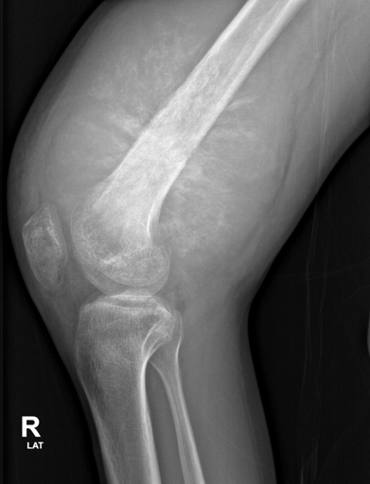
An Intelligent Deep Learning-Based System for Bone Tumor Classification Using X-Ray Images
MAJOR PROJECT - FINAL REVIEW
N. Nandini - 2311CS020469
N. Rupa Lakshmi - 2311CS020480
P. Varshitha - 2311CS020499
Guide: Asst. Prof. Vineela
Department of AIML, School of Engineering, Malla Reddy University
Academic Year 2023 - 2027
Notes:
Introduce the team and guide. One line: we built and evaluated a ResNet50 system that classifies bone-tumor X-rays as benign or malignant and explains each prediction with Grad-CAM.

Slide 2
Presentation Outline
1
Problem and motivation
7
Training and test results
2
Objectives and status
8
Effect of data augmentation
3
Literature review and research gap
9
Explainability and error analysis
4
Dataset (BTXRD)
10
Prototype demo
5
Methodology and model
11
Limitations, conclusion and future work
6
Tools and technologies
Notes:
Walk through the agenda quickly; the core of the talk is the results, explainability and the live demo.

Slide 3



Problem and Motivation
Manual review is slow and expert-dependent
Radiologists inspect every bone X-ray by eye; consistency depends on experience and workload.
PROJECT GOAL
Classify a bone-tumor X-ray as benign or malignant, and show which image regions drove the decision.
Benign and malignant lesions can look alike
Radiographic features overlap, which makes consistent classification difficult.
Deep learning learns visual patterns directly
A preliminary screening aid - not a replacement for a radiologist.
A CNN can learn discriminative features from labelled X-rays without hand-crafted rules.
Notes:
Problem: manual interpretation is time-consuming and benign and malignant tumors can look similar. Our goal is a fast, consistent first-pass classifier with an explanation, explicitly not a diagnostic tool.

Slide 4

Objectives - All Four Achieved
OBJECTIVE 1
Achieved
OBJECTIVE 2
Achieved
Design and develop a deep learning system for bone tumor classification
Preprocess X-rays: resizing, normalization and data augmentation
Trained model + working web prototype (Gradio)
224 x 224, ImageNet normalization, 5 augmentations
OBJECTIVE 3
Achieved
OBJECTIVE 4
Achieved
Implement a ResNet50 model for benign vs malignant
Evaluate with accuracy, precision, recall and F1-score
Two-stage transfer learning on 1,306 training images
Accuracy 0.890 | F1 0.699 | ROC-AUC 0.945
Notes:
These are the four objectives declared in Review 1. Each is implemented and backed by evidence shown later in the deck.

Slide 5
Literature Review
Study | Method | Key finding
He et al., 2020 (EBioMedicine) | Deep learning on primary bone-tumor radiographs, binary and 3-way | DL can classify primary bone tumors from plain X-rays
Kwon et al., 2022 (PLOS ONE) | ResNet50 vs InceptionV3 vs EfficientNet, transfer learning | CNNs promising for benign / malignant / no-tumor; proximal femur only
European Radiology, 2024 | ResNet + transformer features with similar-case retrieval | Learned features support classification and retrieval
Scientific Reports, 2025 | Pretrained CNNs (incl. ResNet50) + explainable AI | Transfer learning + XAI useful; osteosarcoma focus
Biomed. Signal Proc. Control, 2026 | ResNet50-CBAM and CNN-Transformer hybrids | Attention improves performance at higher complexity
Multi-center study, 2026 | Medical-image pretraining, external testing | Domain pretraining improves robustness
Notes:
Prior work shows CNNs and transfer learning work on bone-tumor radiographs. Several studies are limited to one anatomical site, use complex attention models, or call for external validation.

Slide 6

Research Gap and Our Approach
IDENTIFIED GAP
OUR APPROACH
Manual X-ray review is slow and observer-dependent
Automate the first-pass classification with a CNN
Hand-crafted features miss complex radiographic patterns
Learn features end-to-end with ResNet50 transfer learning
Class imbalance and limited data hurt generalisation
Augmentation + class-weighted loss, measured with an ablation
Black-box predictions are hard to trust
Grad-CAM heatmap + plain-language explanation for every prediction
Notes:
Each gap maps to a concrete design choice in our system; the augmentation choice and the explainability are both evaluated later.

Slide 7
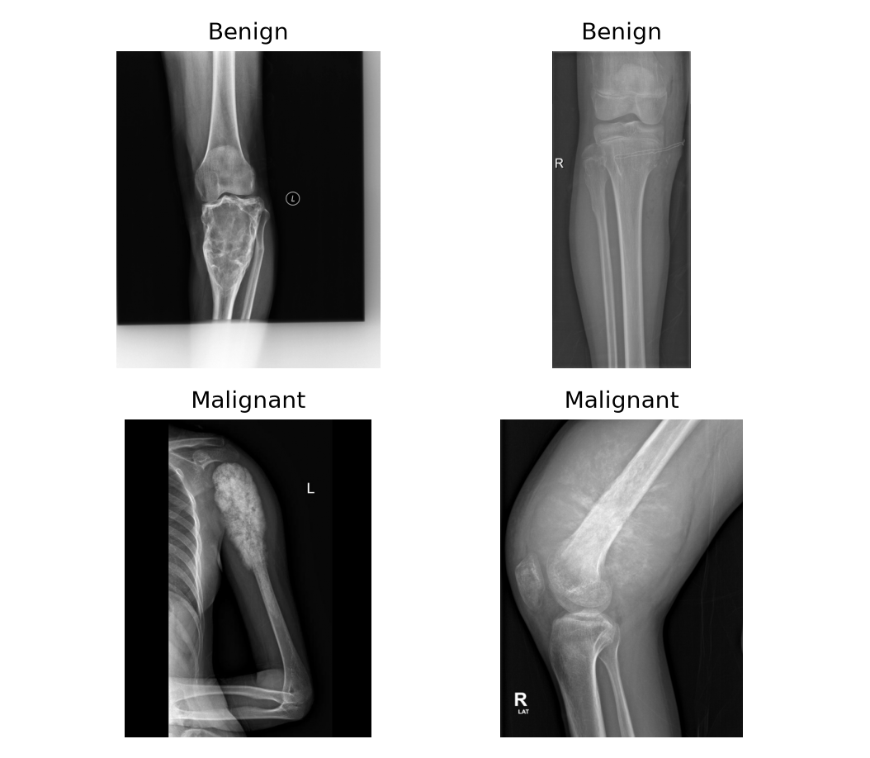
Dataset - BTXRD Bone Tumor X-Ray Dataset
3,746
1,867
1,525
342
radiographs in BTXRD
tumor images used
benign
malignant (18%)
Split (stratified, seed 42) | Images | Malignant
Train (70%) | 1,306 | 240
Validation (15%) | 280 | 51
Test (15%, never seen in training) | 281 | 51
Source: Yao et al., Scientific Data 12, 88 (2025), CC BY 4.0. Normal (no-tumor) images excluded, as defined in the project scope.
Notes:
BTXRD is a public dataset of 3,746 radiographs; we use the 1,867 tumor images. Malignant cases are only 18%, so the classes are imbalanced. The test split is held out completely.

Slide 8
Proposed Methodology
1
2
3
4
5
6
Input X-ray
Preprocess
Augment
ResNet50
Predict
Explain
BTXRD radiograph or user upload
Grayscale, <= 512 px, 224 x 224, normalize
Training only: crop, flip, rotate, shift, contrast
ImageNet weights + new classifier head
Softmax: benign / malignant
Grad-CAM heatmap + text explanation
PHASE 1
PHASE 2
PHASE 3
Weeks 1-3
Weeks 4-6
Weeks 7-8
Problem definition, literature survey, dataset collection
Preprocessing, system design, model implementation
Testing, evaluation, analysis, documentation
Notes:
End-to-end pipeline. The same preprocessing function is used for the training data and for images uploaded in the app, so predictions in the demo match the evaluated model exactly.

Slide 9


Preprocessing and Data Augmentation
Preprocessing (all images)
Augmentation (training only)
8-bit grayscale
Every X-ray converted to one intensity channel
Longest side <= 512 px
Speeds up training without losing the 224 px detail
3 channels, 224 x 224
Grayscale replicated to RGB for the ImageNet backbone
ImageNet normalization
Mean (0.485, 0.456, 0.406), std (0.229, 0.224, 0.225)
Random resized crop
80-100% of the image area
Horizontal flip
Left and right limbs look alike
Rotation +/- 15 deg
Patient positioning varies
Translation +/- 5%
Lesion not always centred
Brightness / contrast +/- 20%
Exposure differs across scanners
Notes:
Preprocessing is identical for training, testing and the app. Augmentation is applied only during training, and the ablation later shows it improves malignant recall.

Slide 10
Model Architecture and Training
ResNet50 backbone
ImageNet-pretrained, 49 conv layers
Setting | Value
Stage 1 | Freeze backbone, train head: 5 epochs, lr 1e-3
Stage 2 | Unfreeze layer3 + layer4: up to 20 epochs, lr 1e-4
Optimizer | AdamW, weight decay 1e-4, batch 32
Imbalance | Class-weighted cross-entropy (0.61 / 2.72)
Schedule | Halve LR when validation F1 plateaus
Stopping | Early stop after 6 epochs without val F1 gain
Selected model | Epoch 18 (stage 2, epoch 13): val F1 0.743
Global average pool
2048 features
Dropout 0.4
Dense 256 + ReLU
Dropout 0.3
Dense 2 + softmax
benign | malignant
Notes:
Transfer learning in two stages: first the new head on frozen ImageNet features, then fine-tuning of the deepest blocks at a lower learning rate. The checkpoint with the best validation F1 is kept.

Slide 11








Tools and Technologies
Python 3
PyTorch 2.14 + torchvision
scikit-learn + Matplotlib
Pillow + NumPy
Implementation language
ResNet50, training, Grad-CAM
Metrics, confusion matrix, ROC, plots
Image loading and preprocessing
Gradio 6
Apple GPU (MPS) / Colab GPU
Windows .bat scripts
Google Colab notebook
Web prototype (upload, predict, explain)
Training hardware
One-click setup and demo
Reproduce the full pipeline
Notes:
Python and PyTorch for the model, scikit-learn for metrics, Gradio for the prototype. It runs on Mac, Windows and Google Colab.

Slide 12
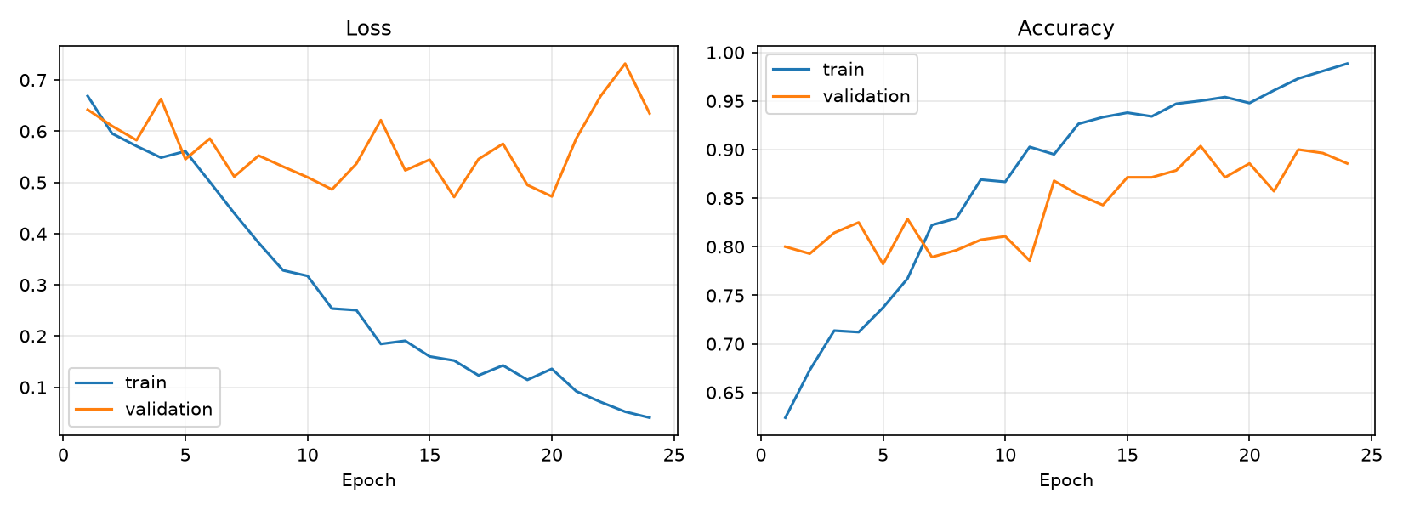
Training Behaviour
Epochs 1-5: stage 1 (head only). Epochs 6-24: stage 2 (fine-tuning).
Training accuracy rises to 0.99
The model fits the training set almost perfectly.
Validation accuracy levels off at 0.87-0.90
Generalisation stops improving after the mid-teens.
Early stopping keeps the best epoch
Epoch 18 (val F1 0.743) is the saved model, avoiding later overfitting.
Notes:
Training accuracy keeps rising while validation flattens - classic overfitting - which is why early stopping on validation F1 selects epoch 18.

Slide 13
Test-Set Results (281 Unseen X-Rays)
89.0%
0.945
70.6%
0.699
Accuracy
ROC-AUC
Malignant recall (sensitivity)
Malignant F1-score
Class | Precision | Recall | F1-score | Test images
Benign | 0.934 | 0.930 | 0.933 | 230
Malignant | 0.692 | 0.706 | 0.699 | 51
Macro average | 0.813 | 0.818 | 0.816 | 281
Reading the numbers
Accuracy is high because most test images are benign. Malignant recall and F1 are the harder, more honest measures: the model finds 36 of 51 malignant tumors.
Notes:
Report all four metrics from Review 1. Point out that accuracy alone is misleading with an 82/18 class split; malignant recall of 70.6% is the key clinical-style number.

Slide 14
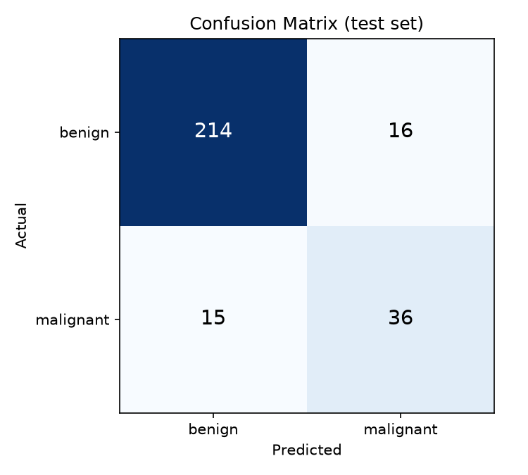
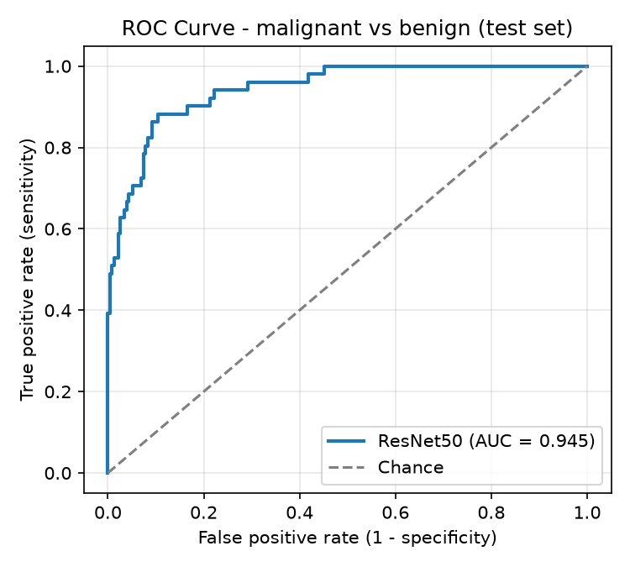
Confusion Matrix and ROC Curve
214 / 230 benign and 36 / 51 malignant correct. 15 malignant tumors missed; 16 benign X-rays flagged as malignant.
AUC 0.945: the model ranks a malignant X-ray above a benign one 94.5% of the time.
Notes:
Specificity 93.0%, sensitivity 70.6%. The ROC curve shows a lower threshold would catch more malignant tumors at the cost of more false alarms - a future-work item.

Slide 15
Effect of Data Augmentation
+0.098
Malignant recall
0.608 -> 0.706
+0.060
Malignant F1
0.639 -> 0.699
+0.044
ROC-AUC
0.901 -> 0.945
20 -> 15
Missed malignant
out of 51
Notes:
Same data split and settings; only augmentation differs. Augmentation mainly improves malignant recall. Caveat: one training run per setting, so part of the gap may be run-to-run variation.

Slide 16
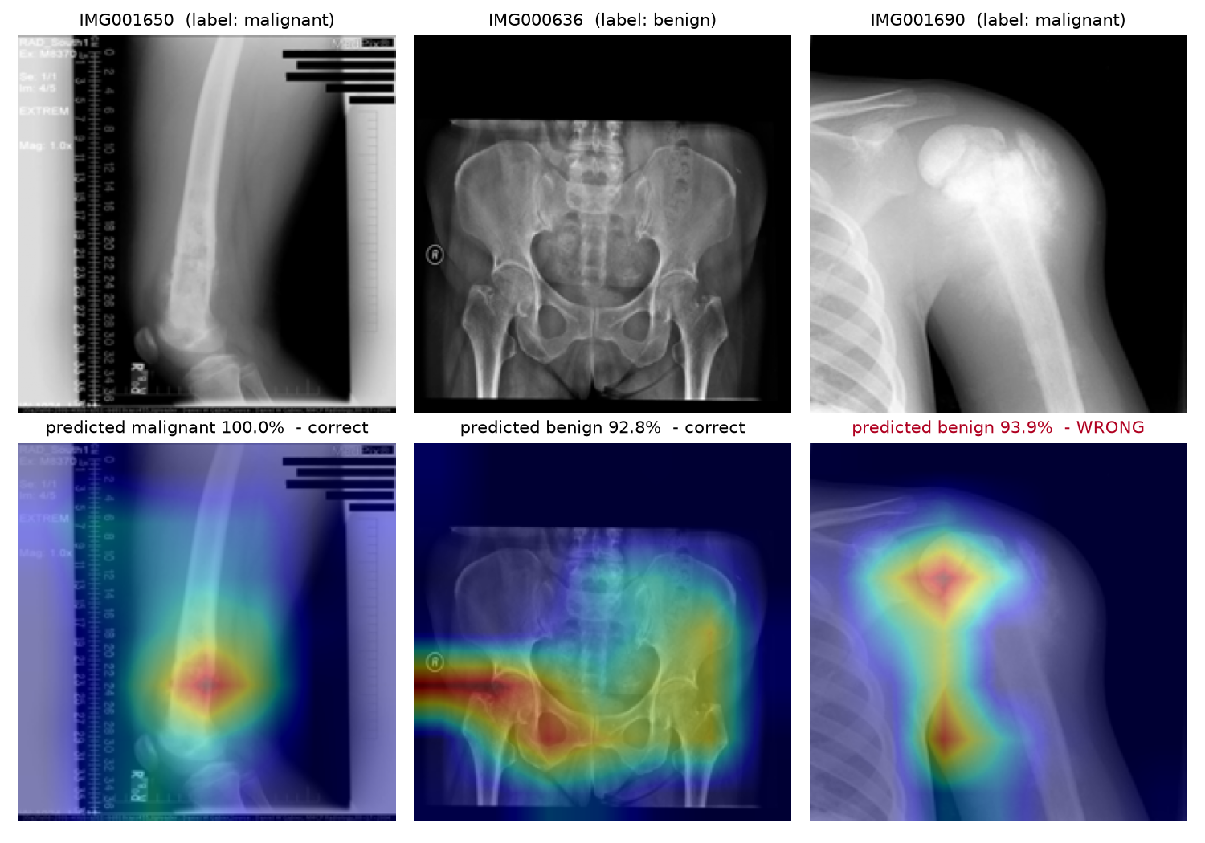
Explainability with Grad-CAM
How it works
Gradients of the predicted class at ResNet50's last block show which regions raised that score.
Verified genuine
Map changes with the image and the target class, and disappears when trained weights are randomised.
Right column: a known failure
Malignant tumor predicted benign with 93.9% - the heatmap is on the lesion, yet the answer is wrong.
Caution
In the benign pelvis case the map partly covers the 'R' side marker, so the model may use non-anatomical cues.
Notes:
Grad-CAM shows where the model looked, not whether it is right. Use the right-hand case to show why a radiologist must review every result.

Slide 17
Error Analysis and Reliability
Model confidence | Test images | Correct
High (>= 90%) | 239 | 95%
Moderate (70-90%) | 28 | 68%
Low (< 70%) | 14 | 21%
31 test errors
15 missed malignant (false negatives) and 16 false alarms.
Some misses are confident
e.g. IMG001690: malignant, predicted benign at 93.9%.
Likely causes
Only 240 malignant training images; overlapping appearance; markers and text in images.
Confidence tracks reliability: low-confidence predictions are flagged as unreliable in the app's explanation.
Notes:
Accuracy by confidence band is computed on the test set and quoted live in the app. The full gallery of misclassified X-rays with heatmaps is in outputs/misclassified.png.

Slide 18
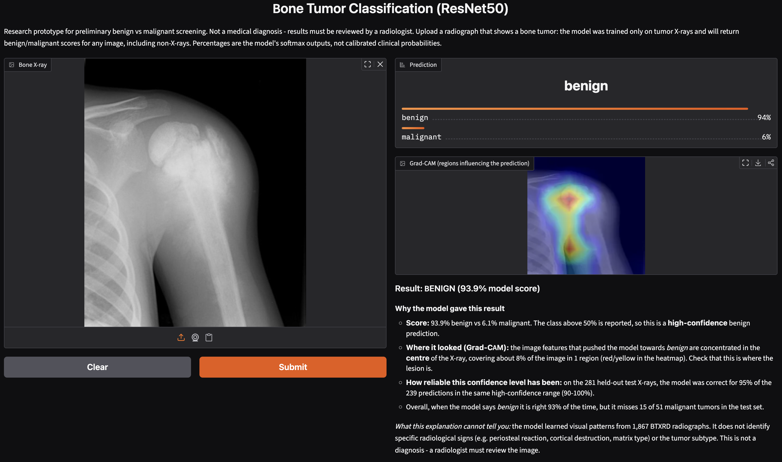
Prototype - Web Application
Upload PNG, JPEG, BMP or TIFF X-rays
Benign / malignant scores
Grad-CAM heatmap
Plain-language explanation with test-set reliability
Clear errors for unreadable, blank or tiny images
Runs on Mac, Windows (.bat) and Google Colab
Screenshot of the running app on a known failure case: a malignant tumor predicted benign (93.9%).
Notes:
Live demo order: (1) samples/malignant_IMG001650.png - correct malignant; (2) samples/benign_IMG000636.png - correct benign; (3) samples/hardcase_missed_malignant_IMG001690.png - a known miss. Backup: this screenshot.

Slide 19






Limitations
Class imbalance
No patient IDs in BTXRD
Only 342 malignant images; 15 of 51 malignant test cases are missed.
Views of one patient may fall in both train and test, so scores may be optimistic.
Single dataset
One training run per setting
No external validation on data from another hospital.
Differences between runs include random variation.
No out-of-distribution check
Grad-CAM shows where, not why
Any image, even a non-X-ray, receives a benign / malignant score.
Heatmaps can highlight markers; they do not identify radiological signs.
Notes:
State limitations before the examiners ask. None of these invalidate the prototype, but they bound what the numbers mean.

Slide 20
Conclusion
1
A working, explainable bone-tumor classifier
ResNet50 transfer learning on 1,867 BTXRD X-rays, delivered as a web prototype.
TAKEAWAY
Suitable as a preliminary screening aid that a radiologist reviews - not as a diagnostic tool.
2
Good overall discrimination
Accuracy 0.890 and ROC-AUC 0.945 on 281 unseen test X-rays.
3
Augmentation measurably helps
Malignant recall 0.608 -> 0.706 and F1 0.639 -> 0.699 versus no augmentation.
4
Transparent about uncertainty
Every prediction comes with a heatmap, an explanation and its test-set reliability.
Notes:
Close the technical part: all objectives met, results measured on held-out data, limitations stated.

Slide 21





Future Work
More malignant data
Patient-level split + external test
Tune the decision threshold
Multi-centre datasets to reduce imbalance and test generalisation
Remove possible leakage; validate on another hospital's X-rays
Trade some specificity for higher malignant sensitivity
Compare architectures
Tumor subtype classification
Localisation and OOD rejection
EfficientNet, DenseNet, ViT and attention (CBAM) models
BTXRD labels 9 subtypes, e.g. osteosarcoma, giant cell tumor
Use BTXRD masks for segmentation; reject non-X-ray uploads
Notes:
Each item addresses a limitation from the previous slide.

Slide 22
References
[1] He, Y., Pan, I., Bao, B., et al. (2020). Deep learning-based classification of primary bone tumors on radiographs: A preliminary study. EBioMedicine, 62, 103121.
[2] Kwon, et al. (2022). Artificial intelligence-based classification of bone tumors in the proximal femur on plain radiographs: System development and validation. PLOS ONE.
[3] Recommender-based bone tumour classification with radiographs - a link to the past. European Radiology (2024).
[4] Enhancing bone cancer detection through optimized pre-trained deep learning models and explainable AI using the osteosarcoma tumor assessment dataset. Scientific Reports (2025).
[5] Deep learning driven radiographic classification of primary bone tumors using attention augmented hybrid models. Biomedical Signal Processing and Control (2026).
[6] Medical image pretraining-based transfer learning for generalizable and robust diagnosis of bone tumors on radiographs: a multi-center study (2026).
[7] Yao, S., Huang, Y., Wang, X., Zhang, Y., et al. (2025). A radiograph dataset for the classification, localization, and segmentation of primary bone tumors. Scientific Data, 12, 88.
[8] He, K., Zhang, X., Ren, S., Sun, J. (2016). Deep residual learning for image recognition. CVPR.
[9] Selvaraju, R. R., et al. (2017). Grad-CAM: Visual explanations from deep networks via gradient-based localization. ICCV.
Notes:
[1]-[6] are from the Review 1 literature survey; [7] is the dataset; [8] and [9] are the ResNet and Grad-CAM papers.

Slide 23
Thank You
Questions and Discussion
Notes:
Invite questions. Keep the demo app open in a browser tab.

