Slide 1
BASIC CALCULATOR
Python GUI Application Using Tkinter
Project By: Ms. Rupanshi Jain
Organization: NextHikes IT Solutions

Slide 2
Introduction
A calculator is used to perform mathematical calculations.
This project is developed using Python.
Tkinter is used to create the graphical user interface (GUI).
Users can perform calculations by clicking buttons.
The application provides a simple and user-friendly interface.

Slide 3
Project Objectives
To develop a basic calculator using Python.
To create a graphical user interface using Tkinter.
To perform addition, subtraction, multiplication, and division.
To implement Clear (C) and Equals (=) buttons.
To understand the fundamentals of GUI application development.

Slide 4
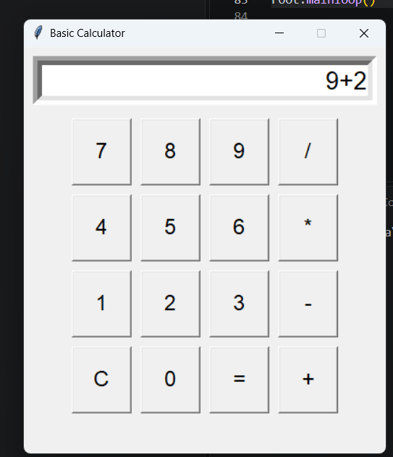
Technologies Used
1. Python
Programming language used to develop the calculator.
2. Tkinter
Library used to create the calculator window and buttons.
3. Visual Studio Code
Code editor used to write and run the Python program.
4. GitHub
Platform used to store and share project code.

Slide 5
Features of the Calculator
Simple and user-friendly graphical interface.
Number buttons from 0 to 9.
Addition (+) and subtraction (-).
Multiplication (*) and division (/).
Equals (=) button to calculate results.
Clear (C) button to erase the display.
Displays the result of mathematical expressions.
Handles invalid expressions and division by zero.

Slide 6
Code Explanation
Import Tkinter: Imports the library used to create the graphical interface.
Create the Window: Sets up the main calculator window.
Display Screen: Shows the numbers and mathematical expressions.
Create Buttons: Adds number buttons and mathematical operators.
Button Functions: Handle clicks, clear the display, and calculate results.
Main Loop: Keeps the calculator window running and responsive.

Slide 7
Output and Conclusion
Project Output
The calculator opens in a graphical window.
Users can enter numbers and mathematical operators.
The result is displayed when the Equals (=) button is clicked.
The Clear (C) button clears the display.
Conclusion
Successfully developed a basic calculator using Python and Tkinter.
Learned how to create a graphical user interface.
Practised using functions, buttons, and user input.
Thank You!

