Slide 1
Capstone Project
TED Talk Views Prediction Rupali Sawant

Slide 2
Content
Problem Statement
Data Summary
Exploratory Data Analysis
Feature Engineering
Models Used
Challenges
Conclusion

Slide 3
Problem Statement
TED is devoted to spreading powerful ideas on just about any topic. These dataset contain over 4,000 TED talks including transcript in many languages founded in 1984 by Richard Salman as a nonprofit organization that aimed at bringing expert from the field of Technology, Entertainment and design together.
TED conference have gone on to become the Mecca of ideas from virtually all walks of the life.
As of the 2015, TED and its sister TEDx chapter have publish more than 2000 talks for free consumption by the masses and its speaker list boasts of the likes of AI Gore, Jimmy Wales, Shahrukh khan and Bill Gates.
The main objective of our predicted model is in which could help in predicting the views of the videos uploaded on the TEDx website.

Slide 4
Data Summary
1] Talk_id : Talk identification number provided by TED
2] title : Title of the talk
3] speaker_1 : First speaker in TED’s speaker list
4] all_speakers : Speaker in the talk
5] occupations : Occupations of the speakers
6] about_speakers :Blurb about each speaker
7] recorded_date : Date the talk was recorded
8] published_date : Date the talk was published to TED.com
9] Transcript : Full transcript of the talk

Slide 5
Data Summary Cont….
10] event : Event or medium in which the talk was given
11] native_lang : Language the talk was given
12] available_lang : All available language for a talk
13] comments : Count of comments
14] Duration : Duration in seconds
15] Topics : Related tags or topics for the talk
16] Related_talks : Related talks
17] url : URL of the talk
18] Description : Description of the talk

Slide 6
Exploratory Data Analysis
Exploratory Data Analysis (EDA) is an approach to analyzing the data sets to summarize their characteristics, often with visual methods.
EDA is about understanding the data and it is important to get insight about data before we start modelling the data.

Slide 7
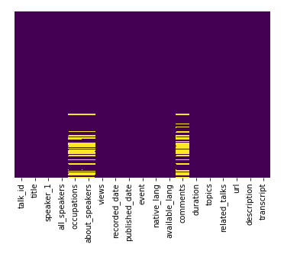
Missing Data Check
KNN imputation for Numerical Features
Replaced Categorical Features Nan values with ‘Unknown’ category.

Slide 8
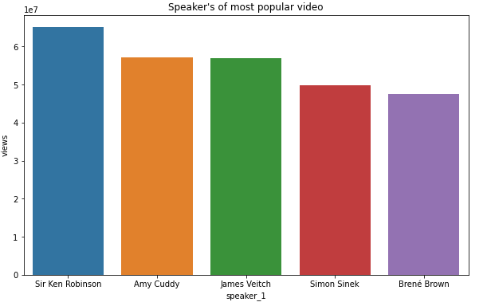
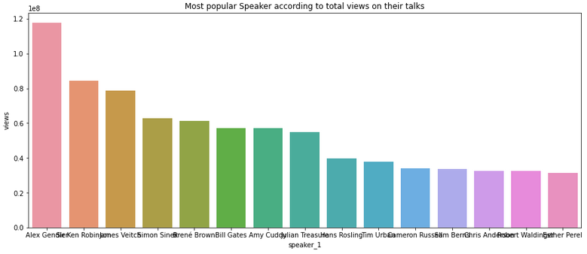
Speakers with Views
Sir Ken Robinson’s talk on ‘Do Schools Kill Creativity?’ is the most popular TED Talk of all time with more than 65 million views.
There only one talk has crossed 60 millions mark.
Alex Gendler is the most popular speaker followed by Sir Ken Robinson

Slide 9
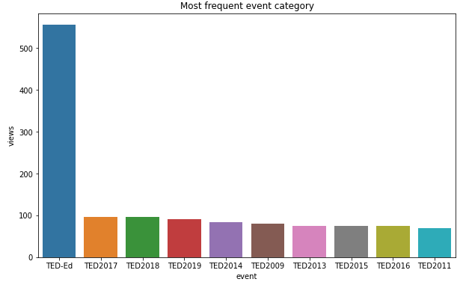
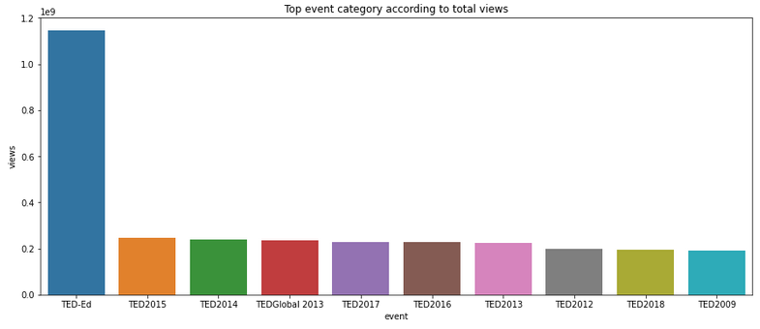
Event with Views
TED – Ed is the most frequent event category with 556 entries followed by TED 2017 and TED 2018
TED –Ed is the most popular event category having maximum number of total views followed by TED 2015

Slide 10
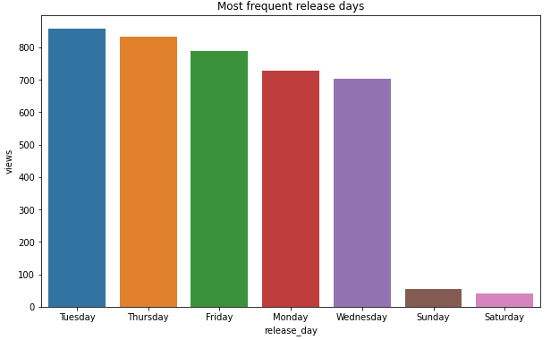
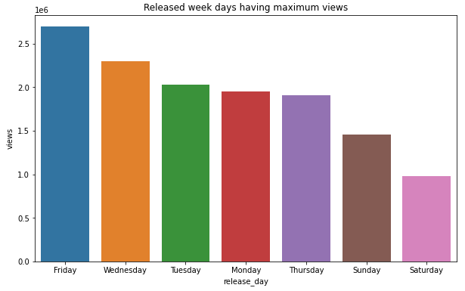
Published Days with Views
Most videos are published on Tuesday followed by Thursday
But the videos published on Friday are more popular followed by Wednesday
Friday release is impacting the views of the video

Slide 11
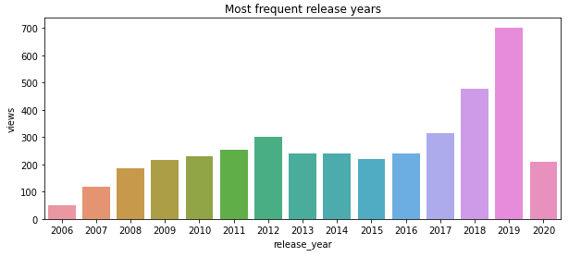
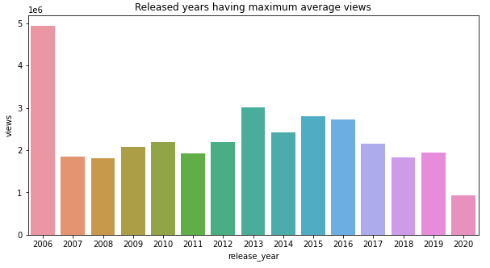
Published Year with Views
Most videos are published in 2019 followed by 2018 and 2017
But the videos published in 2006 are the most viewed followed by 2013 and 2015

Slide 12
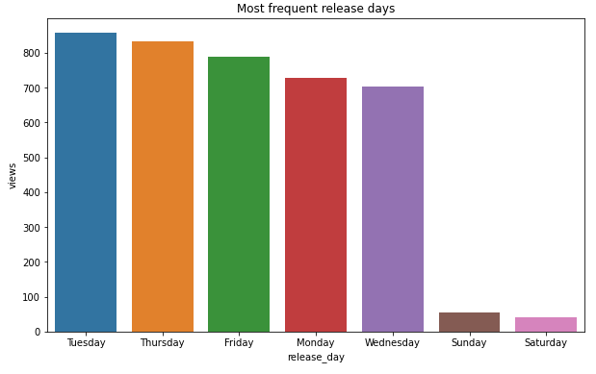
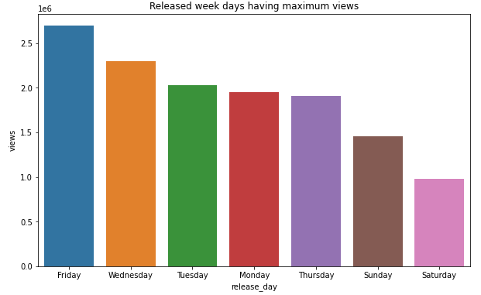
Released Month with Views
Most videos are

Slide 13
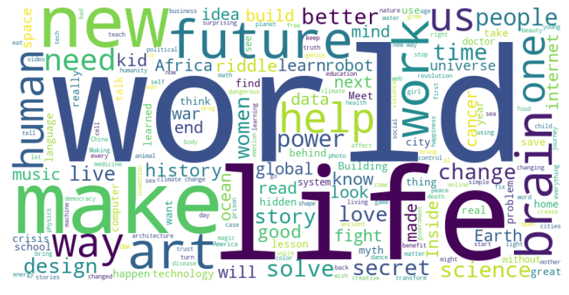
Most Popular Titles
Majority of titles contains words are : world, life, make, future, new, human, power.

Slide 14
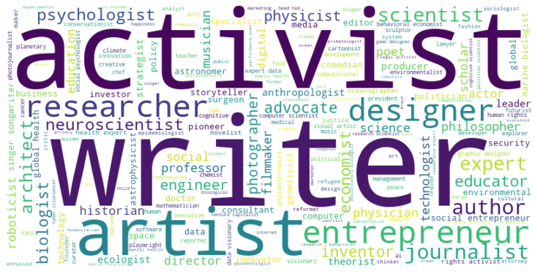
Most Popular Occupations
There are 55651 words in the combination of all occupations

Slide 15
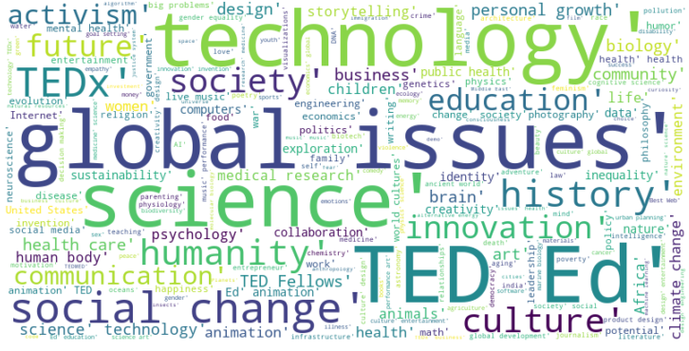
Most Popular Topics According To Views
There are 404126 words in the combination of all the topics

Slide 16
Feature Engineering
Speaker_avg_views
Event_avg_views
Related_views
Topic_wise_avg_views
Num_of_languages
Num_of_tags
Release_day
Release_month
Video_age

Slide 17
Models Used
Lasso Regressor
Ridge Regressor
KNearest Neighbors Regressor
Random Forest Regressor
Extra Tree Regressor
Gradient Boosting Regressor
XGB Regressor

Slide 18
Challenges
Dataset have lots of textual and categorical data having high ordinal number. So the conversion to meaningful numerical data was a challenge.
Treating the outliers in numerical features.
Generation of new features which needs to be added in the model.
Choosing the right features for modelling.
Choosing the models to get the best scores.

Slide 19
Conclusion
We build a predictive model, which could help TED in predicting the views of the talks uploaded on the TEDx website.
TED can increase their views and popularity by increasing videos on sections like technology and science.
TED can tackle the sectors like music by inviting more popular speakers in this sectors like ‘OK GO’ in this category.

Slide 20
Thank You

