Slide 1
NextHikes IT Solutions

Slide 2
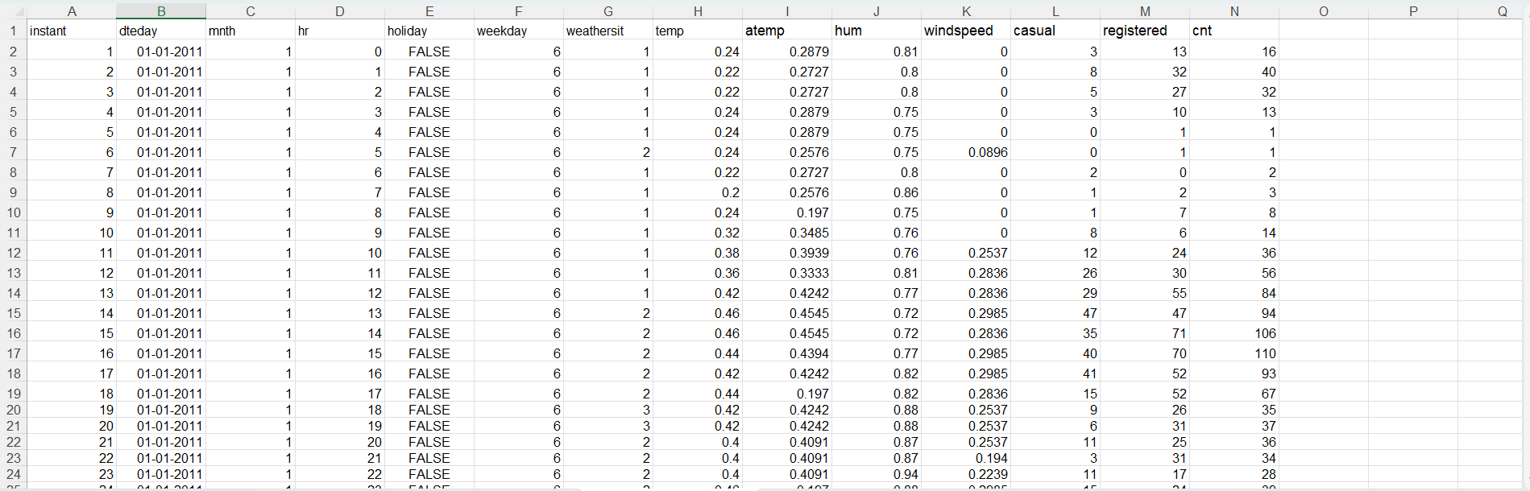
Dataset 1+ Dataset 2

Slide 3
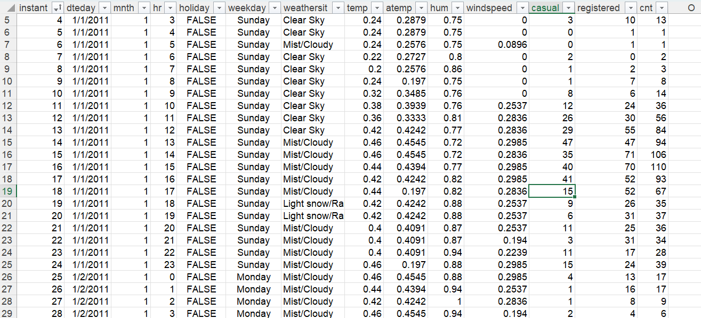
Dataset 1+ Dataset 2 +Dataset 3

Slide 4
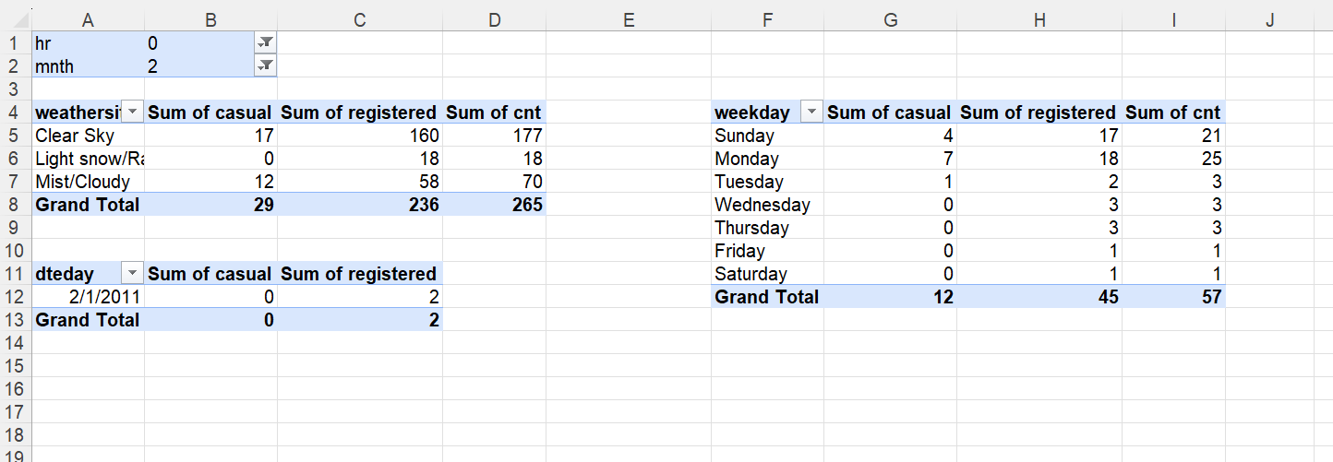
Pivot Table

Slide 5
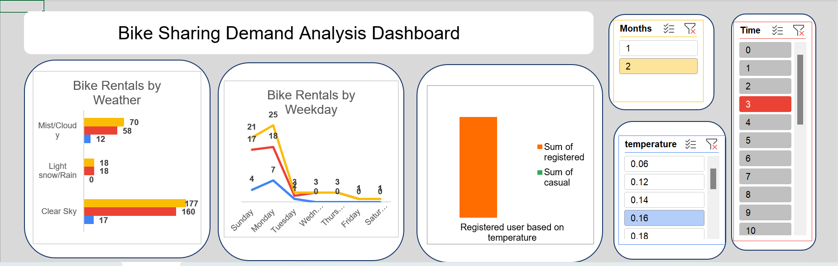
Dashboard

Slide 6
Data Insights
Performed an analysis on the growth over the year 2011.
Registered user rent far more than the casual users.
High Demand during morning and evening hours.
Temperature/Weather usually correlate with increased rentals,
rain significantly deters usage.

Slide 7
Actionable Insight
Marketing: Target casual riders with weekend packages or promotions during good weather.
Resource optimization: Predict demand to ensure bikes are available where needed especially during peak jours.

Slide 8
Thank you

