Slide 1
Next Hikes IT Solutions

Slide 2
EDA of Retail Dataset
Exploratory Data Analysis on 100,000 retail transactions
Objective:
- Understand patterns
- Detect outliers
- Extract insights

Slide 3
Dataset Overview
Rows: 100,000
Columns: 18
Types: Numerical, Categorical, Date
Goal: Business insights & modeling readiness

Slide 4
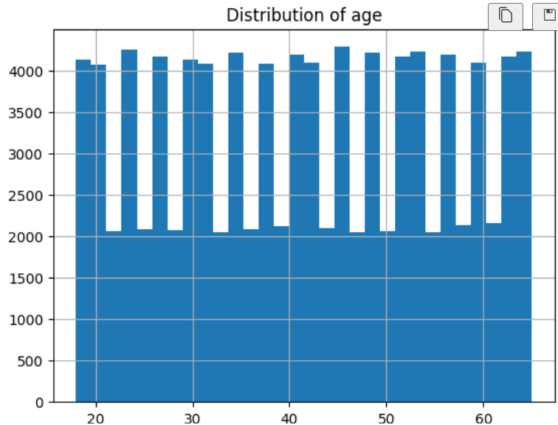
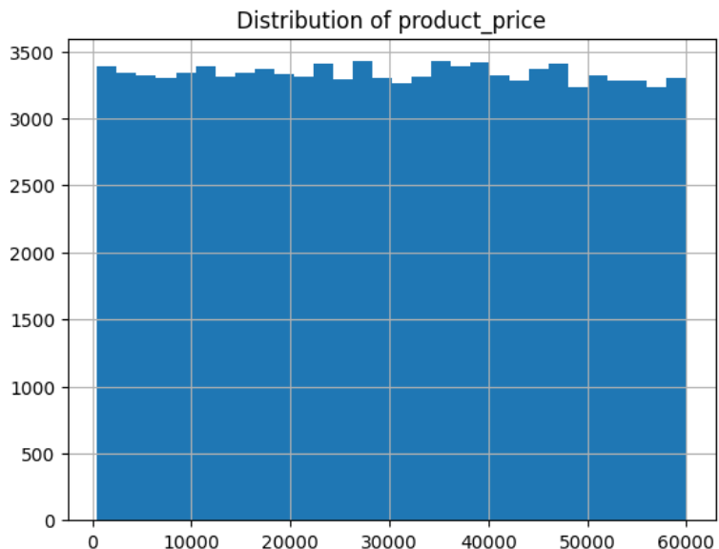
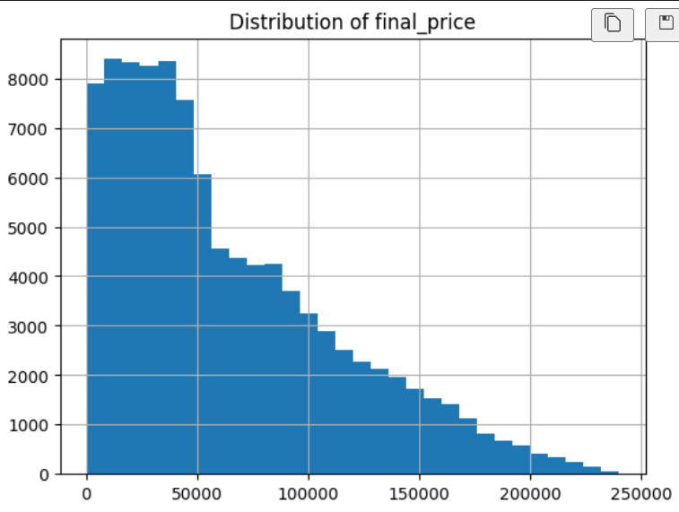
Univariate Analysis - Numerical

Slide 5
Univariate Analysis - Numerical
- Product price is positively skewed
- Final price shows high kurtosis
- Discount is uniformly distributed
Insight: Few high-value transactions drive revenue

Slide 6
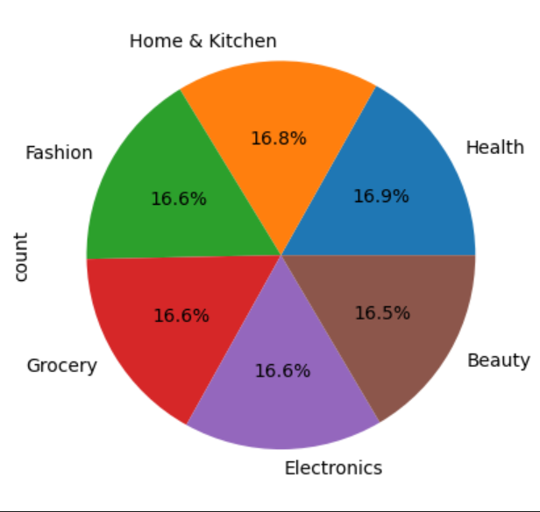
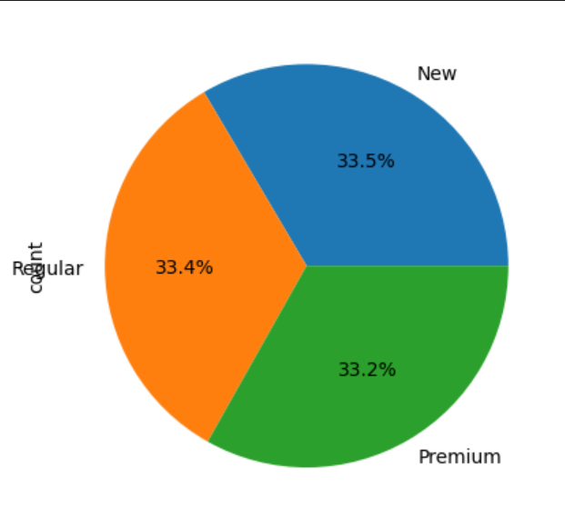
Categorical Analysis

Slide 7
Categorical Analysis
- Majority: Regular customers
- Electronics most sold category
- Return rate ~15%
Insight: Electronics dominates but has returns

Slide 8
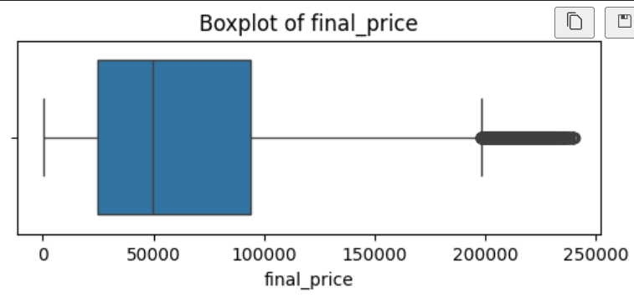
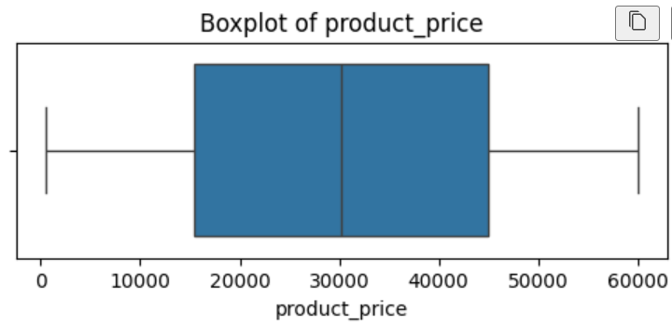
Outlier Detection

Slide 9
Outlier Detection
- Found in product_price & final_price
- Due to bulk/premium purchases
- Delivery delays as operational outliers
Insight: Outliers are valuable, not errors

Slide 10
Bivariate Analysis
- Strong: price vs final_price
- Strong: quantity vs final_price
- Weak: age vs spending
Insight: Revenue depends on price & quantity

Slide 11
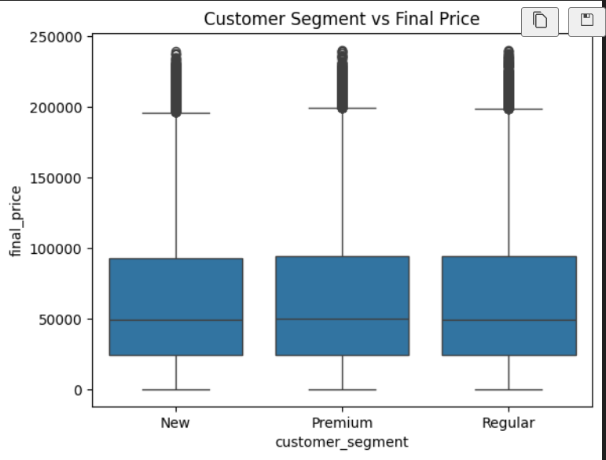
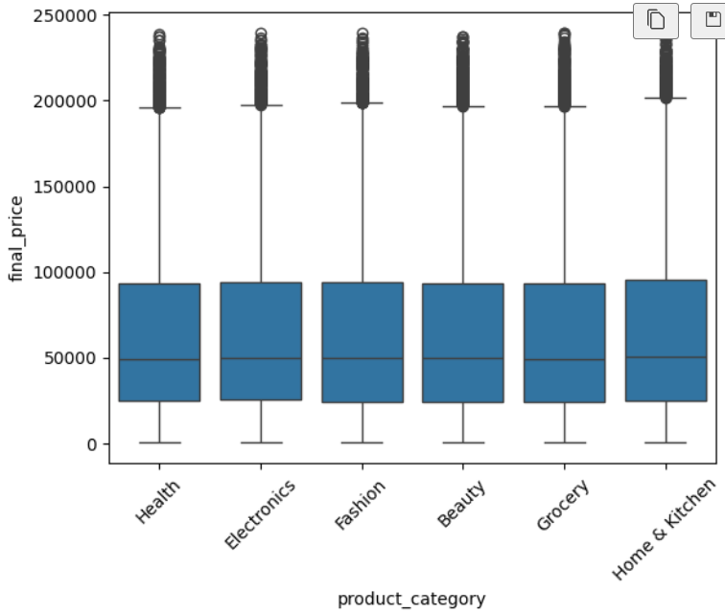
Categorical vs Numerical

Slide 12
Categorical vs Numerical
- Premium customers spend more
- Electronics have higher returns
- Express shipping reduces delivery time
Insight: Customer & logistics impact revenue

Slide 13
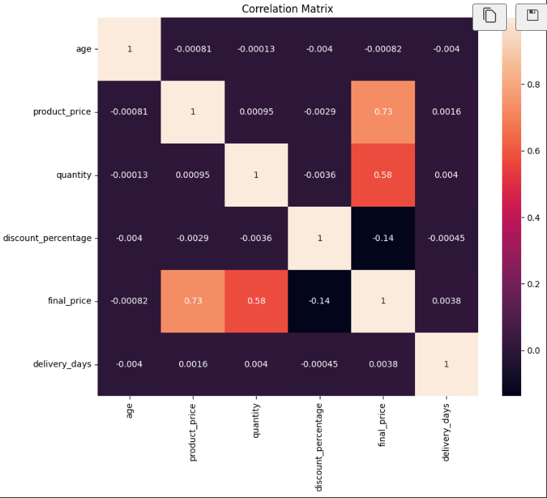
Correlation Analysis

Slide 14
Correlation Analysis
- Final price ↑ with price & quantity
- Negative with discount
- Low link with delivery_days
Insight: Discounts reduce per-unit revenue

Slide 15
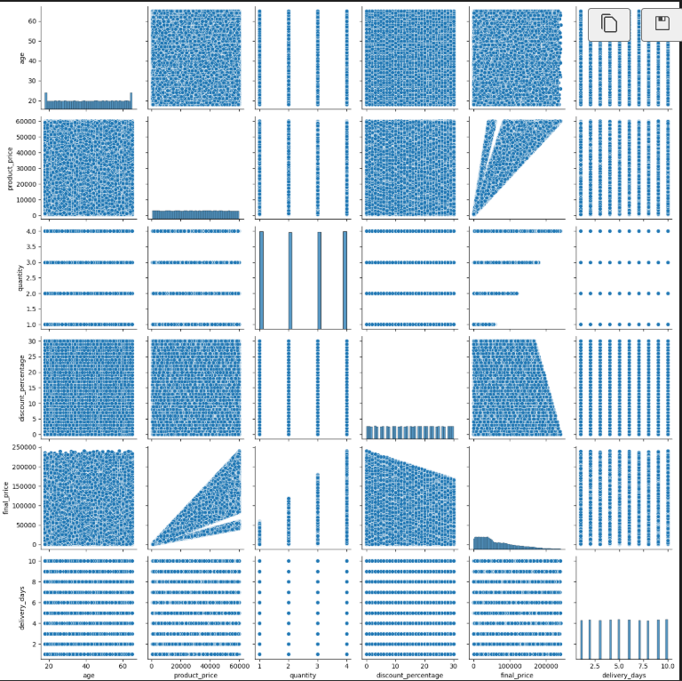
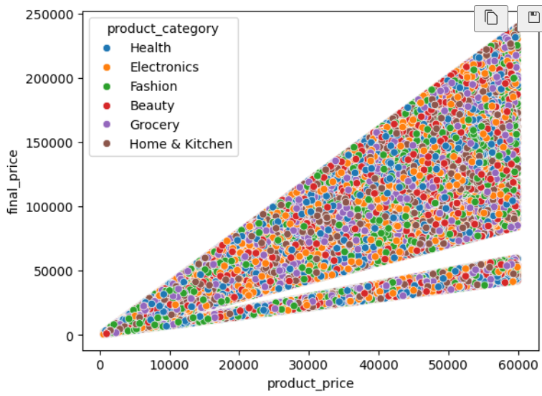
Multivariate Insights

Slide 16
Multivariate Insights
- Electronics + moderate discount = high revenue
- Age 30–45 premium spend most
- Long delivery increases returns
Insight: Pricing + logistics + segment matters

Slide 17
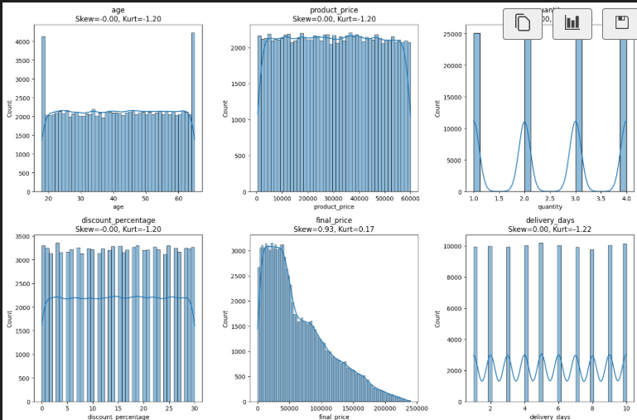
Skewness & Kurtosis

Slide 18
Skewness & Kurtosis
Positive skew: product_price, final_price
High kurtosis: final_price
Insight: Heavy tail → few large transactions dominate

Slide 19
Key Business Insights
- Revenue driven by premium purchases
- Moderate discounts optimal
- Improve delivery to reduce returns
- Focus on premium customers

Slide 20
Conclusion
Revenue is right-skewed (few customers generate most revenue)
Premium customers are key drivers of profit
Moderate discounts maximize revenue
Outliers represent high-value transactions
Longer delivery increases return probability

Slide 21
Thank you

