Slide 1
Next Hikes IT Solutions

Slide 2
Mobile Price Prediction
Project Objective:
Predict mobile prices using features like RAM, battery, processor, etc.

Slide 3
Dataset Overview
Features:
- Model, Color
- RAM, Memory
- Battery
- Camera
- Processor
Target:
- Price

Slide 4
Data Preprocessing
Steps:
- Handled missing values
- Removed duplicates
- Outlier treatment (IQR)
- Encoding categorical variables

Slide 5
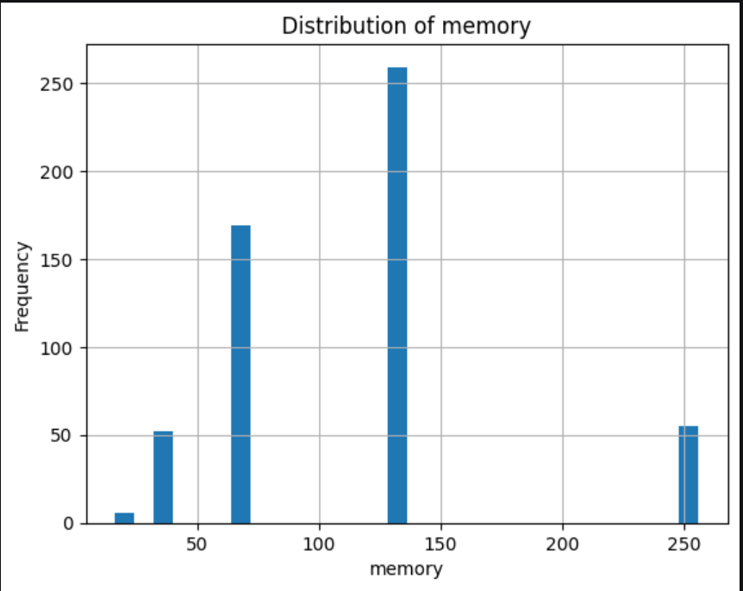
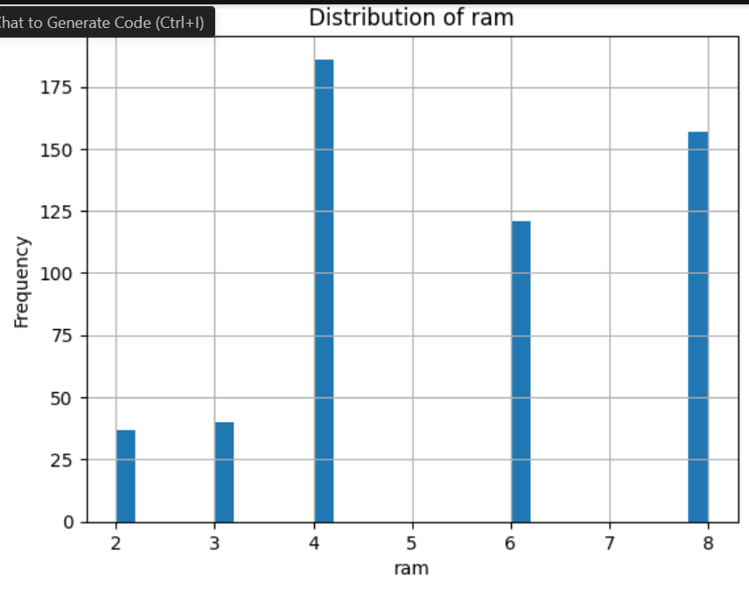
Univariate Analysis

Slide 6
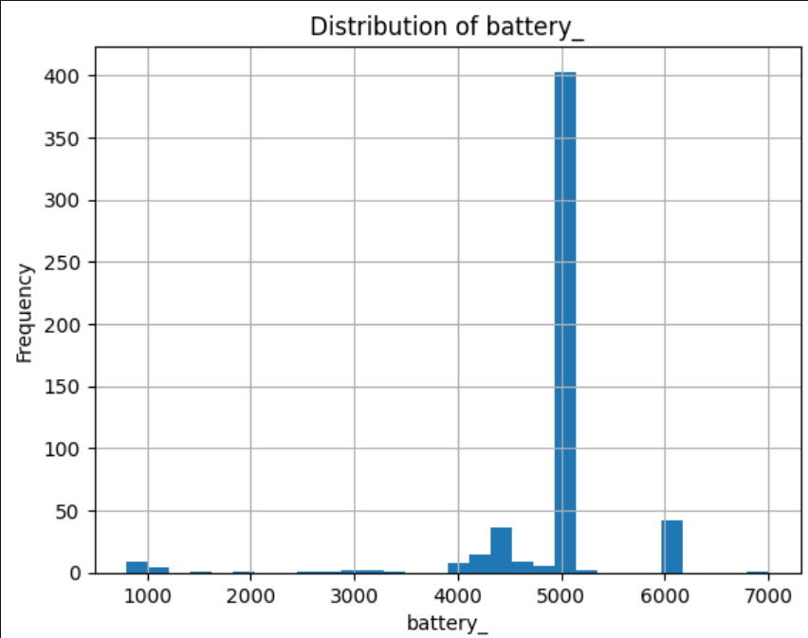
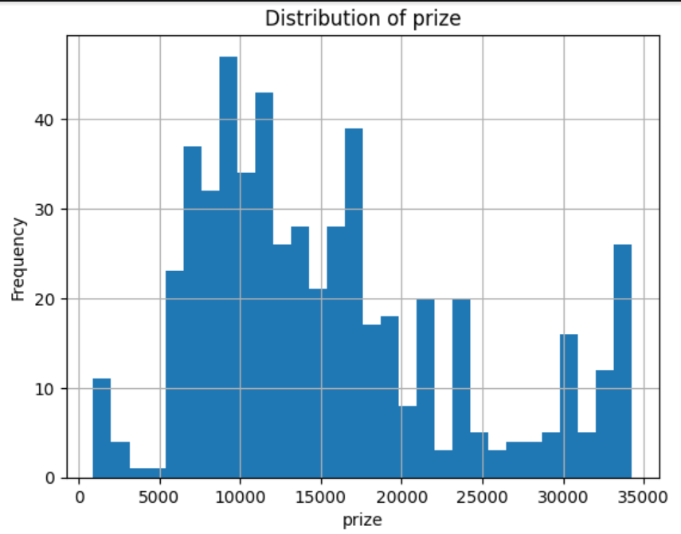

Slide 7
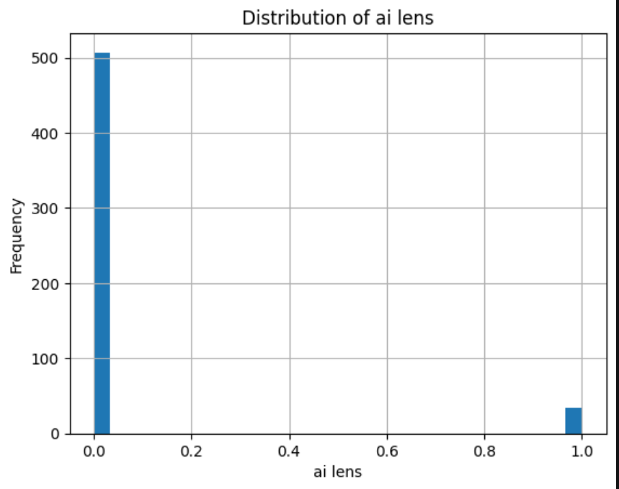
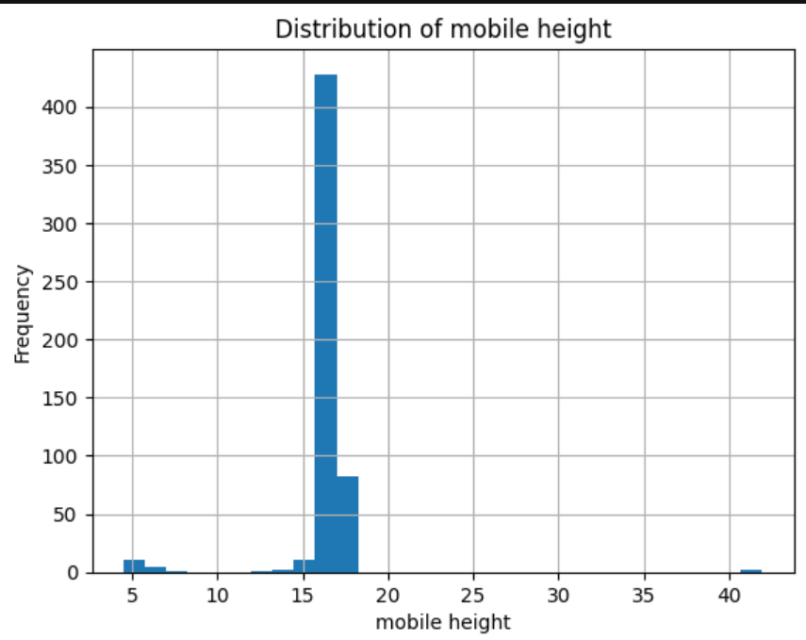

Slide 8
Insight for Univariate Analysis
The market is dominated by mid-range storage devices, while high-end storage variants are limited and likely priced higher
4G RAM is the most common configuration (budget/mid-range segment).
6GB–8GB RAM represents performance-oriented devices
Battery capacity is highly standardized, with 5000 mAh being the industry norm. → This means battery is not a strong differentiating factor for price.
The dataset is dominated by mid-range smartphones
Premium phones act as outliers

Slide 9
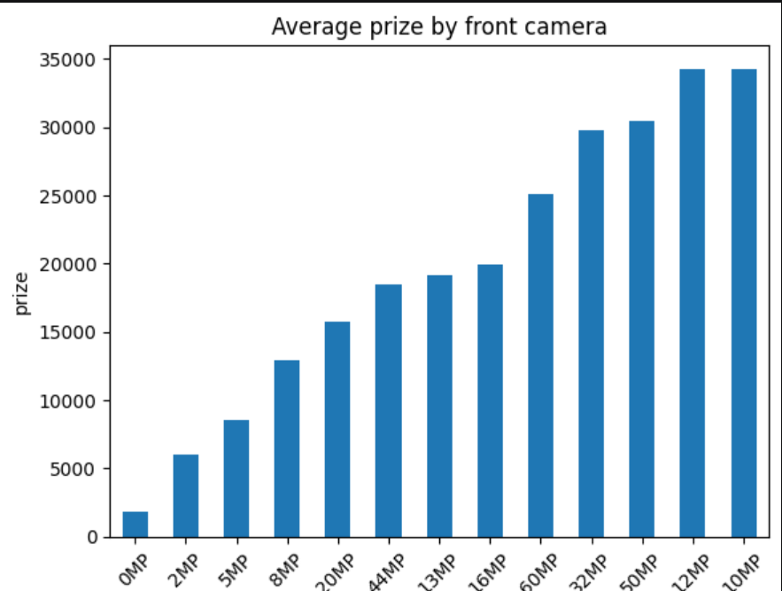
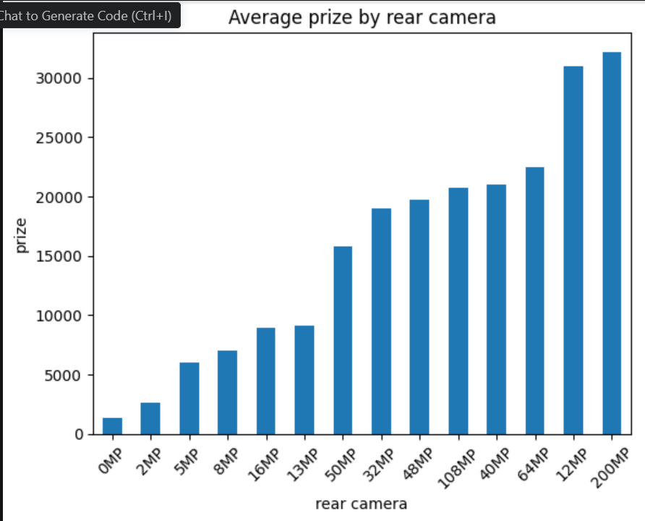
Bivariate Analysis

Slide 10
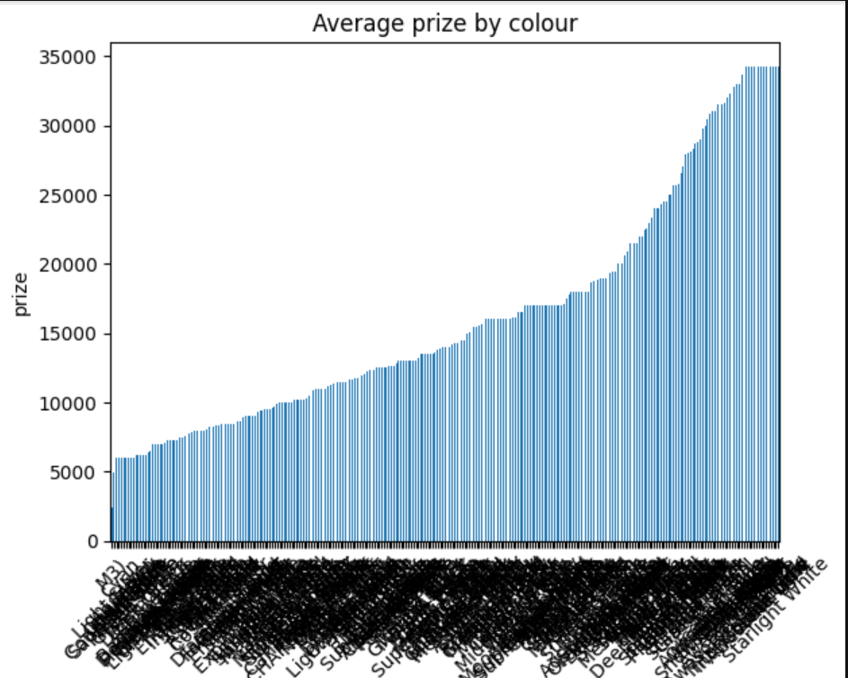
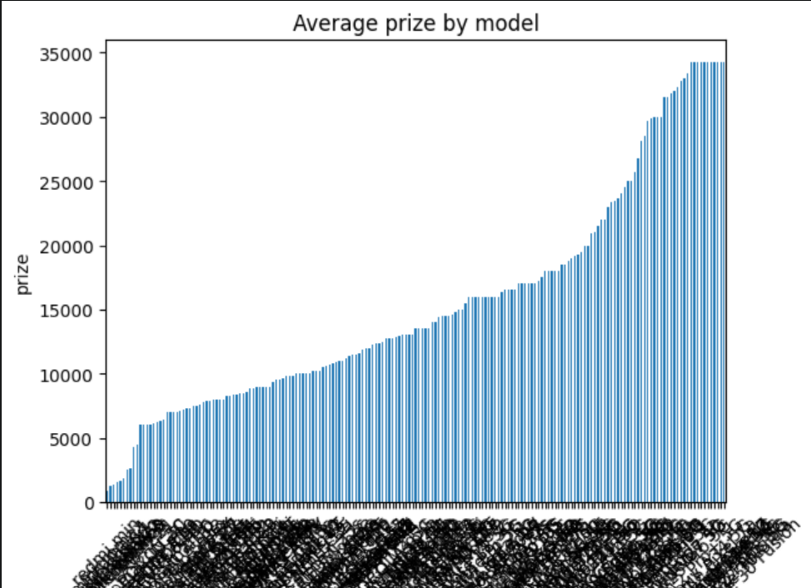

Slide 11
Insights for Bivariate Analysis
RAM is one of the most influential factors affecting mobile price.
Battery contributes to price but is not a primary driver.
Physical dimensions have minimal impact on pricing.
Processor type is a major pricing factor.
Brand/model positioning strongly affects pricing.
Colour has negligible impact on price.
AI features have minor influence on price.

Slide 12
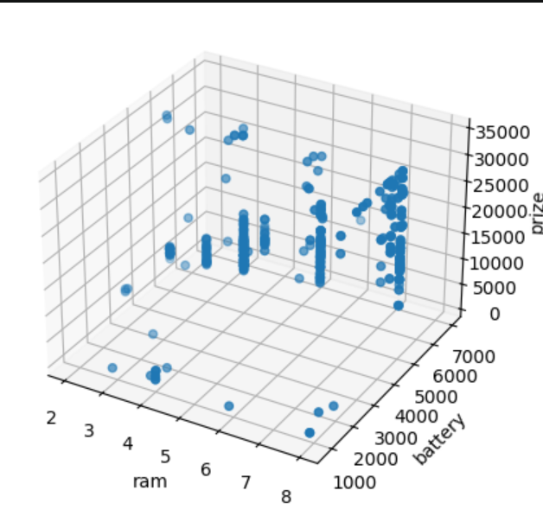
Multivariate Analysis

Slide 13
Insight for Multivariate Analysis
Price is influenced by the combination of features, not a single variable.
The 3D scatter plot demonstrates that RAM has the strongest influence on mobile price, while battery capacity plays a secondary role. The combined effect of multiple features creates clear clusters of budget, mid-range, and premium smartphones, highlighting the importance of multivariate analysis in understanding pricing patterns.

Slide 14
Correlation Analysis
Insights:
- RAM has strong positive correlation with price
- Memory also impacts price
- Weak correlation for color/model

Slide 15
Feature Importance (Random Forest)
Top Features:
- RAM
- Processor
- Internal Memory
- Camera
- Battery
These strongly influence price

Slide 16
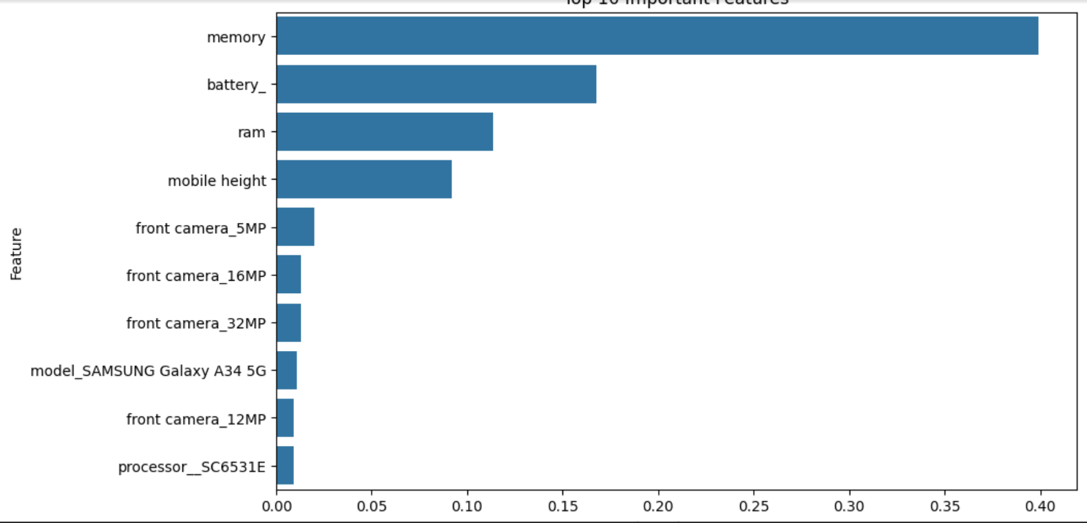
Insight: Higher value = stronger influence on price This is more reliable than correlation

Slide 17
Visualization Insights
Scatter Plots show:
- Higher RAM → Higher price
- Better processor → Premium phones
- Camera improves mid-high range pricing

Slide 18
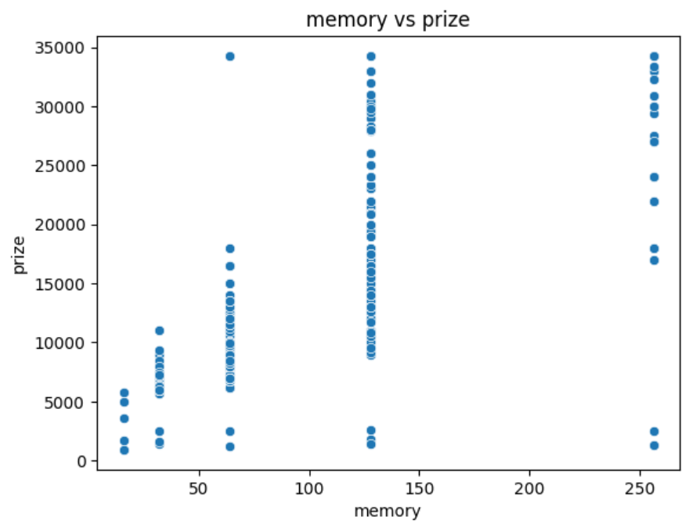
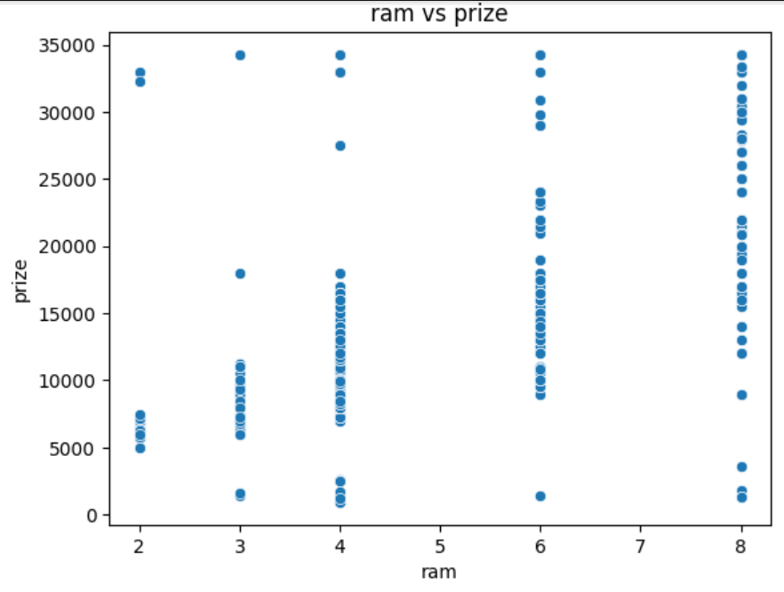
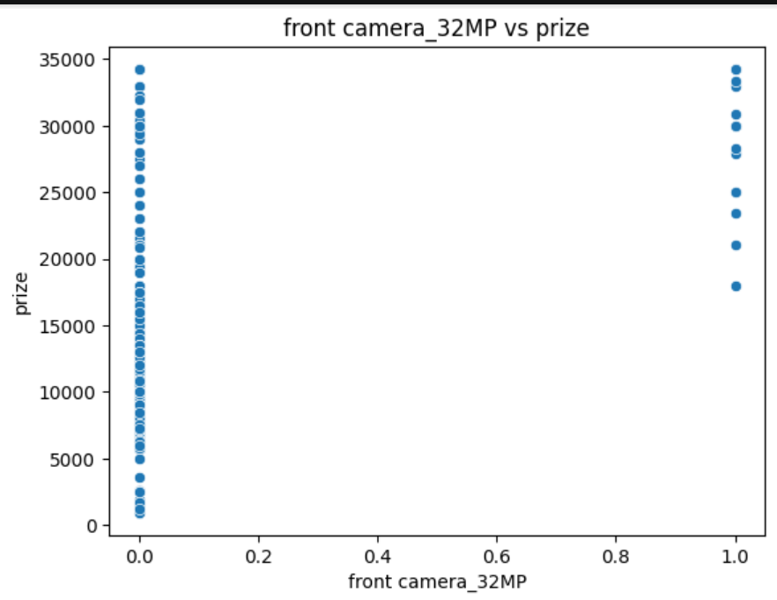
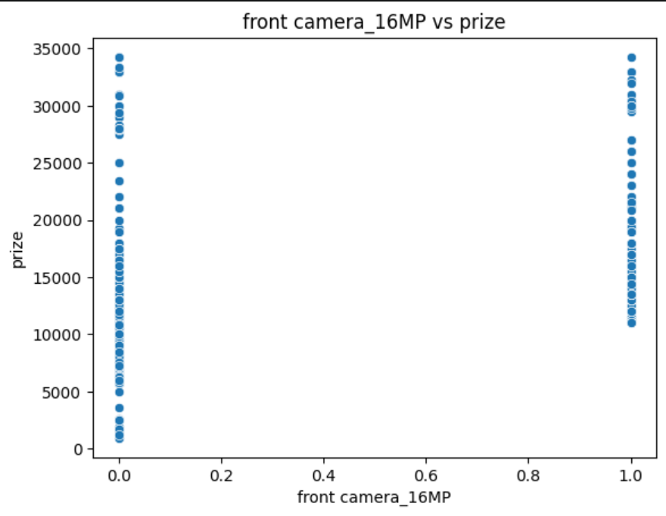
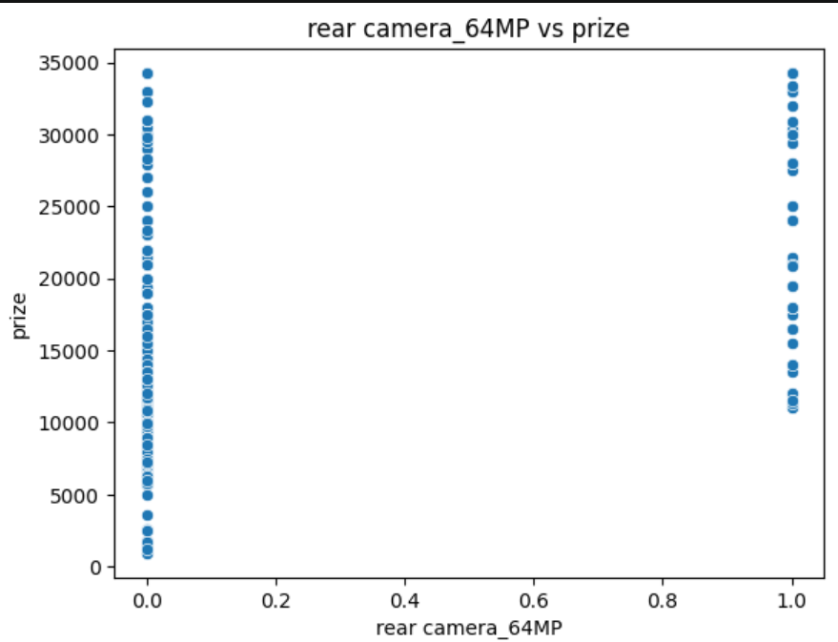

Slide 19
Feature Selection
Selected top features based on importance
Reduced noise and improved model performance

Slide 20
Conclusion
Key Findings:
- Technical specs drive price
- Branding/color less important
- RAM & Processor are dominant factors

Slide 21
Thank you

