Slide 1
Presented by Rupa Shetty
NextHikes IT Solutions Project_7

Slide 2
DATA SCIENCE PROJECT
Job Market
Analysis
Exploring freelance job demand, hourly rates, market trends and similar-job recommendations.
Python • Pandas • Scikit-learn • Streamlit • Render
Prepared for project presentation

Slide 3
1. Project Introduction
• Freelancers need to understand which types of work are being posted and how opportunities change over time.
• Hourly-rate ranges can help compare opportunities when listings contain valid rate information.
• This project transforms raw job listings into charts, summaries and an interactive dashboard.
• Analysis describes this dataset; it should not be interpreted as a complete picture of the entire freelance market.
Job Market Analysis | Project Presentation
2

Slide 4
2. Project Overview
Inputs, analysis and outputs
• Input: an Upwork job-posting CSV containing titles, links, dates, hourly/rate fields, budget and country.
• Preparation: inspect columns, clean text, parse dates, check missing values and duplicates.
• Analysis: category counts, hourly-rate comparisons, country/month trends and posting-volume forecasting.
• Output: a Streamlit dashboard plus a TF-IDF/cosine-similarity job recommender.
Job Market Analysis | Project Presentation
3

Slide 5
3. Business Problem and Objectives
Questions the project aims to answer
• Problem: raw job postings are difficult to compare because information is spread across many records and fields.
• Objective 1: clean the data and make analysis repeatable.
• Objective 2: identify common job-title themes and compare valid hourly rates.
• Objective 3: explore posting volume over time and test a simple forecast baseline.
• Objective 4: recommend similar listings from a text query and share the results through a web app.
Job Market Analysis | Project Presentation
4

Slide 6
4. End-to-End Methodology
A reproducible workflow
• 1. Load the CSV and inspect its shape, columns, types and sample rows.
• 2. Clean missing values, duplicates, text fields and invalid dates.
• 3. Engineer useful fields, including hourly midpoint and calendar periods.
• 4. Explore category, rate, country and time distributions.
• 5. Forecast weekly posting counts using a simple baseline and time-based evaluation.
• 6. Recommend similar listings with TF-IDF and cosine similarity.
• 7. Build the Streamlit app and deploy it on Render.
Job Market Analysis | Project Presentation
6

Slide 7
5. Data Cleaning and Preparation
Quality checks before analysis
• Inspect missing values, duplicate rows and inconsistent column names.
• Convert published_date to datetime and count invalid dates.
• Standardize title text by trimming spaces and normalizing case.
• Convert rate bounds to numeric values and reject invalid or negative rates.
• Calculate midpoint = (hourly_low + hourly_high) / 2 only when both bounds are valid.
• Keep fixed-price budget separate from hourly rates; document every cleaning decision.
Job Market Analysis | Project Presentation
7

Slide 8
7. Exploratory Data Analysis (EDA)
What to inspect and visualize
• Univariate: missingness, title counts, country counts and distributions of rates/budget.
• Bivariate: category vs rate, country vs posting count, month vs posting volume.
• Multivariate: explore how category, date, country and payment type vary together.
• Use bar charts for counts, histograms for distributions, box plots for spread and line charts for time trends.
• Use medians and quartiles for skewed rate data and show sample sizes with comparisons.
Job Market Analysis | Project Presentation
8

Slide 9
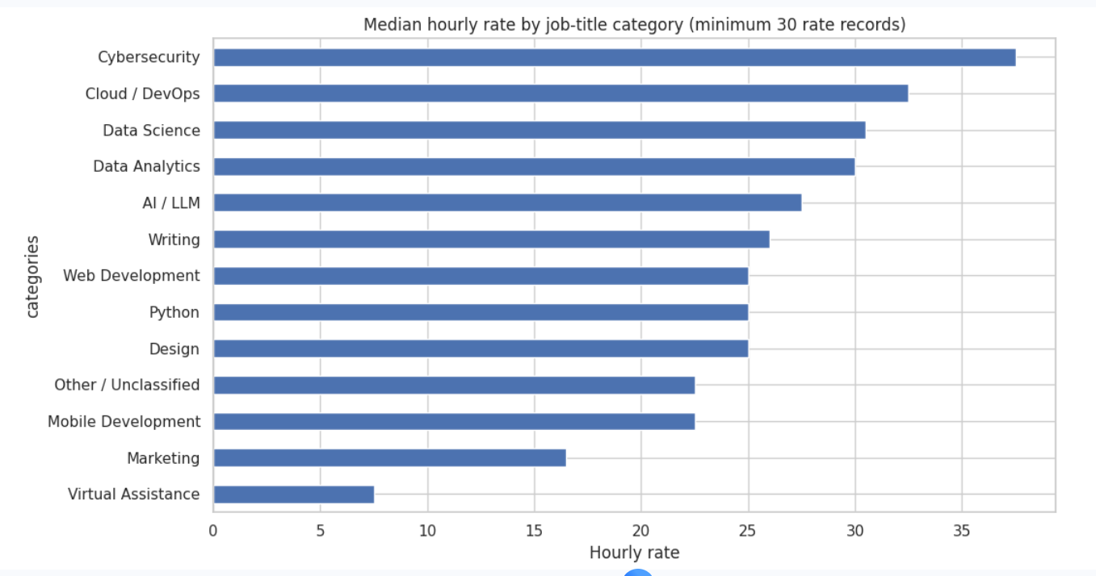
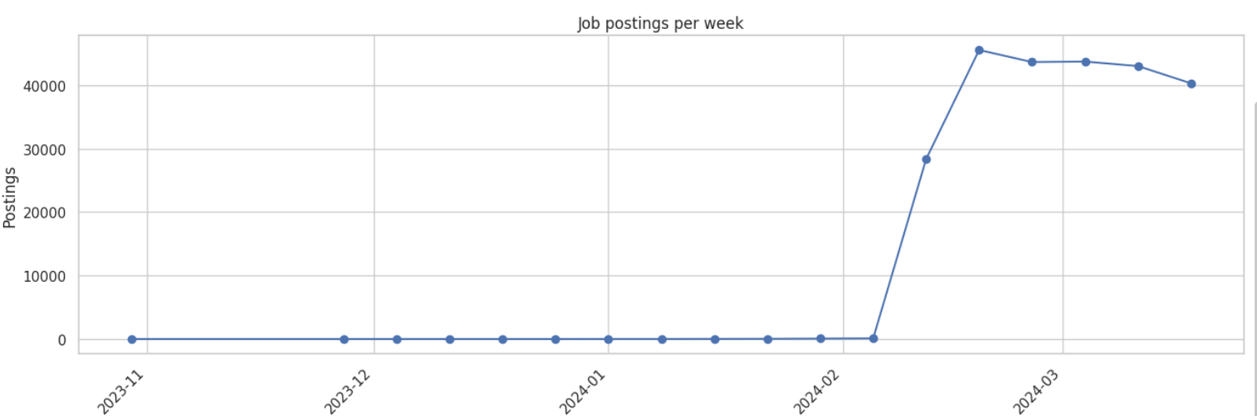

Slide 10
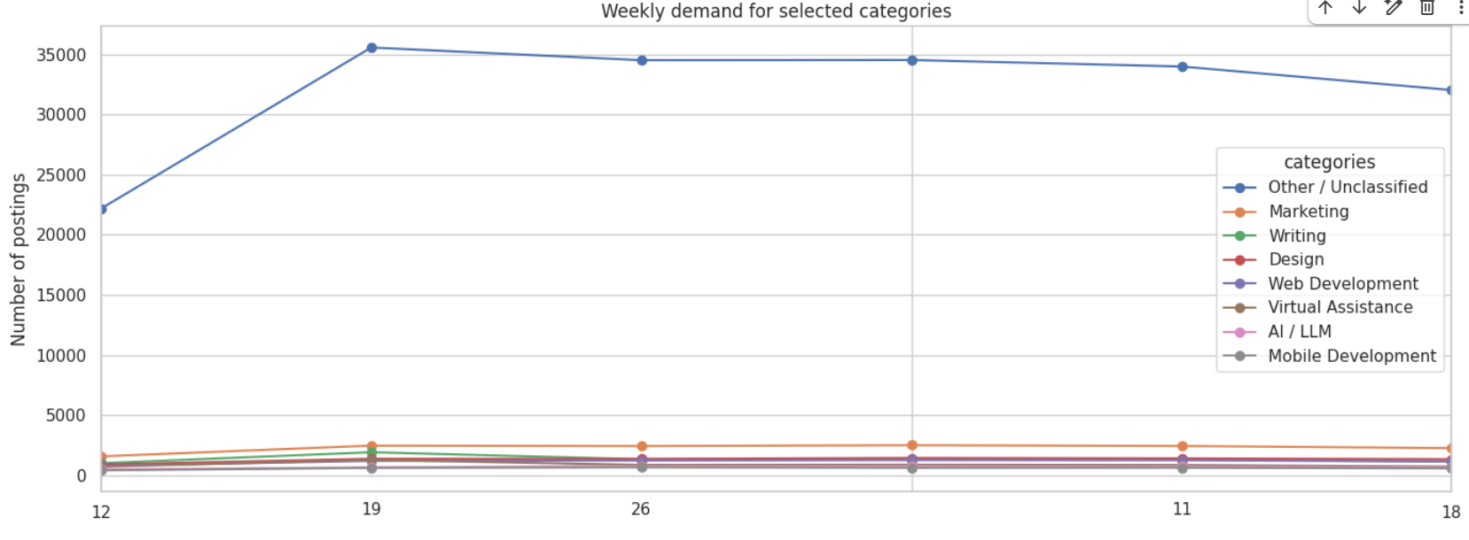
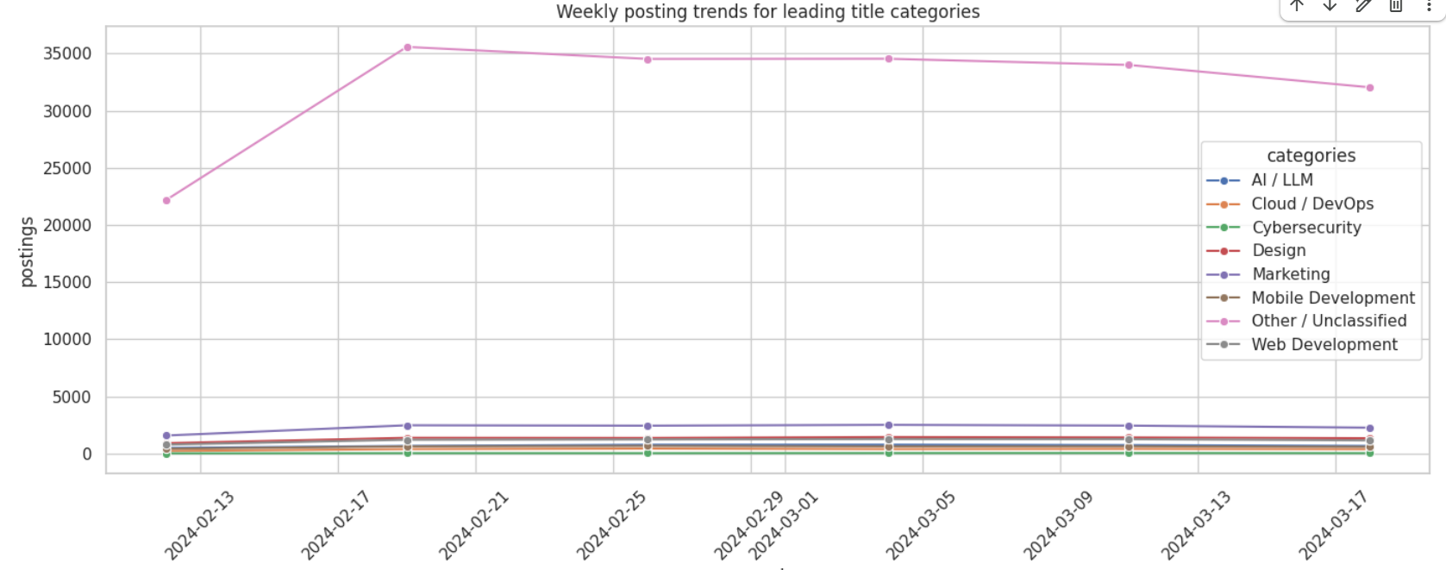

Slide 11
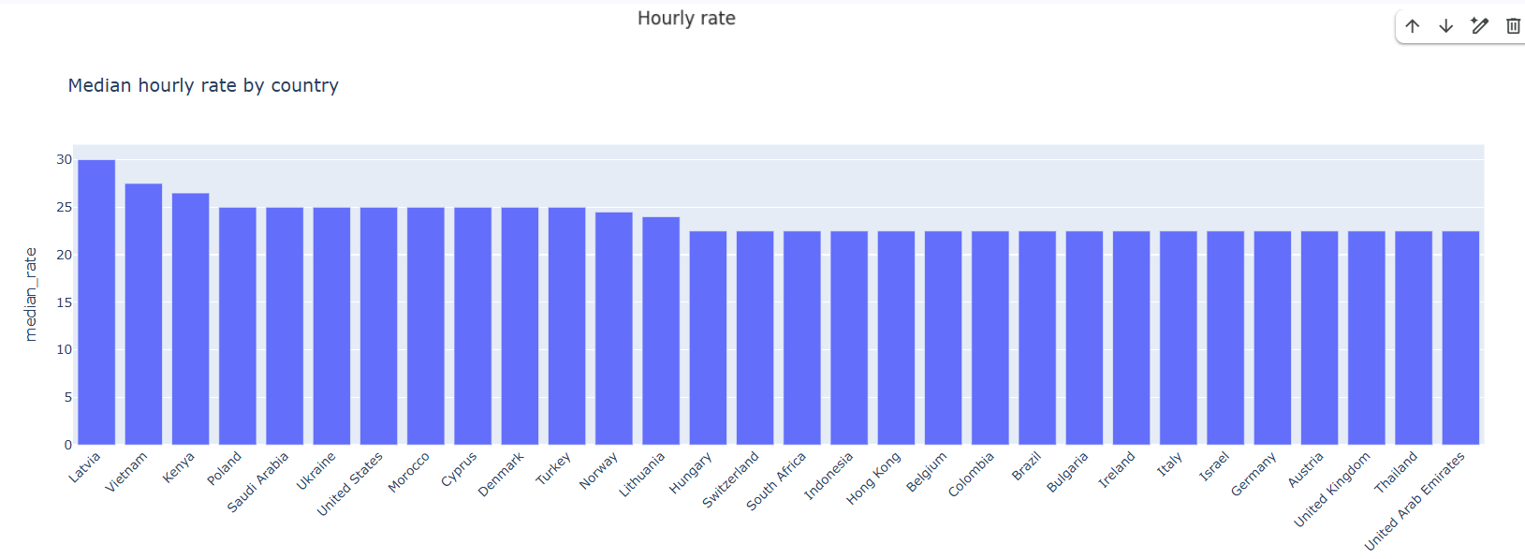

Slide 12
8. Job Titles, Skills and Hourly-Rate Comparisons
Compare like with like
• Extract frequent words from titles; use descriptions too if the dataset contains them.
• Group related titles with transparent keyword rules such as data, design, writing or development.
• Treat these groups as approximations: keyword matching can misclassify ambiguous titles.
• Compare hourly rates only for listings with valid hourly bounds; report median, quartiles and sample count.
• Avoid strong conclusions for categories with few listings or inconsistent rate information.
Job Market Analysis | Project Presentation
9

Slide 13
9. Emerging Job Categories
Signals worth investigating
• Count postings by category and week or month.
• Compare recent category volume with an earlier baseline period.
• Look for sustained growth over several periods, not a single unusual spike.
• Check sample size and possible data-collection changes before calling a category 'emerging'.
• Final finding to insert: categories showing the strongest measured growth in your analysis.
Job Market Analysis | Project Presentation
10

Slide 14
10. Demand Forecasting
An explainable baseline model
• Target: number of job postings per week, either overall or for a selected category.
• Baseline: use the previous week's count as the prediction for the next week.
• Evaluate with a time-based split so later weeks are not used to predict earlier weeks.
• MAE is the average absolute prediction error; RMSE penalizes large errors more heavily.
• Insert the actual MAE, RMSE and evaluation dates from your notebook or dashboard.
Job Market Analysis | Project Presentation
11

Slide 15
11. Country, Monthly and Remote-Work Trends
What the dataset can and cannot tell us
• Country: rank available country values by posting count and keep unknown values visible.
• Monthly: aggregate posting dates by month; note that the first and last months may be partial.
• Remote work: analyze it only if the dataset contains a reliable remote-work field.
• Country metadata may describe the client or listing rather than the freelancer's required location.
• Posting counts represent this dataset and date window—not the whole global freelance market.
Job Market Analysis | Project Presentation
12

Slide 16
12. Skill-Based Job Recommendation System
TF-IDF + cosine similarity
• User enters a short query, for example: 'Python data dashboard'.
• TF-IDF converts words in titles/listings into weighted numeric vectors.
• Cosine similarity measures how closely each listing's text matches the query.
• The app returns the top matching job titles or listings.
• Strength: fast and explainable. Limitation: similar wording does not guarantee quality, fit, budget or seniority.
Job Market Analysis | Project Presentation
13

Slide 17
13. Streamlit Dashboard and Render Deployment
From Python analysis to a web app
• Streamlit creates a browser-based interface from Python code in app.py.
• Keep requirements.txt updated with the libraries used by the app.
• Push app.py, requirements.txt and required files to GitHub.
• On Render, connect the repository, configure the build/start commands and deploy the service.
• Check logs, relative file paths, dataset permissions, secrets and the live URL after deployment.
• For large CSVs, use a reliable hosted download or storage service rather than committing oversized files to Git.
Job Market Analysis | Project Presentation
14

Slide 18
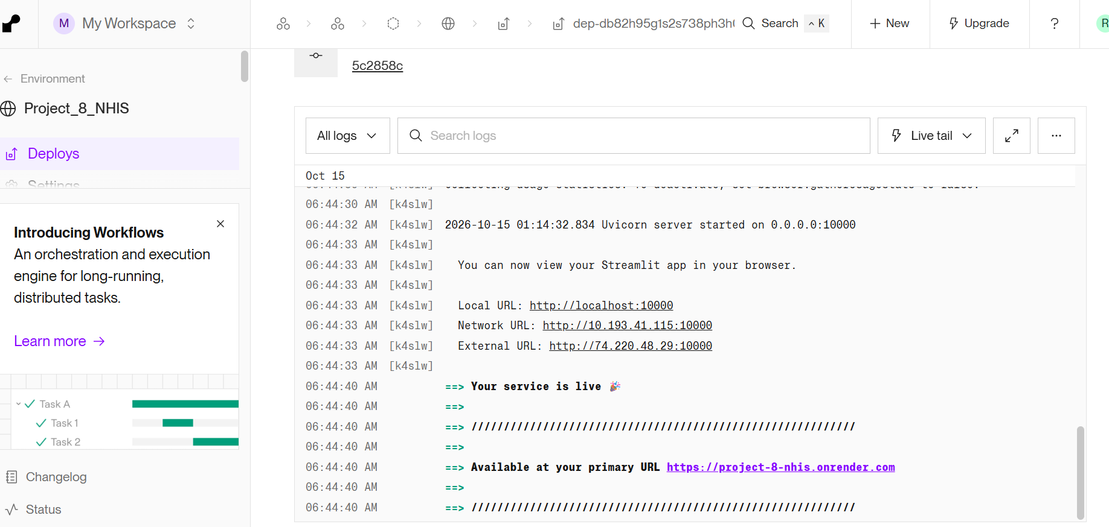

Slide 19
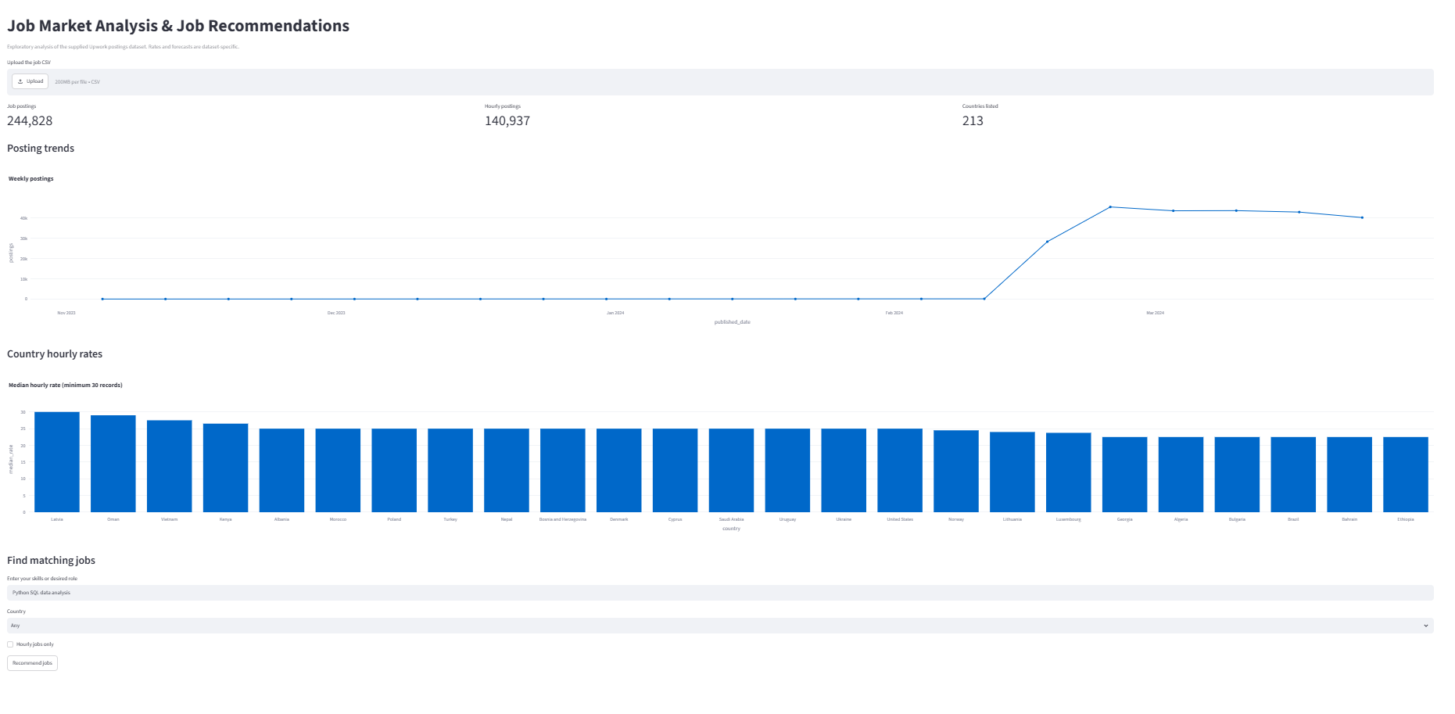

Slide 20
15. Conclusion, Limitations and Future Work
Summary and next steps
• Conclusion: a repeatable pipeline turns raw listings into market summaries and interactive exploration.
• Limitations: short time window, missing/inconsistent fields, possible sampling bias and simple keyword categories.
• Forecasting results depend on the limited history and should not be treated as a guarantee of future demand.
• Future work: add more months of data, improve skill extraction, compare stronger forecasting models and evaluate recommendations.
• Continue improving data-quality checks, app monitoring and deployment reliability.
Job Market Analysis | Project Presentation
16

Slide 21
Appendix: Dockerfile Explained Simply
Docker is optional for a standard Render deployment
Dockerfile instruction | Simple meaning
FROM python:3.11-slim | Choose a lightweight Python environment.
WORKDIR /app | Set the working folder inside the container.
COPY requirements.txt . | Copy the dependency list into the container.
RUN pip install -r requirements.txt | Install the libraries the app needs.
COPY . . | Copy project files into the container build.
EXPOSE 8501 | Document Streamlit's usual container port.
CMD [...] | Tell Docker how to start Streamlit and app.py.
Analogy: Dockerfile = recipe; image = packaged recipe; container = running application.
Job Market Analysis | Project Presentation
17

Slide 22
Thank you

